Slide 1
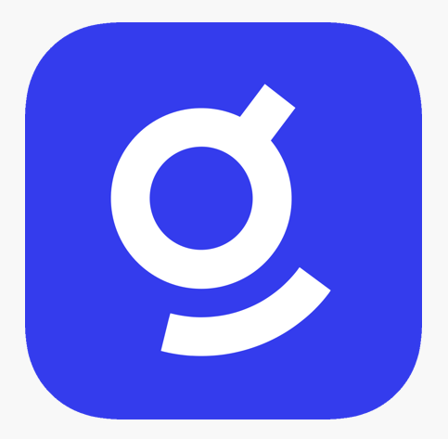


AcmeOne’s Integration
Planning
Solutions Architect, Glean
Rob Barker
rob.barker@glean.com
https://gleaningideas.com

Slide 2
Agenda
01
Overview
What are our objectives today and moving forward.
Technical assumptions & questions.
How to measure success.
Integration Plans
Overview of architecture.
Integration methodology.
02
03
Resources & Project Stages
Project resources to deliver solution.
High-level project stages and tasks.
Enablement Tools
Jupyter Notebook and Visual Studio Code examples.
04

Slide 3
Overview
Current deployment
  Multiple systems integrated with Glean
  Supporting 5,000 employees
Goal: Add 2 new customizations
  Custom Sales CRM Connector
    Add new datasource for Indexing and Search APIs
      Example: SalesForce
  Integrate Glean with internal support Chatbot
    Glean Web SDK
      Example: Intercom (Conversations/Help Center/Tickets)
Notes:
Add new custom Sales CRM datasource
Questions:
What CRM system is this for? We may have a Connector built for it today.
What functionality
Integrate Glean Search with internal support chatbot

Slide 4
Technical Assumptions & Questions
CRM & Chatbot
  Custom features?
  Defined Authorization (AuthZ) & Authentication (AuthN)
  REST API, webhooks
  Based on what platform? Open source?
  Deployment
    Cloud, On-Premises, SaaS
  Company wide availability or targeted teams?
API Framework
  Is there a unified API across all your application fabric? Or per-app API use?
Environment
  Non-production environment available?
  Snapshot updates from prod to non-prod datasources?
Source Management & Tracking
  GitHub Enterprise org/repositories
  JIRA (or similar) available for epics, issues and feature tracking (eg. JIRA Native Connector)
Communication
  Business to business connectivity for collaborative development?
    Example: Slack
Notes:
Add new custom Sales CRM datasource
Questions:
What CRM system is this for? We may have a Connector built for it today.
What functionality
Integrate Glean Search with internal support chatbot

Slide 5
Measuring Success
Productivity Metrics
  Search time reduction
  Search success rates
  Task completion time
  Data access frequency
Telemetry
  “You know what you don’t know”
User Feedback
  UI actionable feedback mechanism.
Release cadence
  Feature improvements based on feedback for nightly release
  Rapid release cycle (CI/CD)
Enabling Users
  No-Code/Low-Code with Glean App Builder
  Developer Workspace
  Jupyter Notebooks
  Visual Studio Code
Notes:
Add new custom Sales CRM datasource
Questions:
What CRM system is this for? We may have a Connector built for it today.
What functionality
Integrate Glean Search with internal support chatbot

Slide 6
Agenda
01
Overview
What are our objectives today and moving forward.
Technical assumptions & questions.
How to measure success.
Integration Plans
Overview of architecture.
Integration methodology.
02
03
Resources & Project Stages
Project resources to deliver solution.
High-level project stages and tasks.
Enablement Tools
Jupyter Notebook and Visual Studio Code examples.
04

Slide 7
Integration Methodology
Custom Sales CRM system
  Glean Apps (No Code/Low Code)
    Triggers and Actions (beta)
  REST & Python SDK
  Glean Web SDK, Sidebar Search
    Provides cross productivity tools use cases
  Glean Client, Indexing and Search APIs
  Glean Assistant
    Actions SDK (Triggers)
Internal Support Chatbot
  Glean Web SDK
    Chat, Recommendations, Sidebar & Modal Search
  Glean Client and Chat APIs
Notes:
Add new custom Sales CRM datasource
Questions:
What CRM system is this for? We may have a Connector built for it today.
What functionality
Integrate Glean Search with internal support chatbot

Slide 8

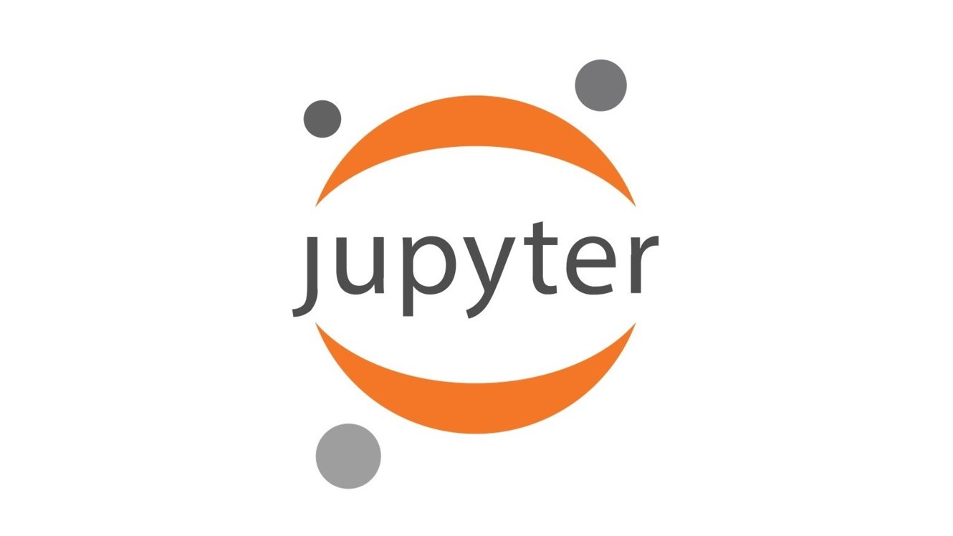
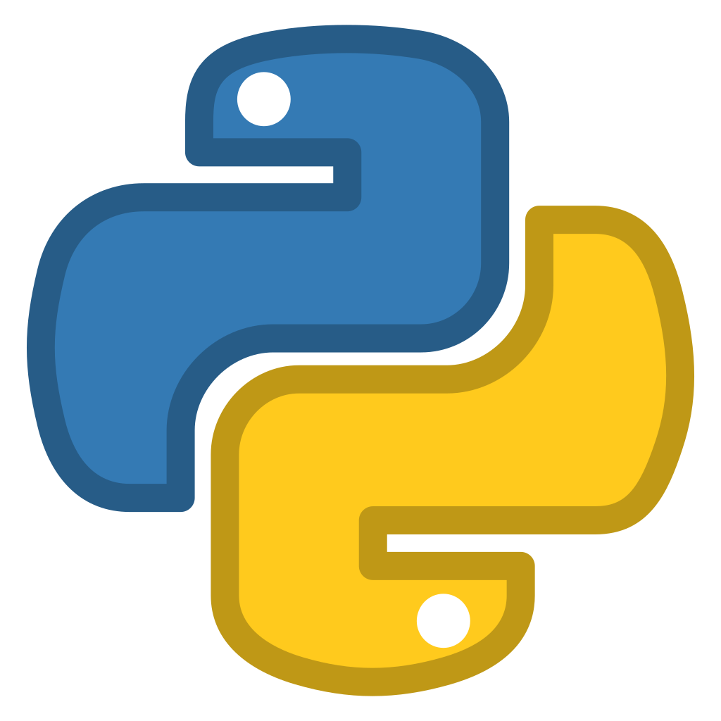



Integration Concept
Developer
Power User
Sales Teams
Support Teams
Developer Tools & Languages
App Builder
Search & Chat
Search & Chat
Indexing API
Search API
Chat
API
Chat
Recomme-ndations
Sidebar
Modal
Triggers &
Actions
Chat API
Glean Client API
Glean JavaScript API Client
Glean Apps
(Self Service)
Connector
Web SDK
Glean Platform Services / API
Authentication (AuthN) & Authorization (AuthZ)
CRM API
ISA API
CRM API
ISA API
AcmeOne
App2
AcmeOne
App1
CRM
System
Internal
Support
App (ISA)
Existing Glean Integrations
Infrastructure (On-premises, Cloud, SaaS)
AcmeOne Applications & Services
Notes:
Add new custom Sales CRM datasource
Questions:
What CRM system is this for? We may have a Connector built for it today.
What functionality
Integrate Glean Search with internal support chatbot

Slide 9
Agenda
01
Overview
What are our objectives today and moving forward.
Technical assumptions & questions.
How to measure success.
Integration Plans
Overview of architecture.
Integration methodology.
02
03
Resources & Project Stages
Project resources to deliver solution.
High-level project stages and tasks.
Enablement Tools
Jupyter Notebook and Visual Studio Code examples.
04

Slide 10
Resource Planning
Role | Responsibility | Team
Executive Sponsor | Support for backing of project and ownership | Glean, AcmeOne
Project Manager | Define project plan, accountability, tracking, comms, team mgmt. | Glean
Business Stakeholders | Line-of-Business members to define features, permissions and success metrics. | AcmeOne
Architects | Review API framework for integration with custom CRM and Chatbot. | AcmeOne, Glean
Engineering | Development teams to collaborate on integration. | Glean, AcmeOne
Testers | Engineering test tasks (scale, pen, error) and end user group for UAT. | Glean, AcmeOne
Infrastructure | Setup environment for development and testing. Keep updated with data imports/snapshots. Manage connectivity for collaborative development. | AcmeOne
DevOps/SRE | Implement deployment CI/CD workflow for rapid deployment and monitoring. | AcmeOne, Glean
SecOps | Review data privacy and penetration testing. | AcmeOne, Glean
IT Support | AcmeOne support team to log issues and assist end users. | AcmeOne
Glean Technical Services/Support | Support for AcmeOne’s developers with future customizations or development questions. | Glean
Notes:
Resources required on both sides of the integration: technical and people (list of resources and what they would be used for)
Project Manager
Define project plan, accountability, tracking, comms, team mgmt.
Executive sponsors
Glean and Customer
Business/Application Stakeholders
Role
From customer
Engineering/Technical Services
Role
From customer and Glean
Infrastructure
Role
Systems access (JIRA, Git,
From customer
Securitty
IT
Customer support team
Test/UAT
Role
From customer and Glean
Solutions Architect
Role
Glean Technical Services
Technical Resources:
Backend developers to implement the custom datasource.
Frontend developers to integrate search results into the chatbot UI.
DevOps engineers for deployment and monitoring.
People Resources:
Project manager to coordinate tasks.
Business analysts to gather requirements.
Security experts to ensure data privacy.

Slide 11
Project Stages
Design Phase
Develop
1 week
Deployment
Monitoring & Cutover
2 – 3 days
CI/CD
Continuous
Review CRM APIs and existing code libraries
Prototype API integration
Review Chatbot API/webhooks
Build basic prototype
Develop Indexing and Search API modules
Integrate CRM and Chatbot API/webhooks
As progress is made with development a CI/CD pipeline should be established to deploy latest code
Defect management
Performance
Issue tracking
01
02
03
04
07
08
∞
05
06
Infrastructure
Testing
Enablement
Runtime
Continuous
2 days
2 – 3 days
Continuous
Conduct multiple testing phases in parallel:
Unit testing
Scale testing to support 5,000 users
Penetration testing (Auth/n/z)
UAT
Deliver training series for end users.
Deliver training series to internal developers/power users on extensibility
Documentation. Code should be self-documented as much as possible
Deploy non-production environment using data extraction or snapshot of CRM system and Internal Chatbot
Create datasources
Connectivity for collaborative development
Auth/n/z configuration
Based on monitoring data determine:
Usability improvements
Feature enhancements
Determine more data elements to expose
Continuous Improvement
Notes:
Rough Project Plan
Design Phase:
Define data mapping between systems.
Design custom datasource schema.
Plan chatbot integration.
Build Phase:
Develop custom datasource code.
Implement search integration.
Set up authentication.
Test Phase:
Unit testing for custom datasource.
Integration testing with chatbot.
Security testing.
Implement Phase:
Deploy custom datasource.
Enable search integration.
Train support team.
Monitor performance.
Design & Build
Semantics, Style, Language, Actions, Behaviors
Create Technical Contracts – Formal interface specifications
Define Nontechnical Contracts - Service level, access rules, usage policies
Generate Effective API Documentation - Auto generation of documentation
Deploy & Document
Continuous build, deploy & operate with security
Security
Threat modeling, continuous scanning, test beds
Auth/n/z
Audit
Manage API lifecycle for continuous improvements using telemetry and community

Slide 12
Agenda
01
Overview
What are our objectives today and moving forward.
Technical assumptions & questions.
How to measure success.
Integration Plans
Overview of architecture.
Integration methodology.
02
03
Resources & Project Stages
Project resources to deliver solution.
High-level project stages and tasks.
Enablement Tools
Jupyter Notebook and Visual Studio Code examples.
04

Slide 13
Enablement Tools
Jupyter
Notebook
Interactive development environment for notebooks, code, and data.
Visual Studio Code
Contextual Coding Assistant

Slide 14
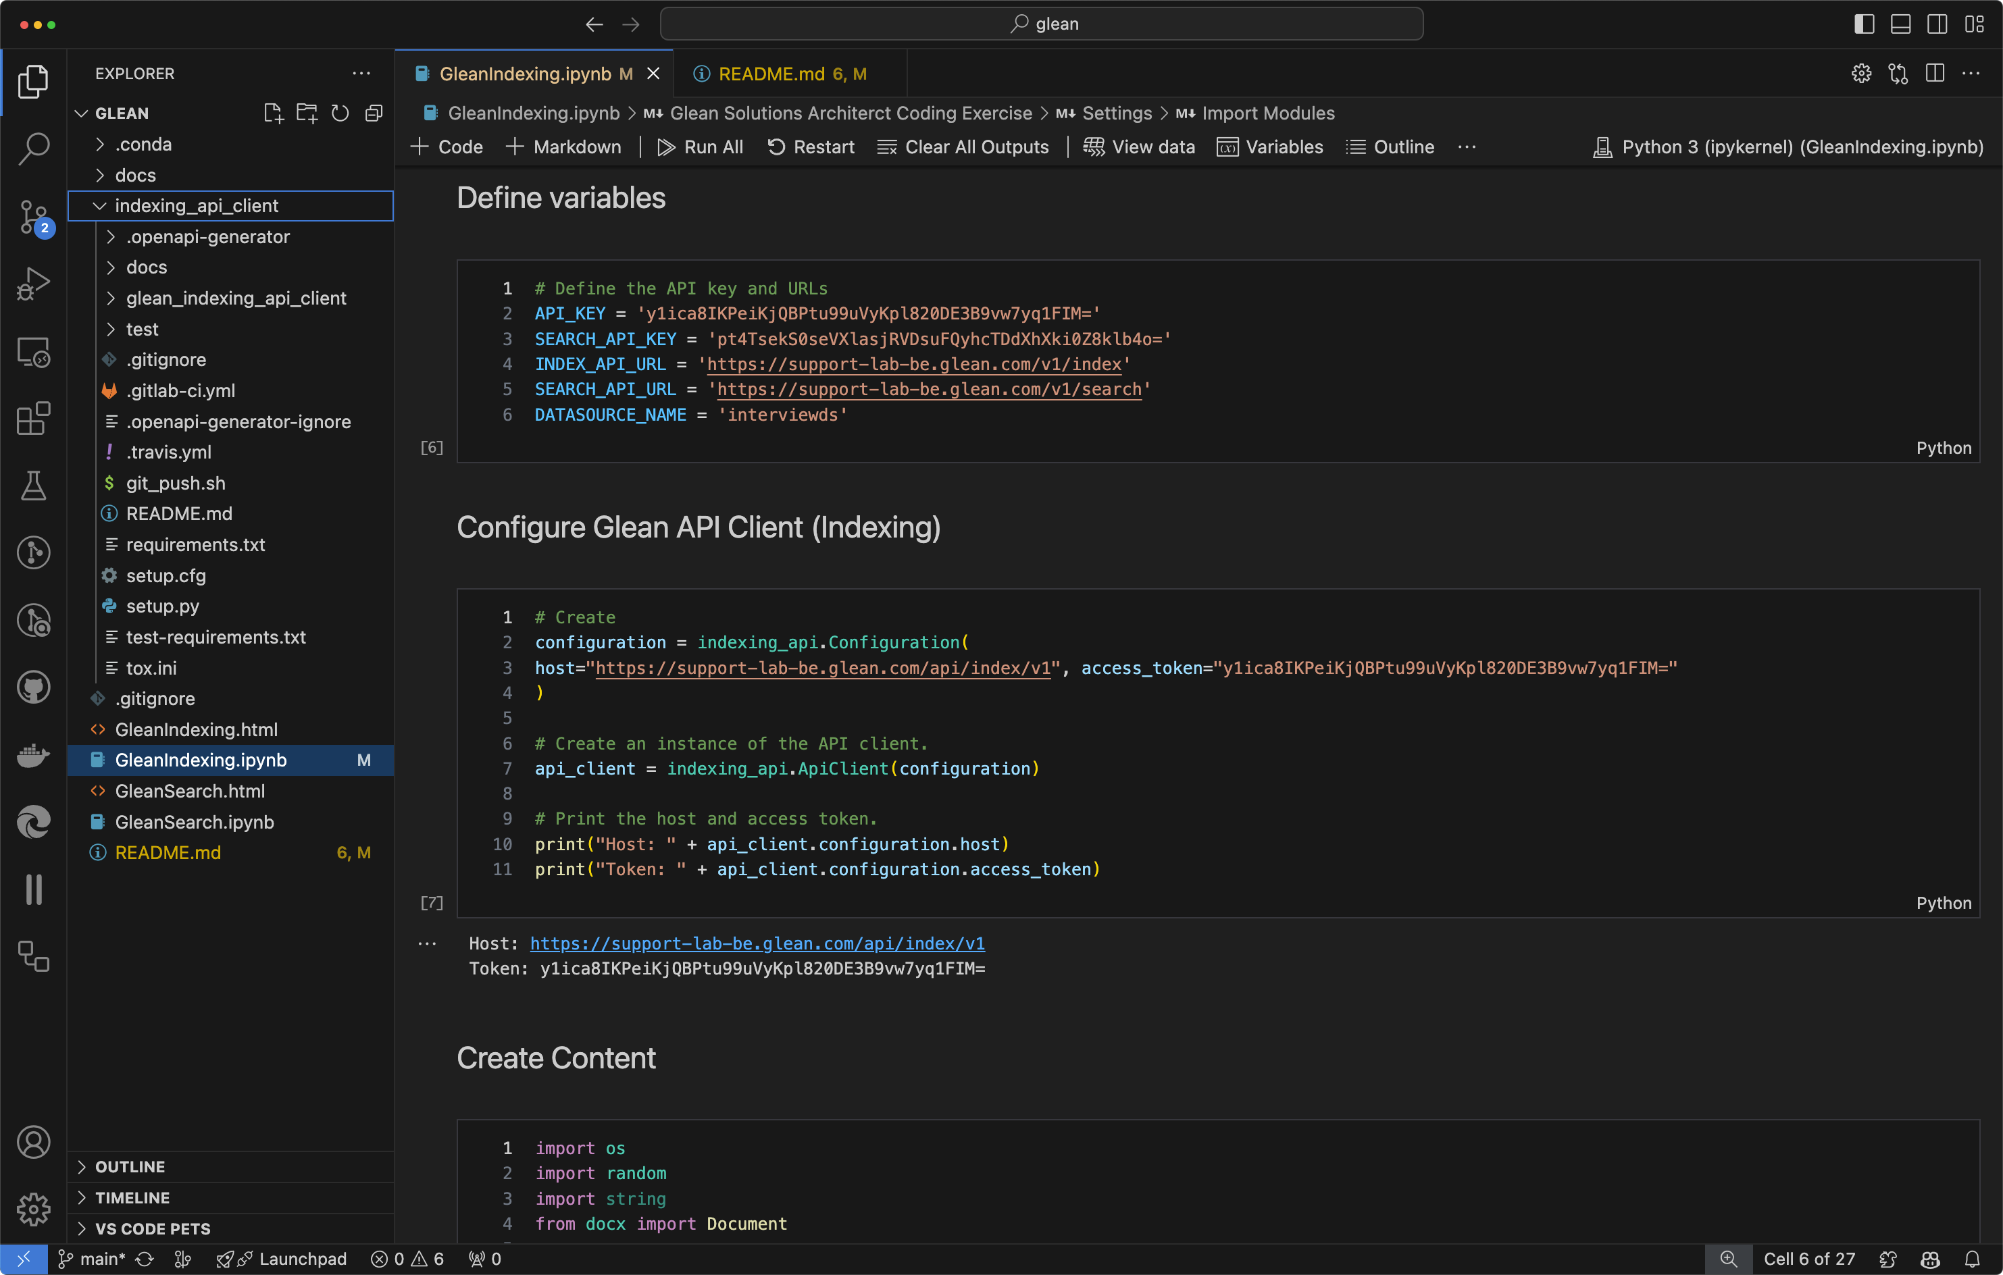

Slide 15
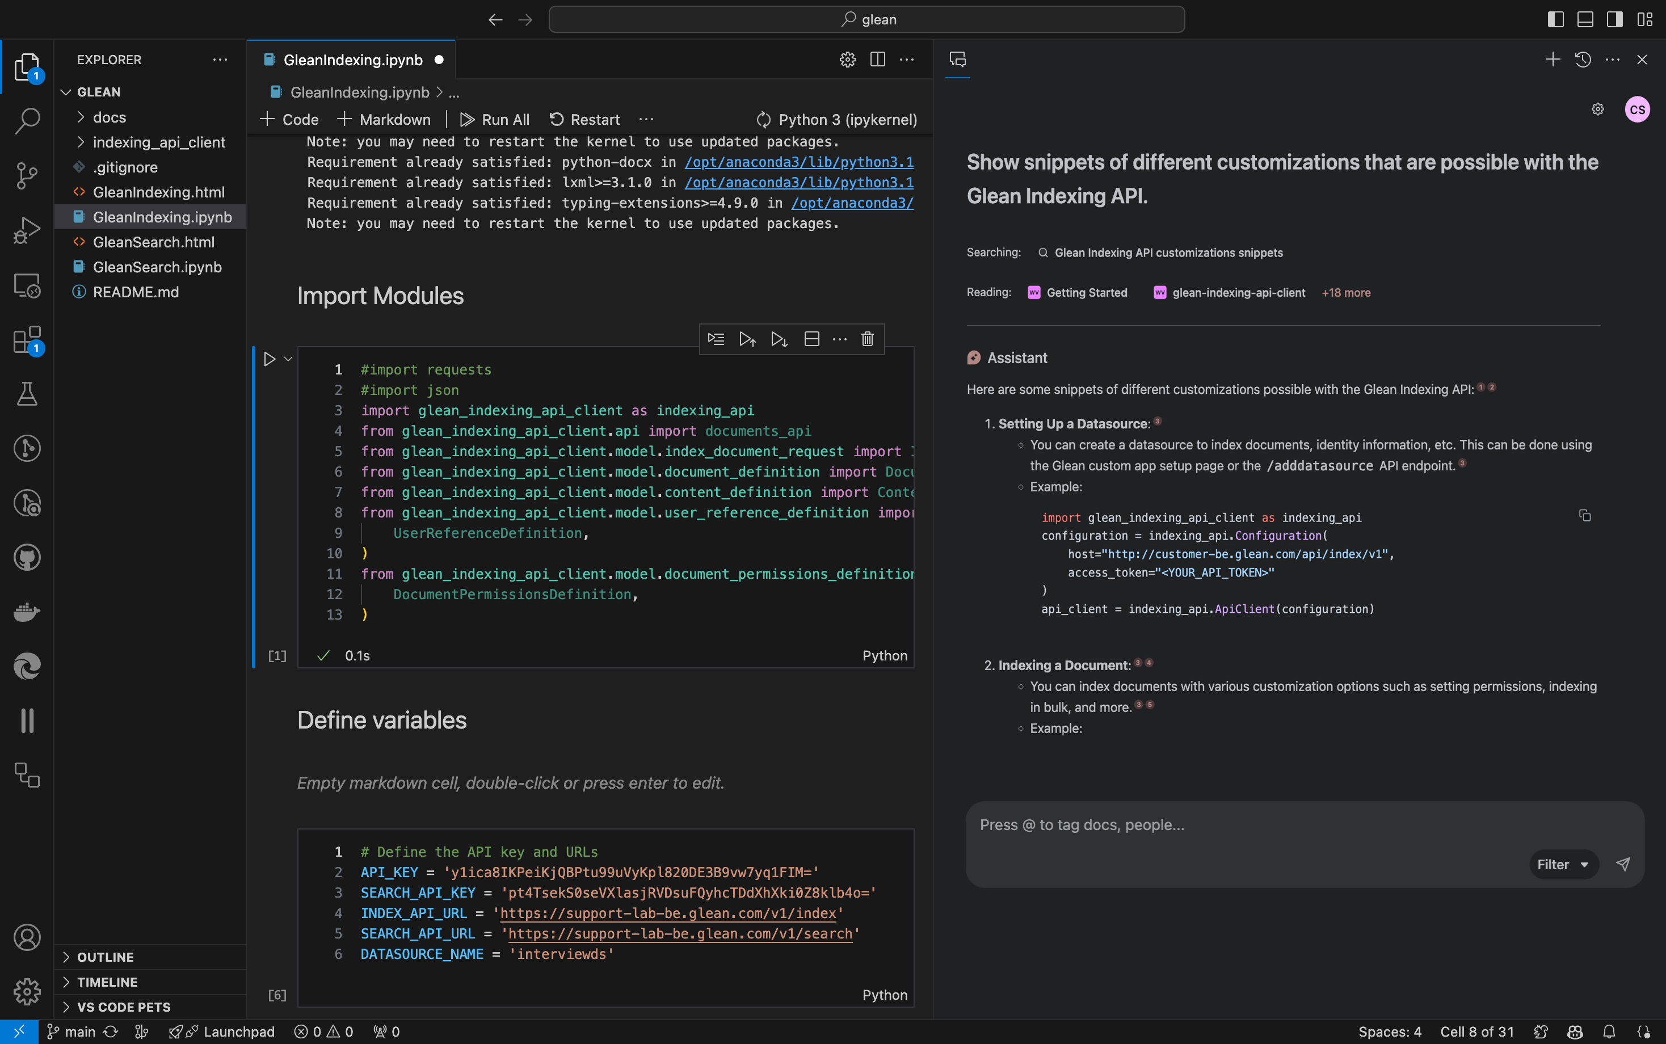

Slide 16
Put AI to work.
At work.
The enterprise AI platform for all your company’s data.
Thank you!
Put AI to work.
At work.
The enterprise AI platform for all your company’s data.

