Slide 1



AcmeOne’s Integration
& Customization
Planning
Solutions Architect, Glean
Rob Barker
rob.barker@glean.com
https://gleaningideas.com

Slide 2
Introductions

Slide 3
Agenda
Introductions
Get to know everyone and what teams are represented.
01
02
Goals
What ore our objectives today and moving forward.
Discuss assumptions.
Measuring success.
Integration Plans
Overview of architecture.
Integration plans.
03
04
Project Plans & Resources
Technical & support resources.
High-level project plans.
Demos!
Jupyter Notebook.
Visual Studio Code Assistant.
05

Slide 4
Agenda
Introductions
Get to know everyone and what teams are represented.
01
02
Goals
What ore our objectives today and moving forward.
Discuss assumptions.
Measuring success.
Integration Plans
Overview of architecture.
Integration plans.
03
04
Project Plans & Resources
Technical & support resources.
High-level project plans.
Demos!
Jupyter Notebook.
Visual Studio Code Assistant.
05

Slide 5
Overview
Current deployment
  Multiple systems integrated with Glean
  Supporting 5,000 employees
Add 2 new customizations
  Custom Sales CRM Connector
    Add new datasource for indexing and search
      Example: SalesForce
  Integrate Glean Search with internal support Chatbot
      Example: Intercom (Conversations/Help Center/Tickets)
Notes:
Add new custom Sales CRM datasource
Questions:
What CRM system is this for? We may have a Connector built for it today.
What functionality
Integrate Glean Search with internal support chatbot

Slide 6
Technical Assumptions & Questions
CRM & Chatbot
Defined Authorization (AuthZ) & Authentication (AuthN)
REST API, webhooks
Based on what platform? Open source?
Deployed on on-premises or cloud?
Communication
  Slack connectivity
API Framework
  Is there a unified API across all integrations?
Environment
  Non-production environment available?
  ETL or snapshot updates to non-prod datasources?
  Business to business connectivity for remote development?
Source Management & Tracking
  GitHub Enterprise org/repositories
  JIRA (or similar) available for epics, issues and feature tracking (eg. JIRA Native)
Notes:
Add new custom Sales CRM datasource
Questions:
What CRM system is this for? We may have a Connector built for it today.
What functionality
Integrate Glean Search with internal support chatbot

Slide 7
Measuring Success
Productivity Metrics
  Search time reduction
  Search success rates
  Task completion time
  Data access frequency
Telemetry
  “You know what you don’t know”
User Feedback
  Collect input from end user testers
Release cadence
  Innovation
  Enhancements
Enable user customization
  No-Code/Low-Code with Glean App Builder
  Developer Workspace
  Jupyter Notebooks
  Visual Studio Code
Notes:
Add new custom Sales CRM datasource
Questions:
What CRM system is this for? We may have a Connector built for it today.
What functionality
Integrate Glean Search with internal support chatbot

Slide 8
Agenda
Introductions
Get to know everyone and what teams are represented.
01
02
Goals
What ore our objectives today and moving forward.
Discuss assumptions.
Measuring success.
Integration Plans
Overview of architecture.
Integration plans.
03
04
Project Plans & Resources
Technical & support resources.
High-level project plans.
Demos!
Jupyter Notebook.
Visual Studio Code Assistant.
05

Slide 9
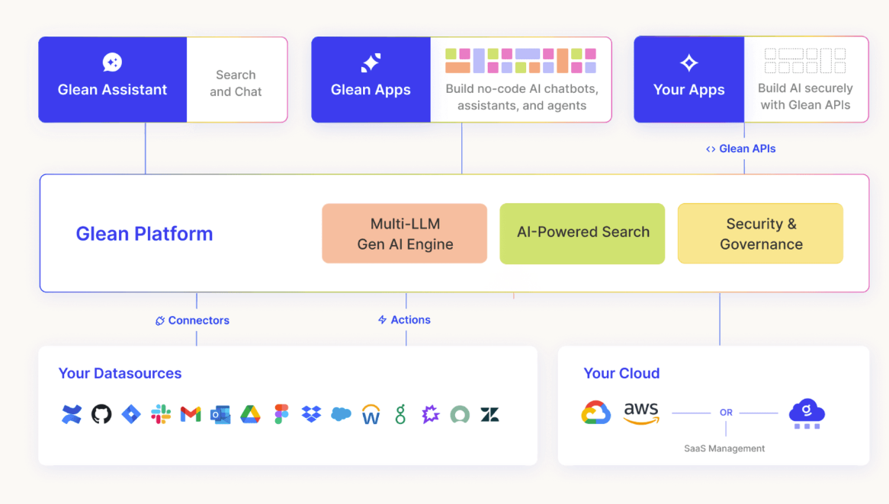

Slide 10
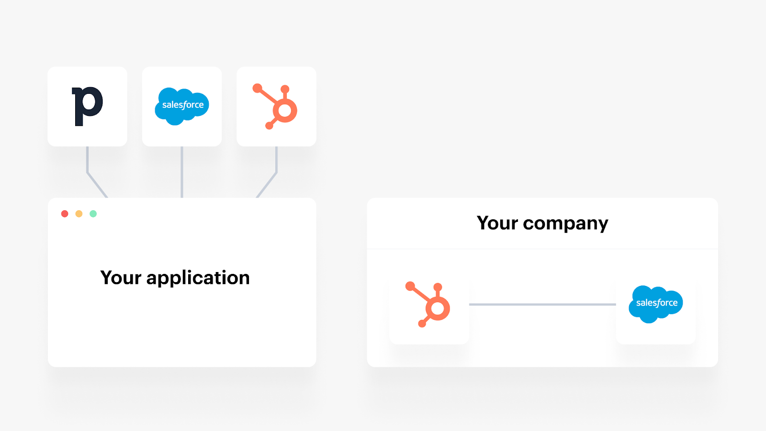

Slide 11
Integration Workflow
High-Level Integration Component and Flow Diagram
  Create a block and arrow diagram to illustrate the integration components.
  Include Glean, the custom sales CRM, and the internal support chatbot.
  Show data flow between these systems.
Notes:
Flow diagram
Glean Web SDK
Jupyter
Glean Web SDK
https://developers.glean.com/docs/browser_api/
Glean Chat
REST API

Slide 12
LLM
Glean Assistant
Glean Search
Analyze
Act
Integration
Workflow
Glean APIs
Option 02
Nunc interdum velit vulputate.

Slide 13
Resource Planning
Role | Responsibility | Team
Executive Sponsor | Support for backing of project and ownership | Glean, AcmeOne
Project Manager | Define project plan, accountability, tracking, comms, team mgmt. | Glean
Business Stakeholders | Line-of-Business members to define features, permissions and metrics. | AcmeOne
Engineering | Development teams to collaborate on integration. | Glean, AcmeOne
Testers | Engineering test tasks (scale, pen, error) and end user group for UAT.
Infrastructure | Setup environment for development and testing. | AcmeOne
DevOps/SRE | Implement deployment workflow for rapid deployment and monitoring. | AcmeOne
SecOps | Data privacy, Pen testing | AcmeOne
IT Support |  | AcmeOne
Architects |  | Glean, AcmeOne
Glean Technical Services/Support |  | Glean
Notes:
Resources required on both sides of the integration: technical and people (list of resources and what they would be used for)
Project Manager
Define project plan, accountability, tracking, comms, team mgmt.
Executive sponsors
Glean and Customer
Business/Application Stakeholders
Role
From customer
Engineering/Technical Services
Role
From customer and Glean
Infrastructure
Role
Systems access (JIRA, Git,
From customer
Securitty
IT
Customer support team
Test/UAT
Role
From customer and Glean
Solutions Architect
Role
Glean Technical Services
Technical Resources:
Backend developers to implement the custom datasource.
Frontend developers to integrate search results into the chatbot UI.
DevOps engineers for deployment and monitoring.
People Resources:
Project manager to coordinate tasks.
Business analysts to gather requirements.
Security experts to ensure data privacy.

Slide 14
High-Level Project Stages
Develop
Deployment
Monitoring
Design Phase
Develop custom datasource code.
Implement search integration.
Set up authentication.
Create non-production environment with data extraction or snapshot of Sales CRM system (datasource).
Defect management
Performance
Issues
Define data mapping between systems.
Design custom datasource schema.
Plan chatbot integration.
01
02
03
04
05
06
07
08
Infrastructure
Setup
Testing
Technical
Enablement
Continuous
Improvement
Conduct multiple testing phases:
Scale testing to support 5,000 users
Penetration testing (Auth/n/z)
UAT
Create non-production environment using data extraction or snapshot of Sales CRM system (datasource) and Internal ChatBot for development and testing.
Deliver training series for end users.
Deliver training series to internal developers/power users on extensibility.
Documentation
Based on monitoring data determine:
Usability improvements
Feature enhancements
Determine more data elements to expose
Continuous Improvement
Notes:
Rough Project Plan
Design Phase:
Define data mapping between systems.
Design custom datasource schema.
Plan chatbot integration.
Build Phase:
Develop custom datasource code.
Implement search integration.
Set up authentication.
Test Phase:
Unit testing for custom datasource.
Integration testing with chatbot.
Security testing.
Implement Phase:
Deploy custom datasource.
Enable search integration.
Train support team.
Monitor performance.
Design & Build
Semantics, Style, Language, Actions, Behaviors
Create Technical Contracts – Formal interface specifications
Define Nontechnical Contracts - Service level, access rules, usage policies
Generate Effective API Documentation - Auto generation of documentation
Deploy & Document
Continuous build, deploy & operate with security
Security
Threat modeling, continuous scanning, test beds
Auth/n/z
Audit
Manage API lifecycle for continuous improvements using telemetry and community

Slide 15
Rough Timeline
2000 2001 2002 2003 2004 2005 2006 2007 2008 2009 2010 2011 2012 2013 2014 2015 2016 2017 2018 2019
Design Phase
Build Phase
Development
Testing
Deployment
Project Name 06
UAT
Training
Documentation
Monitoring
Feedback
…

Slide 16
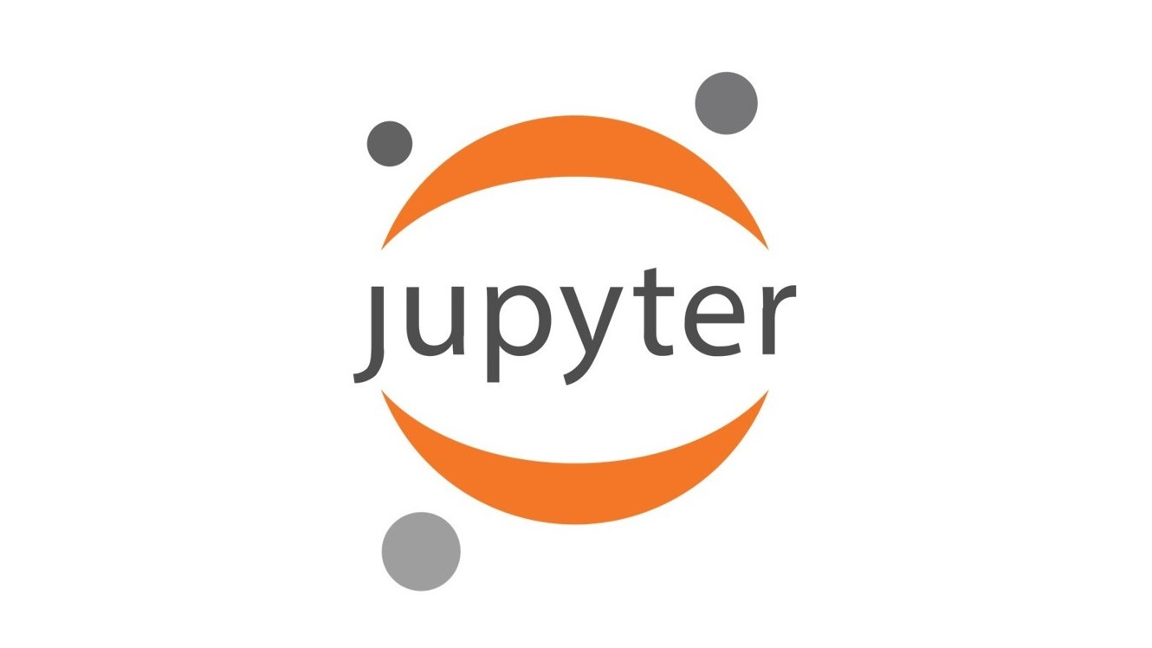

Enablement Tools
Jupyter
Notebook
Interactive development environment for notebooks, code, and data.
Visual Studio Code
Contextual Coding Assistant
01
02

Slide 17
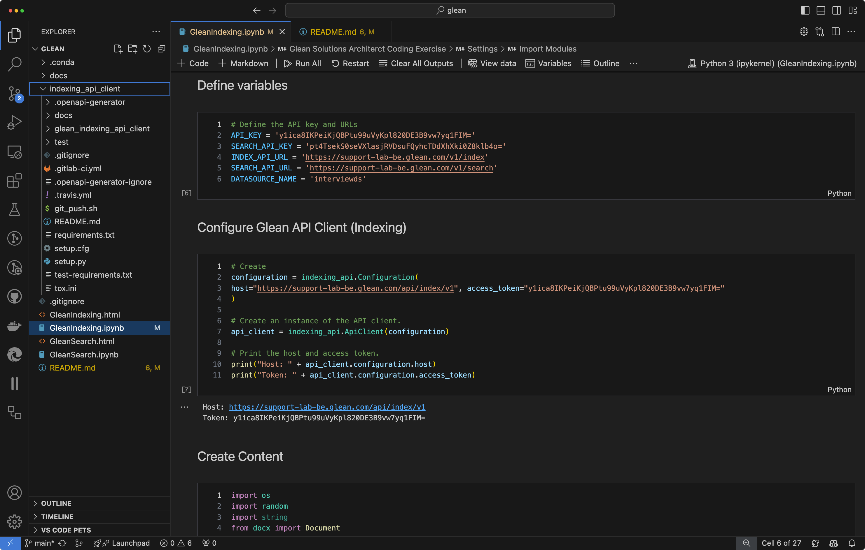

Slide 18
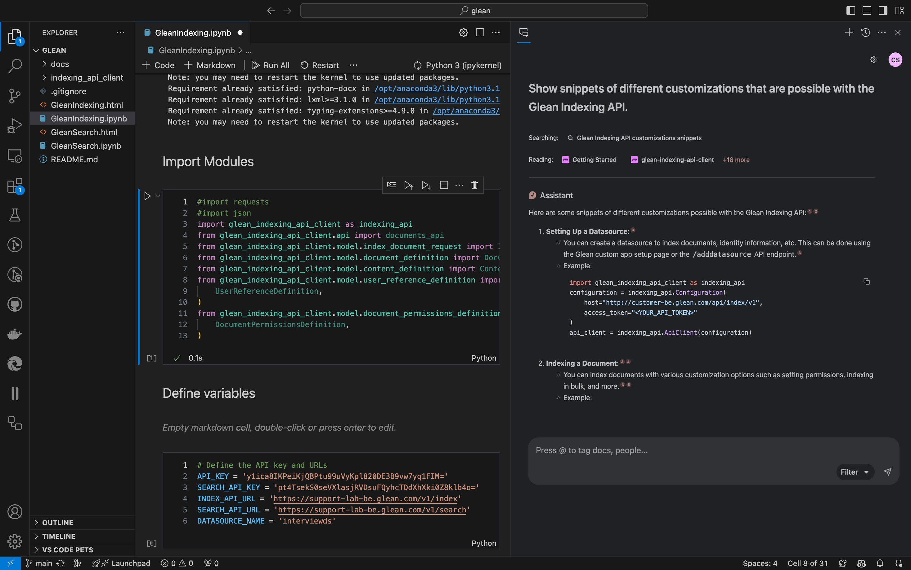

Slide 19
Put AI to work.
At work.
The enterprise AI platform for all your company’s data.
Thank you!
Put AI to work.
At work.
The enterprise AI platform for all your company’s data.

Slide 20


Backup Slides

Slide 21
Overview
5,000 employees
Multiple systems already integrated
2 major customizations
  New custom datasource for CRM data (Similar to SalesForce)
  ChatBot for internal support (eg. Intercom)
How to
Block/arrow diagram
Tech assumptions
Integration method
Resources – Technical and people (who and what for)
Rough project plan – Design, build, test, implement
  Project phases and list of tasks in the phases

Slide 22
Introduction
  Briefly introduce Glean and its purpose.
  Mention the customer’s existing deployment and their specific requests.
High-Level Integration Component and Flow Diagram
  Create a block and arrow diagram to illustrate the integration components.
  Include Glean, the custom sales CRM, and the internal support chatbot.
  Show data flow between these systems.
Technical Assumptions
  List assumptions about the customer’s systems and Glean:
    Glean supports REST APIs for data exchange.
    The custom sales CRM exposes APIs for data retrieval.
    The internal support chatbot has an API for communication.
    Authentication mechanisms are in place (e.g., OAuth, API keys).
Integration Methods
  Custom Datasource (Sales CRM):
    Leverage Glean’s extensibility to create a custom datasource.
    Use REST APIs to pull data from the sales CRM.
    Schedule periodic syncs to keep data up-to-date.
  Search Integration (Internal Chatbot):
    Integrate Glean’s search functionality into the chatbot.
    Use webhook callbacks to trigger searches.
    Display relevant search results within the chatbot interface.
Resources Required
  Technical Resources:
    Backend developers to implement the custom datasource.
    Frontend developers to integrate search results into the chatbot UI.
    DevOps engineers for deployment and monitoring.
  People Resources:
    Project manager to coordinate tasks.
    Business analysts to gather requirements.
    Security experts to ensure data privacy.
Rough Project Plan
  Design Phase:
    Define data mapping between systems.
    Design custom datasource schema.
    Plan chatbot integration.
  Build Phase:
    Develop custom datasource code.
    Implement search integration.
    Set up authentication.
  Test Phase:
    Unit testing for custom datasource.
    Integration testing with chatbot.
    Security testing.
  Implement Phase:
    Deploy custom datasource.
    Enable search integration.
    Train support team.
    Monitor performance.

Slide 23
