Slide 1

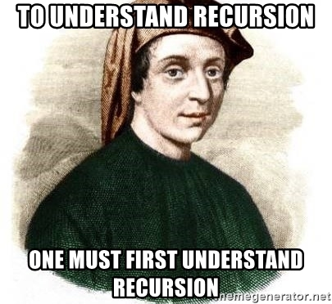
Welcome to the OODP Lesson
How do you feel about recursion?
Send a tasteful pic/gif

Slide 2

What we will cover this week
Lambdas
Higher Order Functions

Slide 3
Higher Order Functions (HOFs) A function which takes in a function and/or returns a function
Function
Function
Function
AND/OR
OR
Input
Output

Slide 4
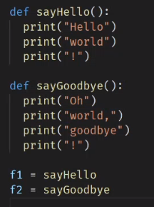
“Function types/code block types are just kind of variables...”
What is the type of the variables f1 and f2?
int
string
function
None

Slide 5
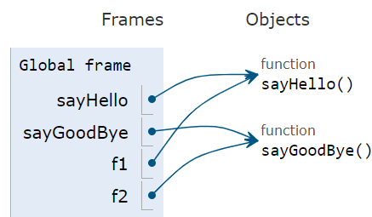
“Function types/code block types are just kind of variables...”
What is the type of the variables f1 and f2?
int
string
function
None

Slide 6
“Function types/code block types are just kind of variables...”
number = 1
A variable binds a name (number) to some data (1)
def saySomething(something):
print(something)
A function binds a name (saySomething) to some behaviour (print(something))
We can think of the behaviour as the “data” that name is bound to

Slide 7

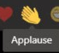
“Function types/code block types are just kind of variables...”
number = 1
A variable binds a name (number) to some data (1)
def saySomething(something):
print(something)
A function binds a name (saySomething) to some behaviour (print(something))
We can think of the behaviour as the “data” that name is bound to

Slide 8
We can pass data to a function
def saySomething(something):
print(something)
s = 'yo!'
saySomething(s)

Slide 9
We can pass data to a function
def saySomething(something):
print(something)
s = 'yo!'
saySomething('yo!')

Slide 10
We can pass data to a function
def saySomething(something = 'yo!'):
print(something)
s = 'yo!'
saySomething(s)

Slide 11
We can pass data to a function
def saySomething(something):
print('yo!')
s = 'yo!'
saySomething(s)

Slide 12
Higher Order Functions (HOFs) A function which takes in a function and/or returns a function
Function
Function
Function
AND/OR
OR
Input
Output

Slide 13
We can pass data to a function
def sayHello():
print('Hello')
def runIt(f):
print('Start')
f()
print('Done')
runIt(sayHello)

Slide 14
We can pass data to a function
def sayHello():
print('Hello')
def runIt(f):
print('Start')
f()
print('Done')
runIt(sayHello)

Slide 15
We can pass data to a function
def sayHello():
print('Hello')
def runIt(f = sayHello):
print('Start')
f()
print('Done')
runIt(sayHello)

Slide 16
We can pass data to a function
def sayHello():
print('Hello')
def runIt(f):
print('Start')
f()
print('Done')
runIt(sayHello)
Start

Slide 17
We can pass data to a function
def sayHello():
print('Hello')
def runIt(f):
print('Start')
sayHello()
print('Done')
runIt(sayHello)
Start

Slide 18
We can pass data to a function
def sayHello():
print('Hello')
def runIt(f):
print('Start')
f()
print('Done')
runIt(sayHello)
Start
Hello

Slide 19
We can pass data to a function
def sayHello():
print('Hello')
def runIt(f):
print('Start')
f()
print('Done')
runIt(sayHello)
Start
Hello
Done

Slide 20

Consider the next scenario and see if you can figure out why.
LATER I will ask you for your answers

Slide 21
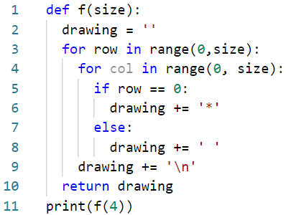



What will this code print?
Vertical line
Square
Horizontal line
Triangle

Slide 22
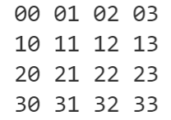
What will this code print?
Vertical line
Square
Horizontal line
Triangle
rc
'****\n \n \n \n'

Slide 23

What will this code print?
Vertical line
Square
Horizontal line
Triangle
rc

Slide 24
What will this code print?
Vertical line
Square
Horizontal line
Triangle
rc

Slide 25

To draw a forward slash (diagonal line) which line of code would you change?
2
5
6
8

Slide 26
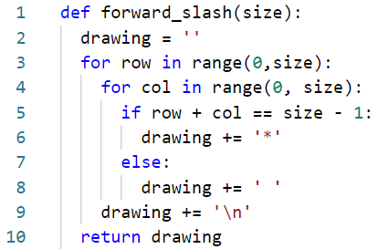
To draw a forward slash (diagonal line) which line of code would you change?
2
5
6
8
rc

Slide 27

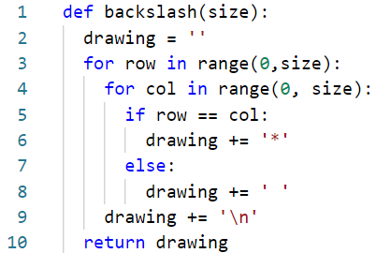
To draw a backslash (diagonal line) what condition would you use on line 5?
row <= col
row == size - 1
row == col
col == size - 1
_________
rc

Slide 28
To draw a backslash (diagonal line) what condition would you use on line 5?
row <= col
row == size - 1
row == col
col == size - 1
rc

Slide 29

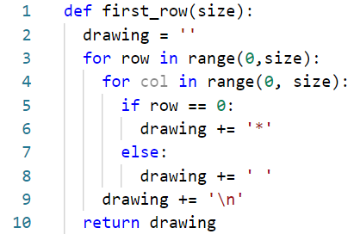
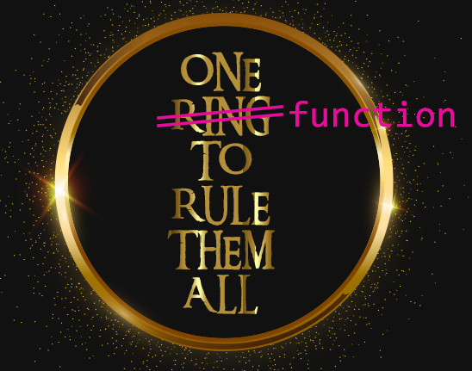
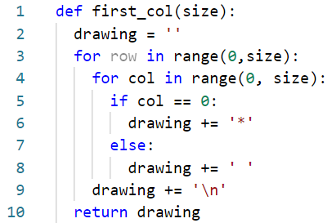

Each function is very similar…

Slide 30

Why are HOFs that take in functions as parameters useful?
Give examples if you like.

Slide 31
Why are HOFs that take in functions as parameters useful?
Functions encapsulate behaviour.
Higher order functions which accept functions as parameters allow us to inject custom behaviour.
Abstraction / Reduce code duplication
We reduced several functions into one
Scalability / reusability
The functions we created can be used to create other shapes
Duplicate code → Duplicate problems
Find a bug, fix it everywhere
Changes needed, change it everywhere
Notes:
Abstraction -> taking our coding skills to another level

Slide 32


Slide 33
Can we achieve similar functionality?
Before
s4 = backslash(4)
s5 = backslash(5)
s6 = backslash(6)
After
s4 = draw(4, pixels_in_backslash)
s5 = draw(5, pixels_in_backslash)
s6 = draw(6, pixels_in_backslash)

Slide 34
Higher Order Functions (HOFs) A function which takes in a function and/or returns a function
Function
Function
Function
AND/OR
OR
Input
Output

Slide 35

Higher Order Functions (HOFs) A function which takes in a function and/or returns a function
Function
Function
Function
AND/OR
OR
Input
Output

Slide 36
Hands up if you think backslash is a function
def pixels_in_backslash(row, col, size):
return row == col
def create_draw_function(requirements):
def draw(size):
drawing = ''
for row in range(0,size):
for col in range(0, size):
if requirements(row, col, size):
drawing += '*'
else:
drawing += ' '
drawing += '\n'
return drawing
return draw
backslash = create_draw_function(pixels_in_backslash)

Slide 37
Hands up if you think backslash is a function
def pixels_in_backslash(row, col, size):
return row == col
def create_draw_function(requirements):
def draw(size):
drawing = ''
for row in range(0,size):
for col in range(0, size):
if requirements(row, col, size):
drawing += '*'
else:
drawing += ' '
drawing += '\n'
return drawing
return draw
backslash = create_draw_function(pixels_in_backslash)
function

Slide 38
How would you invoke the backslash function so that it draws a backslash of size 4?
def pixels_in_backslash(row, col, size):
return row == col
def create_draw_function(requirements):
def draw(size):
drawing = ''
for row in range(0,size):
for col in range(0, size):
if requirements(row, col, size):
drawing += '*'
else:
drawing += ' '
drawing += '\n'
return drawing
return draw
backslash = create_draw_function(pixels_in_backslash)
s = draw(4)
s = backslash(4, pixels_in_backslash)
s = backslash(4)
s = pixels_in_backslash(4)

Slide 39
How would you invoke the backslash function so that it draws a backslash of size 4?
def pixels_in_backslash(row, col, size):
return row == col
def create_draw_function(requirements):
def draw(size):
drawing = ''
for row in range(0,size):
for col in range(0, size):
if requirements(row, col, size):
drawing += '*'
else:
drawing += ' '
drawing += '\n'
return drawing
return draw
backslash = create_draw_function(pixels_in_backslash)
s = draw(4)
s = backslash(4, pixels_in_backslash)
s = backslash(4)
s = pixels_in_backslash(4)

Slide 40
Why are HOFs that return functions useful?
Type your answers in the chat. Give examples if you like.

Slide 41
Why are HOFs that return functions useful?
Higher order functions which return functions allow us to generate new functions (function factories)
backslash(4) VS draw(4, pixels_in_backslash)
Abstraction (Less to think about)
Reduce code duplication
Improved code readability?
Notes:
Obviscate – lass to think about

Slide 42
Do I really need to define a function for this?
def pixels_in_backslash(row, col, size):
return row == col
def create_draw_function(requirements):
def draw(size):
drawing = ''
for row in range(0,size):
for col in range(0, size):
if requirements(row, col, size):
drawing += '*'
else:
drawing += ' '
drawing += '\n'
return drawing
return draw
backslash = create_draw_function(pixels_in_backslash)

Slide 43
No need to store actual parameter in a variable
def saySomething(something):
print(something)
s = 'yo!'
saySomething(s)

Slide 44
No need to store actual parameter in a variable
def saySomething(something):
print(something)
saySomething('yo!')
Can we get similar functionality with functions?

Slide 45
Lambdas aka Anonymous functions A function that can be defined without being bound to a name.
Definition
Function call
def add(a, b, c):
return a + b + c
addL = lambda a, b, c : a + b + c
n = add(1, 2, 3)
n = addL(1, 2, 3)
Can have multiple parameters but only one expression
Tip: The one expression can be a conditional expression:
even = lambda x: 'Even' if x % 2 == 0 else 'Odd'
def even(x):
if x % 2 == 0:
return 'Even'
else:
return 'Odd'
Equivalent to

Slide 46
Lambdas aka Anonymous functions A function that can be defined without being bound to a name.
Definition
Function call
def add(a, b, c):
return a + b + c
addL = lambda a, b, c : a + b + c
n = add(1, 2, 3)
n = addL(1, 2, 3)
Can have multiple parameters but only one expression
Tip: The one expression can be a conditional expression:
even = lambda x: 'Even' if x % 2 == 0 else 'Odd'
def even(x):
if x % 2 == 0:
return 'Even'
else:
return 'Odd'
Equivalent to

Slide 47
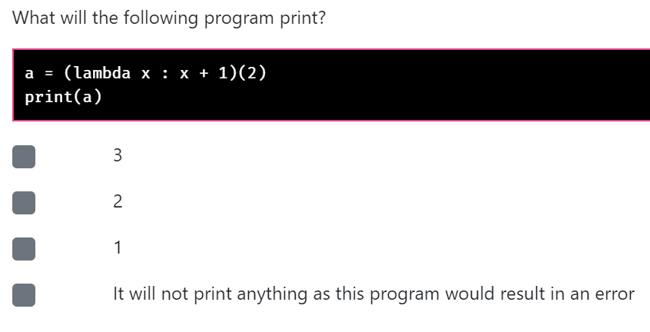
Chapter 5: MCQ Intro 9
A
B
C
D

Slide 48

Chapter 5: MCQ Intro 9
A
B
C
D

Slide 49
Rewrite this function as a lambda
def pixels_in_backslash(row, col, size):
return row == col

Slide 50
Rewrite this function as a lambda
def pixels_in_backslash(row, col, size):
return row == col
pixels_in_backslash = lambda row, col, size: row == col

Slide 51
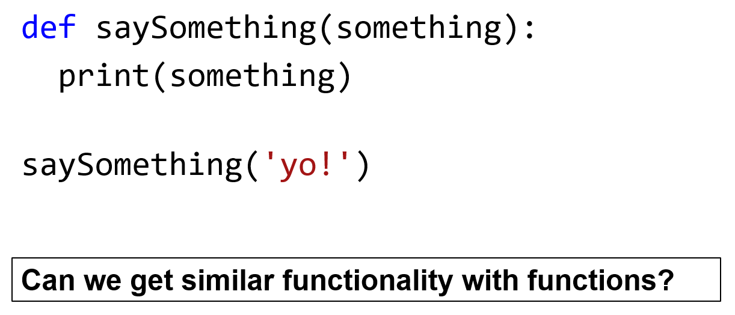
Using this in our program
def create_draw_function(requirements):
def draw(size):
drawing = ''
for row in range(0,size):
for col in range(0, size):
if requirements(row, col, size):
drawing += '*'
else:
drawing += ' '
drawing += '\n'
return drawing
return draw
backslash = create_draw_function(lambda row, col, size: row == col)
s = backslash(4)

Slide 52
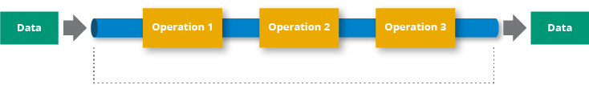
Combining simple functions to build more complicated ones
Think of a number.
Add 3.
Double it.
Subtract 4.
Cut it in half.
Subtract your original number.
Data
Data
Pipeline
Notes:
1

Slide 53
In slow motion…
def then(f, g):
return lambda x: g(f(x))
add3 = lambda x: x + 3
doubleIt = lambda x : x * 2
two_ops = then(add3, doubleIt)
perform_two_ops = two_ops(4)

Slide 54
In slow motion…
def then(f = add3, g = doubleIt):
return lambda x: g(f(x))
add3 = lambda x: x + 3
doubleIt = lambda x : x * 2
two_ops = then(add3, doubleIt)
perform_two_ops = two_ops(4)

Slide 55
In slow motion…
def then(f, g):
return lambda x: doubleIt(add3(x))
add3 = lambda x: x + 3
doubleIt = lambda x : x * 2
two_ops = then(add3, doubleIt)
perform_two_ops = two_ops(4)

Slide 56
In slow motion…
def then(f, g):
return lambda x: g(f(x))
add3 = lambda x: x + 3
doubleIt = lambda x : x * 2
two_ops = lambda x: doubleIt(add3(x))
perform_two_ops = two_ops(4)

Slide 57
In slow motion…
def then(f, g):
return lambda x: g(f(x))
add3 = lambda x: x + 3
doubleIt = lambda x : x * 2
two_ops = lambda x: doubleIt(add3(x))
perform_two_ops = two_ops(4)

Slide 58
In slow motion…
def then(f, g):
return lambda x: g(f(x))
add3 = lambda x: x + 3
doubleIt = lambda x : x * 2
two_ops = lambda x=4: doubleIt(add3(x))
perform_two_ops = two_ops(4)

Slide 59
In slow motion…
def then(f, g):
return lambda x: g(f(x))
add3 = lambda x: x + 3
doubleIt = lambda x : x * 2
two_ops = lambda x: doubleIt(add3(4))
perform_two_ops = two_ops(4)

Slide 60
In slow motion…
def then(f, g):
return lambda x: g(f(x))
add3 = lambda x: x + 3
doubleIt = lambda x : x * 2
two_ops = lambda x: doubleIt(7)
perform_two_ops = two_ops(4)

Slide 61
In slow motion…
def then(f, g):
return lambda x: doubleIt(add3(x))
add3 = lambda x: x + 3
doubleIt = lambda x : x * 2
two_ops = then(add3, doubleIt)
perform_two_ops = two_ops(4) = 14

Slide 62
Combining simple functions to build more complicated ones
ans = sub_my_num(halfIt(sub4(doubleIt(add3(my_num)))))
Think of a number.
Add 3.
Double it.
Subtract 4.
Cut it in half.
Subtract your original number.
Data
Data
Pipeline
Notes:
1

Slide 63
Recap
Why HOFs
HOFs that take in functions
HOFs that return functions
Lambdas
Selection statement (briefly)

Slide 64
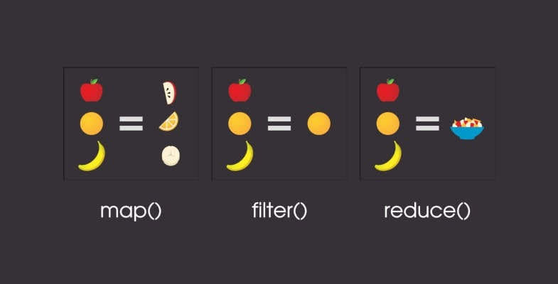


Next Time …
More time to digest HOFs
More HOF examples (map, filter, reduce)

