Slide 1
PowerEnJoy Project presentation
Bagna Francesco
Barletta carmen

Slide 2
Introduction
PowerEnJoy→ an electric car-sharing system, based on a web page and on a smartphone application
Objectives →
Sensitize people in using environmental-friendly means of transport.
Make people gain a correct behavior towards people who live in their same environment
Offer a reliable and widely distributed service of car-sharing.
Users → people with a driving license and a credit card
Operators→ employees of the company who maintain the cars
Administrator → a person of the company that administrates the system.
Embedded Technologies → GEB (Green e-Box)

Slide 3
Goals
[G1] Identify a user in a unique way.
[G2] For every user easy and fast to find available cars in the proximity
[G3] Allow users to reserve a single car for up to one hour in advance to the rental
[G4] Penalize users who reserve a car without taking it in the expected time.
[G5] Allow user to open, enter and use the car.
[G6] Allow user to be constantly aware of the cost of his ride.
[G7] Make easy, for every user, to geolocate all the parking safe areas and all the available special safe areas.
[G8] Incentivize the virtuous behavior of the users
[G9] Provide a way to use the cars in a continuative way
[G10] Maintain an equal distribution of the cars among the areas

Slide 4
Functional Requirements
[G8] Incentivize the virtuous behavior of the users
Block (if he didn’t pay the last ride) and unblock the user (when he fulfills his pending payment)
Detect cars’ battery level
Detect if a car is plugged into the power grid
The system must apply a 10% of discount on the ride, if it’s notified of the presence of at least two other passengers in the car
Detect the ending of a rental, if the engine is stopped, the doors are open and the car is still
The system must apply a 20% of discount on the ride, if the rental has ended and the battery of the car is almost at the 50%
The system must apply a 30% of discount on the ride, if it’s plugged into the power grid
The system must charge 30% more on the last ride, if a car is left at more than 3 KM from the nearest special safe area or with more than 80% of the battery empty

Slide 5
Use Case: User makes a reservation

Slide 6
User Interface
Mobile App mockup → Control flow to manage a Reservation
Notes:
carmen

Slide 7
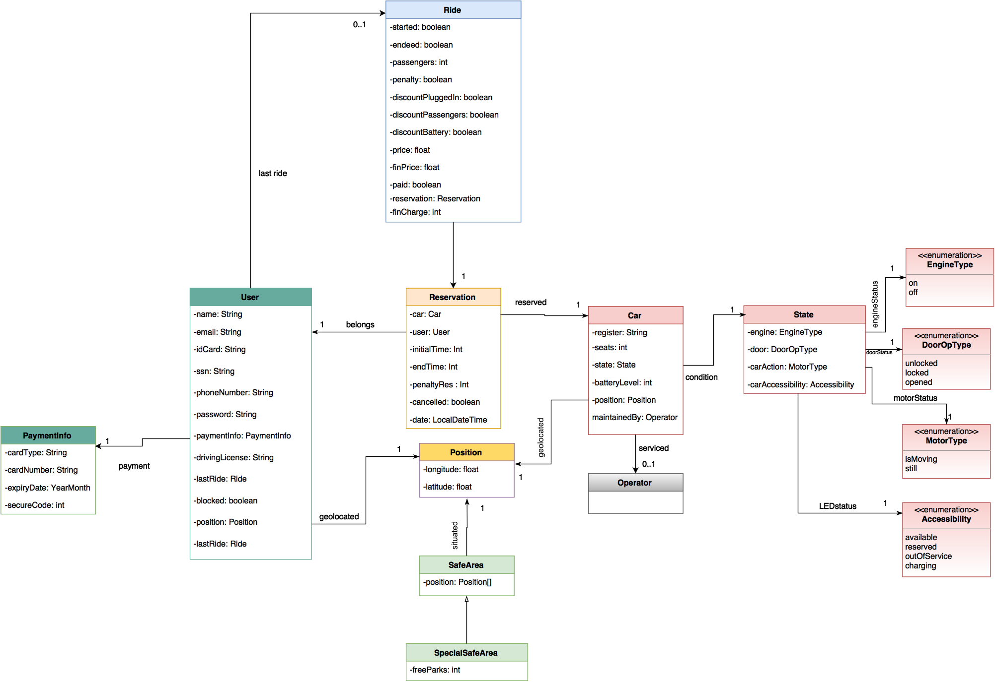
UML

Slide 8
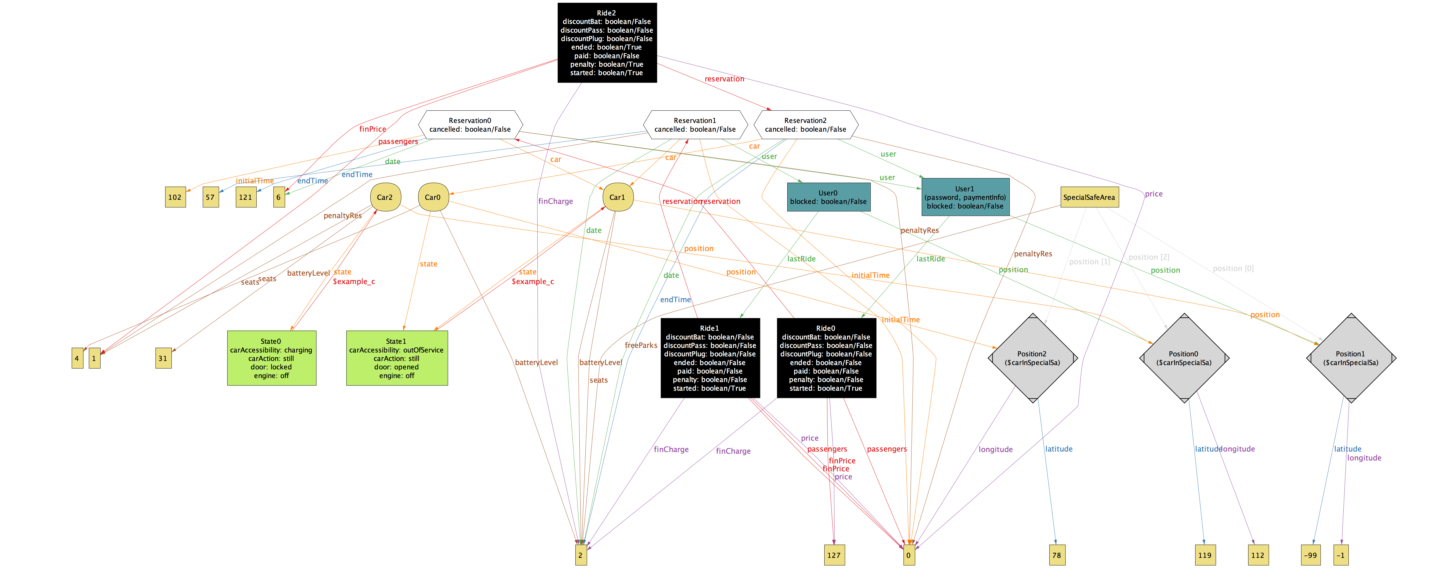
Mapping System on Alloy model

Slide 9
Power EnJoy Architectural Design

Slide 10
Overview

Slide 11
High level components and their interaction
Notes:
carmen

Slide 12
Component view

Slide 13
Deployment view

Slide 14
Runtime View: User makes a reservation
After having seen the reservation form, the user fills it (with an address from where to do a search or with his GPS position) and the form is sent to the Reservation Manager. The information is controlled to be valid, then using the Car Search component all the available cars in the proximity are reached and a response containing the available cars (if any) is sent to the User App. If the information was valid, or if there were no available cars, an error message is shown. Otherwise, the user must choose a car by trying to reserve it. The request is sent to the Reservation Manager, that controls another time that the car chosen by the user is in fact available (in order to avoid double reservations), and reserves the car if bookable. Then a notification of the success/fail of the operation is sent to the user.

Slide 15
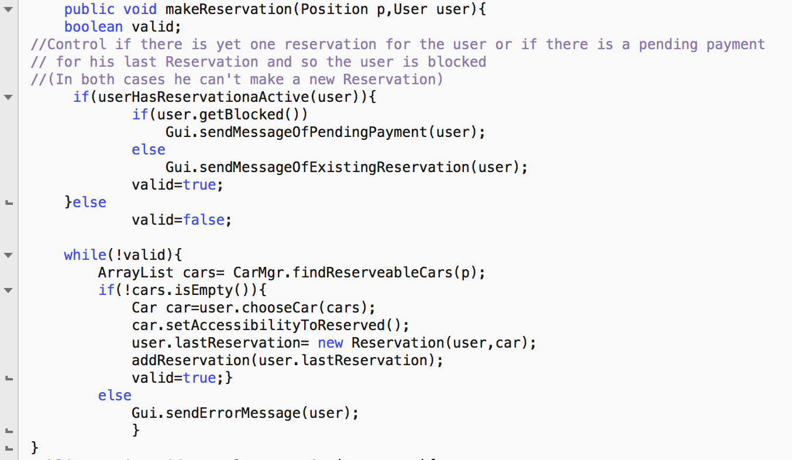
Algorithm design: User makes a reservation
Notes:
carmen

Slide 16
Component interfaces

Slide 17
Power EnJoy Integration Test Plan

Slide 18
ITP
Integration test is a delicate and essential part of the process.
We chose to use a bottom-up testing strategy for our system. This because it’s the most appropriate strategy to test the components as soon as they are developed and to develop the others at the same time, so that we could work in parallel and optimize the time at our disposal.
We assume that the external components have been already tested and must only be integrated with our system.
Notes:
carmen

Slide 19
Phases of Integration-1° phase
The Car Controller. It’s the main subsystem of our system, and will need a number of other components to be integrated. These components are the Location Manager, the Operator App and the external Database and GEB system.
After developing the Car Manager and Car Search subcomponents, we can integrate the full Car Controller subsystem.

Slide 20
Phases of integration-2° phase
Central System. After having integrated the main component, we can integrate the rest of the main system for our project.
This is shaped by the Car Controller plus the Reservation Manager, Ride Manager, User Manager, Administration Manager, Location Manager and Safe Area components.

Slide 21
Phases of integration-3° phase
Finally we can integrate the rest of the external component and the final components developed by us. We then obtain our final system.

Slide 22
Tools and Test Data
We decided to use Rspec, a testing software explicitly developed for the Ruby on Rails Framework, which we have used for the main server. Being an already compatible software, it’s the best choice for testing the components of our system.
Also used is the JUnit framework, useful for testing the interactions between components and unit testing.
Also manual testing will be used for some parts of the system, being it a good method to find faults or bad programming in the software.
Test data will be used in integration testing to test the most crucial parts of the system: each group of data will contain both “good” data and “bad” data (like null or incorrectly formatted objects). A full list is available in the main document.

Slide 23
Power EnJoy Project Plan

Slide 24
Project size
The Internals Logic Files are the homogeneous set of data used and managed by the Power EnJoy applications.
The External Logic Files are homogeneous set of data used by the PowerEnJoy system but generated and maintained by external applications.
ILF | Complexity | FPs
User’s info Driving license info Payment info Administrator info Operator info Car’s info (Special) Safe Area info Reservation Ride | Low Low Low Low Low Avg Low Low Low | 7 7 7 7 7 10 7 7 7
Total |  | 66
ELF | Complexity | FPs
Car searching computation Payment Transactions Driving License Verification | High Avg Low | 10 7 5
Total |  | 22
Notes:
carmen

Slide 25
External Inputs, External Inquiries, External Outputs
EIs | Complexity | FPs
Login/Logout Reservation Delete reservation User Registration Consult historical reservation info, ride info, payment info Insert delate and update (special) safe areas Insert, delete, update operators’ info Insert, delete, update cars’ info Answer to request of maintenance Change the state of a car | Low High Low Avg Avg Avg Low High Low Avg | 2 x 3 6 3 4 3 x 4 3 x 4 3 x 3 3 x 6 3 4
Total |  | 77
EQs | Complexity | FPs
User retrieve profile info User searches cars User searches special safe areas User requests last ride info Admin retrieves car info Admin retrieves safe/special safe areas info Admin retrieves operator’s info Admin retrieves user’s info | Low Avg Low Low Low Low Low Low | 3 4 3 3 3 3 3 3
Total |  | 25
EOs | Complexity | FPs
Notification recharging request Notification of ride ending Notification user blocked Notification penalties Notification reservation OK Notification reserve time expiration | Low Low Low Low Low Low | 4 4 4 4 4 4
Total |  | 24
Notes:
Ei: elementary operations that are performed to elaborate data coming from the external environment

Slide 26
Overall Estimation
Function Type | Value
Internal Logic Files External Logic Files External Inputs External Inquiries External Outputs | 66 22 77 25 24
Total | 214
Considering to use Java Enterprise Edition to develop the system, the estimated source line of code, basing on the Functional Points are:
SLOC (lower bound) = 214 * 46= 9844
SLOC (upper bound) = 214* 67= 14338

Slide 27
Cost, Effort and Schedule estimation COCOMO II
EFFORT (lower bound) = A * EAF * KSLOCE= 2.94 * 1.68692 * 9.844 1.0353 = 53.237 PM ≈ 54 PM
EFFORT (upper bound) = A * EAF * KSLOCE= 2.94 * 1.68692 * 14.3381.0353 = 78.119 PM ≈ 79 PM
Duration (lower bound) = 3.67*(EffortLowerBound)^{F} = 3.67*(53.237)^{0.30506} = 12.33 months
Duration (upper bound) = 3.67*(EffortLowerBound)^{F} = 3.67*(78.119)^{0.30506} = 13.86 months
Notes:
carmen

Slide 28
Risk Management
Main issues:
Technical → inexperienced HR, loss of source code, changing of agreements’ terms for some APIs, delays in the project schedule
Political → concurrency, changing of government’s priorities or laws
Financial → budget reduction, changing of price for the used external components like the GEB
Proposed solutions:
Design components as portable as possible, so to make more easy the eventual shift to others systems or services
Distributed backup of source code and data
Involve stakeholders as much as possible, through frequent meetings

Slide 29

Thanks for your attention!

