Slide 1
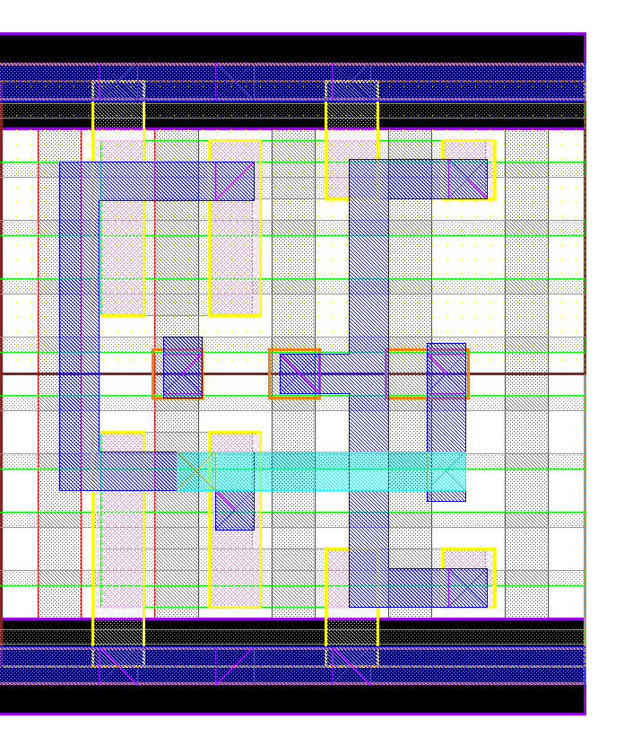
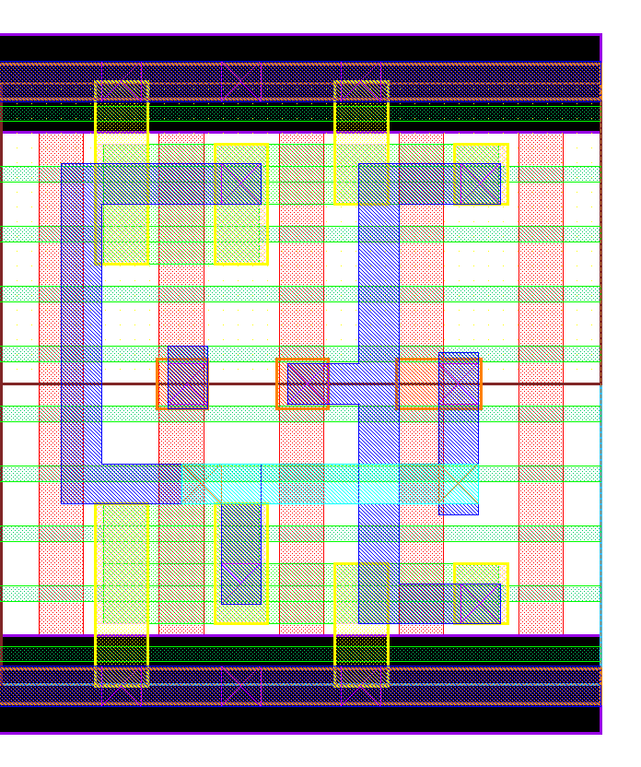
3:1
3 fins inverter
1 fin latch
P1
P2
P0
P1
P2
P0
N1
N2
N0
In
Out
P1
P2
P0
N1
N2
N0
2:1
2 fins inverter
1 fin latch
N1
N2
N0

