Slide 1
SWING
(Layout Manager)
Lect-06
Abdul Rochman

Slide 2
Layout Manager
Setiap container memiliki sebuah default layout manager.
Layout Manager adalah suatu object yg mengimplemen interface LayoutManager.
Lec05-<number>

Slide 3
Layout Manager (Cont…)
Java menyediakan layout manager mulai dari yang paling sederhana (FlowLayout dan GridLayout) ke khusus (BorderLayout dan CardLayout) ke paling fleksibel (BoxLayout dan GridBackLayout ).
aJPanel.setLayout(new BorderLayout());
Container contentPane = getContentPane();
contentPane.setLayout(new FlowLayout());
Lec05-<number>

Slide 4
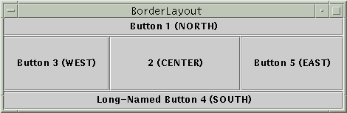
Border Layout
BorderLayout adalah default layout manager untuk setiap content pane. Sebuah BorderLayout memeliki lima daerah yang dapat ditempati components: NORTH, SOUTH, EAST, WEST, dan CENTER.
Lec05-<number>

Slide 5
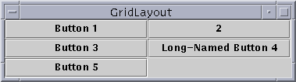
Grid Layout
GridLayout, membagi area menjadi grid cell, tiap cell berukuran sama.
Lec05-<number>

Slide 6
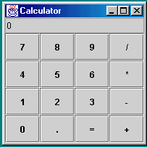
Case-1(Kalkulator)
Lec05-<number>

Slide 7
GridBagLayout
GridBagLayout adalah layout manager yang paling fleksibel.
Suatu GridBagLayout meletakkan komponen-komponen dalam sebuah grid (dari baris dan kolom) .
Suatu komponen dapat direntangkan dalam beberap kolom atau baris. Tingggi dari tiap baris tidak perlu sama, begitupula lebar dari tiap kolom.
Lec06-<number>

Slide 8
GridBagLayout (Cont…)
Setting GridBagLayout
GridBagLayout gridbag = new GridBagLayout(); GridBagConstraints c = new GridBagConstraints();
JPanel pane = new JPanel();
pane.setLayout(gridbag);
… //setting variabel-variabel GridbagConstrain
gridbag.setConstraints(theComponent, c);
pane.add(theComponent);
Lec06-<number>

Slide 9
GridBagLayout (Cont…)
Varibel gridx , gridy
Specify the row and column at the upper left of the component. The leftmost column has address gridx=0 and the top row has address gridy=0.
We recommend specifying the gridx and gridy values for each component; this tends to result in more predictable layouts.
Lec06-<number>

Slide 10
GridBagLayout (Cont…)
Variable gridwidth, gridheight
Specify the number of columns (for gridwidth) or rows (for gridheight) in the component's display area. These constraints specify the number of cells the component uses, not the number of pixels it uses.
Lec06-<number>

Slide 11
GridBagLayout (Cont…)
Variabel fill
Used when the component's display area is larger than the component's requested size to determine whether and how to resize the component.
Valid values (defined as GridBagConstraints constants) are NONE (the default), HORIZONTAL, VERTICAL, and BOTH.
Lec06-<number>

Slide 12
GridBagLayout (Cont…)
Variabel ipadx, ipady
Specifies the internal padding: how much to add to the minimum size of the component. The default value is zero. The width of the component will be at least its minimum width plus ipadx*2 pixels, since the padding applies to both sides of the component. Similarly, the height of the component will be at least its minimum height plus ipady*2 pixels.
Lec06-<number>

Slide 13
GridBagLayout (Cont…)
Variabel insets
Specifies the external padding of the component -- the minimum amount of space between the component and the edges of its display area. The value is specified as an Insets object. By default, each component has no external padding.
Lec06-<number>

Slide 14
GridBagLayout (Cont…)
Variabel anchor
Used when the component is smaller than its display area to determine where (within the area) to place the component. Valid values (defined as GridBagConstraints constants) are CENTER (the default), NORTH, NORTHEAST, EAST, SOUTHEAST, SOUTH, SOUTHWEST, WEST, and NORTHWEST.
Lec06-<number>

Slide 15
GridBagLayout (Cont…)
Variabel weightx, weighty
Weights are used to determine how to distribute space among columns (weightx) and among rows (weighty); this is important for specifying resizing behavior.
Generally weights are specified with 0.0 and 1.0 as the extremes: the numbers in between are used as necessary. Larger numbers indicate that the component's row or column should get more space.
Lec06-<number>

Slide 16
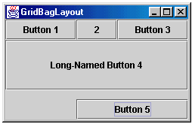
Case-2
Lec06-<number>

