Slide 1

Open Source and the Dept. of Veterans Affairs
CTOSC
By
Mike Barlow
Central Transylvania Open Source Conference
17 Oct 2015

Slide 2

Open Source and the Dept. of Veterans Affairs
By
Mike Barlow

Slide 3
Who Am I?
Mike Barlow
barlowm@gmail.com
In computer industry…
Background…
http://mwbarlow.com/CPOSC15.pptx

Slide 4
US Department of Veterans Affairs (VA)
Second largest agency of the US Federal Government
Employs more than 280,000 people
Annual budget close to $150 Billion
Benefits close to 23 Million Veterans
Provides Health Care to 8.7 Million Patients
Notes:
http://opensource.com/government/14/3/interview-stephen-warren-cio-department-veterans

Slide 5
Healthcare
Largest integrated Health Care System
More than 1700 Hospitals and Clinics

Slide 6
Open Source Initiative
Open Source Initiative started by CIO Roger Baker
First major open source program for Electronic Health Records started in 2011
Notes:
https://www.osehra.org/blog/cio-va-roger-baker-vista-open-source-initiative-memo
http://www.fiercegovernmentit.com/story/qa-dave-peters-open-source-adoption-within-veterans-affairs/2014-04-04

Slide 7
Open Source Policy Memorandum
7 June 2015 –
Executive Policy Memorandum
Mandating a thorough evaluation of
“Open Source Software (OSS) solutions when the VA acquires software.”
Notes:
http://www.openhealthnews.com/hotnews/va-releases-open-source-policy-memorandum
http://www1.va.gov/vapubs/viewPublication.asp?Pub_ID=804&FType=2

Slide 8
Technical Reference Model (TRM)
List of nearly 3000 Technologies and Standards
Including many commonly known standards
Linux
Node.js
Jasmine
Mocha
Perl
WordPress
OpenOffice
Mozilla Firefox
GIMP
GIT
7-Zip
Ubuntu
Notes:
http://www.va.gov/TRM/

Slide 9
VHA Innovations
The VHA (Veterans Health Administration) Innovation Program identifies, tests, and evaluates innovative solutions to help VA better serve Veterans
https://github.com/VHAINNOVATIONS
Currently over 20 repositories
Maternity Tracker
Family History
Mobile Hearing Aid Adjustments
COMS
Notes:
Maternity-Tracker - An enhancement of CPRS/VistA, the “Maternity Tracker”, assists the coordination of maternity care in a seamless fashion between VA and Non-VA providers, in order to support optimal care of pregnant Veterans.
FamilyHistoryCPRS - Family History in CPRS is an enhancement to the VA's Computerized Patient Record System GUI application that adds the ability to enter a patient's family history data
COMS
The Chemotherapy Ordering Management System (COMS) is a web-based application providing oncology teams with ordering, preparation, and documentation of chemotherapy
VANS
A web-based application to enable schedulers to preview, edit and send appointment letters electronically
Mobile-Distance-Hearing-Aid-Application
Phonak - Hearing Aid App: a solution enabling patients to receive hearing aid adjustments remotely via a Bluetooth, Internet-enabled smartphone.

Slide 10
Electronic Health Records (EHR)
Problems with Electronic Health Records
Costs associated with the acquisition and support of EHR
Limited Availability of timely and accurate access
One solution, Lower Cost of acquiring EHR by using Open-Source, Free Software
Notes:
The costs associated with the acquisition and support of an EHR can be a barrier to improving the quality of health care provided by limiting the availability of timely and accurate access to electronic patient information. Part of the solution is to lower the cost of acquiring an EHR by using a software stack consisting of open-source, free software
such as VistA. VistA is public domain and freely available through the US Freedom of Information Act (FOIA).

Slide 11
VistA
Veterans Health Information Systems and Technology Architecture (VistA)
A rich, automated environment that supports day-to-day operations at local Department of Veterans Affairs (VA) health care facilities.
First introduced in 1996
Currently over 128 installations of VistA
Notes:
OSEHRA is directly involved with what we call our VistA standardization project.
128 installations of VistA in different medical centers across the country.
Due to the nature of the way VistA evolved, just about every one of those deployments has slight differences in the way they were implemented.
Some have Class 3 software installed.
What we're doing, with help of OSEHRA, is identifying all the differences, doing an assessment, and figuring out which piece of source code as we're looking to make the scalable version.
http://worldvista.org/AboutVistA
https://en.wikipedia.org/wiki/VistA
http://www.ehealth.va.gov/VistA_Monograph.asp

Slide 12
OSHERA
Open Source Electronic Health Record Alliance (OSHERA)
https://www.osehra.org/
github.com/OSEHRA
Over 30 Repositories
http://architecture.osehra.org/

Slide 13
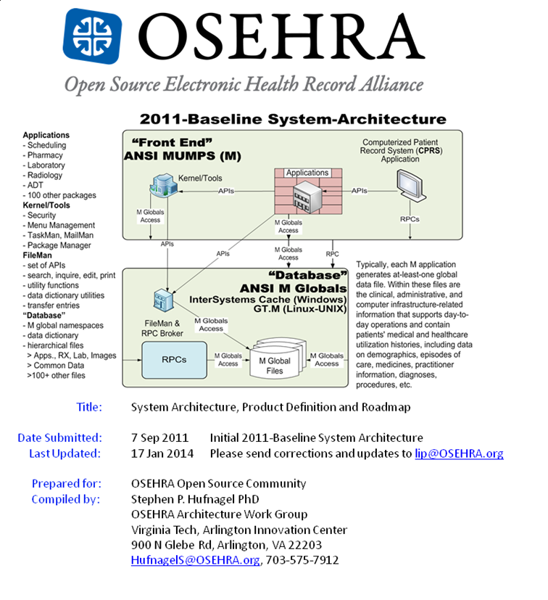
Notes:
http://architecture.osehra.org/index.htm?goto=5:17:2178

Slide 14
OSHERA
Applications – Over 100 packages
Scheduling
Pharmacy
Laboratory
Admission/Discharge/Transfer/Registration
Financial
Kernel/Tools
File Management
Database
Medical Domain Web Services
M-to-M Broker
Notes:
http://architecture.osehra.org/
http://www.va.gov/VDL/documents/Infrastructure/M_to_M_Broker/xwb1_1p34sp.doc
The VistA M-to-M Broker is a new implementation of the RPC Broker offering Client/Server functionality resident solely within a VistA non-Graphical User Interface (GUI) environment. It enables the exchange of VistA M-based data and business rules between two VistA M servers, where both servers reside on local and/or remote VistA systems:

Slide 15
Innovation Webinar Series
https://www.osehra.org/osehra-innovation-webinar-series
Monthly presentations on cutting-edge projects in open source
Webex Archive available
Notes:
Started in Oct 2014 - 9 presentations currently available
https://www.osehra.org/content/osehra-innovation-webinar-series-archive

Slide 16
OneVA Pharmacy
VHAInnovation Project
Provide a single interface to multiple VistA instances to provide pharmacists direct access to any active, refillable prescription from any VA Healthcare System
Notes:
Think of this as an open source version of Walgreens or CVS pharmaceutical tracking system.

Slide 17
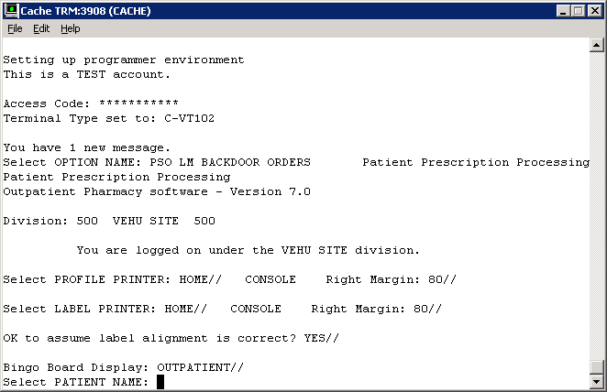

Slide 18
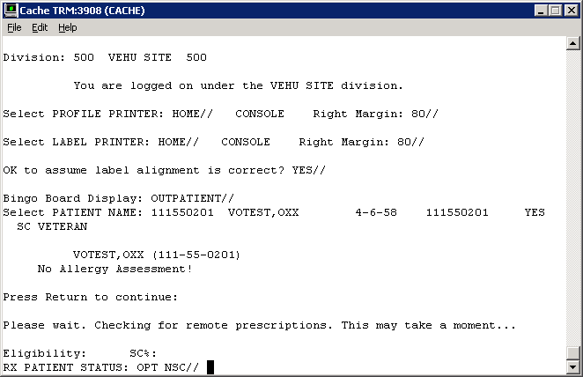

Slide 19
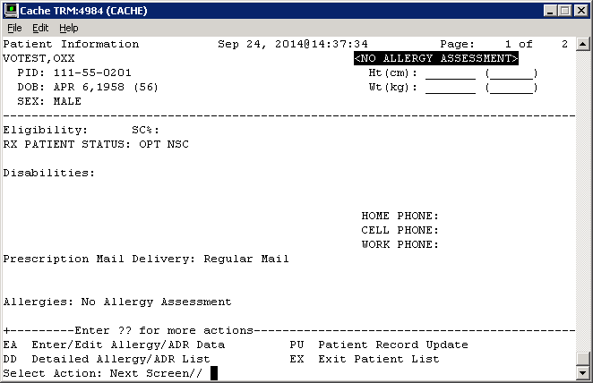

Slide 20
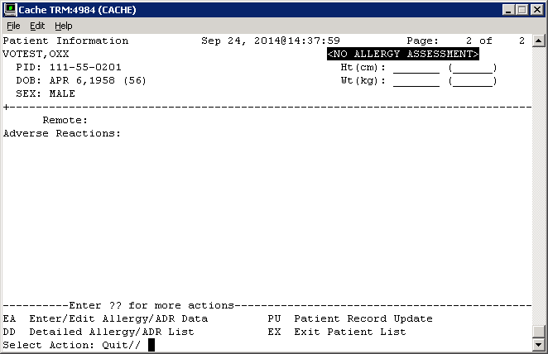

Slide 21
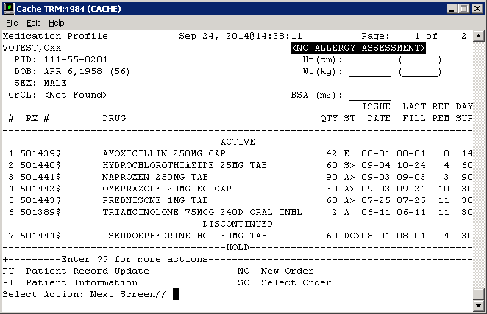

Slide 22
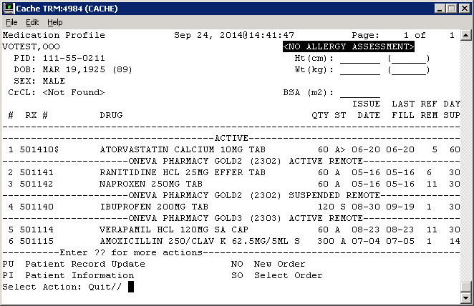

Slide 23
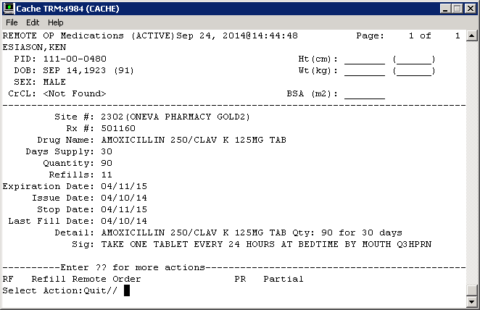

Slide 24
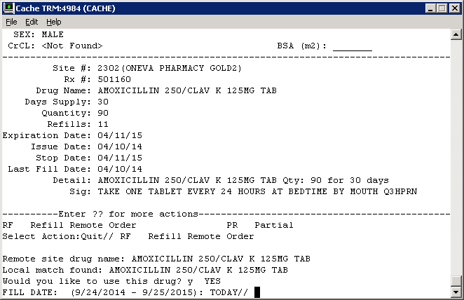

Slide 25
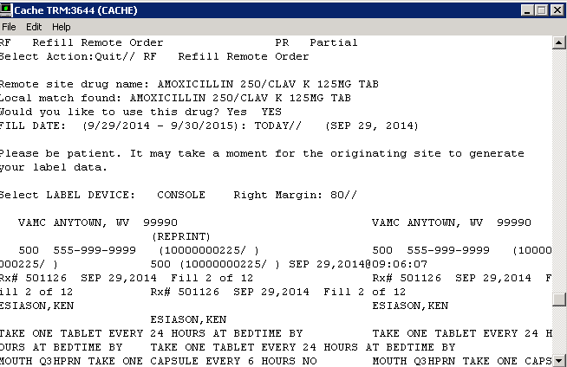

Slide 26
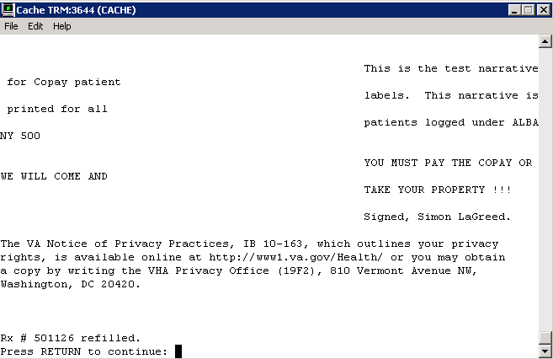

Slide 27
Chemotherapy Ordering Management System (COMS)
The COMS application supports oncology healthcare teams in
Ordering
Preparing
Documenting
Cancer treatment through five clinical modules
Notes:
Chemotherapy has a narrow therapeutic window High toxicity Low tolerance for error
Implementation of Electronic Health Record in VHA in late 1990s did not accommodate chemotherapy ordering
Multiple requests for electronic ordering of chemo dating to early 2000s
In 2009, VA Center for Innovations Employee Innovation Competition selected chemotherapy ordering
http://www.hsrd.research.va.gov/
http://www.hsrd.research.va.gov/for_researchers/cyber_seminars/archives/896-notes.pdf

Slide 28
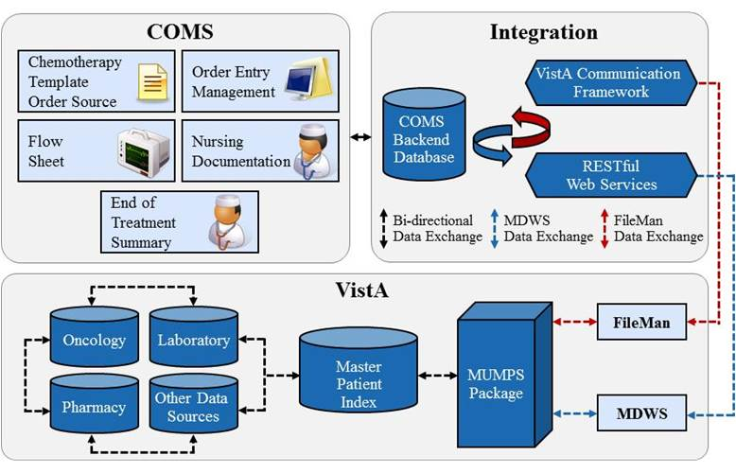
COMS Architecture

Slide 29
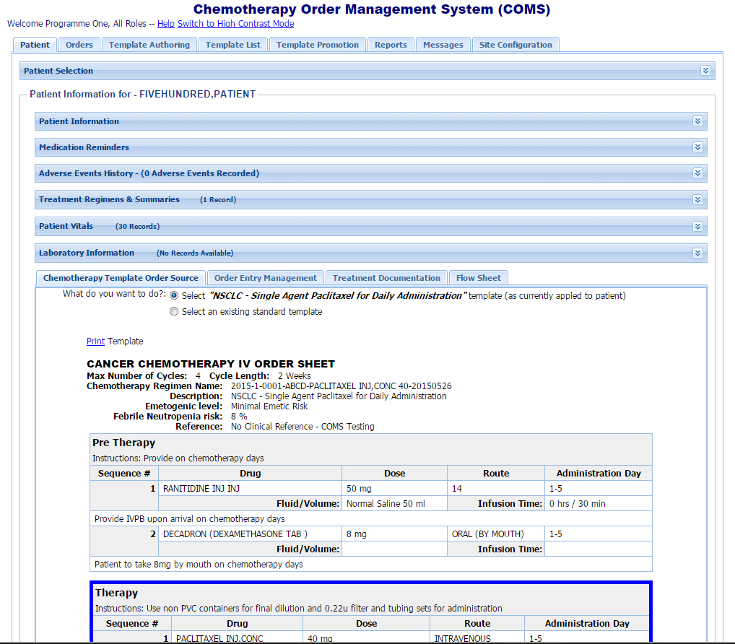

Slide 30
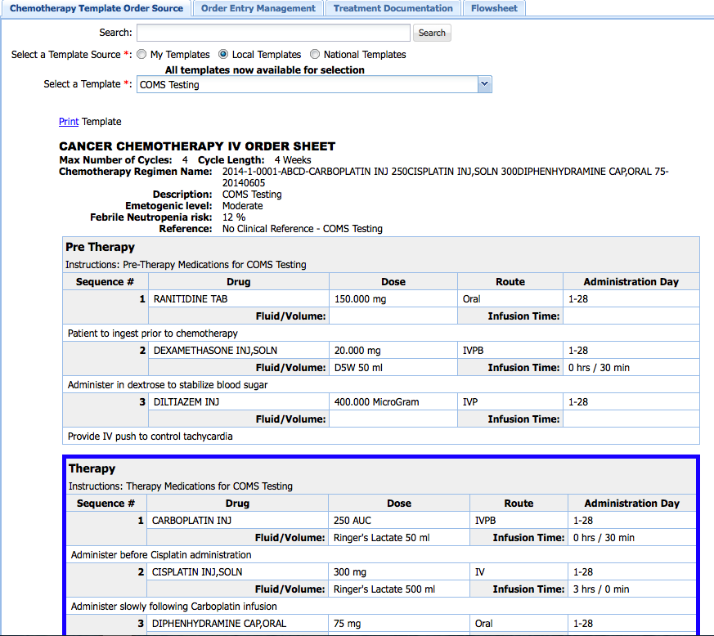

Slide 31
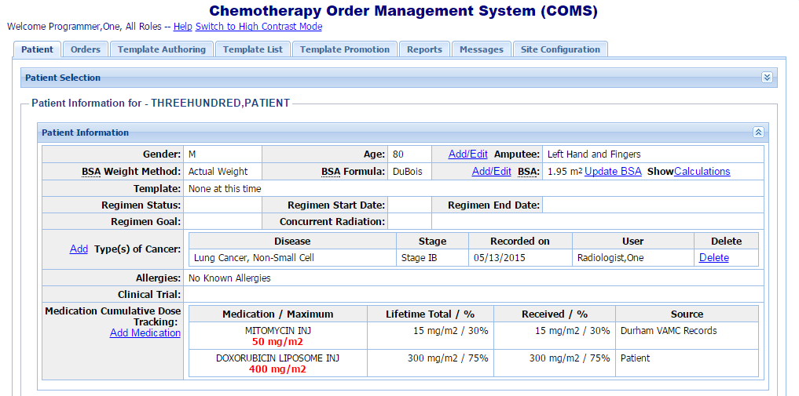
Patient Information

Slide 32
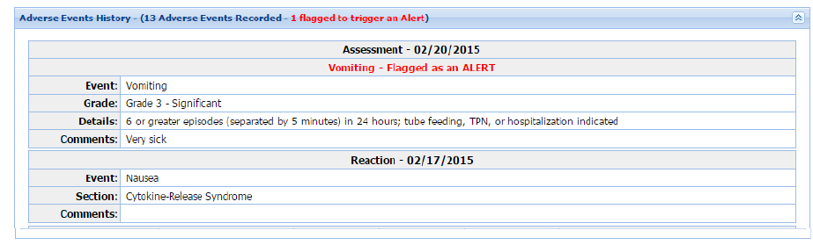
Clinical Assessments

Slide 33
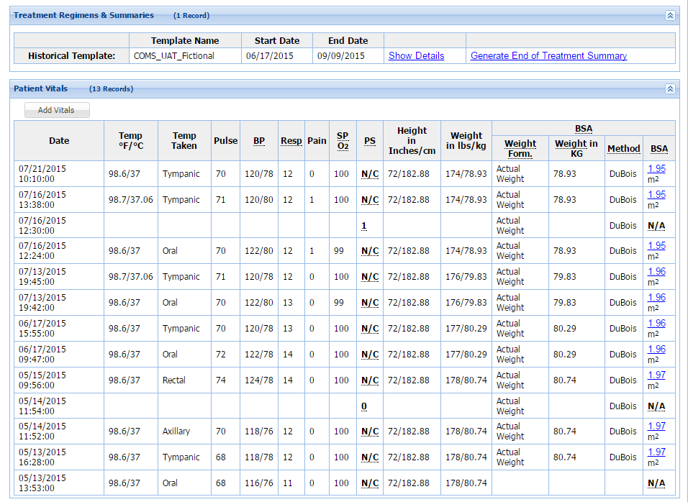
Vitals

Slide 34
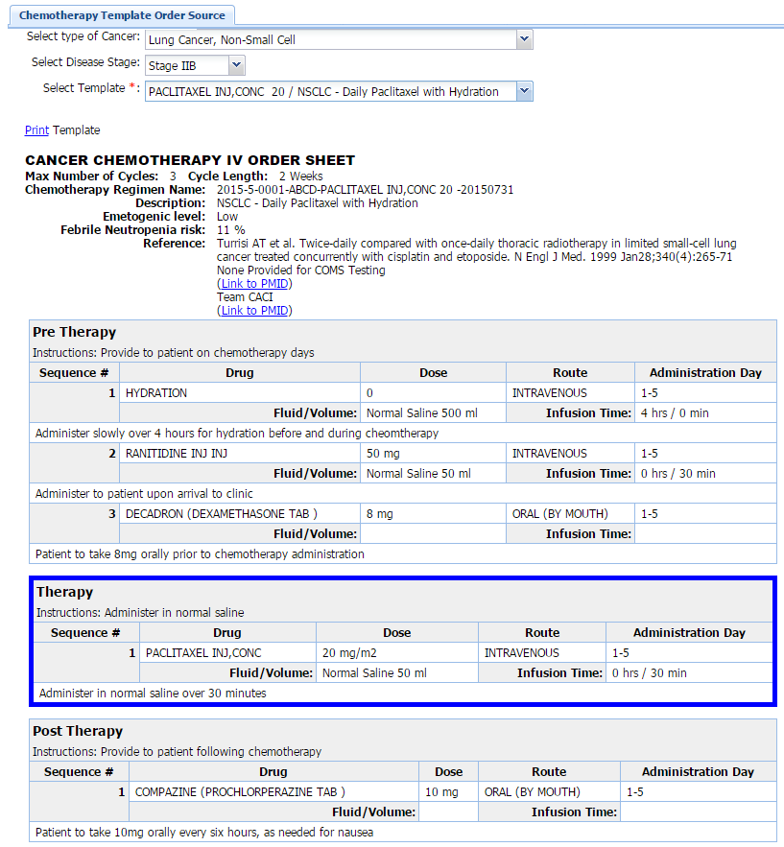
Order Sheet

Slide 35
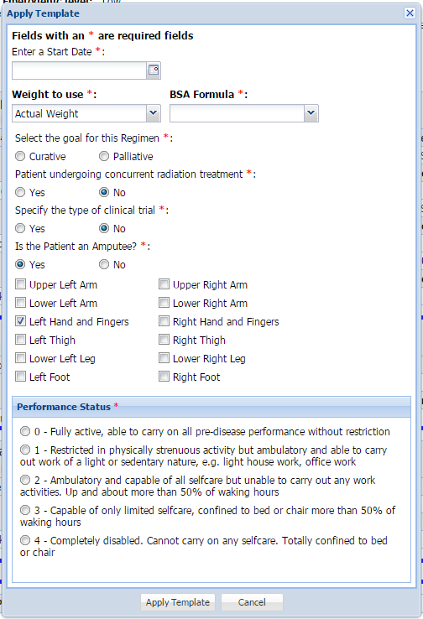
Apply Template

Slide 36
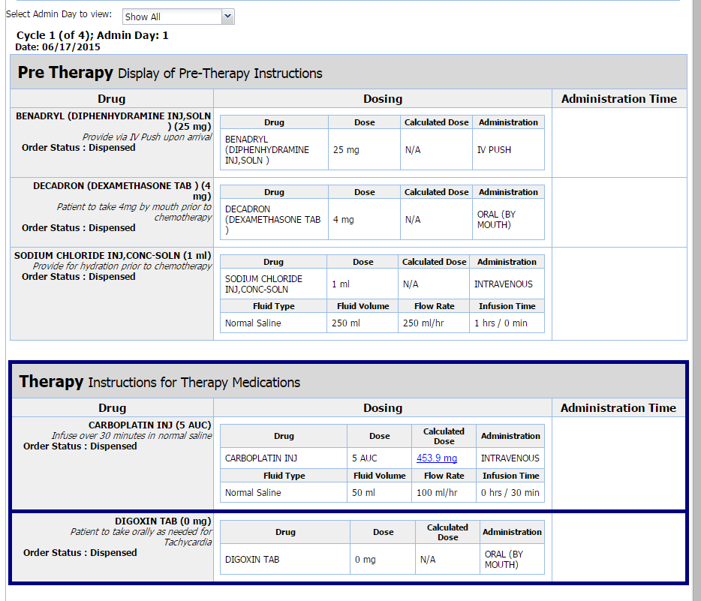
Sample Order

Slide 37
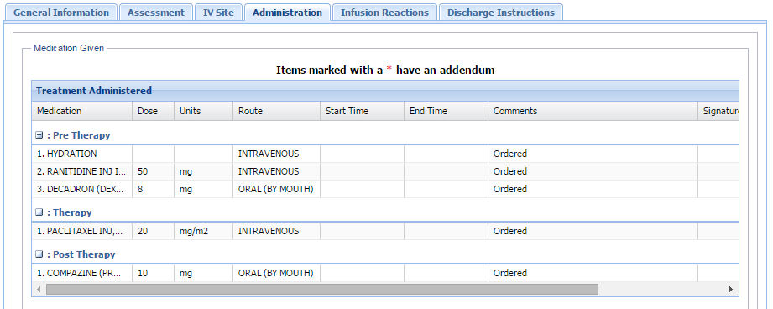

Slide 38
The Project
PHP, ExtJS, NodeJS, SQL
Jenkins
Postman
Swagger
ESLint

Slide 39

Postman
https://www.getpostman.com

Slide 40
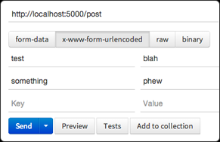
Postman
Notes:
Create requests quickly
Create and send any HTTP request using the awesome Postman request builder. The clean user interface keeps only those elements that you need in focus. Postman also encodes data for you, uploads files, and sends binary data.

Slide 41
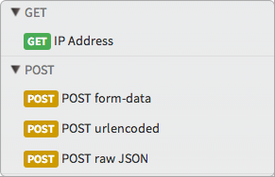
Postman
Notes:
Replay and organize
Every request sent using Postman is stored and can be loaded into the builder later. No more fiddling with the command-line! You can also store requests for an API in Collections to organize them according to function. This makes finding and reusing specific API requests a cinch. Along with storing request data you can also store request specific documentation.

Slide 42
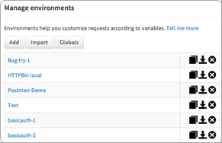
Postman
Notes:
Switch context quickly
Have to switch between different values for local, staging, and production servers? Using environment variables in your request will set their values according to the active environment while sending a request. Postman users have quit using other tools for this feature alone!

Slide 43
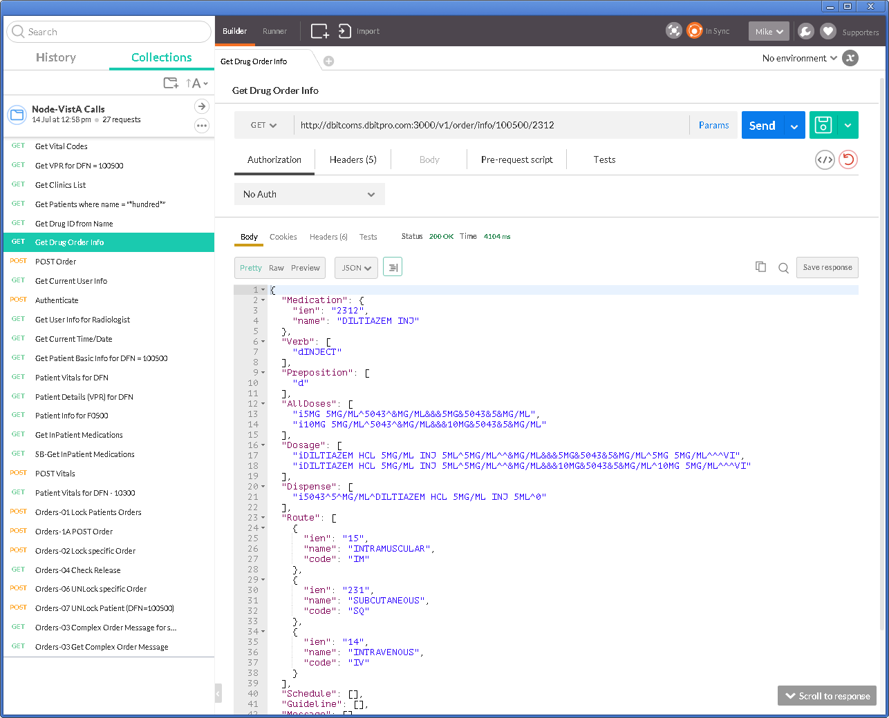

Slide 44

Swagger
http://swagger.io

Slide 45
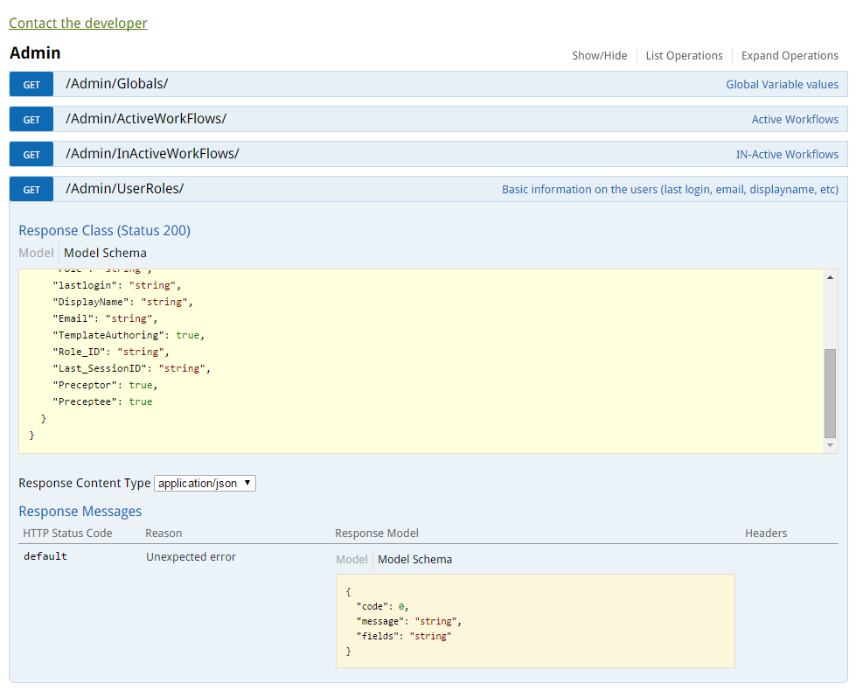

Slide 46
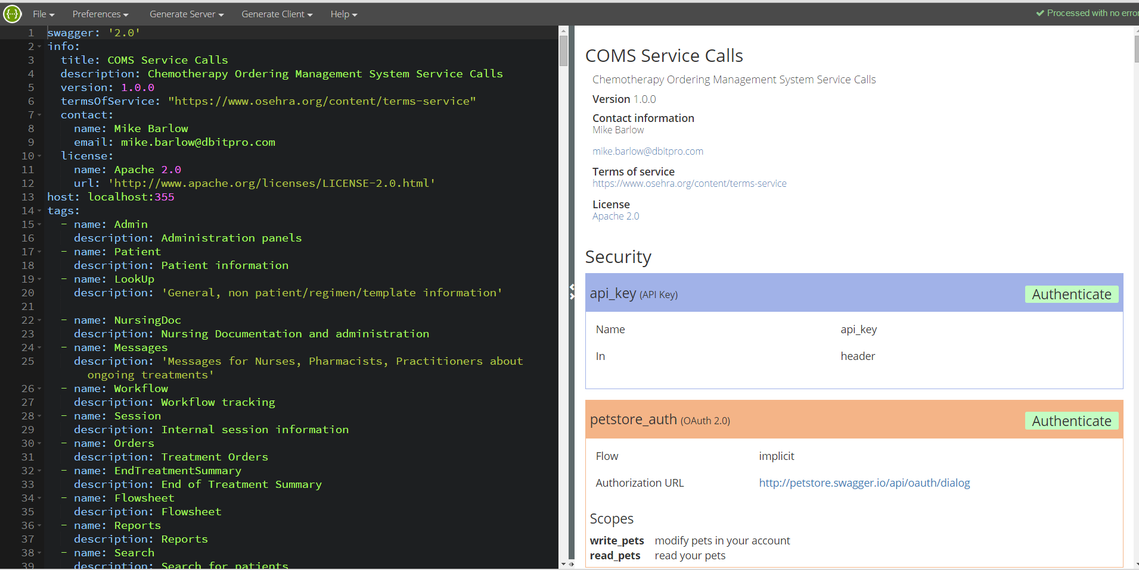
Swagger Editor

Slide 47
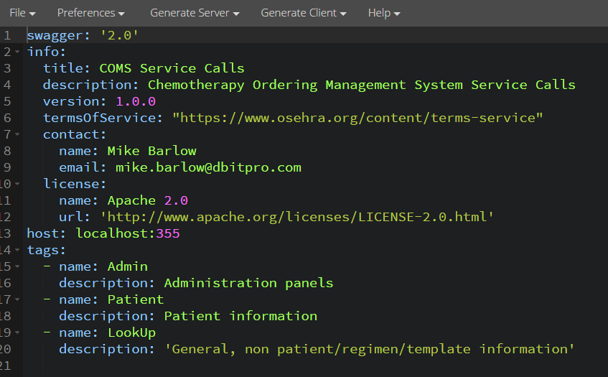
Swagger Editor

Slide 48
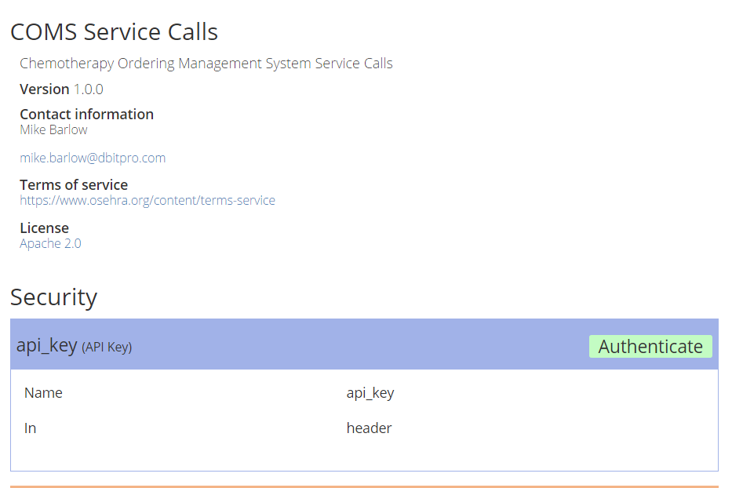
Swagger Editor

Slide 49
ESLint
http://eslint.org/
Rules based pluggable linting utility for JavaScript
Possible Errors
Best Practices
Strict Mode
Variables
NodeJS, Common JS
Stylistic Issues
Notes:
Some examples
Possible Errors
The following rules point out areas where you might have made mistakes.
comma-dangle - disallow or enforce trailing commas (recommended)
no-cond-assign - disallow assignment in conditional expressions (recommended)
no-console - disallow use of console in the node environment (recommended)
no-constant-condition - disallow use of constant expressions in conditions (recommended)
no-control-regex - disallow control characters in regular expressions (recommended)
no-debugger - disallow use of debugger (recommended)
no-dupe-args - disallow duplicate arguments in functions (recommended)
no-dupe-keys - disallow duplicate keys when creating object literals (recommended)
Best Practices
These are rules designed to prevent you from making mistakes. They either prescribe a better way of doing something or help you avoid footguns.
block-scoped-var - treat var statements as if they were block scoped
complexity - specify the maximum cyclomatic complexity allowed in a program
consistent-return - require return statements to either always or never specify values
curly - specify curly brace conventions for all control statements
eqeqeq - require the use of === and !== (fixable)
yoda - require or disallow Yoda conditions
Variables
These rules have to do with variable declarations.
init-declarations - enforce or disallow variable initializations at definition
no-catch-shadow - disallow the catch clause parameter name being the same as a variable in the outer scope
no-delete-var - disallow deletion of variables (recommended)
no-label-var - disallow labels that share a name with a variable
Stylistic Issues
These rules are purely matters of style and are quite subjective.
array-bracket-spacing - enforce spacing inside array brackets (fixable)
block-spacing - disallow or enforce spaces inside of single line blocks (fixable)
brace-style - enforce one true brace style
camelcase - require camel case names
comma-spacing - enforce spacing before and after comma

Slide 50
Questions?
Mike Barlow
barlowm@gmail.com
http://mwbarlow.com/CPOSC15.pptx
Notes:
http://worldvista.org/AboutVistA https://en.wikipedia.org/wiki/VistA http://www.ehealth.va.gov/VistA.asp
https://www.osehra.org/content/osehra-innovation-webinar-series-archive http://opensource.com/government/14/3/interview-stephen-warren-cio-department-veterans http://www.va.gov/health
http://www.oit.va.gov/docs/oit_fact_sheet/VA_Open_Source_Factsheet_12092014.pdf https://www.osehra.org http://www.fiercegovernmentit.com/story/qa-dave-peters-open-source-adoption-within-veterans-affairs/2014-04-04 http://www.openhealthnews.com/hotnews/va-releases-open-source-policy-memorandum http://www1.va.gov/vapubs/viewPublication.asp?Pub_ID=804&FType=2 https://www.osehra.org/marketplace http://www.nextgov.com/cio-briefing/2013/04/former-veterans-affairs-cio-roger-baker-joins-agilex-chief-strategy-officer/62251 https://www.osehra.org/discussion/roger-baker-va-cio-refactoring https://www.osehra.org/blog/cio-va-roger-baker-vista-open-source-initiative-memo http://www.blogs.va.gov/VAntage/3645/va-begins-implementation-of-open-source-ehr

