Slide 1
Visualizing Data Distributions and
Analyzing Relationships
A Comparative Statistical Analysis of Video Game Player Metrics and Health Monitoring Indicators
Capstone Project Final Report Presentation | Barsha Barman (B25BS3109) | COHORT - 5
Notes:
Welcome to the capstone project presentation. Today we will present a comparative analysis of two diverse datasets, exploring how exploratory data analysis and appropriate correlation coefficients allow us to extract meaningful, mathematically reliable insights from raw numbers.

Slide 2
Two Diverse Datasets Capture 60 Player Reviews and 120 Health Profiles
1. Video Game Reviews Dataset (N = 60)
Core objective: Evaluate playing habits and player satisfaction of a newly launched title.
Variables Analyzed:
- Player ID: Unique identifier for each player (Categorical/Nominal)
- Hours Played: Total gaming time logged (Continuous Numerical)
- Review Score: Player satisfaction score out of 100 (Continuous Numerical)
Statistical Focus: Testing the commercial hypothesis that extended game engagement directly drives higher satisfaction ratings.
2. Health Monitoring Dataset (N = 120)
Core objective: Assess cardiovascular metrics and demographic lifestyle profiles.
Variables Analyzed:
- Participant ID: Unique participant identifier (Categorical/Nominal)
- Age: Participant age, grouped into brackets (20s, 30s, 40s, 50s, 60+)
- Blood Pressure (mmHg): Systolic measurement (Continuous Numerical)
- Smoking Status: Self-reported smoking habits (Binary Categorical: Yes/No)
Statistical Focus: Evaluating blood pressure variation across age cohorts and testing associations with smoking behavior.
Notes:
This slide lays out our data environment. We analyze two distinct datasets. The Video GameReviews dataset has 60 unique player entries, allowing us to evaluate continuous relationships. The Health Monitoring dataset has 120 unique patient records, providing an ideal sample for grouping by age bracket and analyzing binary-to-continuous associations.

Slide 3
Review Scores Center at 80.50 with Symmetric Skewness of -0.06
MEDIAN REVIEW SCORE
80.50
Mean: 80.62 | Mode: 89.00
Standard Deviation: 9.91
INTERQUARTILE RANGE (IQR)
17.25
Q1 (25th): 71.75 | Q3 (75th): 89.00
Central 50% are highly clustered
IDENTIFIED OUTLIERS
0.00
Lower Fence: 45.88 | Upper Fence: 114.88
Zero data points fall beyond whiskers
Core Observations & Exploratory Insights:
• High Consensual Quality: The review scores are centered tightly around the median of 80.50. The standard deviation of 9.91 indicates moderate variation in review scores, with scores generally centered around the median of 80.50.
• Symmetric Distribution: The skewness coefficient is -0.06, indicating that the review score distribution is approximately symmetric. There is no positive or negative bias tailing off.
• Outlier Analysis: Applying the 1.5x IQR rule reveals exactly zero outliers. The minimum review score is 63.30 and the maximum is 100.00, both of which fall safely within the upper and lower fences.
Notes:
This slide presents the five-number summary and summary statistics for player reviews. The key takeaways are that reviews are highly consistent, approximately symmetric with a skewness of -0.06, and have no outliers whatsoever. This baseline of player sentiment is highly stable and represents broad user consensus.

Slide 4
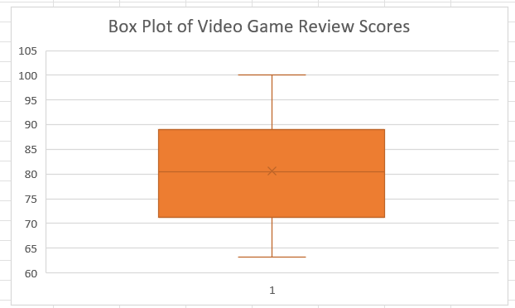
Player Playtime Positively Skews to 1.28 with a Mean of 16.33 Hours
Analysis of Gaming Engagement (Hours Played)
• Positive Right Skewness (1.28): Unlike the review scores, hours played exhibits a strong right-skewed distribution. The mean of 16.33 hours is pulled upwards from the median of 16.00 hours.
• Concentrated Playtime Core: The middle 50% of players log between 11.00 (Q1) and 21.00 (Q3) hours, illustrating a very consistent baseline play cycle for the standard audience.
• Extended Right Tail: A subset of hyper-engaged individuals logs up to 45.00 hours. This creates an extended right tail in the distribution, though it is not classified as an outlier.
Exploratory Insight:
While player enjoyment is symmetrically centered, their play behaviors are highly asymmetric. Highly engaged players and light players co-exist in this ecosystem, but both report highly similar satisfaction levels.
Notes:
Here we contrast review scores with playtime. Playtime is highly right-skewed at 1.28, with a mean of 16.33 hours and a max of 45 hours. The embedded box plot on the right displays the approximately symmetric of review scores, marking the median of 80.50 and the narrow whiskers with zero outliers.

Slide 5
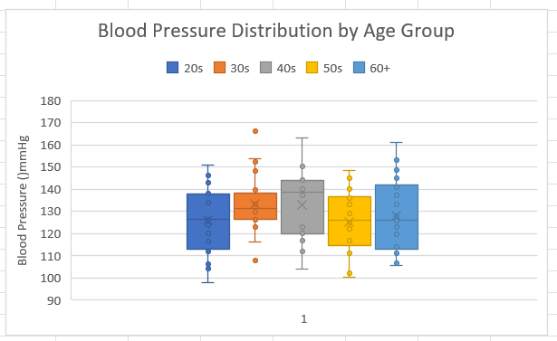
Grouped Analysis Shows the 40s Cohort Has the Highest Median BP
Physiological Age Cohort Dynamics (N = 120)
• Non-Linear Trend with Age: Systolic blood pressure does not increase linearly. The 40s group displays the highest median blood pressure (138.50 mmHg), exceeding all older and younger cohorts.
• Maximum Physiological Variability: The 60+ age group exhibits the largest variability with an IQR of 28.00 mmHg (Q1 = 113.00, Q3 = 141.00), demonstrating diverse physiological pathways in older age.
• Extremely Uniform 30s Cohort: The 30s group exhibits the lowest baseline variability with an IQR of 8.65 mmHg. This suggests highly consistent pressure readings among most young adults.
Key Takeaway:
The 40s group has the highest median blood pressure (138.50 mmHg) in this dataset, while the 60+ group shows the greatest variability.
Notes:
This slide introduces our grouped analysis of systolic blood pressure across age cohorts. The most striking finding is the non-linear relationship with age: the highest median blood pressure of 138.50 mmHg is found in the 40s group, not the 60+ group. The 60+ group exhibits the largest variability, reflecting diverse physiological aging profiles.

Slide 6
Four Statistical Outliers Identified in the 30s Cohort
Outlier Context & Mathematical Fences
The 30s cohort represents an intriguing statistical profile. It displays the tightest overall central clustering (IQR = 8.65 mmHg, Q1 = 126.75, Q3 = 135.40).
Under the 1.5x IQR rule, the mathematical fences are:
• Lower Fence: 113.78 mmHg
• Upper Fence: 148.38 mmHg
A highly uniform cohort with such low baseline variability is exceptionally sensitive to any deviations, making extreme readings stand out immediately as formal outliers.
Identified Outlier Records (N = 4)
Four participants in their 30s fell beyond the fences:
P081: 108.00 mmHg — Statistical outlier
P107: 152.40 mmHg — Statistical outlier
P115: 153.50 mmHg — Statistical outlier
P005: 166.00 mmHg — Statistical outlier
Analytical Significance:
These four observations fall outside the 1.5×IQR fences for the 30s group. They indicate greater deviation from the central pattern within this age group and may warrant further investigation in a larger dataset.
Notes:
This slide focuses on the 30s cohort's outliers. Because the IQR of the 30s group is extremely narrow (8.65 mmHg), its mathematical fences are very tight (113.78 to 148.38 mmHg). Consequently, four participants are identified as outliers. These observations are statistical outliers under the 1.5×IQR rule and should be interpreted as exploratory findings rather than clinical conclusions

Slide 7
Two Correlation Models Account for Variable Types and Binary Associations
Pearson Product-Moment Correlation
• Methodological Justification: Pearson correlation is mathematically designed to measure the strength and direction of a linear relationship between two continuous numerical variables.
• Variables: Hours Played (Continuous) vs. Review Score (Continuous).
• Mathematical Formulation:
r = [ nΣXY - (ΣX)(ΣY) ] / √[ (nΣX² - (ΣX)²)(nΣY² - (ΣY)²) ]
Proper choice ensures we capture true continuous linear associations without ranking distortion.
Point-Biserial Correlation
• Methodological Justification: Point-Biserial correlation is mathematically mandatory when evaluating the relationship between a truly dichotomous binary variable and a continuous numerical variable.
• Variables: Smoking Status (Binary: 0/1) vs. Blood Pressure (Continuous).
• Mathematical Formulation:
r_pb = [ (M_1 - M_0) / s_y ] * √[ (n_1 * n_0) / (n * (n - 1)) ]
Using Pearson on a binary variable is equivalent to Point-Biserial, but formulating it this way emphasizes the difference in group means.
Notes:
This slide justifies our selection of correlation coefficients. Selecting the correct statistical model is vital. For Video Games, both variables are continuous, which dictates Pearson. For Health, smoking status is binary and blood pressure is continuous, which dictates a Point-Biserial model. This ensures our analysis remains statistically sound and mathematically reliable.

Slide 8
No Statistical Significance Links Playtime or Smoking Status to Performance Metrics
PLAYTIME VS. REVIEW SCORE (PEARSON)
r = 0.01 | p-value = 0.96
There is an extremely weak positive correlation. The p-value of 0.96 is far greater than 0.05, indicating that playtime does not show a statistically significant relationship with review scores.
SMOKING STATUS VS. BLOOD PRESSURE (POINT-BISERIAL)
r = -0.13 | p-value = 0.16
There is a weak negative association. The p-value of 0.16 is greater than 0.05, indicating that smoking status does not show a statistically significant relationship with blood pressure.
Deep Interpretation of Statistical Insignificance:
• Decoupling of Playtime and Sentiment: Playing more hours does not lead to higher review scores. Player sentiment is driven by qualitative game elements, not merely hours spent playing.
• Counter-Intuitive Group Means: The mean blood pressure of smokers is 125.95 mmHg (N = 40), whereas the mean for non-smokers is 130.10 mmHg (N = 80). While a negative correlation of -0.13 is observed, the p-value of 0.16 proves this association is not statistically significant and likely due to sampling noise.
• Confounding Lifestyle Factors: Crucial confounding parameters such as diet, physical activity, smoking intensity/duration, and genetics were not captured, explaining why the expected clinical link was not detected.
Notes:
This slide presents our main correlation findings. Playtime and reviews are completely decoupled with r = 0.01 and p = 0.96. For smoking and BP, we see a weak negative r = -0.13 with a p-value of 0.16. Since both p-values exceed 0.05, neither relationship is statistically significant. We must emphasize that the negative smoking association is likely due to sampling noise and unmeasured lifestyle confounders.

Slide 9
Key Insights, Limitations & Conclusion
1. Game Development
• Avoid Inflation Mechanics: Since playtime does not correlate with review scores, developers should avoid artificial 'grinding' design choices.
• Focus on Quality: Direct development resources toward qualitative elements—narrative depth, polished mechanics, intuitive UI, and technical stability—to drive highly positive and consistent player feedback.
2. Health Monitoring Insights
• The 40s group had the highest median blood pressure (138.50 mmHg).
• The 60+ group had the highest variability (IQR = 28.00 mmHg).
• Four statistical outliers were identified in the 30s group.
• These findings are exploratory and should be investigated further using larger datasets.
3. Disclaimers & Limits
• Analytical Limitations: The datasets are small (N=60 and 120), cross-sectional snapshots, and lack key lifestyle and biological confounders (e.g., diet, genetics, daily smoking intensity).
• Clinical Disclaimer:
The findings suggest that blood pressure variability should be examined across age groups, while the identified 30s outliers warrant further investigation in a larger dataset. These findings should not be interpreted as clinical conclusions.
Notes:
In this final slide, we deliver our strategic recommendations, study limitations, and a crucial clinical disclaimer. On the gaming side, we recommend focusing on narrative and mechanical quality over grind length. On the health monitoring side, the analysis highlights differences in blood pressure variability across age groups and identifies four statistical outliers in the 30s cohort. These findings are exploratory and require further investigation using larger datasets.

