Slide 1

Zomato
RESTAURANT ANALYSIS
Barnana Chakraborty
20.07.2025

Slide 2

ABOUT ZOMATO
Zomato is a popular food-tech platform that helps people discover and enjoy food from a wide range of restaurants. It started in 2008 and now operates in over 20 countries. Whether someone wants to order food online, book a table, or just explore nearby restaurants, Zomato makes it easy. The platform gives detailed information like menus, reviews, ratings, and photos. As of now, Zomato has more than 80 million monthly active users and works with over 1.6 million restaurants around the world.
Along with helping users, Zomato also supports restaurant owners by giving them tools to manage their listings, connect with customers, and grow their business. In FY2024-25, Zomato handled over 600 million food orders, showing how widely it’s used. With a simple design and helpful features, Zomato continues to be a go-to platform for both customers and restaurant partners, making the entire food experience smoother and smarter.

Slide 3
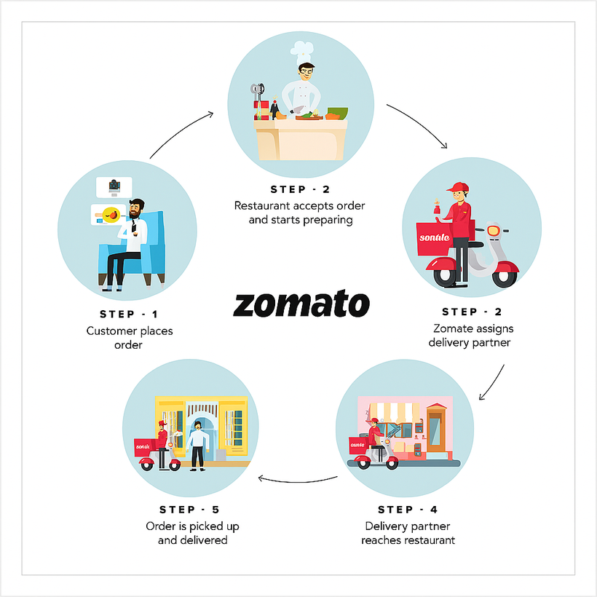
How Zomato Works
Zomato works by connecting users with restaurants through an easy-to-use platform where they can search for eateries based on location, cuisine, ratings, or price. Users can explore menus, read reviews, view photos, and either place orders for delivery or book tables directly. At the same time, restaurants use Zomato to manage their profiles, update menus, respond to customer feedback, and access performance insights. This two-way system helps users enjoy a smooth food discovery and ordering experience while enabling restaurants to grow and serve their customers better.

Slide 4
Agenda
Problem Statement
Insightful Observation
Data Overview & Data Snapshot
Strategic Suggestion and Dashboard
Objective Key Metrics and Visualizations
Conclusion

Slide 5
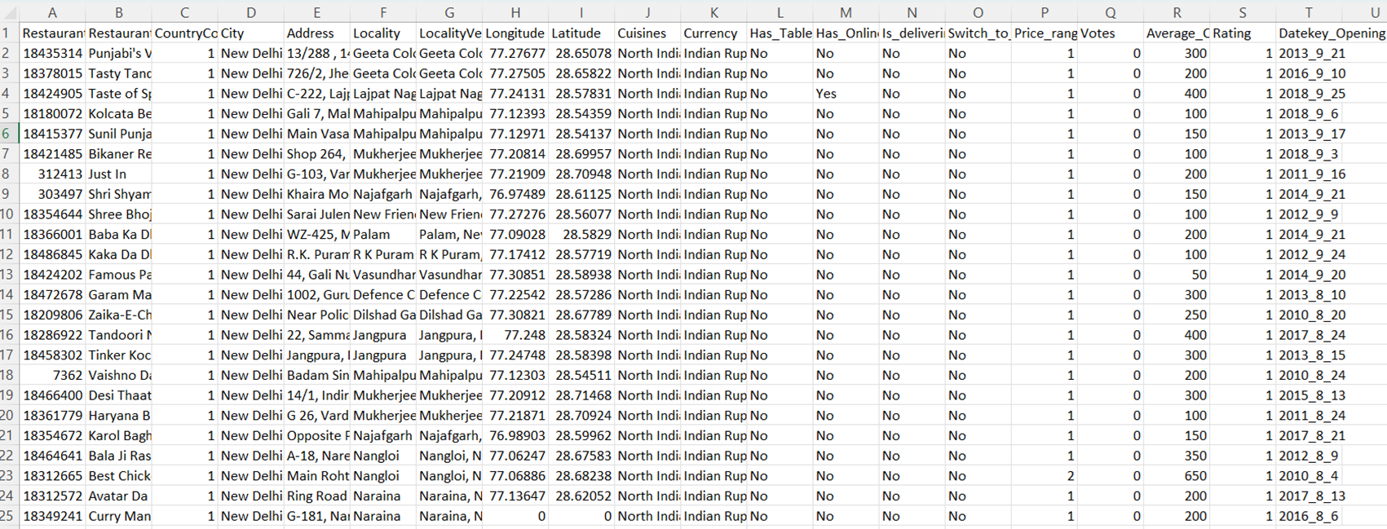
Zomato Problem Statement
You are hired as a consultant data analyst by Zomato where the team is looking for expansion and opening restaurants. Your task is to come up with strategies/suggestions about opening newer restaurants.

Slide 6
Zomato Data Overview
The dataset includes details for 9,551 restaurants, with 20 columns capturing various attributes of each establishment. Here's a brief overview of the information available in the dataset:
Restaurant ID: Unique identifier for each restaurant.
Restaurant Name: The name of the restaurant.
CountryCode: Country code of the location where the restaurant is situated.
City: The city where the restaurant is located.
Address: The specific address of the restaurant.
Locality: The locality or neighborhood where the restaurant is situated.
Locality Verbose: Detailed information about the locality.
Longitude: The geographical longitude coordinate of the restaurant.
Latitude: The geographical latitude coordinate of the restaurant.
Cuisines: The type of cuisine offered by the restaurant.
Currency: The currency used for transactions in the restaurant.
Has_Table_booking: Indicates whether the restaurant has a table booking option (Yes/No).
Has_Online_delivery: Indicates whether the restaurant offers online delivery (Yes/No).
Is_delivering_now: Indicates whether the restaurant is currently delivering (Yes/No).
Switch_to_order_menu: Indicates whether users can switch to the order menu (Yes/No).
Price_range: A numeric value indicating the price range category of the restaurant.
Votes: The number of votes or ratings/(feedback) received by the restaurant.
Average_Cost_for_two: The average cost for two people dining at the restaurant.
Rating: The overall rating of the restaurant is based on user reviews.
Datekey_opening: The date when the restaurant was opened.

Slide 7
Zomato Data Snapshot & Data Preparation
Total Number of Restaurants: From 2010 to 2018, 9551 restaurants were established in 15 countries.
Number of Cities: There are 141 cities with a variety of restaurants.
Data Cleaning
Removed Missing Values: Rows with missing values in the Cuisines column were removed to ensure the data is complete and suitable for analysis.
Trimmed Extra Spaces: Unwanted spaces were trimmed from the Address, Locality, and Locality Verbose columns to maintain uniformity and prevent errors in grouping or filtering.
Filled Missing Cost Values: Missing entries in the Average Cost for Two column were filled using the median value, based on the Price Range, to retain consistency in pricing data.
Converted Strings to Date Format: The ‘Date_key_Opening’ column, initially stored as String, was converted into proper date format to enable accurate date-based analysis.
Variety of Cuisines: With 1825 different types of cuisines, including popular choices like Italian, Mexican, Chinese, Indian and American, each cuisine adds its distinct flavors, ingredients, and cooking methods, enriching the diverse world of gastronomy.
Ratings: Restaurant ratings with average of 2.9, provide insights into the performance of each establishment.
Online services: Shows availability of table booking, online delivery, and current delivery status.
Data Pre-Processing
Extracted Year and Month: From the formatted date column, new columns for Year and Month were created to support time-based insights and trend analysis.
Mapped Country Names: Country names were added by mapping each Country Code using a reference table through VLOOKUP, enhancing the geographic understanding of the data.
Standardized Currency: All values in the Average Cost for Two were converted to INR, and a new column Average_Cost_for_Two_INR was created to group restaurants into cost ranges for easier comparison.

Slide 8
Analytical Methods and Tools
To explore and understand the data thoroughly, I applied the following methods and tools during the course of my analysis:
Data Cleaning: I used functions like TRIM to remove extra spaces and Conditional Formatting to highlight inconsistencies. I also removed rows with missing values to ensure the dataset was clean and reliable.
Data Enrichment: Using the TEXT function, I extracted specific date components, and with VLOOKUP, I added columns such as country names to improve the overall clarity and context of the dataset.
Descriptive Analysis: I used Pivot Tables to break down and analyze data based on countries, cuisines, pricing, and ratings. This helped me identify key trends and compare various aspects of restaurant performance.
Visualization: I created different types of charts to visually represent the data, which made it easier to spot patterns, track comparisons, and share insights in a clear and engaging way.

Slide 9
Objective Key Metrics and Visualizations

Slide 10
Number of Restaurants Opened in Each Country
The graph shows that India and the United States have the highest number of restaurants opened, which means there is more competition in these countries.
Canada has the lowest number of restaurant openings over the years.
Other countries have between 20 to 80 restaurants opened.
This graph can help the management decide where to open new restaurants in the future.

Slide 11
Number of Restaurants Opened in Each Year
In 2018, the highest number of restaurants were opened.
The year 2012 had the lowest number of restaurant openings.
Overall, from 2010 to 2018, the number of restaurants gradually increased each year.
This trend can be useful for future analysis to check if there are any changes in the pattern of restaurant openings.

Slide 12
Average Number of Votes in Each Country
The number of votes gives an idea of the average footfall or customer engagement in restaurants across different countries.
Indonesia has the highest average number of votes, suggesting more customer activity or feedback.
Brazil and Singapore have the lowest average votes, indicating relatively lower customer interaction.

Slide 13
Insightful Observations

Slide 14
Suggested Countries Having Less Competition
To identify ideal countries for expansion, I started by analyzing regions with lower restaurant competition but good customer engagement. The goal was to find less saturated markets that still show strong potential, based on demand signals like vote count.
Canada
Australia
Sri Lanka
Only 4 restaurants across 4 cities, so there’s plenty of room to grow.
Having less customer satisfaction means we can improve and make a real difference.
By carefully expanding into new cities and focusing on quality, we can capture untapped markets and build a strong competitive advantage.
Sri Lanka’s market is still largely untapped, giving us a real chance to establish a strong presence.
There’s clear customer interest, but also room to raise the quality and stand out.
By expanding thoughtfully beyond the current city, we can capture growing demand and build lasting loyalty.
Despite coverage in 23 cities, there are only 24 restaurants, so supply is clearly limited.
Less customer satisfaction shows there’s room to improve and elevate the experience.
With wide geographic reach but low density, careful expansion can meet demand and strengthen our position.

Slide 15
Suggested Countries Having High Market Potential
To identify ideal countries for expansion, I focused on regions with a low number of restaurants but strong customer engagement and satisfaction. The aim was to find high-appeal markets that are not yet saturated but show clear potential.
countries | Avg of Rating | Avg of Votes | No. of Restaurants
India | 2.7 | 137 | 4
Canada | 3.5 | 103 | 20
Singapore | 3.5 | 32 | 20
Australia | 3.6 | 111 | 20
Brazil | 3.8 | 20 | 21
Sri Lanka | 3.8 | 146 | 22
USA | 4.0 | 431 | 24
Qatar | 4.0 | 164 | 34
United Kingdom | 4.1 | 205 | 40
South Africa | 4.2 | 315 | 60
United Arab Emirates | 4.2 | 494 | 60
New Zealand | 4.2 | 243 | 60
Indonesia | 4.2 | 772 | 80
Turkey | 4.3 | 431 | 425
Philippines | 4.4 | 407 | 8652
Indonesia
Philippines
Indonesia shows strong interest, with a 4.3 rating from 772 votes.
Only 22 restaurants in 4 cities point to low competition and limited reach.
This makes Indonesia a strategic choice for early expansion, allowing us to meet existing demand and grow ahead of competitors.
The country holds a solid 4.5 average rating, which clearly shows people enjoy what's being offered.
But despite interest across 9 cities, there are only 22 restaurants, so the overall presence still feels minimal.
This indicates a clear gap between demand and availability, making it the right time to deepen our footprint in existing cities and scale further.

Slide 16
Food Expenditure Trends In The Suggested Countries
To understand how people spend on dining, I compared the average cost for two across all suggested countries. This gave a clear picture of affordability and spending behavior, key to shaping our pricing and setup.
In Sri Lanka and Indonesia, food is affordable. We should consider simple, cost-effective restaurant models here, with value-driven pricing to attract a broader audience.
In Australia and Canada, spending is moderate. With smart cost control and the right locations, we can position mid-range outlets that balance quality with profitability.
In the Philippines, spending is significantly higher. This signals an opportunity for premium restaurants in urban hubs where customers are ready to pay more for a refined experience.
By adjusting our investment, pricing, and positioning to match each market’s spending behavior, we can enter strategically and run operations more efficiently.

Slide 17
Cuisines To Focus In Newer Restaurants
To decide which cuisines to focus on in new restaurant openings, I analyzed two key metrics: average rating (to reflect customer satisfaction) and total votes (to measure popularity). This helped identify cuisines with strong performance and market relevance.
countries | Suggested Cuisines
Australia | Mediterranean, Seafood
 | Modern Australian, Australian
 | Pizza, Bar Food
Canada | Italian, Mediterranean, Pizza
Indonasia | Asian, Indonesian, Western
 | Burger
 | Cafe, Coffee and Tea, Western
 | Cafe, Desserts, Beverages
 | Cafe, Italian, Coffee and Tea, Western, Indonesian
 | Cafe, Western
 | Desserts, Bakery, Western
 | Japanese, Sushi, Ramen
 | Sunda, Indonesian
 | Sushi, Japanese
Phillipines | American, Asian, Italian, Seafood
 | Cafe, Bakery, American, Italian
 | European, Asian, Indian
 | Filipino
 | Filipino, Mexican
 | Japanese
 | Japanese, Sushi
 | Seafood, American, Mediterranean, Japanese
Srilanka | Juices, Desserts
 | Seafood
Analysis:
In Australia, several cuisines consistently score above 4.2, showing strong customer satisfaction.
In Canada, Italian, Mediterranean, and Pizza lead with average ratings around 4.3, making them strong candidates.
In Indonesia, high ratings above 4.2 and solid vote counts point to both quality and demand.
In the Philippines, recommended cuisines get over 350 votes and ratings above 4.2, highlighting wide appeal.
In Sri Lanka, options like juices, desserts, and seafood stand out with ratings above 4.2, clear customer favorites.
By focusing on what already works in each market, we can make smarter, demand-driven expansion choices.

Slide 18
Cuisine Recommendations for Suggested Countries
Based on the insights gathered from customer ratings and vote counts, it’s clear that selecting the right cuisines plays a key role in driving restaurant performance. For the countries identified as having strong potential for expansion, Australia, Canada, Indonesia, Philippines, and Sri Lanka—certain cuisines have consistently shown better customer engagement and satisfaction, making them ideal choices for new restaurant openings.
Recommendation:
Focus on Italian, Mediterranean, and Pizza in Canada and Australia as they’re familiar and well-rated.
In Indonesia and Sri Lanka, lighter options like Cafes, Juices, and Seafood match local tastes.
For the Philippines, introduce popular picks like Sushi, Ramen, and Mexican, as they have strong appeal and high ratings..
Avoid broad or mixed categories like Asian, Modern Australian, North Indian, and Chinese, since they don’t perform well in most of these regions.
Aligning with local demand will support better results and smoother market entry.

Slide 19
Online Delivery And Table Booking Services
To understand the effect of online services on customer satisfaction, I compared ratings and vote counts between restaurants that offer delivery or table booking and those that don't. The idea was to understand if there is a pattern in customer ratings and engagement based on service availability. This helped determine whether offering these features in suggested expansion countries—where they’re currently missing—could lead to better ratings and higher engagement.
Insights
In regions where these services are available, restaurants show consistently higher ratings and vote counts.
For example, in India, restaurants with online services have an average rating of 3.6, while those without average only 2.5.
The clear difference in ratings (3.6 vs. 2.5) strongly supports the positive impact of these services on customer satisfaction.

Slide 20
Online Delivery And Table Booking Services
Recommendations:
Introduce online delivery and table booking in the suggested countries to improve customer experience and fill the existing service gap.
Higher vote counts further indicate better engagement and brand connection among customers.
Enabling these services early can offer a strategic advantage and contribute to sustainable growth in new markets.
Used doughnut charts to represent categorical data like booking options and delivery services, providing a clear overview of key operational features.
NO. OF RESTAURANTS | YES | NO
Table Booking Available | 1158 | 8384
Provides Online Delivery | 2451 | 7091

Slide 21
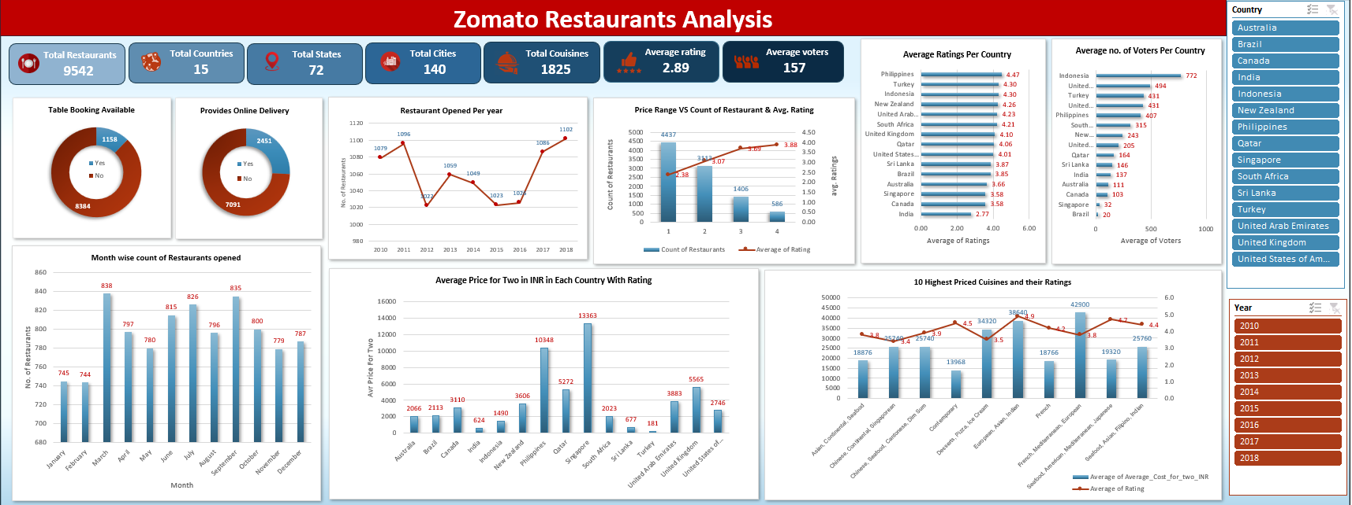
Dashboard
Based on all the insights gathered, I created an interactive dashboard featuring key charts and added slicers for countries and years to make data visualization more dynamic and easier to explore.

Slide 22
Suggestions
STRATEGIC SUGGESTIONS
Target high-potential countries like Sri Lanka, Indonesia, and the Philippines where restaurant presence is still low but customer interest is strong.
Start in less crowded cities within these countries to avoid heavy competition and build a loyal customer base early.
Learn from top competitors to offer something better—whether it’s unique food, faster service, or a more inviting dining experience.
OPERATIONAL SUGGESTIONS
Add online delivery and table booking from the start—data shows it improves both customer experience and restaurant ratings.
Serve popular cuisines that customers already love in each country to increase satisfaction and footfall.
Keep pricing smart and local-friendly by matching it with how much people usually spend in each region.

Slide 23
Conclusion
This analysis offers strategic insights by studying key aspects such as price range, customer ratings, average cost for two, and the number of votes. These factors help understand market potential and customer behavior across countries.
Important business questions have been addressed through a clear and interactive dashboard that uses visuals like line charts, column charts, pie charts, and slicers for better understanding.
The use of country and year slicers allows users to easily filter and explore the data specific to different regions and timeframes.
Additional findings, such as top cuisines among all countries, based on ratings, names of States and cities in the suggested countries, the current quality regarding ratings, are also included in the attached spreadsheet for clarity and planning.

Slide 24

THANK YOU

