Slide 1
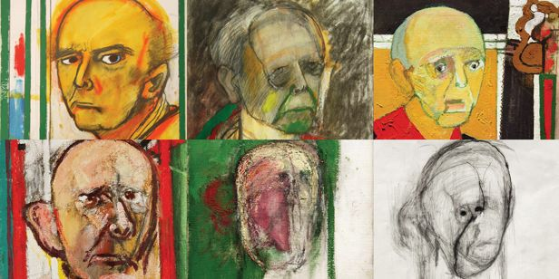
Addressing Machine Learning Challenges to Perform Automated Prompting
PhD Preliminary Exam
Barnan Das
November 8, 2012
***Self-portraits by William Utermohlen, an American artist living in London, after he was diagnosed with Alzheimer’s disease in 1995. Utermohlen died from the consequences of Alzheimer’s disease in March 2007.

Slide 2


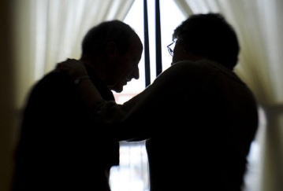
36
million
Worldwide Dementia population
Actual and expected number of Americans >=65 year with Alzheimer’s
$200
billion
Payment for care in 2012
15
million
Unpaid caregivers
Source: World Health Organization and Alzheimer’s Association.

Slide 3
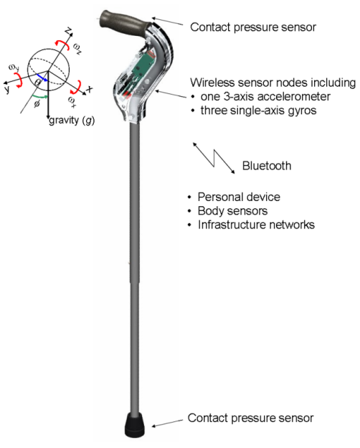
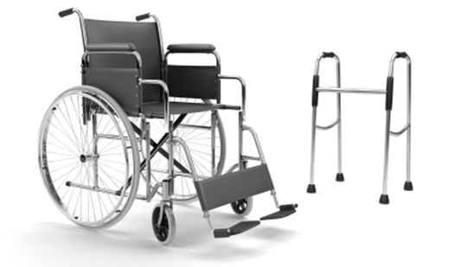
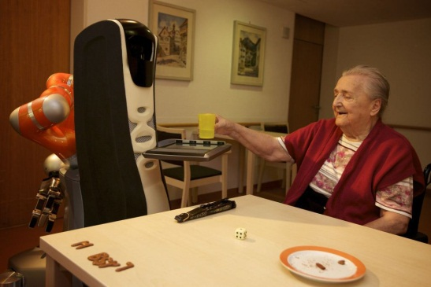
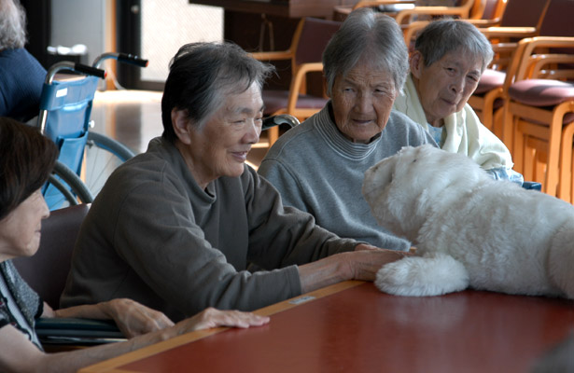
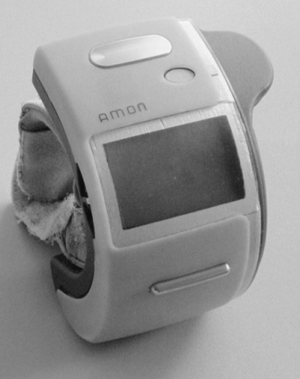
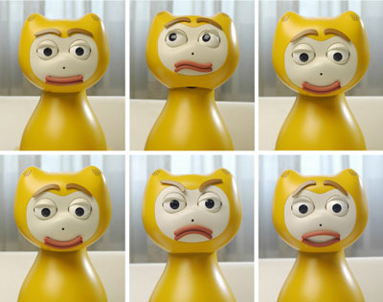

Slide 4
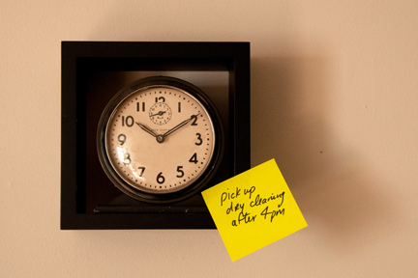

Automated Prompting
Help with Activities of Daily Living (ADLs)

Slide 5
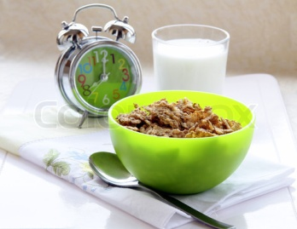

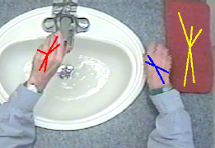


Existing Work
Rule-based (temporal or contextual)
Activity initiation
RFID and video-input based prompts for activity steps
Our Contribution
Learning-based
Sub-activity level prompts
No audio/video input

Slide 6
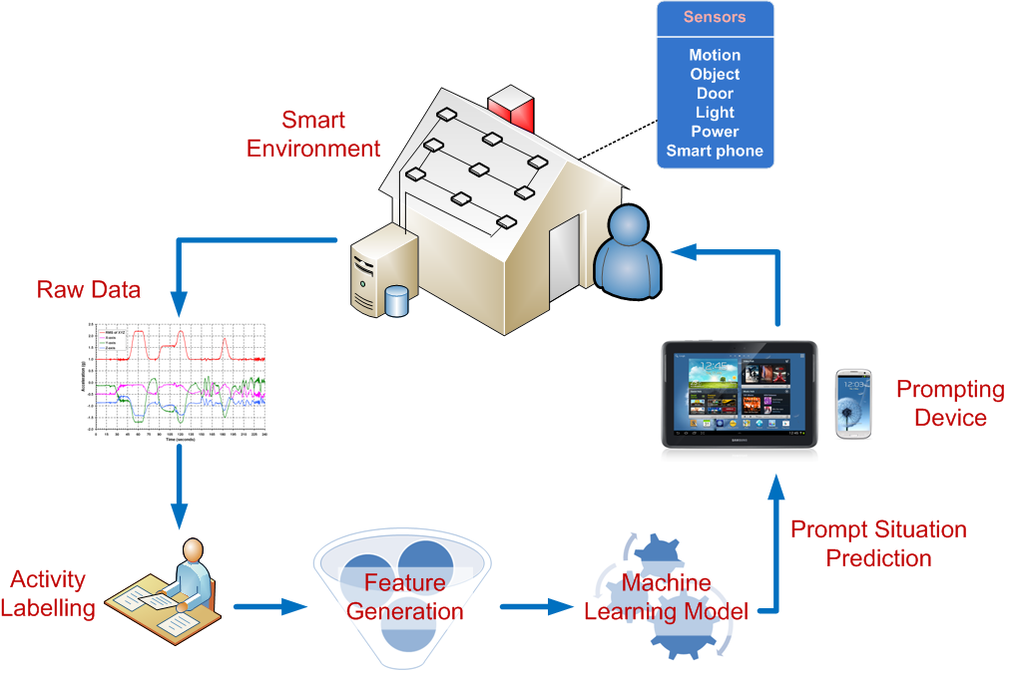
System Architecture
Published at ICOST 2011 and Journal of Personal and Ubiquitous Computing 2012.

Slide 7
Outline of Work
Automated Prompting
Off-line Classification of Activity Steps
On-line Prediction for Streaming Sensor Events
Imbalanced Class Distribution
Overlapping Classes

Slide 8
Outline of Work
Automated Prompting
Off-line Classification of Activity Steps
On-line Prediction for Streaming Sensor Events
Imbalanced Class Distribution
Overlapping Classes

Slide 9
prompt
Off-line Classification of Activity Steps
no-prompt

Slide 10
Data Collection
Experiments
8 Activities of Daily Living (ADLs)
128 older-adult participants
Annotation
ADLs
Predefined ADL steps
Clean Data
1 ADL step = 1 data point
Class labels = {prompt, no-prompt}
Prompt/No-prompt
17 engineered attributes
Prompts issued when errors were committed

Slide 11
Class Distribution
Total number of data points
3980

Slide 12
Imbalanced Class Distribution

Slide 13
Existing Work
Preprocessing
Sampling
Over-sampling minority class
Under-sampling majority class
Oversampling minority class
Spatial location of samples in Euclidean feature space

Slide 14

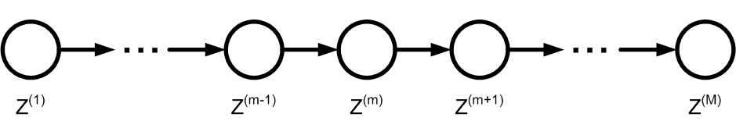

Proposed Approach
Preprocessing technique
Oversampling minority class
Based on Gibbs sampling
Attribute Value
Markov Chain
Node
Submitted at Journal of Machine Learning Research, 2012.

Slide 15
Proposed Approach
Markov Chains
Minority Class Samples
Majority
Class Samples

Slide 16
(wrapper-based)RApidly COnverging Gibbs sampler: RACOG & wRACOG
Differ in sample selection from Markov chains
RACOG:
Based on burn-in and lag
Stopping criteria: predefined number of iterations
Effectiveness of new samples is not judged
wRACOG:
Iterative training on dataset, addition of misclassified data points
Stopping criteria: No further improvement of performance measure (TP rate)

Slide 17
Experimental Setup
Datasets
prompting
abalone
Classifiers
C4.5 decision tree
SVM
Other Methods
SMOTE
SMOTEBoost
car
nursery
letter
connect-4
k-Nearest Neighbor
Logistic Regression
RUSBoost
Implemented Gibbs sampling, SMOTEBoost, RUSBoost

Slide 18
Results (RACOG & wRACOG)
Geometric Mean (TP Rate, TN Rate)
TP Rate

Slide 19
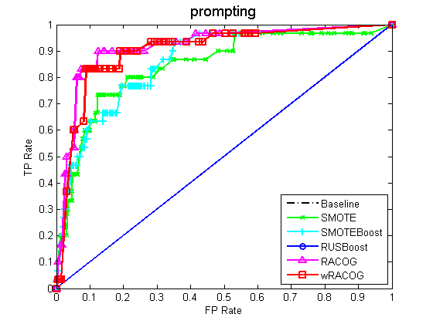
Results (RACOG and wRACOG)
ROC Curve

Slide 20
Outline of Work
Automated Prompting
Off-line Classification of Activity Steps
On-line Prediction for Streaming Sensor Events
Imbalanced Class Distribution
Overlapping Classes

Slide 21
Overlapping Classes

Slide 22
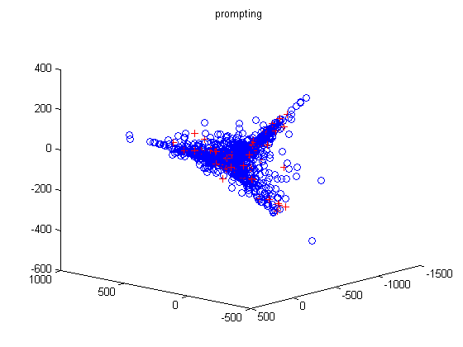
Overlapping Classes in Prompting Data
3D PCA Plot of prompting data

Slide 23
Existing Work
Discard data of the overlapping region
Treat overlapping region as a separate class

Slide 24
Tomek Links

Slide 25
Cluster-Based Under-Sampling(ClusBUS)
Form clusters
Under-sampling interesting clusters
Published in IOS Press Book on Agent-Based Approaches to Ambient Intelligence, 2012.

Slide 26
Experimental Setup
Dataset | prompting
Clustering Algorithm | DBSCAN
Minority class dominance | Empirically determined threshold
Classifiers | C4.5 Decision Tree Naïve Bayes k-Nearest Neighbor SVM

Slide 27
Results (ClusBus)

Slide 28
Outline of Work
Automated Prompting
Off-line Classification of Activity Steps
On-line Prediction for Streaming Sensor Events
Imbalanced Class Distribution
Class Overlap

Slide 29
Outline of Work
Automated Prompting
Off-line Classification of Activity Steps
On-line Prediction for Streaming Sensor Events
Imbalanced Class Distribution
Class Overlap

Slide 30
s₁
s₂
Unsupervised Learning of Prompt Situations on Streaming Sensor Data
s₄
s₁
s₃
s₂

Slide 31
Motivation
Several hundred man-hours to label activity steps
High probability of inaccuracy
Needs activity-step recognition model

Slide 32
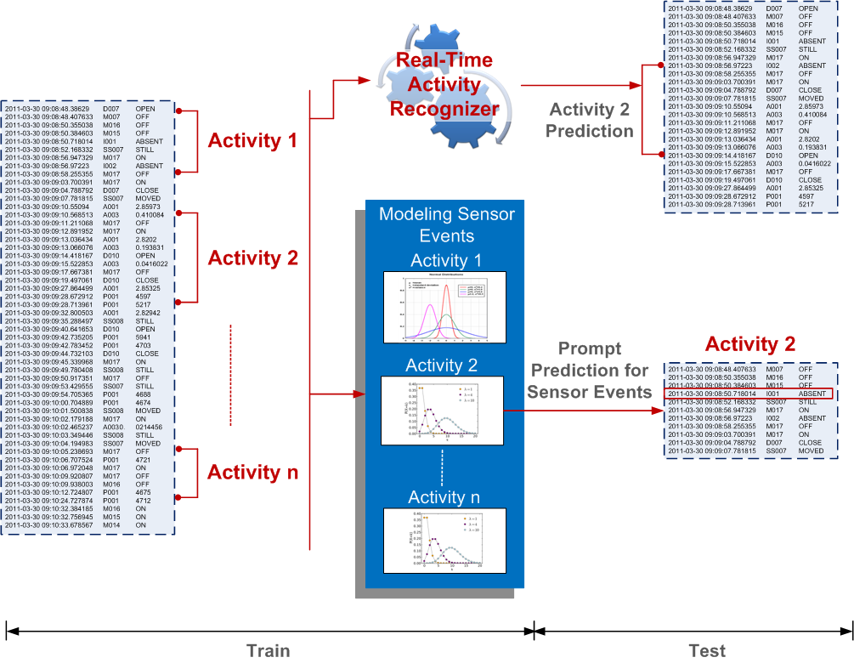
Knowledge Flow

Slide 33
Data Collection
ADLs
Sweeping
Medication
Errors
Abnormal Occurrence
Delayed Occurrence
Cooking
Watering Plants
Hand Washing
Cleaning Kitchen Countertops
Participants | 33
Normal Activity Sequences | 33
Erroneous Activity Sequences | 33x3

Slide 34
Modeling Activity Errors
Abnormal Occurrence
Delayed Occurrence | Gaussian distribution of time elapsed for n^{th} occurrence of s_{i}
 | Gaussian distribution of sensor trigger frequency for n^{th} occurrence of s_{i}
Abnormal Occurrence
Delayed
Occurrence

Slide 35
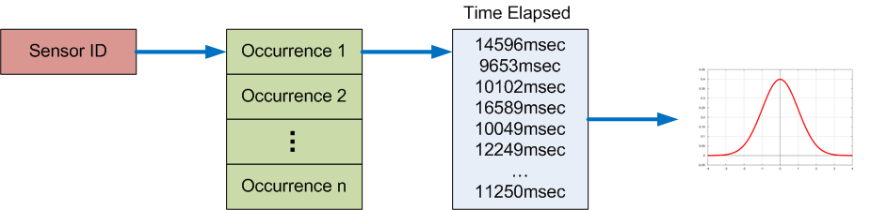
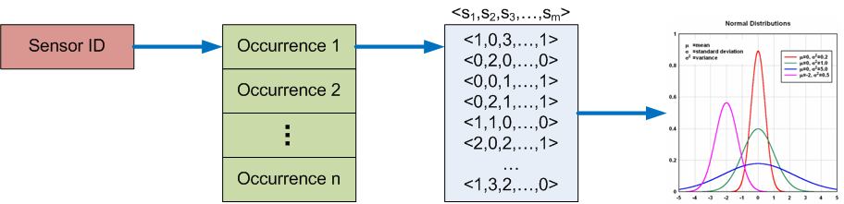
Modeling Delayed Occurrence
Elapsed Time
Sensor Frequency

Slide 36
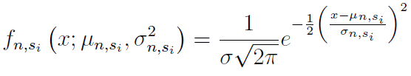
Predicting Errors
At every sensor event evaluate:
Likelihood of
sensor s_{i} occurrence for participant p_{j}
Probability of elapsed time for current n^{th} occurrence of sensor s_{i}
Probability of all sensor frequency for current n^{th} occurrence of sensor s_{i}

Slide 37
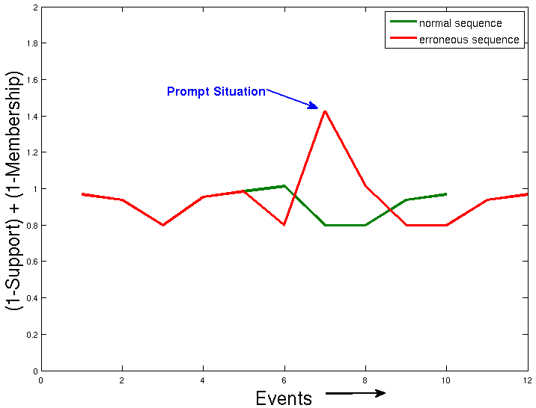
Preliminary Experiments
Elapsed Time
No observable trend
Sensor Frequency
No observable trend

Slide 38
Current Obstacles
Noisy data
Unwanted sensor events, specifically, object sensors
Erroneous activity sequences not suitable for model evaluation

Slide 39
Proposed Plan
Identifying suitable distributions for modeling sensor frequency and elapsed time
Finding out additional statistical measures that can model the errors better
Building generalized prompt model for all six ADLs (if at all possible(?))
Need data to evaluate proposed model
Synthetically generate erroneous sequences from normal sequences(?)
Collect more data if necessary

Slide 40
Publications
Book Chapters | B. Das, N.C. Krishnan, D.J. Cook, “Handling Imbalanced and Overlapping Classes in Smart Environments Prompting Dataset”, Springer Book on Data Mining for Services, 2012. (Submitted) B. Das, N.C. Krishnan, D.J. Cook, “Automated Activity Interventions to Assist with Activities of Daily Living”, IOS Press Book on Agent-Based Approaches to Ambient Intelligence, 2012.
Journal Articles | B. Das, N. C. Krishnan, D. J. Cook, “RACOG and wRACOG: Two Gibbs Sampling-Based Oversampling Techniques”, Journal of Machine Learning Research , 2012. (Submitted) A.M. Seelye, M. Schmitter-Edgecombe, B. Das, D.J. Cook, “Application of Cognitive Rehabilitation Theory to the Development of Smart Prompting Technologies”, IEEE Reviews on Biomedical Engineering, 2012. (Accepted) B. Das, D.J. Cook, M. Schmitter-Edgecombe, A.M. Seelye, “PUCK: An Automated Prompting System for Smart Environments”, Journal of Personal and Ubiquitous Computing, 2012.
Conferences | S. Dernbach, B. Das, N.C. Krishnan, B.L. Thomas, D.J. Cook, “Simple and Complex Acitivity Recognition Through Smart Phones”, International Conference on Intelligent Environments (IE), 2012. B. Das, C. Chen, A.M. Seelye, D.J. Cook, “An Automated Prompting System for Smart Environments”, International Conference on Smart Homes and Health Telematics (ICOST), 2011. E. Nazerfard, B. Das, D.J. Cook, L.B. Holder, “Conditional Random Fields for Activity Recognition in Smart Environments”, International Symposium on Human Informatics (SIGHIT), 2010. C. Chen, B. Das, D.J. Cook, “A Data Mining Framework for Activity Recognition in Smart Environments”, International Conference on Intelligent Environments (IE), 2010.
Workshops and Demos | B. Das, B.L. Thomas, A.M. Seelye, D.J. Cook, L.B. Holder, M. Schmitter-Edgecombe, “Context-Aware Prompting From Your Smart Phone”, Consumer Communication and Networking Conference Demonstration (CCNC), 2012 B. Das, A.M. Seelye, B.L. Thomas, D.J. Cook, L.B. Holder, M. Schmitter-Edgecombe, “Using Smart Phones for Context-Aware Prompting in Smart Environments”, CCNC Workshop on Consumer eHealth Platforms, Services and Applications (CeHPSA), 2012. B. Das, D.J. Cook, “Data Mining Challenges in Automated Prompting Systems”, IUI Workshop on Interaction with Smart Objects Workshop (InterSO), 2011. B. Das, C. Chen, N. Dasgupta, D.J. Cook, “Automated Prompting in a Smart Home Environment”, ICDM Workshop on Data Mining for Service, 2010. C. Chen, B. Das, D.J. Cook, “Energy Prediction Using Resident’s Activity”, KDD Workshop on Knowledge Discovery from Sensor Data (SensorKDD), 2010, C. Chen, B. Das, D.J. Cook, “Energy Prediction in Smart Environments”, IE Workshop on Artificial Intelligence Techniques for Ambient Intelligence (AITAmI), 2010.

Slide 41


