Slide 1
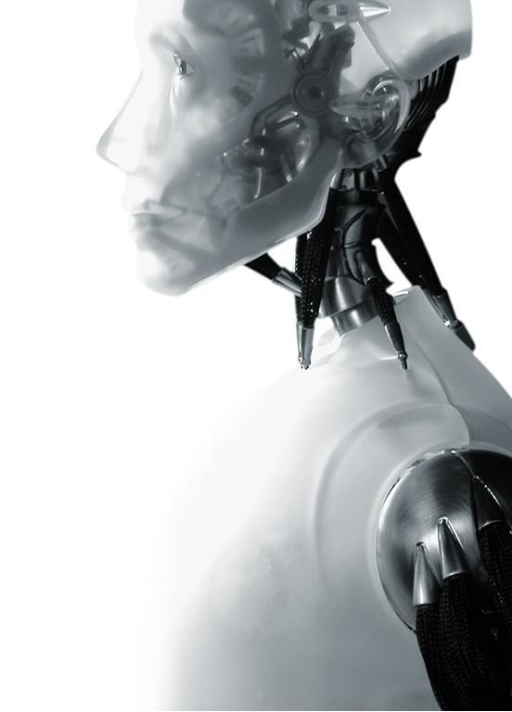
Smart Environments
Presented By:
Barnan Das
February 5, 2010
*Courtesy: Dr. Diane Cook, Professor, School of EECS, WSU

Slide 2
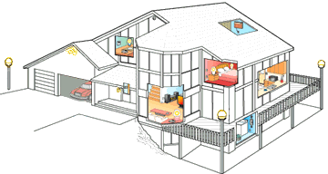
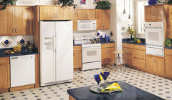
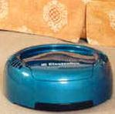
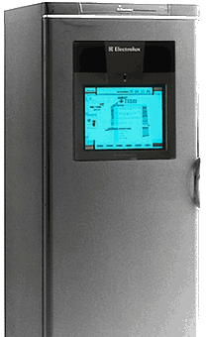
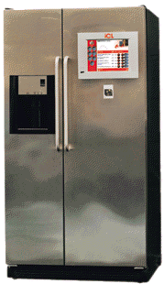
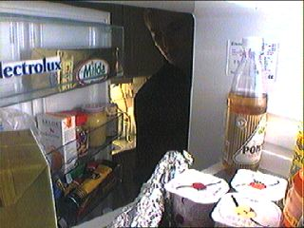
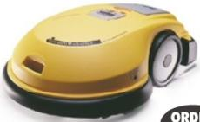
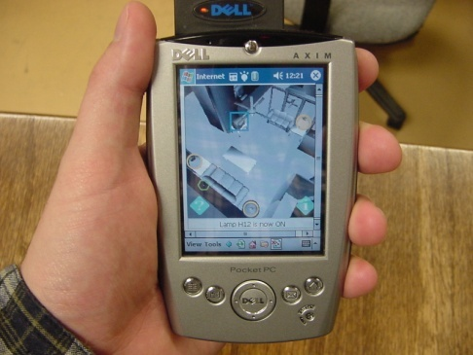
Imagine
Door/lock controllers,
Surveillance system
Face recognition, automated door entry
Climate control
Intelligent appliances
Robot vacuum cleaner
Lighting control
Robot lawnmower
Remote site monitoring and control
Smart sprinklers

Slide 3
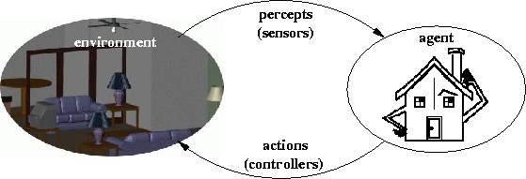
What is a Smart Environment?
An environment able to acquire and apply knowledge about the resident and the physical surroundings to improve the resident’s experience.

Slide 4
How it Works?
Reason
Data mining
Prediction
Decision maker
Rule engine
Action
PLC
Sensor
network
Perception
Sensor
network
Off-the-shelf
sensors

Slide 5
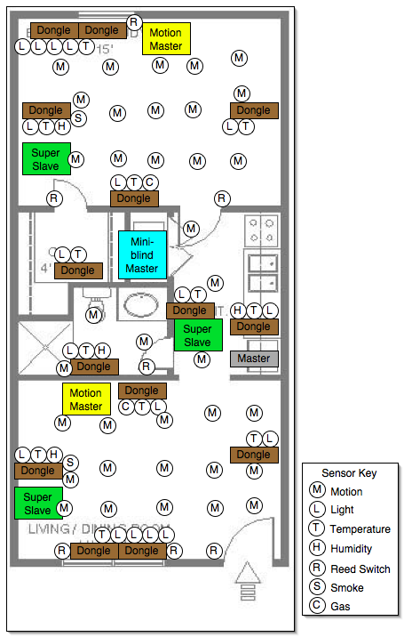
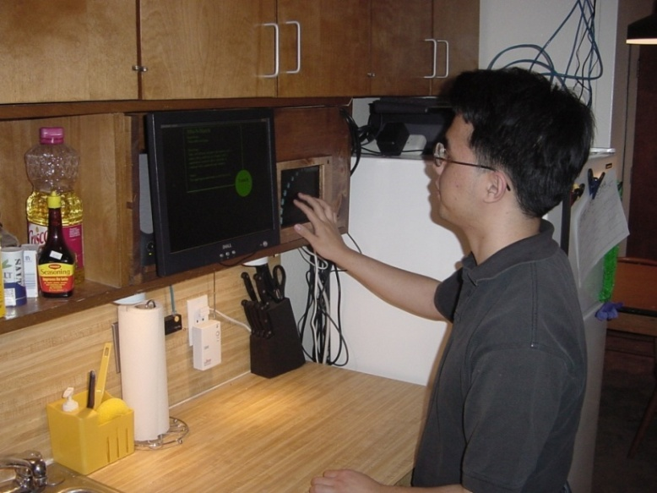
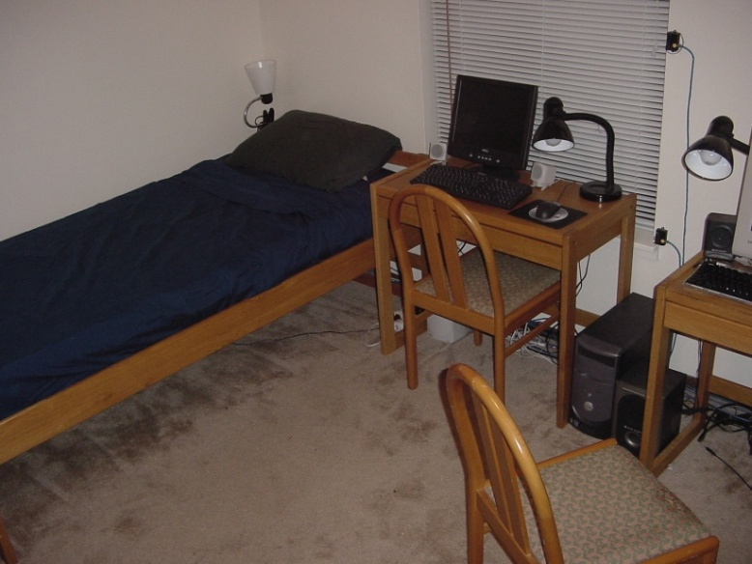
Smart Apartment
Smart Apartment

Slide 6
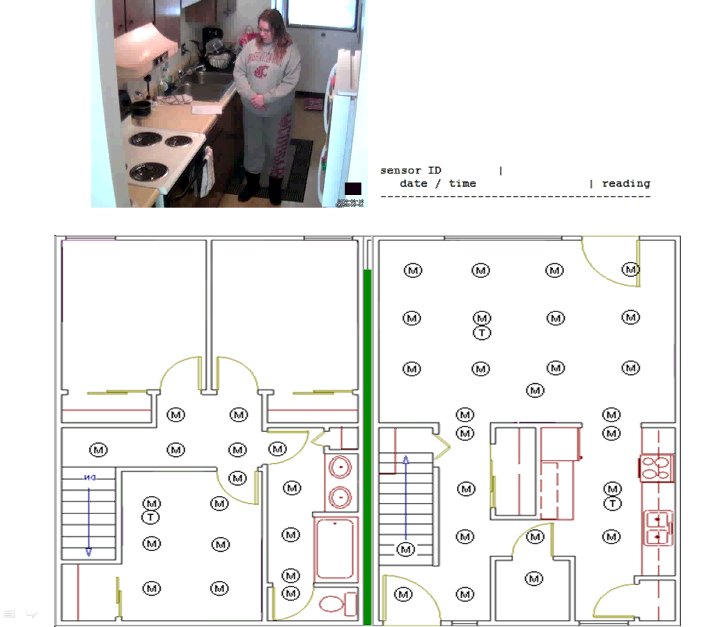
Smart Apartment
Smart Apartment

Slide 7
What Good is a Smart Environment?
Comfort and Productivity
Health and Safety
Energy and Sustainability

Slide 8

Smart Apartment Prototype

Slide 9
What Good is a Smart Environment?
Comfort and Productivity
Health and Safety
Energy and Sustainability

Slide 10
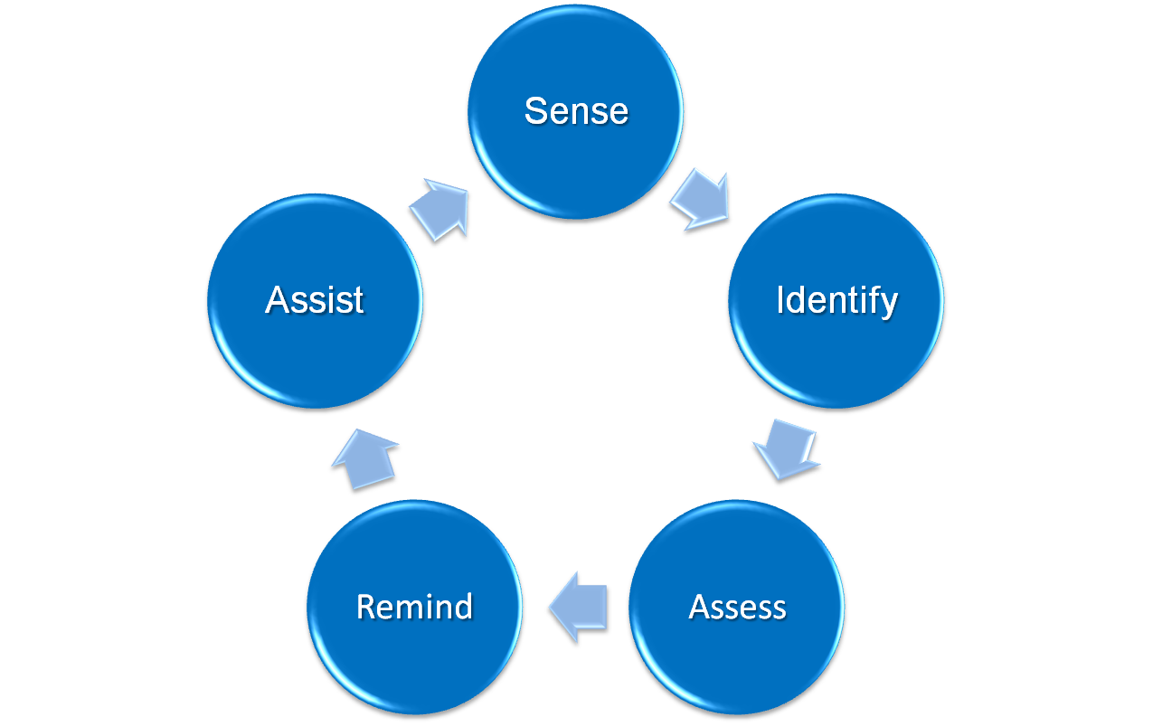
Aid to Psychological Patients

Slide 11
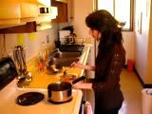
Aid to Psychological Patients

Slide 12
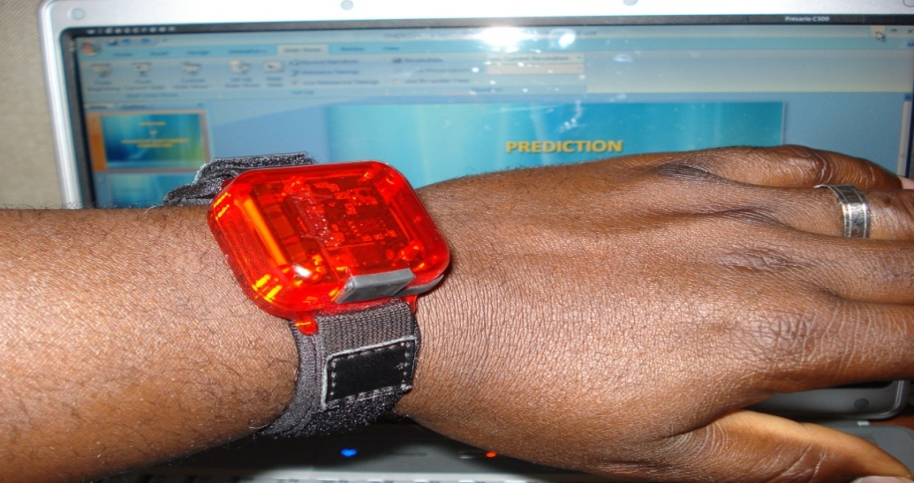


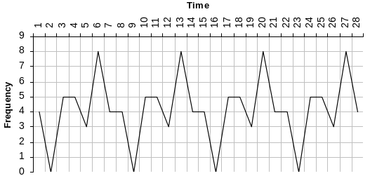

Other Health Applications
Energy Expenditure
Sleep
Temporal Analysis

Slide 13
What Good is a Smart Environment?
Comfort and Productivity
Health and Safety
Energy and Sustainability

Slide 14

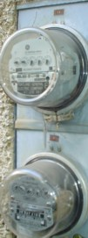
Energy & Sustainability
Visualize energy usage.
Predict energy usage.
Identify trends.
Energy efficient automation.

Slide 15
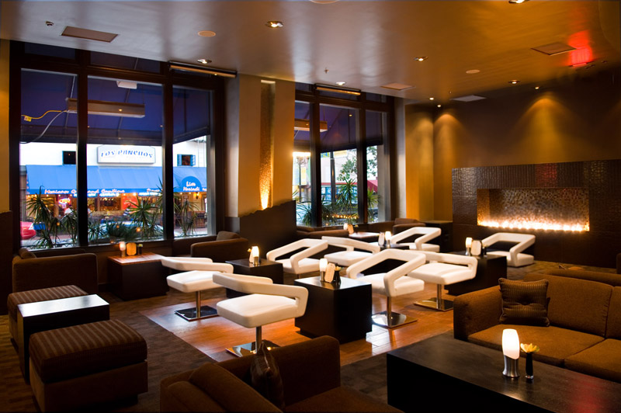
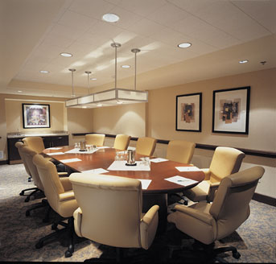

Implementations in the Madrona Project
Smart Heating Systems

Slide 16
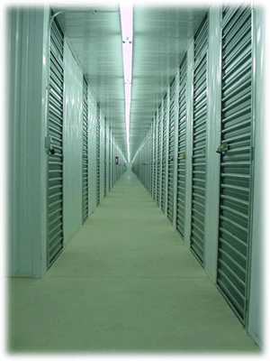
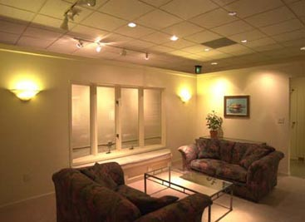
Implementations in the Madrona Project
Smart Lighting Controls

Slide 17


Slide 18
Link to the PPT
www.eecs.wsu.edu/~bdas1/Madrona.ppt

