Slide 1

INTRO TO DIGITAL ACCESSIBILITY
A Workshop for Faculty & Staff
Facilitated By: Anisa Bora

Slide 2
INTRODUCTIONS
Meet CSC Staff

Slide 3
WORKSHOP OVERVIEW

Slide 4
Workshop Overview:
Digital Accessibility
Google Slides Activity
Reflection & Wrap Up
Snacks & Mingling
(5:00-5:30)

Slide 5
DIGITAL ACCESSIBILITY

Slide 6
Digital Accessibility
Reflect:
How do you access content in the digital world? What senses or parts of body do you use when engaging with digital content on a computer, mobile phone, or other device?
Discuss:
In what situations or temporary circumstances has your ability to access content in the digital world been impaired? (ex: impaired vision, hearing, mobility, etc.)
Accessibility needs can be:
Permanent
Temporary
Situational

Slide 7
INCLUSIVE DESIGN
Designing products and services that can be used by everyone, regardless of ability

Slide 8
ACTIVITY
Design a Google Slide

Slide 9
Activity
Choose a topic to make a slide about:
Theme: Your favorite…(book, movie, artist, color, animal, food, geographic location, etc.)
Google Slide Template (Make A Copy):
https://bit.ly/ida-activity

Slide 10
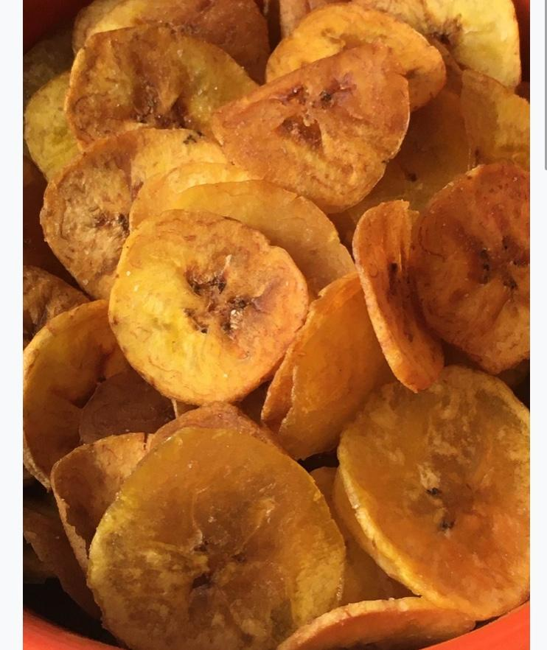
My Favorite Snack
My favorite snack is plantain chips!
My favorite flavors:
Sweet
Salty
I really like the Trader Joe’s plantain chips. Learn more about the Trader Joe’s plantain chips.

Slide 11
SMALL GROUP SHARE OUT
Share your Slide with a Partner!

Slide 12
Small Group Share Out (5 mins)
Share with a partner (optional):
Chosen topic
Title
Image (& alt text)
Text
Link (& link text)
Bullet points
Color Contrast Ratio (text/background)
Reading Order
Switch after 2.5 minutes
Notes:
https://www.youtube.com/watch?v=auUwAuJ8P-I

Slide 13
SESSION REFLECTION
Reflect on your workshop experience!

Slide 14
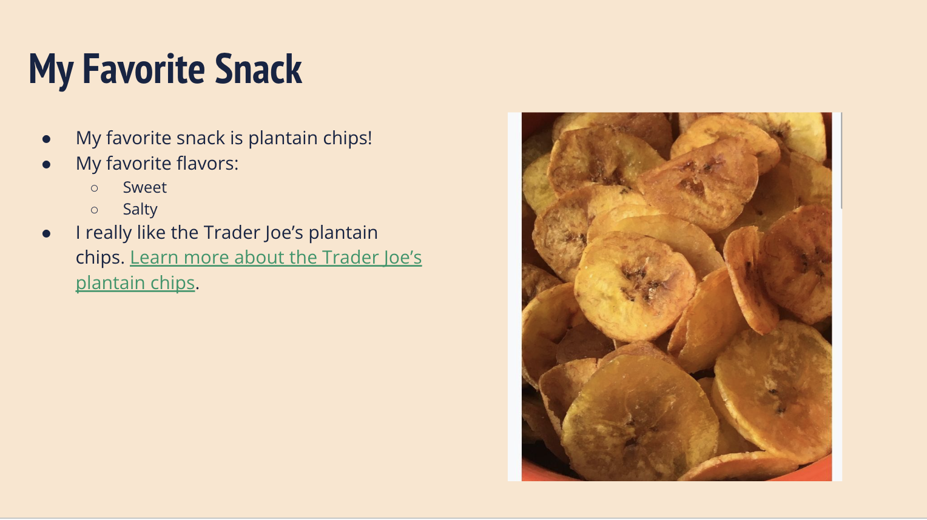
Session Reflection
Post to Padlet (anonymous) : https://bit.ly/ida-reflection
Digital Accessibility
Overview
Google Slides Activity

Slide 15
Workshop Overview:
Digital Accessibility
Overview
Google Slides Activity
Reflection & Wrap Up
Snacks & Mingling
(5:00-5:30)

Slide 16
ACCESSIBILITY WEEK CTD.
NEXT UP…

Slide 17
Disability (Research) Salon
Tuesday, April 8 | 5:30 p.m. - 7 p.m. | James Room, Barnard Hall 4th Floor
Join us for the Disability (Research) Salon during Accessibility Week, the week of April 7th! Students will have the opportunity to present research or theses related to disability studies or lived experiences with disability/chronic illness and then engage in discussion with the community. Opening remarks and facilitation will be provided by Prof Mara Green, Anthropology and instructor of the Disability course taught in the Fall 2023 & 2024 Semesters. This event is co-sponsored by BLAIS.
Food and refreshments will be provided.

Slide 18
Thank You!

