Slide 1


Slide 2
Workshop 1: Finding Census Data

Slide 3
Agenda
Background of the Census and American Community Survey
Metadata
Margin of Error
Geographical Units
Three Sites:
Data.census.gov
NHGIS (through IPUMS)
NYC Population Factfinder

Slide 4
Census
Representation
How many seats in the House of Representatives
How many electoral votes the state has
Funding
How much federal funding communities will receive for roads, schools, housing, social programs, etc
Districting
Whether/how electoral districts will be adjusted or redrawn
Helps Communities Make Decisions

Slide 5
Census
Every 10 years
Who gets counted?
Everyone.
Goal: Count each person “Once, Only Once and in the Right Place”
What challenges could there be to doing that?

Slide 6
Census - Challenges
people with more than one address
people incarcerated in correctional facilities
those who live in different places at different times of the year
those who don’t have an address

Slide 7
Census - Challenges
Young children
Marginalized communities
Low income communities
Non-English speakers
Undocumented immigrants
… and many more

Slide 8
Census – Over Time
https://pudding.cool/2020/03/census-history/

Slide 9
Questions?

Slide 10
Census vs the American Community Survey
Census
ACS
Official count of the population
Every 10 years
Collected over the span of a few months
Attempts to count each person
From 1790
Info on the social and economic characteristics/needs of a community
Every year
Collected every month
Only samples a portion of the population
From 2005

Slide 11
Data about Data
Metadata/data dictionary
metadata files may include:
general descriptions about the contents of the file
definitions for the various terms used to identify records (rows) and fields (columns)
the range of values for fields
the quality or reliability of the data and measurements
how the data were collected
when the data were collected
who collected the data

Slide 12
Data Quality
Accuracy
how close a measurement is to its actual value and is often expressed as a probability
Positional accuracy (accuracy to true location on earth)
Attribute accuracy (incorrect value recorded in table)
Temporal accuracy (age/timeliness of a dataset)
Data completeness

Slide 13
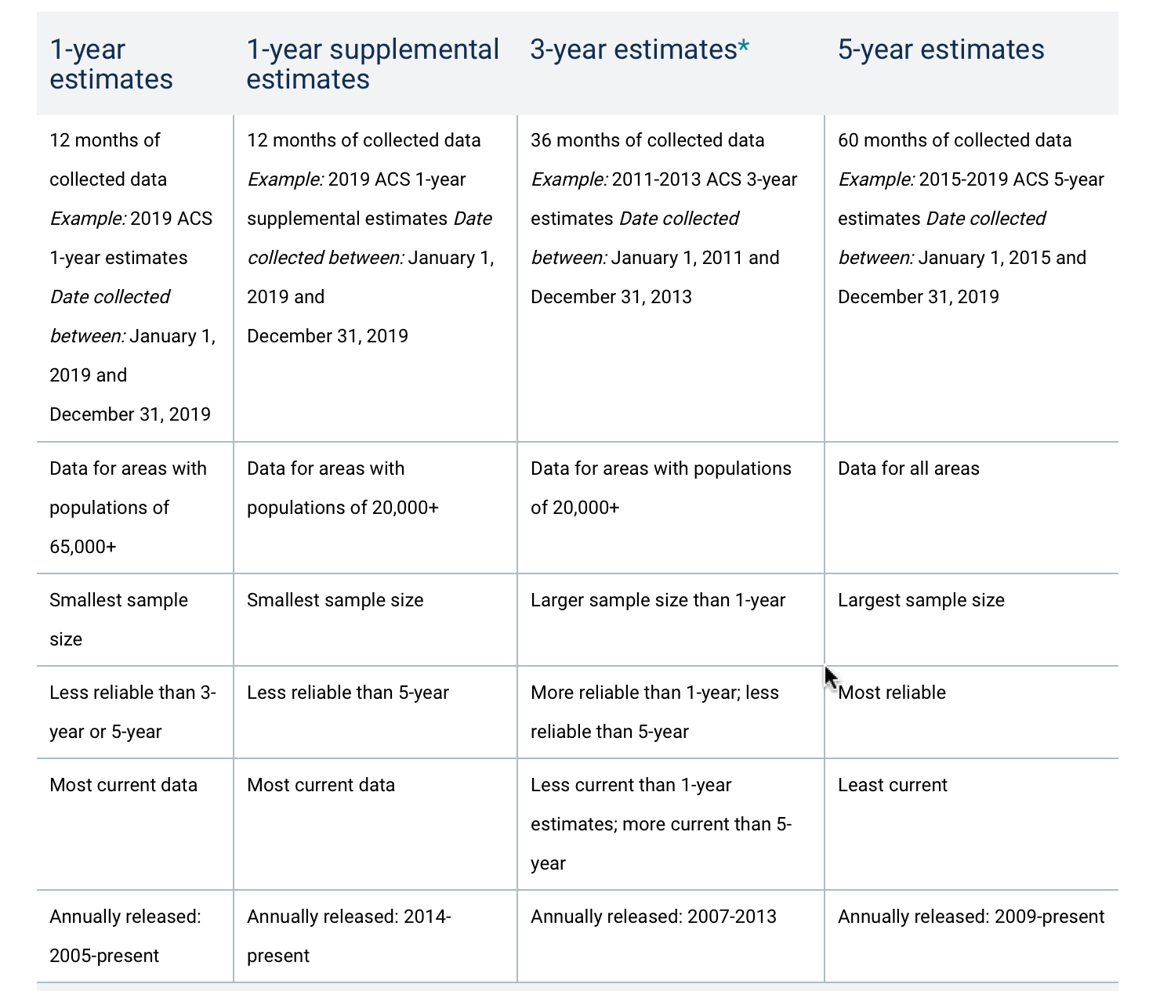
ACS

Slide 14
Questions?

Slide 15
Margin of Error (MOE)
a measure of the possible variation of the estimate around the population value
at a given confidence level, the estimate and the actual population value will differ by no more than the value of the MOE
Matters for estimates with large MOE’s and for statistical testing

Slide 16
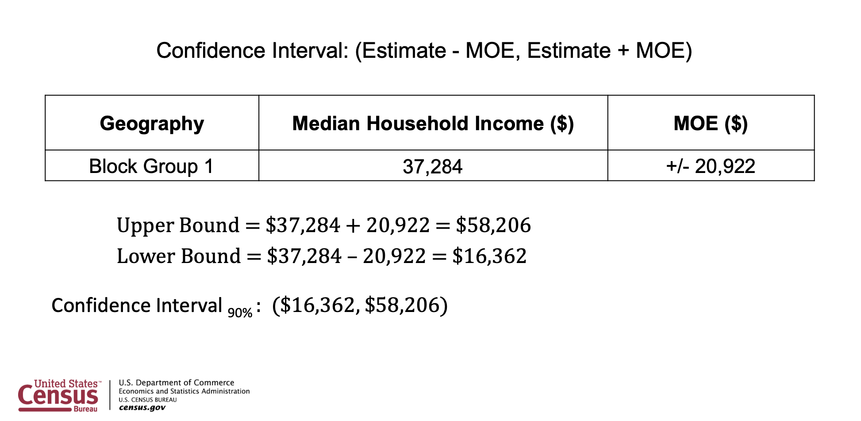

Slide 17
Questions?

Slide 18
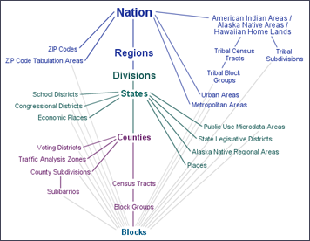
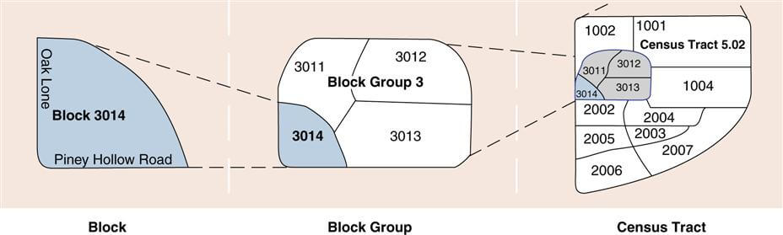
Geographies

Slide 19
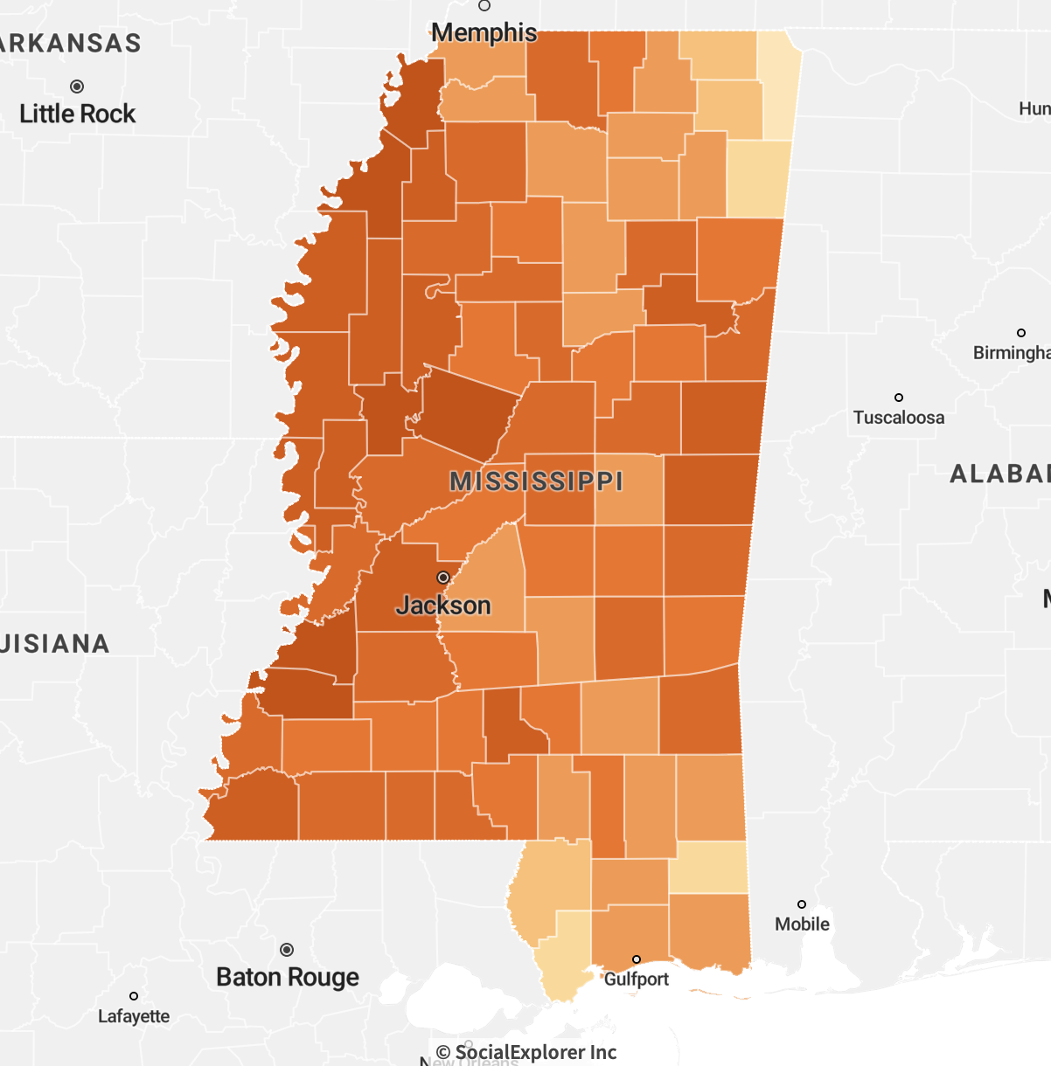

Slide 20
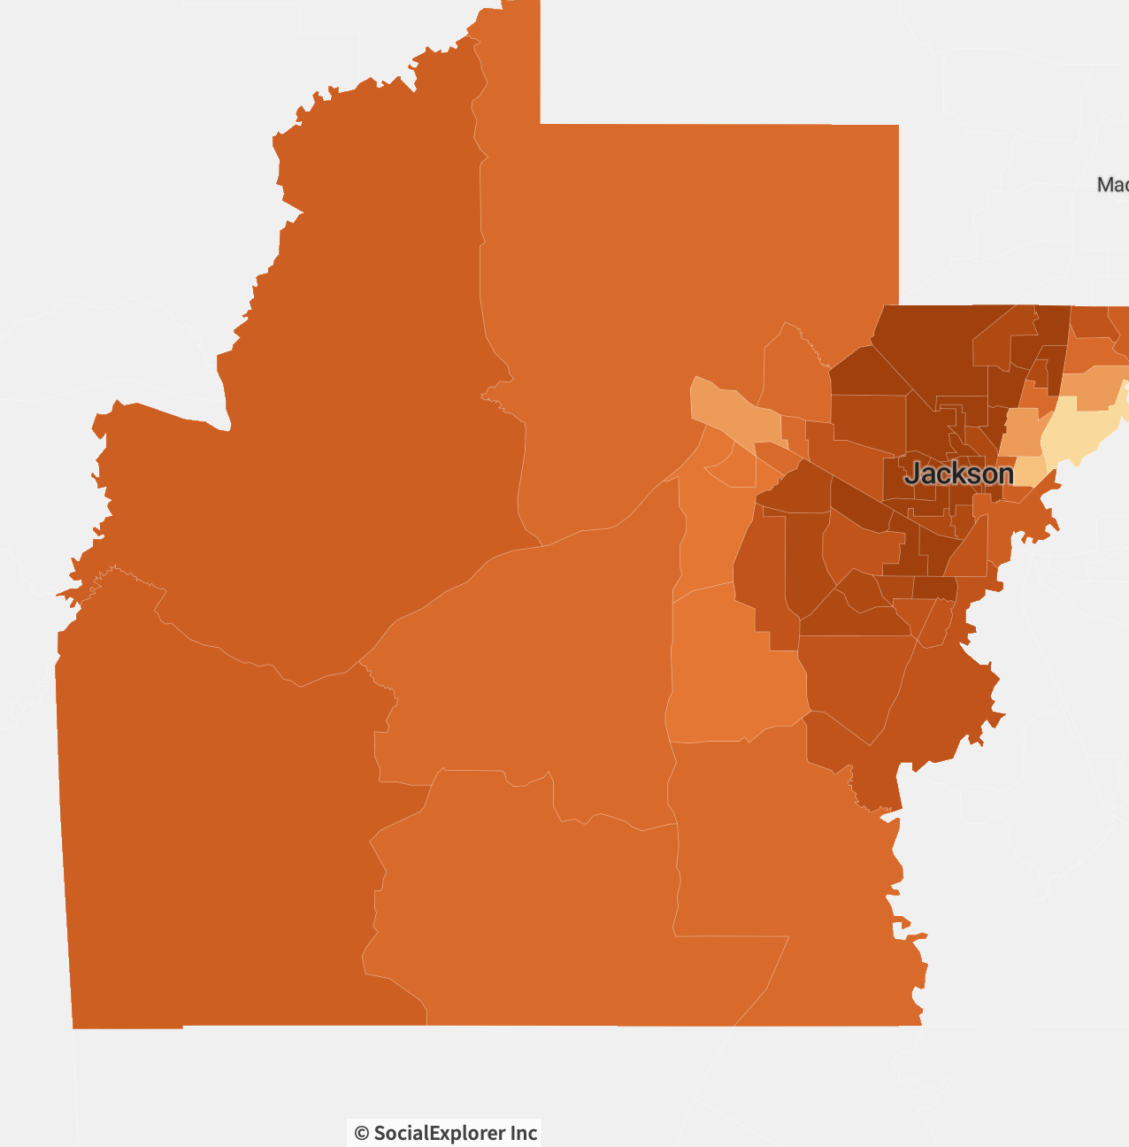

Slide 21
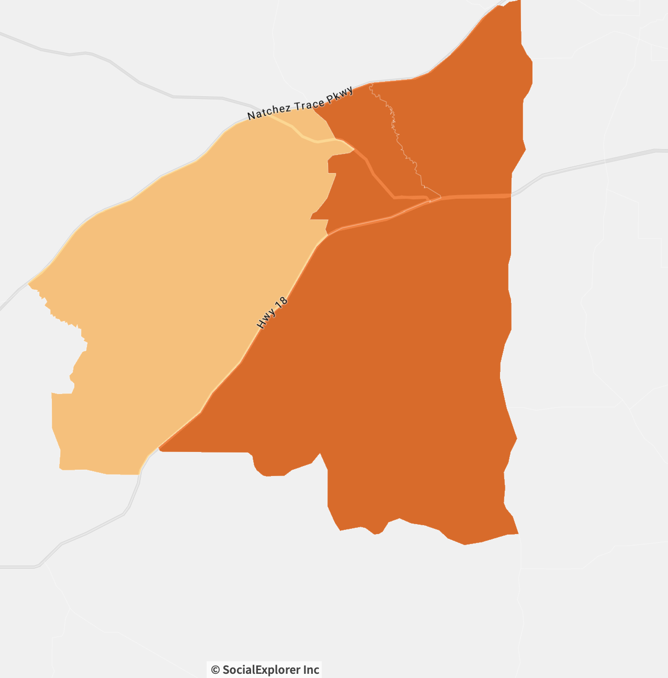

Slide 22
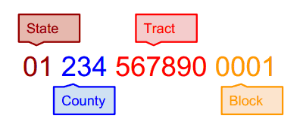
Geographies - identifiers

Slide 23
Exploring Change Over Time
Geographies may have changed
The census question may have changed
are they comparable?
ACS Data must be non-overlapping

Slide 24
Three Possible Sites
Data.census.gov
ipums.org
https://popfactfinder.planning.nyc.gov/

Slide 25
If you have additional questions:
https://calendly.com/fkoli

