Slide 1

ASSESSMENT OF BREATHING
PACU Breathing Learning and Teaching Resource
All images purchased from
Shutterstock unless otherwise stated.
©BARNA.2021

Slide 2
Learning outcomes
By the end of this session you will understand:
How to recognise the signs of normal breathing function
Impact of surgery/anaesthesia on normal breathing function
How to recognise abnormal breathing function in the post anaesthetic period
The importance of risk assessment in post anaesthetic care

Slide 3
Normal respiratory function

Slide 4
Normal delivery of oxygen from air to tissue cells depends on :
Clear upper airway
Efficient respiratory centre to stimulate breath
Effective intercostal muscles for inspiration
Healthy clear alveoli and pulmonary blood supply for exchange of gases
Efficient cardiac output for oxygen transport
Healthy haemoglobin to attach oxygen
Healthy cells to receive oxygen and give up carbon dioxide
Ventilation = elimination of C0₂ from tissues to lungs for expiration
depends also on the above factors
* Revise Breathing : Basic Sciences

Slide 5
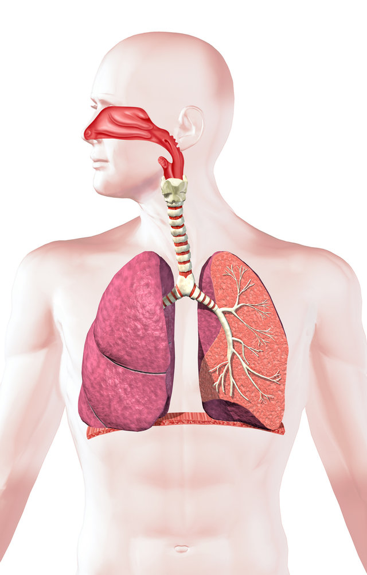
Look - Listen – Feel!
Mental status
Alert and orientated
Airway
Clear, quiet breath sounds
Colour
Pink. Hb loaded with O₂ to
deliver to tissues
Sa0₂
100% on supplemental 0₂ =
Hb saturated with 0₂
Breathing :
Rate : 12-15 bpm
Good depth resps
Regular breathing
Equal chest movement
Diaphragm action
Breath sounds clear at apex and base
ETC0₂
Confirms ventilation
adequate
ABG’s
pH, Pa0₂, PaC0₂
within normal limits
Cardio-vascular
BP, HR, ECG all normal
Signs of normal respiratory function

Slide 6
Indicators of normal respiratory function : monitored information
Sa0₂ [saturation of oxygen measured by pulse oximetry]
100% Sa02 on supplemental 0₂
indicates all Hb molecules saturated with 0₂
ETC0₂ [end tidal carbon dioxide]
within normal parameters 35-45mmHg or 4.6-6kPa
confirms efficient ventilation and exhalation of carbon dioxide
ABG’s [arterial blood gases] : normal parameters
pH : 7.38-7.42
Pa0₂ : 75-100mmHg [10.5-13.5 kPa]
PaC0₂ : 38-42mmHg [5.1-5.6 kPa]

Slide 7
Surgical and anaesthetic factors
that impair
normal breathing

Slide 8
Effect of anaesthetic drug mix
The cocktail of drugs given to deliver general anaesthesia is responsible for many of post operative respiratory problems, primarily hypoventilation [slow, shallow respirations and weakness of respiratory muscles].
Refer to Breathing : Anaesthesia and Surgery for a fuller account

Slide 9
GA drug mix : effect on airway, breathing
Drug group | Specific drugs | Action | Residual effect : Hypoventilation [with hypoxia & C0₂ retention]
Induction | Propofol Isoflurane | Renders patient unconscious | Respiratory depression Airway obstruction
Triad 1.Hypnotic | Sevoflurane Desflurane | Maintains unconscious state | Respiratory depression Sedation Airway obstruction
Triad 2.Narcotic | Fentanyl 30-60 mins duration Morphine 4 hours duration | Relieves pain | Respiratory depression Sedation Airway obstruction
Triad 3.Muscle relaxant | Atracurium Mivicurium | Relaxes muscle | Residual paralysis Respiratory muscle weakness
* Midazolam may contribute to respiratory depression

Slide 10
Anaesthetic drugs and more….
As well as the drug risks, the techniques used in surgery and anaesthesia impact on the patients breathing [next slide].
Finally the patient brings his or her own risks to the table. Age, weight, history all increase patient risk of hypoventilation.

Slide 11
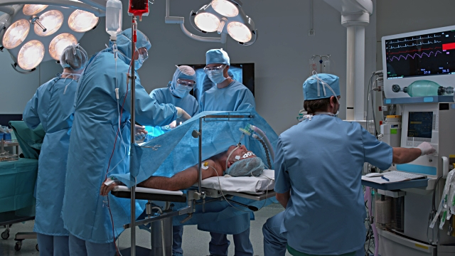
Anaesthesia & Surgery impact on normal breathing
Anaesthetic drugs
depress respirations
Nitrous Oxide
N0₂ displaces 0₂ in the lungs
Surgery
abdominal thoracic incisions make breathing difficult
Ventilation
Causes loss of surfactant and
FRC = loss of alveoli and oxygen reserve
Immobility and position
on table causes
alveolar shutdown
Trendelenberg
may cause basal airway collapse as abdomen is pushed up
Obesity and prolonged procedures
exacerbate the above risks

Slide 12
Additional patient risk factors….
RISK | NOTES
AGE | Elderly : increasing inefficiency of respiratory centre, weakened intercostal muscles, loss of FRC
SMOKER | Cilia flattened, hypersecretions, irritable airways, alveoli loss
COPD | Increased secretions, bronchospasm, reduced surface area for gas exchange
ASTHMA | Airway hyperactivity, bronchospasm, laryngospasm
OBESITY | Risk of basal collapse as abdomen pushes up on thorax
SURGERY | Abdomen - gastrectomy pain may impair deep breathing due to pain Thoracic surgery may induce pneumothorax

Slide 13
Respiratory assessment in post anaesthetic period
Recognising hypoxia

Slide 14
Assessment of Physical Status & Risk
Physical Assessment
look - listen - feel
informs us about the patient’s actual clinical condition
+
Risk Assessment
Determines the risk of breathing problems from appraisal of known patient facts from their previous medical history also the anaesthetic and surgical record

Slide 15
Patient’s breathing post anaesthesia
The anaesthetist aims to tailor the anaesthetic to ensure the patient on arrival in PACU is able to :
Maintain his/her airway unassisted
Take adequate breaths to ensure that oxygen is delivered to the tissues and carbon dioxide exhaled
All of above will avoid the risk of hypoxia and hypercarbia

Slide 16
Physical assessment on arrival Airway - Breathing
On patient arrival airway and breathing assessments are almost simultaneous:
Airway
Is the airway clear? Are there signs of obstruction?
Breathing
Are respirations adequate to ensure alveolar ventilation and to
prevent hypoventilation with resulting hypoxia and hypercarbia?
Check :
Colour / Sa0₂ / Breathing Rate, Depth and Pattern / Level of Consciousness

Slide 17
Breathing may be impaired
Normal early return of respiratory function is an indication of carefully planned, well executed delivery of general anaesthesia
Sometimes however, the anaesthetic plan may be upset : ie - if surgery is brought to a rapid close, the patient may still be heavily under the influence of the anaesthetic drug mix which may impair his respiratory function……

Slide 18
Look - Listen – Feel
ABG’s
pH, Pa0₂, PaC0₂
outside normal range
Sensorium :
Agitation, confusion, restlessness –classic signs
of cerebral hypoxia
Airway
Noisy breathing : obstruction
Silence : total obstruction
Colour
Pallor – cyanosis at lips or
conjunctivae sign of severe
hypoxia
Sa0₂
If falls below 90% : sign of
severe hypoxia
ETC0₂
Rising ETC0₂ a sign of retained C0₂
Breathing :
Shallow, slow breaths or
rapid shallow breaths
Irregular breathing
Use of accessory muscles
Unequal chest movement
Limited air entry at apex or base
Dyspnoea ; work of breathing increased
CVS : tachycardia,
hypertension, ectopics
indicate compensation for hypoxia
Signs of impaired respiratory function

Slide 19
Look : for indicators of respiratory insufficiency
LOOK | Implication
Conscious level | Delayed return of consciousness may indicate respiratory depression with risk of airway obstruction / irritation, confusion indicates cerebral hypoxia
Mask misting | Implies transfer of gases from lungs to atmosphere : if deficient may indicate respiratory depression/obstruction
Colour | Bluish discolouration of lips and conjunctivae indicate failure to deliver oxygen to tissues. Cyanosis = severe hypoxic state
Sa0₂ | Falling oxygen saturation indicates progressive hypoxia
ETC0₂ | Rising ETC0₂ indicates hypoventilation and rising levels of C0₂ as breathing impaired
Rate and depth of breaths | Falling rate and depth of breaths indicate respiratory depression and will lead to hypoxia
Breathing pattern | See saw breathing indicates advanced airway obstruction. One sided inspiration indicates pneumothorax on affected side
Accessory muscles/tracheal tug | Use of accessory muscles indicates acute dyspnoea and work of breathing / tracheal tug indicative of acute obstruction

Slide 20
‘Listen Feel’ for indicators of respiratory insufficiency
LOOK | Implication
Cardio-vascular signs | In respiratory compromise the heart will pump faster and harder to ‘compensate’ and increase the blood flow and oxygen to tissues
LISTEN
Breathing noise | Noisy breathing indicates upper and lower airway obstruction. Silence in presence of other indicators may indicate total obstruction
Breath sounds | Lung auscultation : rhonchi indicate lung congestion, quiet breath sounds indicate alveoli collapse
FEEL
Air movement at lips | Feel of expired air at lips, nose indicates air is being transferred / patient is breathing
Feel chest, adbomen | Feel thorax and abdomen for movement indicating inspiratory excursion

Slide 21
Classic physical signs of hypoxia
Early signs
Mental changes : lack of concentration, confusion, restlessness, agitation*
Tachycardia
Falling Sa0₂ below 95%
Cyanosis
Later signs
Pallor
Rapidly falling Sa0₂ to lower 90’s or below
Ischaemic chest pain
ECG changes
Hypotension, bradycardia
Coma
Death [asystolic arrest]
*These signs may be natural consequence of recovery from GA. In early
stages hypoxia is difficult to confirm unless there is obvious cyanosis or by
ABG analysis

Slide 22
Falling Saturation of Oxygen [Sa0₂]
Real time information from pulse oximetry is vital in respiratory assessment
Sa0₂ of 95% and above is considered safe
When Sa0₂ falls below 95% you need to question why
A rapid fall in Sa0₂ to lower 90’s indicates that the partial pressure of oxygen in the blood [measured by ABG] is insufficient to hold oxygen onto the Hb – oxygen detaches and Sa0₂ falls
Below 90% this process accelerates* : the patient is seriously hypoxic and cyanosed
* see Breathing : Basic Sciences

Slide 23
Hypoxia leads to cyanosis
Cyanosis = bluish discoloration of lips, peripheries
Occurs when there is 3 gms of deoxygenated haemoglobin resulting in Pa0₂ - <6.6KPa [50mmHg] Sa0₂ - <85%
Anaemic patients may not be cyanosed even when hypoxic!
Central Cyanosis
caused by severe hyoxaemia
Cyanosis on inside of mouth, conjunctivae, tongue will be accompanied by peripheral cyanosis
Peripheral Cyanosis
caused by poor peripheral circulation [without central cyanosis]
Blue hands, feet, nailbeds

Slide 24
Hypercarbia
Hypercarbia = increased PaC0₂ in the blood
PaC0₂ greater than 6.2kPa [normal : 5.1-5.6 kPa] ]
Often exists alongside hypoxia, or independently where oxygen levels
are adequate but ventilation is poor
SIGNS
Vasodilation [C0₂ causes vessels to dilate] flushed appearance
Skin : sweating
Increased respiratory rate
Bounding pulses : tachycardia
Extrasystoles
Dizziness, confusion, headache
Drowsiness leading to coma
Hypercarbia leads to Hypoxia once PaC0₂ exceeds 10.53 kPa

Slide 25
Value of End Tidal C0₂ monitoring
ETC0₂ monitoring is becoming established in most PACU units
Remember the normal values of PaC0₂ are 4.6-6kPa
ETC0₂ = the level of carbon dioxide in the blood
If reading is elevated, the patient is retaining C0₂ – he is not exhaling C0₂ – he is hypoventilating
If reading is lower than normal range, the patient is blowing off too much C0₂ – hyperventilating
Either way you need to find out why

Slide 26
Using risk and physical assessment
Establishing the exact cause of hypoxia in the immediate post anaesthetic period may be complex due to the multiple factors involved -
For example airway obstruction quickly leads to hypoxia and may be single causation factor
Airway obstruction is also a ‘by-product’ of respiratory depression leading to prolonged unconsciousness & slow, shallow respirations.
The primary ‘cause’ of hypoxia here is respiratory depression which must be treated alongside the airway obstruction
Consideration of risk factors along with physical indicators will usually lead to the cause of hypoxia

Slide 27
Risk Assessment helps inform physical indicators
Check
What drugs did patient receive?
Opioids? When given? Dose? Time of last dose?
Volatiles?
Midazolam? Dose? When given?
Muscle relaxant – was this used? Was it reversed?
How long on the table? Ventilated? Position?
What surgery performed?
How old is the patient?
Is the patient obese?
Is the patient a smoker?
Has the patient a history of lung disease?
If concerned about any of above risks, consult with anaesthetist to plan management EARLY!

Slide 28
Urgent intervention
If the patient is hypoxic urgent intervention is needed
There will not be time to establish the cause of the problem often
Treat with oxygen, oxygen, oxygen
Encourage to take deep breaths and augment ventilation
The next module will detail management for specific breathing problems……..

Slide 29
Summary
Risk Assessment enables the nurse to anticipate and prevent respiratory complications
If a complication occurs meticulous physical assessment and knowledge of patient plus intra-operative assault enables efficient management
All of above are dependent on a thorough knowledge of applied basic sciences and anaesthetic technique and drugs

Slide 30
References
Hatfield A. [2020] The Complete Recovery Room Book [6th ed]. Oxford University Press Oxford
Odom-Forren J. [2017] Drain’s PeriAnesthesia Nursing: A Critical Care Approach [7th ed] Amsterdam: Elsevier Health Sciences
Smedley P. & Quine N. [2012] Postoperative Care. In K.Woodhead & L.Fudge [eds] Manual of Perioperative Care : An essential guide. Chichester : Wiley-Blackwell
Benson A (2017) The A-G assessment tool (Airway, Breathing, Circulation, Disability, Exposure,
Further information and Goals). Clinical Skills. Net Clinical Skills Limited
Miskovic A., A.B.Lumb [2017] Postoperative pulmonary complications. British Journal of Anaesthesia
Volume 118, Issue 3, Pages 317-33. Access at : https://doi.org/10.1093/bja/aex002
Ball L., Pelosi P., [2017] Intraoperative ventilation and postoperative respiratory assistance. BJA
Education, Volume 17, Issue 11, Pages 357-362. https://doi.org/10.1093/bjaed/mkx025
Hochhausen N. et al [2018] Estimating Respiratory Rate in Post-Anaesthesia Care Unit Patients Using
Infrared Thermography : An Observational Study
Mimoz O. et al [2012] Accuracy of respiratory rate monitoring using a non-invasive acoustic method
after general anaesthesia. BJA Volume 108, Issue 5, Pages 872-875
Access at : DOI:https://doi.org/10.1093/bja/aer51012(17)32239-0/

