Slide 1

MANAGEMENT OF BREATHING : general guidelines
PACU Breathing Learning and Teaching Resource
All images purchased from
Shutterstock unless otherwise stated.
©BARNA.2022

Slide 2
Learning outcomes
By the end of this session you will understand:
Routine respiratory management for promotion of optimal respiratory performance and to pre-empt complications
General guidelines on the management of respiratory complications in stages one : two : three
*Specific complications are covered in PPP : Specific
Respiratory Complications]

Slide 3
The patient arrives from theatre following GA ….
Having received a cocktail of drugs to keep him unconscious, lying static on the table and breathing via a ventilator. Alveolar collapse will have occurred due to the complex mix of the above factors. The longer the surgery, the greater the risk.
For all patients respiratory management must be to maintain airway, deliver oxygen, encourage deep breathing and coughing. These actions will open up the alveoli to ensure oxygen is delivered and prevent atelectasis, pneumonia and other complications.

Slide 4
Management of ‘routine recovery’

Slide 5
‘Routine’ recovery care includes:
Oxygen delivery via mask
Stimulate the patient to wake if still unconscious or semi conscious [stir up regime]
Ensure pain controlled
Encourage deep breathing / coughing
Position to aid respiratory excursion
Use of incentive spirometer/ CPAP where needed
Careful patient assessment of the effect of the above interventions
We will now consider each of the above in turn

Slide 6
Oxygen delivery
All patients receive oxygen
Deliver 6 litres of oxygen via mask for at least 10 minutes or according to patient condition
This will help displace anaesthetic gases and prevent hypoxia
Nitrous oxide [N₂0] sits in the lung sacs and needs to displaced by oxygen. Failure to do may result in Diffusion Hypoxia
Supports the cardio-vascular system

Slide 7
Stir up regime / Position
Assess level of consciousness
For unconscious or semi-conscious patients
Gentle stimulation of patient, call name, massage hand --- this usually brings them round
When conscious the patient will be able to cooperate with instructions to breathe deeper
Sit up to aid respiratory excursion
The above measures are vital to help open up the airways, oxygenate patients and to encourage the exhalation of carbon dioxide

Slide 8
Pain relief
For patients undergoing thoracic or abdominal surgery
Regular analgesia is essential to enable the patient to take deep breaths
Ensure that regular analgesia is ongoing
Administer appropriate drugs [opioids, Paracetamol, NSAID’s or top up local anaesthetic]

Slide 9
Deep breathing and coughing
Deep breathing is essential to strengthen respiratory muscles, + ensure adequate tidal volume of air is exchanged and to open up airways
It will ensure that C0₂ is exhaled to avoid hypercarbia
Coughing helps to ‘blast open’ shut down alveoli
It is useful to use a pillow to ‘splint’ the cough and will encourage the patient compliance
Coughing is a challenge in this early period of recovery, encouragement is needed

Slide 10
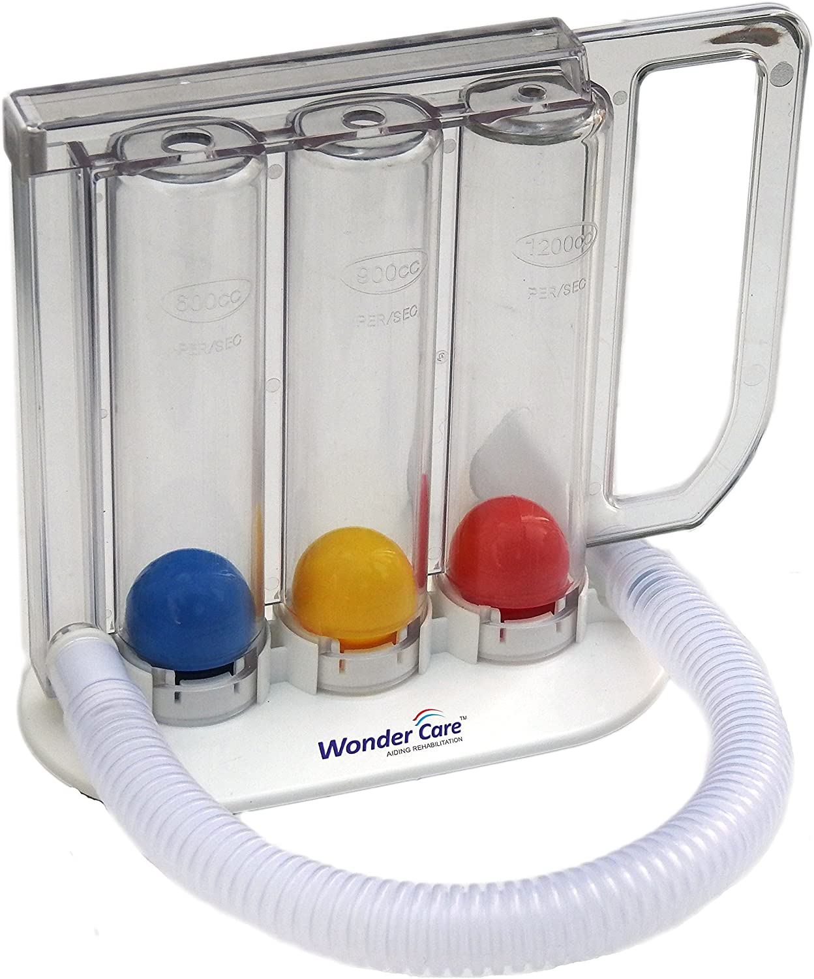
Use of incentive spirometer
This device will keep the lungs well-inflated and healthy
It is useful where patients are too sore
to take deep breaths
[post chest or abdominal surgery]
By holding the spirometer piece in the mouth
and exhaling, inhaling, the piece in the
spirometer will rise
The aim is for the piece to rise as high as possible
This device is useful for the longer term recovery period but can be used in PACU with the patient holding a pillow tightly to the belly to minimise discomfort in thoracic/abdominal surgery

Slide 11
Use of Continuous Positive Airway Pressure
CPAP = continuous positive airways pressure
The patient breathes out against a pressure valve which helps open up the airways and keeps alveoli open at end of expiration
CPAP masks are uncomfortable and the patient will need encouragement to wear one
CPAP opens up airways to receive oxygen and avoid atelectasis
CPAP is very effective in elimination of C0₂ and avoiding hypercarbia

Slide 12
When things go wrong
3 stage management guidelines

Slide 13
When things go wrong….
Most patients enjoy a ‘normal’ recovery
However, respiratory insufficiency is a constant risk, and complications set in fast
Meticulous and ongoing assessment is essential
Risk appraisal allows practitioner to be on the alert for problems

Slide 14
Risk appraisal
Gather information about the patient’s respiratory status from-
Anaesthetic handover
Anaesthetic chart
Patient notes
Incorporate the above evidence into a risk appraisal –
- History of respiratory disease?
Length of time and position on operating table?
Use of ventilation?
Drug mix – timings for opioids?
Age – elderly?
Smoker?
Weight – obese?
The greater the number of risk factors, the greater chance of complications…. Be ready!

Slide 15
3 stage management
1.
Airway* : Breathing management
Airway support : Increase oxygen : Stir up regime
2.
Positive pressure ventilation
Oxygen forced into lungs with bag-valve-mask
3.
Intubation and ventilation
Monitor SaO₂, ECG, BP [Auscultate lungs, CXR, ABGs]
*[refer to Airway Management PPP for more detail]

Slide 16
MAIN LINES OF TREATMENT in all stages
OXYGEN - OXYGEN - OXYGEN
to treat hypoxia
VENTILATION
deep breathing to blow off CO₂

Slide 17
Stage one
Same management guidelines as for the ‘normal recovery’ in previous slides
If the patient shows signs of respiratory compromise [falling Sa0_{2,} change in breathing pattern, confusion] increase Fi0₂ and continue to encourage deep breathing, while closely observing and assessing status for small changes
Incentive spirometry, CPAP, analgesia prn
Rapid deterioration demands immediate action … see next 2 slides to determine when to call for help

Slide 18
Signs of deterioration : when to call for help!
Airway : Clear? Signs of obstruction? [airway adjuncts/position]
Conscious level: Deeply or semi-unconscious?
Mental status : Agitated : confused?
Colour Pallor ? Cyanosis?
Falling Sa0₂ : rising ETC0₂?
Pin point pupils?
Breathing
Falling rate? With shallow respirations?
Rising rate of fast shallow respirations?
Ease of Breathing - forced? Use of accessory muscles?
Noise of Breathing - wheeze?
Muscle tone – Weak? Little respiratory excursion?
Is respiratory effort adequate to maintain alveolar ventilation rate?
If No
Call for HELP ! Proceed to Stage 2

Slide 19
REMEMBER
When Respiratory Function deteriorates
Get help!
AND
First save the patients life - then find out what is wrong’
Hatfield & Tronson

Slide 20
Stage 2 : Bagging the patient Positive pressure ventilation
2 person operation ideally:
Secure the airway
Bag air/oxygen mixture into the patient using re-breathe circuit [or bag-valve-mask if competent]
Assemble emergency intubation equipment and drugs
Continue ongoing physical assessment

Slide 21
Next steps in Stage 2
Bagging the patient ensures oxygen delivery to the patient and gives the anaesthetist time to work out the next steps
If the reason for respiratory insufficiency is clear [i.e. residual paralysis, respiratory depression*], appropriate drugs [neostigmine/narcan/dopram] will treat the problem
If the cause remains unknown and the patient remains dependent on assisted ventilation, then intubation will proceed [Stage 3]
Specific respiratory problems and management will be detailed in next presentation : ‘Breathing : Specific Complications’

Slide 22
Stage 3 : Intubation and ventilation
Prepare intubation equipment [see airway module]
Assist the anaesthetist in intubation with endo-tracheal tube or insertion of laryngeal mask / iGel
Prepare emergency drugs : suxamethonium to relax the vocal cords
Assist in supporting patient’s breathing until patient transferred / attached to ventilator

Slide 23
Summary
Meticulous ongoing assessment of physical signs and risk appraisal will ensure that practitioner is ‘one step ahead’ in management
Early intervention and treatment will avoid problems getting out of hand
Oxygenate and improve ventilation………..
After each intervention appraise effectiveness and proceed through 3 management stages if necessary
Always ask for help : EARLY!

Slide 24
Discuss this ‘high risk patient’
Elderly >85 years
Abdominal resection under GA
Obese
Cigarette smoker ~ 40 years
Chronic obstructive airway disease
Duration of procedure : 3 hours
List the risk factors for potential breathing problems
What indicators may present for respiratory insufficiency?
Discuss the management of this patient

Slide 25
Further Reading
Hatfield A. [2020] The Complete Recovery Room Book [6th ed]. Oxford University Press Oxford
Mills G.H. [2018] ‘Respiratory complications of anaesthesia’ Association of Anaesthetists. Accessed at https://associationofanaesthetists-publications.onlinelibrary.wiley.com/doi/10.1111/anae.14137
Miskovic A., Lumb A.B. [2017] Postoperative pulmonary complications. BJA : British Journal of Anaesthesia, Vol 118, Issue 3, March 2017, pp 317-334
Accessed at https://doi.org/10.1093/bja/aex002
Odom-Forren J. [2017] Drain’s PeriAnesthesia Nursing: A Critical Care Approach [7th ed] Amsterdam: Elsevier Health Sciences
Smedley P. & Quine N. [2012] Postoperative Care. In K.Woodhead & L.Fudge [eds] Manual of Perioperative Care : An essential guide. Chichester : Wiley-Blackwell

