Slide 1
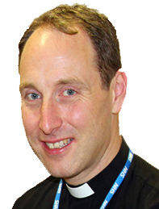
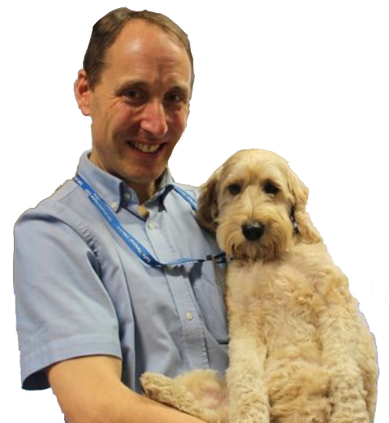

Caring for your Colleagues
A BARNA Webinar on Tuesday 23rd March at 7.30pm
We are proud to present to our Members Registered Psychotherapist and Chaplain of the East Lancashire NHS Trust, Reverend David Anderson, who will talk about caring for your colleagues at this stage of the Covid pandemic when stress remains high, exhaustion has set in and inner reserves are depleted.
David has recently been awarded the British Empire Medal for his work with staff, patients and their families during the Covid Pandemic. Amongst his other work he published the findings of his research into Self Harm in the February 2018 Nursing Times and if we are lucky he may also introduce us to his ‘Therapy Dog’ Jasper.*
This event is free for Members who will be sent a link to this webinar which will include a question and answer session.
This event will be recorded.
* www.nursingtimes.net/clinical-archive/accident-and-emergency/enhancing-acute-hospital-care-for-patients-who-have-self-harmed-29-01-2018/
www.lancashiretelegraph.co.uk/news/17743612.meet-jasper-therapy-dog-duty-blackburn-hospital/
www.barna.co.uk

