Slide 1
How child advocacy centers use technology in investigations
Presented by: Jhanvi Barnes

Slide 2
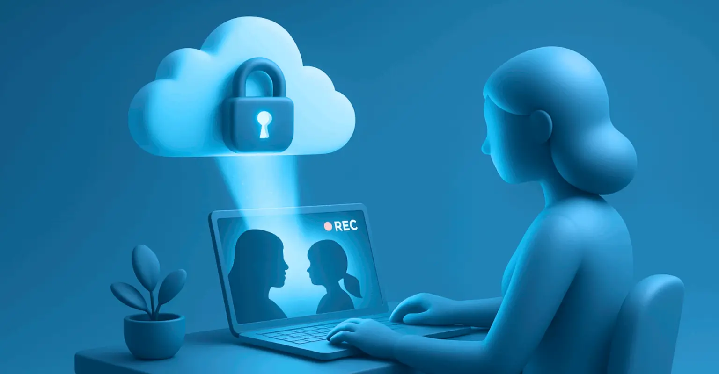
WHY DIGITAL RECORDING MATTERS IN CAC INVESTIGATIONS
Preserves accuracy of children’s statements
Captures verbal and non-verbal cues
Reduces repeated questioning & retraumatization
Allows MDT professionals to observe remotely
Supports clear documentation for investigations
https://guardify.com/when-evidence-gets-exposed-how-to-tell-if-your-digital-evidence-management-system-is-truly-secure/

Slide 3

Sylvia’s child advocacy center
Forensic interviews digitally recorded with cameras & microphones
Enables observation by law enforcement & child protective services without repeated questioning
Preserves the accuracy of the child’s disclosure & cues
Minimizes trauma by reducing how often a child recounts their experience
Supports effective, child-sensitive investigations
https://sylviascac.org

Slide 4
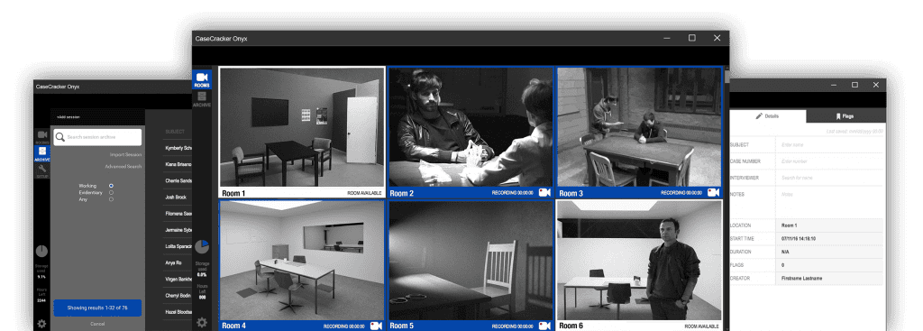
Cardinal peak technologies
CaseCracker Onyx: easy-to-use digital recording system for child advocacy centers
One-button recording state & quick file saving, even for large files
In-interview note-taking and metadata tagging for efficient documentation
High-definition microphones capture clear audio throughout the interview
Enhances reliable documentation & reduces the need for repeated questioning
https://www.casecracker.com

Slide 5

importance of case management & data sharing
Organizes all case information in one digital system
Supports data sharing across multidisciplinary teams
Improves accuracy and reduces missing information
Enhances decision-making through data analysis
Ensures secure handling of sensitive records
https://www.skillcast.com/blog/gdpr-data-sharing-compliance-tips

Slide 6

Chapin Hall
Supports state agencies in building & using administrative data systems
Creates databases for quality improvement, policy analysis, & performance measurement
Uses data linking to merge records across programs securely
Ensures high data quality and security standards
Provides training and technical support for child welfare professionals
https://bulk.ly/data-sharing-best-practices/

Slide 7

CAC carenet
Cloud-based case management platform for child advocacy centers
Supports forensic interview videos, documentation, & multidisciplinary team collaborations
Permission controls for data access & editing
Includes medical & therapy modules to track client services
HIPAA- and SOC- certified servers ensure strong data protection
Enables centralized documentation and efficient coordination
https://caccarenet.com/2020/09/22/929/

Slide 8

how ai supports cac investigations
Speeds detection of abusive images/videos online
Identifies grooming behavior and risky interactions
Reduces exposure to traumatic material for staff
Helps categorize and prioritize digital evidence
Supports prevention and early intervention
https://medium.com/@chaudharisarvesh10/generative-ai-transforming-user-experience-design-c81a35756399

Slide 9

Weprotect global alliance
AI enables fast identification, classification, & moderation of abusive content online
Chatbots detect grooming behavior in real time & provide prevention/support
Raises serious concerns: user privacy risks & misuse of AI-generated content
Calls for transparency & ethical frameworks for responsible AI use
Balances benefits with caution in child protection efforts
https://nwgnetwork.org/80732-2/

Slide 10

Unicri
AI assists law enforcement & child advocacy centers worldwide in investigations
Detects & analyzes child sexual abuse material online, speeding investigations
Reduces emotional toll on professionals exposed to traumatic content
Emphasizes ethical AI use & professional training
Highlight AI’s growing critical role in enhancing child protection
https://en.wikipedia.org/wiki/UNICRI_Centre_for_AI_and_Robotics

Slide 11

benefits of technology in cac investigations
Enhances accuracy & preserves integrity of forensic interviews
Streamlines case management & facilitates data sharing
Enables faster identification & analysis of digital evidence
Reduces trauma for children & professionals
Supports multidisciplinary collaboration & informed decision-making
https://hudsonofficeinc.com/the-benefit-of-technology-for-improved-productivity/

Slide 12

challenges and ethical considerations
Privacy concerns & safeguarding sensitive data
Risk of data breaches & unauthorized access
Potential AI biases affecting fairness & accuracy
Emotional toll on investigators dealing with traumatic content
Need for transparency and responsible AI deployment
https://salestechstar.com/sales-engagement/challenges-and-ethical-considerations-of-using-ai-in-sales/

Slide 13

Future directions
Continued integration of AI & advanced analytics
Improved training for professionals on technology use & ethics
Development of trauma-informed digital tools
Enhanced data sharing between agencies
Ongoing efforts to balance innovation with privacy and ethics
https://www.freepik.com/premium-vector/illustration-business-finance-man-seeing-future-direction_14324887.htm

Slide 14
References
CAC CareNet. (n.d.). Benefits. Retrieved November 21, 2025, from https://caccarenet.com/benefits/
CaseCracker (Cardinal Peak Technologies). (n.d.). Children’s advocacy centers. Retrieved November 21, 2025, from https://www.casecracker.com/industries/child-advocacy-centers/
Chapin Hall at the University of Chicago. (n.d.). The Center for State Child Welfare Data. Retrieved November 21, 2025, from https://www.chapinhall.org/project/the-center-for-state-child-welfare-data/
Sylvia’s CAC. (n.d.). Forensic interviews aid the investigation of a crime. Retrieved November 21, 2025, from https://sylviascac.org/forensic-interviews/
United Nations Interregional Crime and Justice Research Institute (UNICRI). (n.d.). AI for Safer Children. Retrieved November 21, 2025, from https://unicri.org/topics/AI-for-Safer-Children
WeProtect Global Alliance. (n.d.). Artificial intelligence and ‘Gen AI’. Retrieved November 21, 2025, from https://www.weprotect.org/thematic/artificial-intelligence-and-gen-ai/

