Slide 1
Introduction to R Yurij Bukin Limnological Institute, Irkutsk, Russia

Slide 2
Introduction to R
R (programming language) https://www.r-project.org/
R is a programming language and software environment for statistical computing and graphics
free software
≈ 5000 - packages for the implementation of various statistical and graphical functions
packages for bioinformatics:
ape
pegas
phangorn
bios2mds
and others
packages for biological statistics:
- vegan

Slide 3
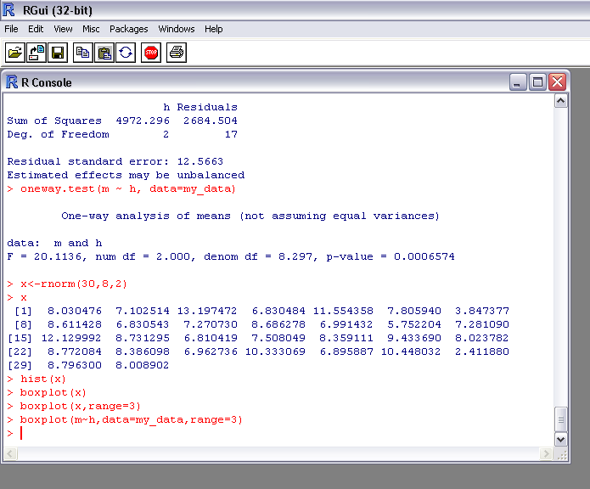
Console R
command line

Slide 4
Data types R
Vector in R – main data type
a <- c(1,2,5.3,6,-2,4) # numeric vector
b <- c("one","two","three") # character vector
c <- c(TRUE,TRUE,TRUE,FALSE,TRUE,FALSE) #logical vector
# - comment
c() - function to set the vector

Slide 5
Data types R
ways of defining vector
a <- c(1,2,5.3,6,-2,4) # numeric vector
a <- c(1:20) # assignment numeric vector
a <- numeric(20) # assignment numeric vector
n <- 20
a <- numeric(n) # assignment numeric vector
a <- character(n) # assignment character vector
a <- logical(n) # assignment logical vector

Slide 6
Data types R
operations on vectors
a <-c(20:40) # numeric vector
b <- c(1:20)
d <-c(a,d) # combining vectors
a <- c(a,b) # add elements into the vector
d <- a+b # summation elements of vectors
d <- a-b # vector from the selected numbers

Slide 7
Data types R
changing the number of elements in the vector
a <-c(20:40) # numeric vector
a <- a[-2] # removing the second element
n <- c(5,6,8)
a <- a[-n] # deleting several elements
a <- a[n] # select several elements with the given numbers
b <- c(3:8)
a <- append(a,b,6) # add an elements to the vector

Slide 8
Data types R
sorting the elements numerical vector
a <-c(20:40) # numeric vector
a <- sort(a, decreasing = FALSE) # sort on descending
a <- sort(a, decreasing =TRUE) # sort on increasing

Slide 9
Data types R
assignment vectors via RNG
a <- rnorm(20,5,2) # numeric vector normal distribution
a <- runif(20,3,5) # numeric vector uniform distribution
a <- rpois (20,3) # numeric vector Poisson distribution
a <- rexp (20,3) # numeric vector exponential distribution

Slide 10
Data types R
Vector of factors
a <- c ("a", "b", "c", "ab", "ac", "bc")
a <- factor(a) # conversion character vector to vector factors
a <- factor(a, levels=c("ab", "bc", "c", "a", "ac", "c"))

Slide 11
Data types R
List - combining of vectors on a particular meaning
a <- c(178,186,167,175)
b <- c(74,79,62,76)
d <- c( 69,78,67,80)
p <- list(m=a, g=b, h=d)
p
$m
[1] 178 186 167 175
$g
[1] 74 79 62 76
$h
[1] 69 78 67 80

Slide 12
Data types R
changing the value of the element
a <- c(178,186,167,175)
a[3]<-171 # changing the value of the element of vector
b <- c(74,79,62,76)
d <- c( 69,78,67,80)
p <- list(m=a, g=b, h=d)
p$m[3] <- 171 ⬄ p[[1]][3]<-171 # changing the value of the element of list
p$g[3] <-70 ⬄ p[[2]][3]<-70

Slide 13
Data types R
Data frame
a <- c(178,186,167,175)
b <- c(74,79,62,76)
d <- c( 69,78,67,80)
my_data<-data.frame(a, b, d) # combining vectors in date frame
The length of the vector must be the same
my_data[1,2]<-79 ⬄ my_data$b[1]<-79

Slide 14
Data types R
Data frame row name and column name
a <- c(178,186,167,175)
b <- c(74,79,62,76)
d <- c( 69,78,67,80)
my_data<-data.frame(a, b, d) # combining vectors in date frame
colnames(my_data)
[1] "a" "b" "d"
my_names<-c("s","f","l")
colnames(my_data)<-my_names
colnames(my_data)<
[1] "s" "f" "l"

Slide 15
Data types R
Data frame row name and column name
a <- c(178,186,167,175)
b <- c(74,79,62,76)
d <- c( 69,78,67,80)
my_data<-data.frame(a, b, d) # combining vectors in date frame
rownames(my_data)
[1] "1" "2" "3" "4"
my_names<-c("p1", "p2", "p3", "p4")
rownames(my_data)<-my_names
rownames(my_data)
[1] "p1" "p2" "p3" "p4"

Slide 16
Data types R
Sort data frame by row
a <- c(178,186,167,175)
b <- c(74,79,62,76)
d <- c( 69,78,67,80)
my_data<-data.frame(a, b, d)
my_data<-my_data[order(b),]

Slide 17
Data types R
Matrix in R
A <- matrix( + c(2, 4, 3, 1, 5, 7), # the data elements + nrow=2, # number of rows + ncol=3, # number of columns + byrow = TRUE)
> A # print the matrix [,1] [,2] [,3] [1,] 2 4 3 [2,] 1 5 7

Slide 18
Data types R
Matrix in R
c_names<-c("p1","p2","p3","p4")
colnames(A)<- c_names
r_names<-c("a1","a2")
rownames(A)<- r_names

Slide 19
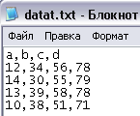
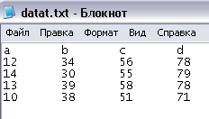
Data types R
Read data from disk
sep ,
sep tab

Slide 20
Data types R
Read data from disk
my_data<-read.table("data.txt", header=TRUE, sep=",")
my_data<-read.table("data.txt", header=TRUE, sep="\t")
> my_data
a b c d
1 12 34 56 78
2 14 30 55 79
3 13 39 58 78
4 10 38 51 71

Slide 21
Testing of statistical hypotheses R
Test sample on normal distribution
Shapiro-Wilk test of normality H0 - sample matches normal distribution
x<-c(23,54,78,21,32,45,67,87,54,16,78,45,38)
shapiro.test(x)
Shapiro-Wilk normality test
data: x
W = 0.9489, p-value = 0.5812
p-value >0.05 H0 are accepted

Slide 22
Testing of statistical hypotheses R
Test two samples on equality of means
two sample Student's t-Test H0 - two samples means are equal
x<-c(23,54,78,21,32,45,67,87,54,16,78,45,38)
y<-c(33,74,78,28,32,95,67,87,34,26,79,64,38)
t.test(x,y)
Welch Two Sample t-test
data: x and y
t = -0.7852, df = 23.853, p-value = 0.4401
alternative hypothesis: true difference in means is not equal to 0
95 percent confidence interval:
-27.08135 12.15827
sample estimates:
mean of x mean of y
49.07692 56.53846
p-value > 0.05 H0 are accepted

Slide 23

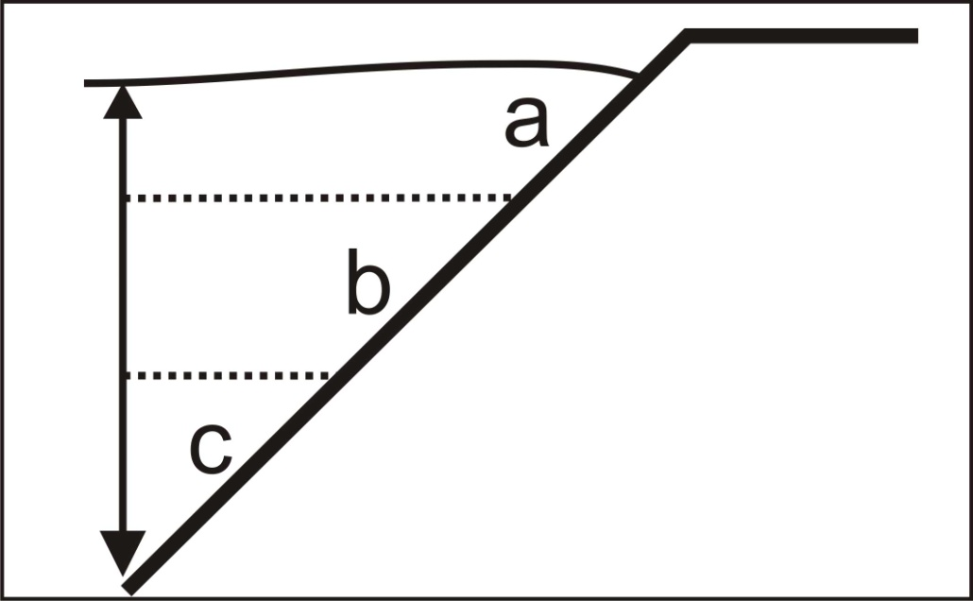
Testing of statistical hypotheses R
ANOVA

Slide 24
Testing of statistical hypotheses R
ANOVA
H0 - factor does not affect on the average mark of samples
my_data<-read.table("data.txt", header=TRUE, sep=",")
oneway.test(m ~ h, data=my_data)
One-way analysis of means (not assuming equal variances)
data: m and h
F = 20.1136, num df = 2.000, denom df = 8.297, p-value = 0.0006574
p-value<0.05 H0 - reject

Slide 25
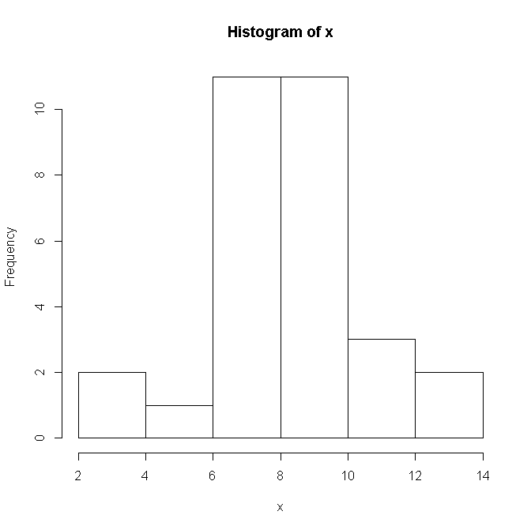
Data visualization R
Histogram of distribution
x<-rnorm(30,8,2)
> x
[1] 8.030476 7.102514 13.197472 6.830484 11.554358 7.805940 3.847377
[8] 8.611428 6.830543 7.270730 8.686278 6.991432 5.752204 7.281090
[15] 12.129992 8.731295 6.810419 7.508049 8.359111 9.433690 8.023782
[22] 8.772084 8.386098 6.962736 10.333069 6.895887 10.448032 2.411880
[29] 8.796300 8.008902
hist(x)

Slide 26
Data visualization R
boxplot
x<-rnorm(30,8,2)
> x
[1] 8.030476 7.102514 13.197472 6.830484 11.554358 7.805940 3.847377
[8] 8.611428 6.830543 7.270730 8.686278 6.991432 5.752204 7.281090
[15] 12.129992 8.731295 6.810419 7.508049 8.359111 9.433690 8.023782
[22] 8.772084 8.386098 6.962736 10.333069 6.895887 10.448032 2.411880
[29] 8.796300 8.008902
boxplot(x,range=3)

Slide 27
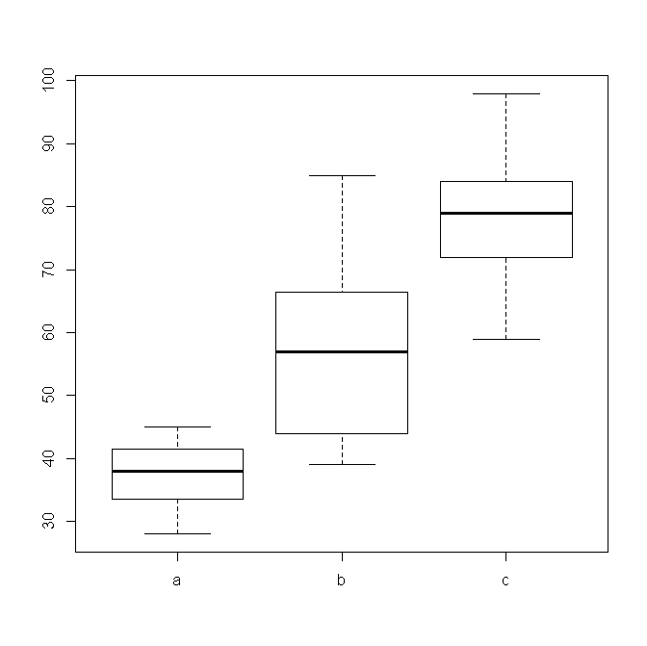
Data visualization R
Boxplot
my_data<-read.table("data.txt", header=TRUE, sep=",")
boxplot(m~h,data=my_data,range=3)

Slide 28
Object-oriented programming (OOP) R
Object-oriented programming (OOP) is a programming paradigm based on the concept of "objects", which are data structures that contain data, in the form of fields, often known as attributes; and code, in the form of procedures, often known as methods.
data
Object
methods

Slide 29
Object-oriented programming (OOP) R
x_y_mean<-function(x,y) # the average value of the difference between the elements of the sample
{
pts<-list(x=x,y=y)
class(pts) <- "x_y_mean"
return(pts)
}
mean_twoo<- function(x,y)
{
ro<- x_y_mean(x,y)
return(ro)
}
print. x_y_mean = function(obj)
{
z<-obj$x-obj$y
m<-mean(z)
str<-paste("The average difference between the elements is m=", m, "\n", sep="")
cat(str)
}

Slide 30
Object-oriented programming (OOP) R
x<-rnorm(10,30,3)
y<-rnorm(10,20,4)
mean_twoo(x,y)

