Slide 1


Slide 2
CONTROL
UNIT
RegWrite, MemRead, MemWrite, MemtoReg, ALUSrc1, ALUSrc2, ALUOp
Instruction
Exception_temp
RegDst
Branch
Jump
5’d26
1
Interrupt
RegDest
rd
0
0
1
BranchSrcA
5’d31
2
PC_next
ExtOp
LuOp
0
EXForwardSrc
1
branchCmpA
Instruction
Memory
Data
Register
MEMForwardSrc
2
rs
ReadSrcA
DataBusA
WBForwardSrc
3
PC
Read
Address
Out
rt
BranchSrcB
BranchCond
SelectUnit
Branch
Cond
ReadSrcB
DataBusB
WrEn
WB.RegWrite
WrDest
WB.RegDest
0
WrData
WB.DataBusC
1
32’b0
branchCmpB
2
reset
Imm16
3
ExtUnit
0
Imm32
LuUnit
1
Instruction
JumpTarget
Calc Unit
JumpTarget
PC[31]
Exception
PC
shamt
reset
stall
IDEXFlush
IFIDFlush

Slide 3
CONTROL
UNIT
RegWrite, MemRead, MemWrite, MemtoReg, ALUSrc1, ALUSrc2, ALUOp
RegWrite, MemRead, MemWrite, MemtoReg
RegWrite, MemtoReg
Instruction
Exception_temp
Branch
ALUSrc1, ALUSrc2, ALUOp
MemRead, MemWrite
Peripheral
Device
Controller
RegDst
Jump
MemtoReg
Interrupt
RegDest
WB.RegWrite
5’d26
1
RegDest
RegDest
WB.RegDest
rd
0
0
ALUOut
MemReadOut
0
1
ALUOut
WB.DataBusC
BranchSrcA
ALUSrc1
1
5’d31
2
ALUSrc2
ALUOp
PC_next
ExtOp
LuOp
Forward1
Sort
Data
ROM
0
MemtoReg
Address
Read
Data
EXForwardSrc
1
branchCmpA
branchCmpA
0
Instruction
Memory
Data
Register
MEMForwardSrc
2
rs
MEMForwardSrc
1
0
MEMForwardSrc
WBForwardSrc
ReadSrcA
DataBusA
WBForwardSrc
3
WBForwardSrc
2
1
Data
Memory
PC
Read
Address
Out
rt
BranchSrcB
BranchCond
SelectUnit
Branch
Cond
ReadSrcB
DataBusB
MemRead
WrEn
WB.RegWrite
Forward2
RdEn
MemWrite
WrEn
Read
Data
WrDest
WB.RegDest
0
0
WrData
WB.DataBusC
branchCmpB
branchCmpB
ALU
WrData
1
32’b0
0
2
ALUOut
2
1
0
Address
reset
Imm16
3
2
3
ExtUnit
0
Imm32
Imm32
1
LuUnit
1
Instruction
EXForwardSrc
JumpTarget
Calc Unit
JumpTarget
PC[31]
Exception
PC
PC
+4
shamt
shamt
ExtUnit
reset
stall
IDEXFlush
IFIDFlush

Slide 4
CONTROL
UNIT
RegWrite, MemRead, MemWrite, MemtoReg, ALUSrc1, ALUSrc2, ALUOp
RegWrite, MemRead, MemWrite, MemtoReg
RegWrite, MemtoReg
Instruction
Exception_temp
Branch
ALUSrc1, ALUSrc2, ALUOp
MemRead, MemWrite
Peripheral
Device
Controller
RegDst
Jump
MemtoReg
Interrupt
RegDest
WB.RegWrite
5’d26
1
RegDest
RegDest
WB.RegDest
rd
0
0
ALUOut
MemReadOut
0
1
ALUOut
WB.DataBusC
BranchSrcA
ALUSrc1
1
5’d31
2
PC
ALUSrc2
ALUOp
PC_next
ExtOp
LuOp
Forward1
Sort
Data
ROM
0
MemtoReg
Address
Read
Data
EXForwardSrc
1
branchCmpA
branchCmpA
0
Instruction
Memory
Data
Register
MEMForwardSrc
2
rs
MEMForwardSrc
1
0
MEMForwardSrc
WBForwardSrc
ReadSrcA
DataBusA
WBForwardSrc
3
WBForwardSrc
2
1
Data
Memory
PC
Read
Address
Out
rt
BranchSrcB
BranchCond
SelectUnit
Branch
Cond
ReadSrcB
DataBusB
MemRead
WrEn
WB.RegWrite
Forward2
RdEn
MemWrite
WrEn
Read
Data
WrDest
WB.RegDest
0
0
WrData
WB.DataBusC
branchCmpB
branchCmpB
ALU
WrData
1
32’b0
0
2
ALUOut
2
1
0
Address
LED, Digit, SysTick, Timer, Interrupt
reset
Imm16
3
2
3
ExtUnit
0
Imm32
Imm32
1
LuUnit
1
Instruction
EXForwardSrc
JumpTarget
Calc Unit
JumpTarget
PC[31]
Exception
PC
PC
+4
shamt
shamt
ExtUnit
reset
stall
IDEXFlush
IFIDFlush

Slide 5
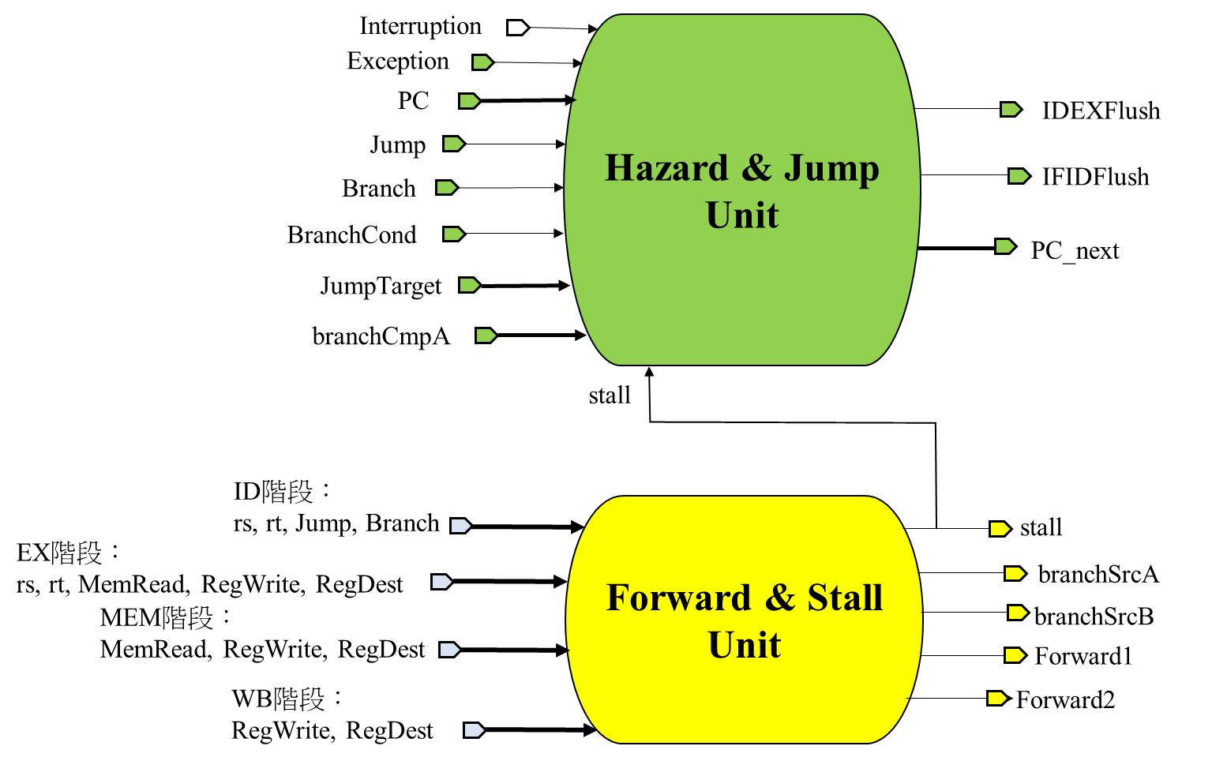
Interruption
Hazard & Jump
Unit
Exception
PC
IDEXFlush
Jump
Branch
IFIDFlush
BranchCond
PC_next
JumpTarget
branchCmpA
stall
ID階段：
rs, rt, Jump, Branch
Forward & Stall
Unit
stall
EX階段：
rs, rt, MemRead, RegWrite, RegDest
branchSrcA
MEM階段：
MemRead, RegWrite, RegDest
branchSrcB
Forward1
WB階段：
RegWrite, RegDest
Forward2

Slide 6
如何閱讀本圖
線：線的粗細反映信號位寬，線的顏色本身沒有特殊含義，但相同顏色的線上載相同的訊號。故當圖上不可避免需產生交叉時，我用不同顏色的線區分不同信號。為免與相鄰線產生混淆，線上所載訊號的名稱一律記於水平線上方或鉛直線右側，如下圖所示。
Input/ Output Port：形如
當引入/出流水線中其他階段訊號時，或引入/出信號供Hazard and Jump Unit、Forward and Stall Unit使用時繪之。同一階段流水線的訊號引用不作此記號。不同底色的Port代表不同意義：
由於需使用到系統時鐘信號(CLK)之裝置甚多，本圖中不一一標明，凡在時鐘上升沿才寫入新值的時序邏輯電路埠，均加入 標誌以資識別。
Imm32
ALUOp
其中一端接入自/接出至流水線的其他階段
其中一端與Forward & Stall Unit 相連
其中一端與Hazard & Jump Unit 相連
其中一端與CPU外設相連

