Slide 1
Sleep Stage Classification
By: Jacob Baron and Harry Chong
17_JacobBaron_Chong

Slide 2
Project Background
Today, there is no good way to determine what sleep stage a patient is currently in without someone supervising the patient. There is no autonomous way to track a patient’s sleep stages in real time.
Others have attempted to classify nREM vs REM with varying success, but not many have classified Wake, nREM, and REM.
Literature suggests nREM vs REM classification is approximately 85% accurate.
Question: Is it possible to classify an individual’s sleep state based on their brain signals?
Our approach
Convolutional Neural Network (CNN)
K Nearest Neighbor (KNN)
17_JacobBaron_Chong
Reference: https://ieeexplore.ieee.org/document/5626211

Slide 3
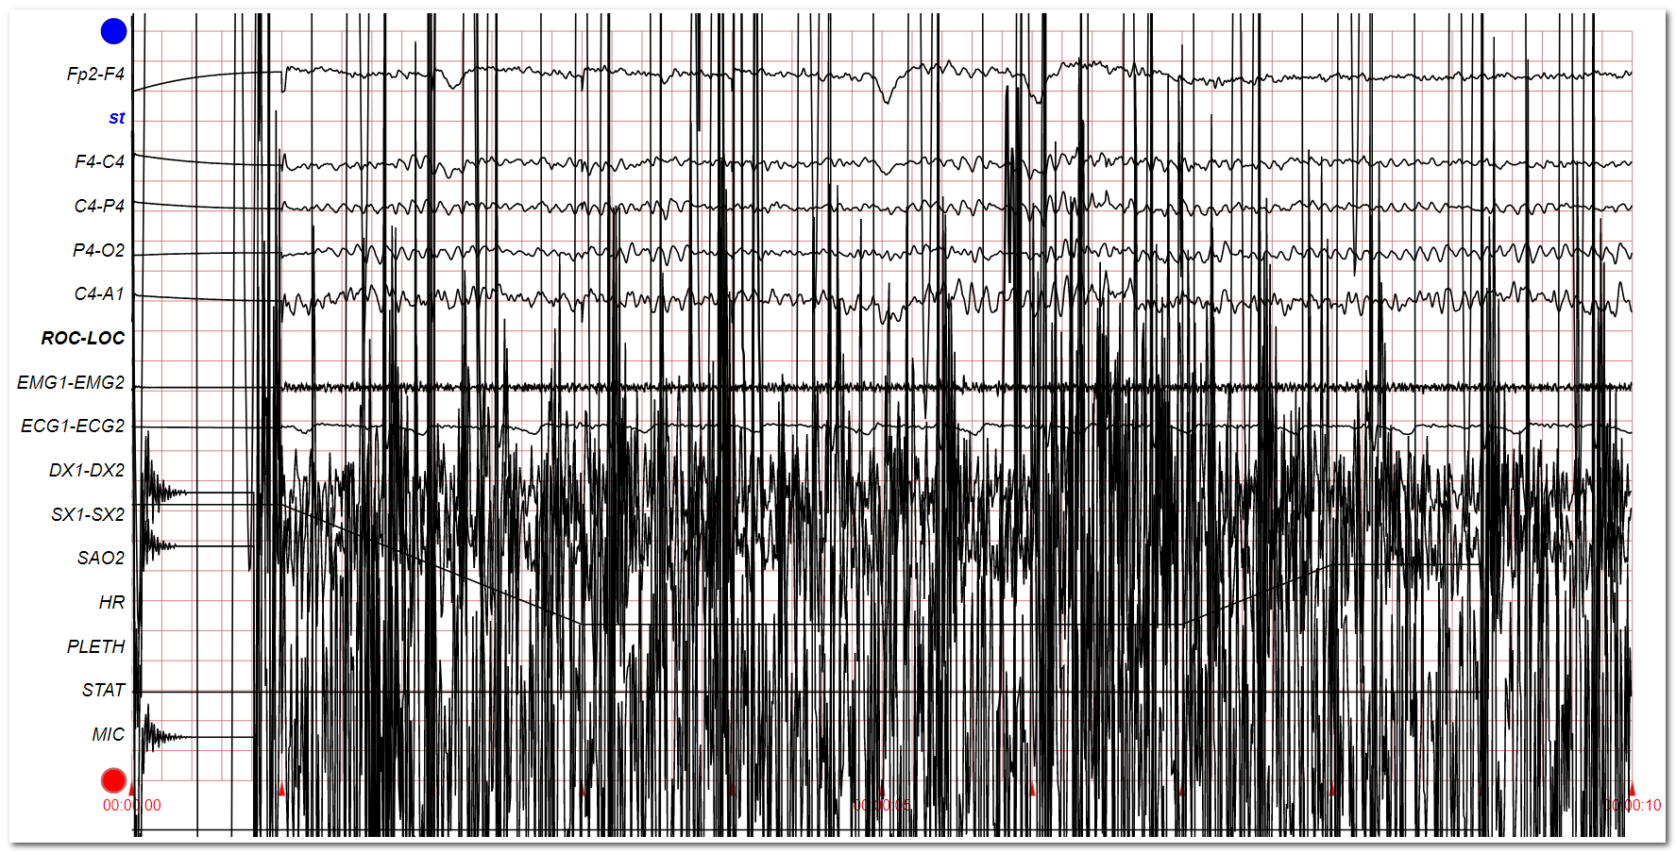
Original Data
17_JacobBaron_Chong

Slide 4
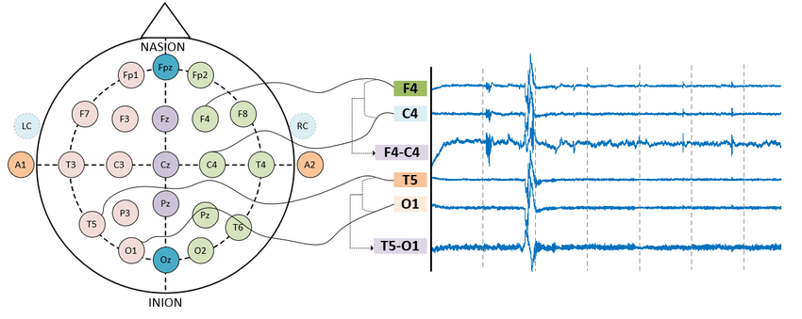
Key Mapping of Signals Channels
Reference: https://www.researchgate.net/figure/Graphical-representation-of-the-acquisition-of-T5-O1-and-F4-C4-EEG-signals-in-the-TCP_fig3_328875447
17_JacobBaron_Chong

Slide 5
Data Preprocess and Representation
Convert the chosen channel signals into useable values by extracting from .edf file.
Note: EDF = European Data Format commonly used for storage of medical data
512 ticks per second with recordings of approximately 9 hours
Labels were provided in a separate file -- one label every 30 seconds.
Wake
REM (Rapid Eye Movement)
nREM (Non-Rapid Eye Movement)
Challenges with the data
Nearly 17 million measurements per signal. Remember: 4 signals used per patient!
The timelines between signal data and label data were out of sync. Signal readings began before the labels were being assigned.
After normalization of the timelines, we ended with approximately 68 million data points across 4 signals for each patient.
End Total Data = approximately 340 million data points (~6GB of signal data)
17_JacobBaron_Chong
Notes:
Aim to drive home the struggles of figuring out how to use the data and the overall size of the data.

Slide 6
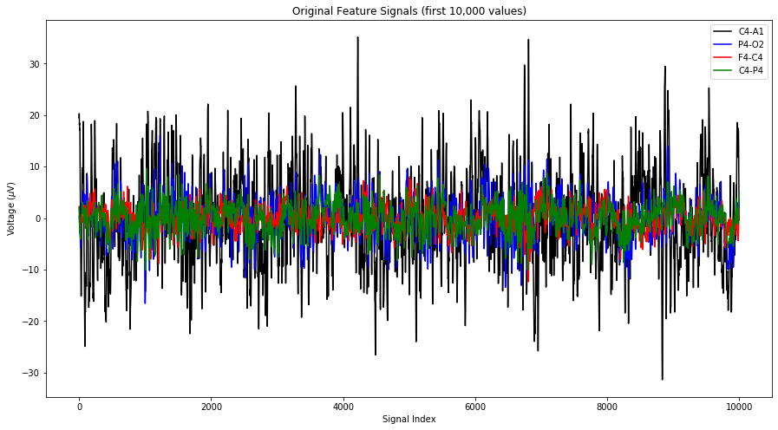
Waveforms Used
17_JacobBaron_Chong

Slide 7
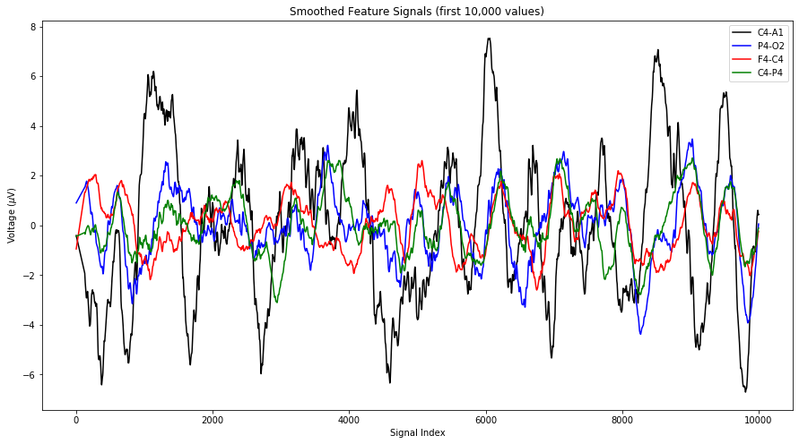
Applying a Savitzky–Golay Filter
17_JacobBaron_Chong

Slide 8
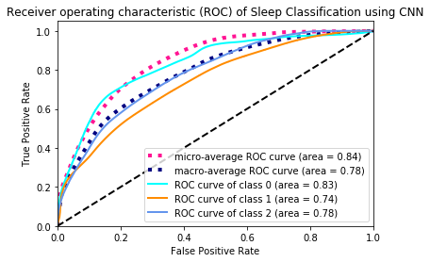
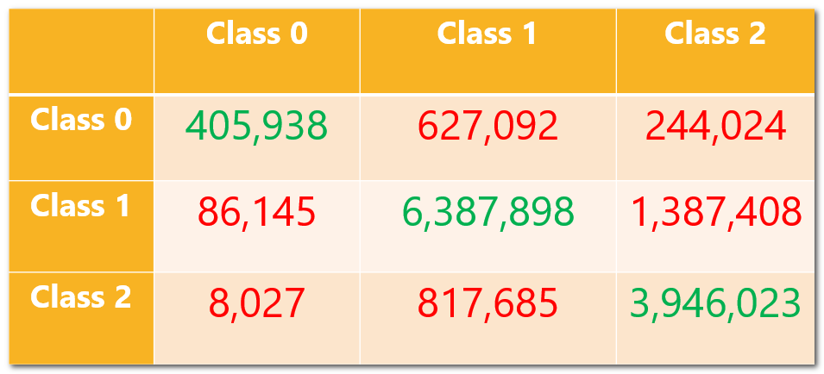
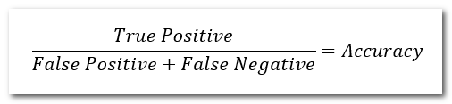
Results: Convolutional Neural Network (CNN)
Receiver Operating Curve (ROC)
Confusion Matrix
True Positives Total: 10,737,859
False Positives/Negatives Total: 3,170,381
Accuracy: ~77.21%
17_JacobBaron_Chong

Slide 9
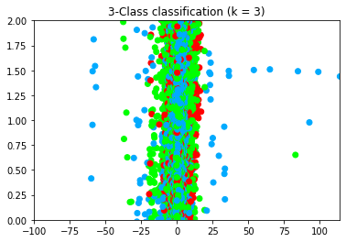
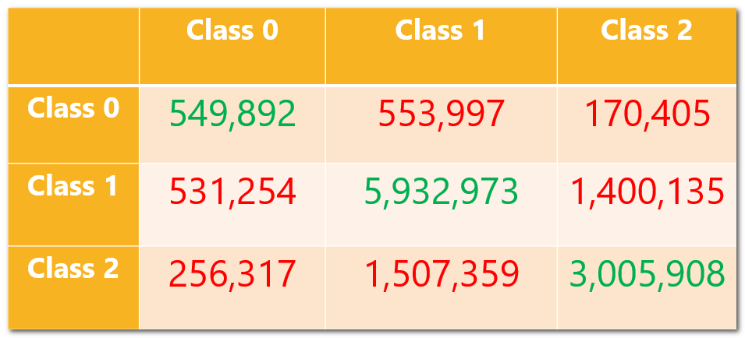
Results: K-Nearest Neighbor (KNN)
K-Nearest Neighbor (KNN)
Confusion Matrix
True Positives Total: 9,488,773
False Positives/Negatives Total: 4,419,467
Accuracy: ~68.24%
17_JacobBaron_Chong

