Slide 1
Midterm Product Evaluations
Kevin Baron
Info 498 A Autumn 2022 – Professor Megan Boddum
University of Washington

Slide 2
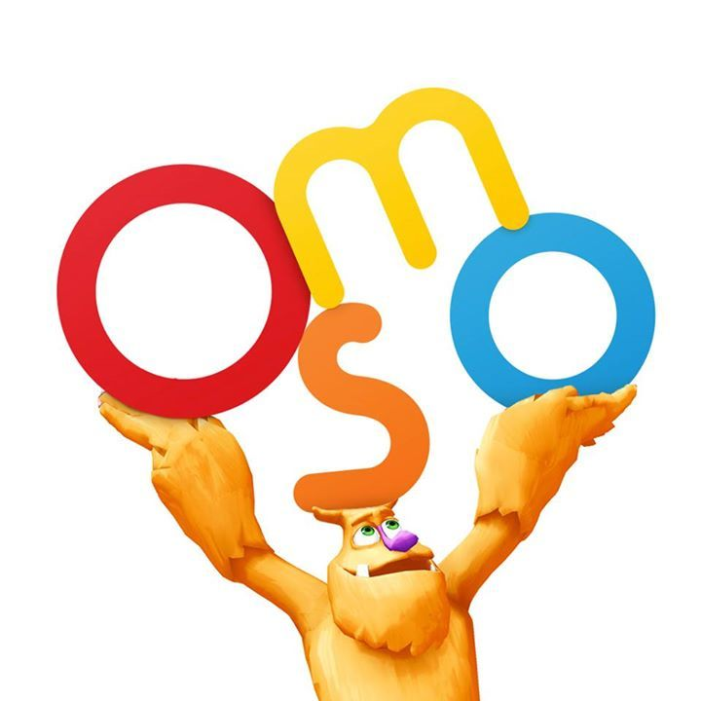
What are your initial impressions of the products?
This seems like a cool idea.
I would think that the success of the toy would be mostly determined by the execution and accuracy of the interactivity between the user and the app, in how well and quickly the drawing recognition processes user's drawings and how precisely the user has to put tangrams together to register as the correct shape pattern for example.

Slide 3
What stands out to you and why?
A couple of things stand out to me.
The first one is the simplicity of the hardware involved.
You just put the iPad on the stand and put the reflector on the camera and open the app and you're ready to go.
That is huge as a consumer product, especially one meant for children, and even more especially one meant for young children, as many of the Osmo packages are designed.
It potentially decreases the required parent involvement for set-up and clean-up.
The other thing that stands out is the characters and storylines that the main packages use consistently.
Mo is the main character for the drawing package and appears also, in a different digital form, in the coding package.

Slide 4
What children’s and or learning setting(s) do you see these products being applicable for?
This is totally applicable to a wide range of children's settings, from playdates with other kids at home to YouTuber A for Adley - Learning & Fun's use as a more interactive substitute activity for bedtime reading.
It could also be used in libraries and classrooms, and potentially in daycare, beforecare, and aftercare settings, although the cost may be prohibitive for the budgets of most of those extracurricular settings.

Slide 5
Do you think these products are a good investment? Why/why not?
I think Osmo is a great investment for the manufacturer, since as technology has mostly stalled as far as development of completely new or radically new ways of using it and interacting with it for the last decade, Augmented Reality is one avenue that has been slowly opening up during that stall.
It has high demand (I imagine, for quality products) and little competition.
That's a recipe for a banger!
For parents and families, how good of an investment Osmo is will depend on financial flexibility.
As the Smarter Learning Guide compiles the details for in its review, Osmo isn't cheap, which limits availability for less well-off families, but for families who can afford and would consider Osmo, it is a stand-out option compared to other products in the same learn/play space which have likely already been exhausted or nearly exhausted.

Slide 6
What are the learning objectives presented in these products?
There are many different learning objectives depending on the kit and app. Osmo's website lists all these subjects as check boxes and displays different add-on games and full kits accordingly:
- Coding
- Critical Thinking
- Drawing
- Geography
- Imaginative Play
- Literacy
- Math
- Puzzles
- Science
As mentioned in Chapter 11 of "Exploring Key Issues..." it is important for children to be able to personalize their education with their own interests, which is exactly what Osmo allows them to do naturally and seamlessly

Slide 7
What types of learning styles do these products lend well to?
One of the main features promoted by Osmo and its reviewers is that it has something for everyone.
It has music games for musical learners
Most of its apps involve touching physical objects in front of the iPad, which is great for bodily-kinesthetic learners
It has coding games and other math games for logical-mathematical learners
Many of the apps involve visuals in both the space on the screen and the interactivity space in front of the iPad
And it can be played alone or with friends and family, which is perfect for intrapersonal and interpersonal learning, respectively.

Slide 8
What are the relevant Periods of Development for each product?
The target audience seems to straddle early childhood (2-6) and middle childhood (6-12) at 4-8, while there are certainly applications for earlier in the early childhood period, possibly even toddlerhood.
Although it seems a bit too high-tech for most parents to want to mess with it with their toddler, as well as later in middle childhood.

Slide 9
What are the relevant Domains of Development for each product?
Physical to draw, dance, move letters, tangrams, and coding blocks around
Cognitive to understand how what you do in the physical space corresponds with the digital space, problem solving, story following
Social/Emotional to understand Mo's reactions, playing with others
Linguistic Development for listening, following instructions, reading

Slide 10
What are the relevant Development Theories for each product?
Cognitive Development Theory for Zone of Proximal Development as child learns how to use Osmo on their own, learns how to set up / clean up independently.
Cognitive Theory for changing intelligence over time and different apps to suit different levels over time.
Operant Behavior Theory for learning as responses to stimuli, both digital and physical.

Slide 11
If the theorists we covered played with these toys today, what do you think they would have to say?
Vygotsky: Hey, do you guys think you could help me set this device up? All I'm seeing on the screen are my own nose hairs. I'm still in the Zone of Proximal Development for technology.
Bronfenbrenner: It's ok, Lev, you're just outside of your normal learning environment, but I'm sure you thrive at a writing desk by light of an oil lamp.
Watson: Yes, you'll only become proficient by way of practice!
Skinner: No, it's the shame and embarrassment of seeing his own nose hairs that he will drive him to discover, associate, and remember the solution!
Piaget: I think I'll have to invent a new stage of development for this extraordinary case: Former Operational!
Bandura: You just have to flip the mirror upside down, like this. Here, Lev, now you try!

Slide 12
What would our guest lecturers have to say about these products?
Joey would notice how fun it is, and how different it is from other technologies. The tactile nature of physical objects could be crucial for the learning of some of her students.
Cathy would probably have a lot of fun playtesting different apps with kids and families and getting their responses.
Donna would be thrilled to see the evolution from Mr. Rogers's Neighborhood to this.

Slide 13
Class readings referenced
Exploring Key Issues in Early Childhood and Technology: Evolving Perspectives and Innovative Approaches: Chapters 11, 13, 14

Slide 14
Class lectures referenced
Class 4 (10/10/2022): Childhood Development Periods, Domains, and Theories
Class 8 (10/24/2022): Expanded Learning Styles

Slide 15
Guest lecturers referenced
> Joey Chapman
> Cathy Tran
> Donna Mitroff

Slide 16
Other sources
https://www.playosmo.com/en/
https://www.youtube.com/watch?v=uMMF2MK06Qw
https://www.youtube.com/watch?v=t9kO0nlI58E
https://www.youtube.com/watch?v=1JoIqEGuSlk
https://smarterlearningguide.com/osmo-review/

Slide 17

What are your initial impressions of the products?
This seems like a typical modern learn-to-read app at first.
It looks fun and colorful, which is important for the students, and the website has engagement options for parents and educators.
The multisensory aspect reminds me of Osmo, having researched that product first. I wonder which of these came first.

Slide 18
What stands out to you and why?
The parent/educator engagement options stand out to me because for a product like this, while the learning itself while in the app will be up to the student and the quality of the interface, getting the kid to open up this app over any of the other whizbang choices one app away, and keeping them on the app regularly to stimulate linguistic development is half the battle, at least.
Providing Parent and Teacher Portals makes tracking progress easy, too.
Having the two friends Square Panda and Cameo help the learner through all the different minigames and environments is helpful for the story / character familiarity.

Slide 19
What children’s and or learning setting(s) do you see these products being applicable for?
At home and in school, mostly in classroom settings.
Assuming this app would be selected as a core learn-to-read interface to develop reading and writing skills for kids, having it in regularly accessible places such as these is important, so the library and sporadically in beforecare and aftercare wouldn't be as appropriate.

Slide 20
Do you think these products are a good investment? Why/why not?
This product definitely seems like a good investment for preschool through second grade teachers or schools looking to provide teachers of those ages with tech tools to help all types of learners learn together and at their own pace simultaneously.
At free download for all Square Panda apps, it is a great investment for parents at home.
It does also have Home Edition at $99.95 and Classroom Edition at $169.00, which include the physical accessories and books.
This seems well worth it if it is chosen as the app to be committed to for a solid and fun foundation of lifelong literacy skills.
In a world, as referenced in Childhood 2.0, where there is so much overstimulation digitally, it is helpful for products like this to include tactile objects for learning, as well as books and sounding out, to be incorporated with digital learning.

Slide 21
What are the learning objectives presented in these products?
There are many subobjectives within the main umbrella objective of phonetic learning:
- drawing/writing letters
- sounding out individual letters
- blending multiple letters/sounds into words
- recognizing names of letters
-associating the names of letters with the sounds they make

Slide 22
What types of learning styles do these products lend well to?
Square Panda is advertised as being for learners of all types and styles.
Reading with others can be interpersonal, and can give feedback about real-world application for how blending is being heard by fellow students, and the app is set up for individual use as well.
It has letter blocks and books that are great for bodily-kinesthetic learners, and the app focuses on developing the auditory aspect for all learners, associating letters with sounds and being able to convert between the two and blend multiple phonemes.

Slide 23
What are the relevant Periods of Development for each product?
Ed Tech Impact's review lists Square Panda as being for ages 2-8, which covers the Early Childhood period and edges into the Middle Childhood Period.

Slide 24
What are the relevant Domains of Development for each product?
Physical by using letter blocks and opening books
Cognitive to understand how sounds relate to the shapes of letters and combinations of letters
Social/Emotional to practice reading with fellow students
Linguistic Development is most relevant because it is specifically for developing the association between reading, writing, speaking, and listening

Slide 25
What are the relevant Development Theories for each product?
Definitely Cognitive Development Theory. The whole app is a giant, multimodal, complex scaffolding architecture.
Square Panda also employs aspects of Social Learning Theory for learning how to sound out letters by hearing them spoken by a speaker on the screen.
Cognitive Theory is also relevant because the app has different levels of phonetic difficulty corresponding with different levels of ability of learners.

Slide 26
If the theorists we covered played with these toys today, what do you think they would have to say?
Piaget: Sacré bleu! What a wonderful app for learners of all different ages and abilities!
Bronfenbrenner: In varied ecological systems, from classrooms to bedrooms, as well!
Square Panda: YES!
Bandura: YES!
Watson: Once more, so that we condition the concept: YES!
Skinner: NO! Oh, wait, that's incorrect. I'll remember that next time. YES!
Vygotsky: Let's all sound it out: Sss-ccc-aaa-fff-oh-lll-ddd-eee-ngngng!

Slide 27
What would our guest lecturers have to say about these products?
This would be another fun app to playtest for Cathy.
Jen would probably be interested in purchasing the Classroom Edition for the kindergarten through second grade classes in her district.
Ingrid might be interested in the voices used for imitation and the location or environments visited by Square Panda and Cameo.
Lily might think about how to design a curriculum around this app, thinking about what other tools teachers might use in tandem with Square Panda, or perhaps could give recommendations about how certain concepts would be taught in a classroom traditionally to inform how to display the teaching in the app.

Slide 28
Class readings referenced
Childhood 2.0

Slide 29
Class lectures referenced
Class 4 (10/10/2022): Childhood Development Periods, Domains, and Theories

Slide 30
Guest lecturers referenced
> Cathy Tran
> Jen Sethasang
> Ingrid Simone
> Lily Jones

Slide 31
Other sources
https://squarepanda.com/
https://edtechimpact.com/products/square-panda
https://www.youtube.com/watch?v=RHm1j2FEhME
https://www.youtube.com/watch?v=LIjbl6WuId8
https://www.businesswire.com/news/home/20170807005273/en/Square-Panda%E2%84%A2-Drops-Price-of-Its-Learning-System-to-99.95#:~:text=The%20Square%20Panda%20Home%20Edition%20is%20sold%20at%20MSRP%20%2499.95,App%20Store%20or%20Google%20Play.

Slide 32
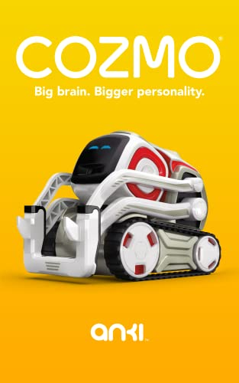
What are your initial impressions of the products?
Cozmo totally reminds me of a Lego NXT robotics set that my parents got me for Christmas one year.
I thought it was cool, but I never really got that into it, which I always felt somewhat guilty about.
This was the fear that Theresa mentioned parents had, that they would get something that their kids didn't actually want specifically.

Slide 33
What stands out to you and why?
The disparity between Cozmo's high-power software, especially for the time it was released, and his somewhat dinky hardware that seems easily breakable stands out to me.
So far, no reports about breakage have come from Megan, Theresa, or the other material viewed, but this is something to look into as far as customer reviews and complaints.

Slide 34
What children’s and or learning setting(s) do you see these products being applicable for?
Cozmo seems like it's meant for playing at home, but just like the NXT I mentioned, the classroom setting, especially a computer or robotics class, would be totally applicable for Cozmo.
As much as he can navigate obstacles, the park or soccer field seem like doomsday places for Cozmo.
The car is another place he isn't really suited for.
As much as he seems to have been designed for single Cozmo use, the play sessions Megan and Theresa have described gave a unique opportunity to multi-Cozmo.
Inter-Cozmic-activity is something that could have been explored more in later iterations.

Slide 35
Do you think these products are a good investment? Why/why not?
For kids, the investment of asking your parents for a cool robot toy friend is definitely worth it. You could learn some programming and just have a little robot scurrying around to show your friends when they come over.
For parents, the $150-$200 mark is more questionable. I feel like if the robot itself were just bigger, partially for the destructibility of it, but also just for the perceived "amount" of thing that it is, it would have been more worth it. Conversely, if it were smaller, it would be less worth it. Hard to say. Did your kid beg for it? Or are they begging for something else?
With those ideas about sizing in mind, yes the product does seem like it was a good investment for Anki, but with a few tweaks, could have been an even better one.

Slide 36
What are the learning objectives presented in these products?
It seems like the focus is more loosely on the programming side for kids, and is more about learning that technologies like facial recognition and obstacle awareness exist and are implementable, to spur the imagination of the child owner to think about these and related technologies, which the child could then apply directly into the coding of Cozmo.
As Fred Rogers mentions about children being special just the way they are, even without personalizing Cozmo, he is kind of a fun robot with his factory coding, with some games pre-installed. I imagine a large number of users never got around to programming him much.

Slide 37
What types of learning styles do these products lend well to?
Cozmo lends itself pretty well to all learning styles, making faces for visual learners, making corresponding noises for auditory learners, moving around and doing motion for kinesthetic learners, and having the capacity to have code read and written for reading/writing learners.
Although the lattermost learning type is probably the weakest for Cozmo, since the code blocking is almost a language of its own, as Marina Umaschi Bers points out in Chapter 10: Coding As Another Language of “Exploring Key Issues.”

Slide 38
What are the relevant Periods of Development for each product?
Early Childhood - 2 to 6
Middle Childhood - 6 to 12
And Old Adolescence - 12 to 19
Emphasis on Middle Childhood as kids are beginning to develop the cognitive capacity to experiment with Cozmo but aren't too old to think he's stupid or childish

Slide 39
What are the relevant Domains of Development for each product?
Physical to play with him, navigating physical world and ecological system
Cognitive to understand why he does what he does, and to code him themselves
Weak Social/Emotional to understand his "emotions" and when playing with others
Linguistic Development of processing, predicting, writing, and debugging code.

Slide 40
What are the relevant Development Theories for each product?
Cognitive Development Theory for Zone of Proximal Development when children require the scaffolding of learning how to code Cozmo before they are able to do it on their own.
Operant Conditioning Theory for the reward of Cozmo doing what you intended for him to do, negative stimulus of him being buggy. This is part of why I lost interest in my NXT.
It might also require aspects of the Social Learning Theory for a child to acquire coding ability.

Slide 41
If the theorists we covered played with these toys today, what do you think they would have to say?
Vygotsky: Wow! What an incredible robot! What an incredible computational device as well!
Bandura: You should see what they have after that! Watch and learn! [takes controller, races Cozmo around, bumping it into Skinner]
Skinner: [Angered, stomps on Cozmo] That's right! Learn by punishment not to run into a real psychologist, you Mountie scum!
Bronfenbrenner: Everybody calm down, now. Let's consider the ecological system we're in, and try not make it one that negatively affects us with emotional conflict.
Piaget: Right you are, Urie! You two are acting like a bunch of sensorimotor-year-olds!
Watson: Exactly! Think of how that will affect poor young Cozmo, assuming he recovers from the stomping. Next thing you know, he'll be smashing anything he runs into, since he does learn behaviors from his environment!

Slide 42
What would our guest lecturers have to say about these products?
Compared to the big learning boards that Jen bought for her district, Cozmo might not be that expensive, so she might consider buying multiple for different technology classes.
Amanda would probably appreciate the usability of the Scratch-like coding interface.
In the way that Theresa mentioned that a lot of Cozmo's humor was universal across languages and cultures, Joey would probably also appreciate how his mannerisms can be understood by some types of disabilities, even if not all

Slide 43
Class readings referenced
Exploring Key Issues in Early Chilhood and Technology: Evolving Perspectives and Innovative Approaches: Chapter 10: Coding As Another Language…
Fred Rogers Documentary

Slide 44
Class lectures referenced
First lecture, when Megan described boys ramming Cozmo's into one another (re-referenced when Theresa gave her guest lecture)
Class 4 (10/10/2022): Childhood Development Periods, Domains, and Theories

Slide 45
Guest lecturers referenced
> Theresa Manteiga
> Jen Sethasang
> Amanda Richardson
> Joey Chapman

Slide 46
Other sources
https://www.digitaldreamlabs.com/pages/cozmo

