Slide 1

CSE555 – Deep Learning (Spring 2018) Yrd.Doç.Dr.Yakup GENÇ Prof. Dr. Yusuf Sinan AKGÜL
Harlinton Palacios Mosquera

Slide 2
Facial Expression Recognition via Deep Learning-2017
Abir Fathallah
ENISO, Sousse university
Sousse, Tunisia
Email: abir.fathallah1803@gmail.com
Lotfi Abdi
ENISO, Sousse university
Sousse, Tunisia
Email: lotfiabdi@hotmail.com
Ali Douik
ENISO, Sousse university
Sousse, Tunisia
Email: ali.douik@enim.rnu.tn

Slide 3
1. Introduction
2. Related Work
3. PROPOSED APPROACH
4. Experimental Results
5. CONCLUSION

Slide 4

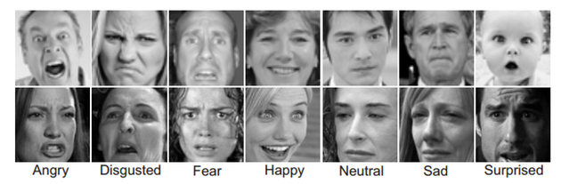
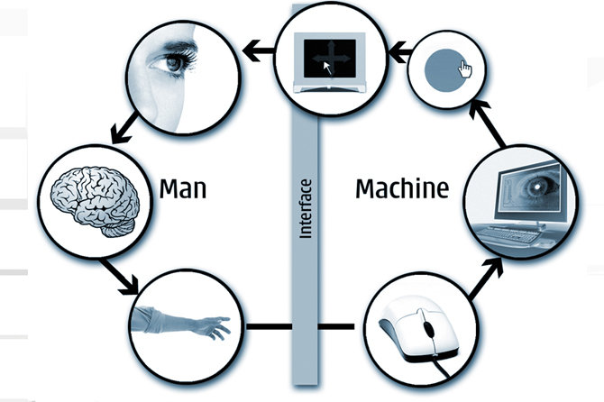
1. Introduction
The goal is to determine from a face the internal emotional state of a person. An automatic facial expression recognition system is an important component in human machine interaction.
Motivated by this, They present in this paper an effective approach system based on ConvNets for facial expression recognition. They proposed a new architecture which the input of the system is an image; then, they use CNN to predict the facial expression label which should be one these labels : anger, happiness, sadness, disgust, surprise and neutral.
Notes:
-The face is the most expressive and communicative part of a human being
-Facial expression is a visible manifestation of a face from the state of mind (emotion.
-Deep learning methods have been successfully applied to extract features and classification, in particular Convolutional
Neural Networks (CNN) architectures which are biologically inspired multi-step

Slide 5
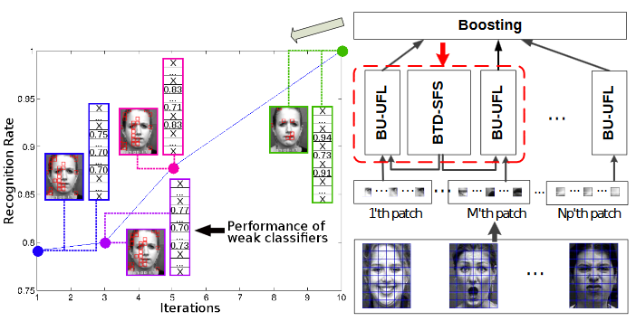
2. Related Work
- Data mining-based facial expressions recognition system : proposed a method which is able to monitor the intensity variation of facial expression and to reduce the classification confusion between facial expressions classes.
Vector Field Convolution (VFC)
-Facial expression recognition via a boosted deep belief network,
- Boosted Deep Belief Network (BDBN)
Notes:
The approach uses Vector Field Convolution (VFC) method to segment facial feature contours
-The BDBN framework consists of two interconnected learning processes
(BU-UFL) process that learns feature representations given input data
(BTD-SFS) process that refines the features jointly in a supervised way

Slide 6
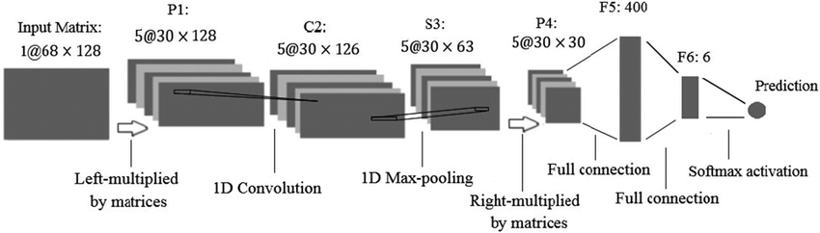
-A deep neural network-driven feature learning method for multi-view facial expression recognition.
Proposed a novel deep neural network: DNN-driven

Slide 7
PROPOSED APPROACH
Notes:
Their purpose is to improve the accuracy of facial expression classification by using a new CNN architecture.
As deep networks need a big database for the training, they combine many databases to get a final one.

Slide 8
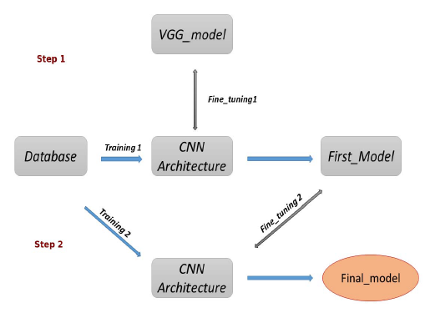
DNN model
Notes:
First step--After preparing the database they fixed the batch size input of CNN architecture to 165 × 165 then they trained the architecture with fine tuning by (VGG) model to generate the first model.
In second step to improve the classification we repeat the training of our CNN architecture and finally we get their final model

Slide 9
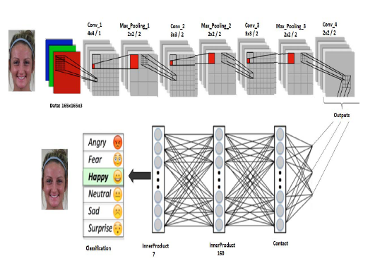
Architecture of the convolutional neural network
Notes:
This ConvNet contain four convolutional layers (with three max-pooling layers) to extract features hierarchically, followed by the fully-connected layer and the softmax output layer indicating 6 expression classes. The input of the network is 165×165 × k(ONE HUNDRED SIXTY FIVE) for all patches, where k = 3 for color patches and k = 1 for gray patches. The output is one of the 6 expression classes.

Slide 10
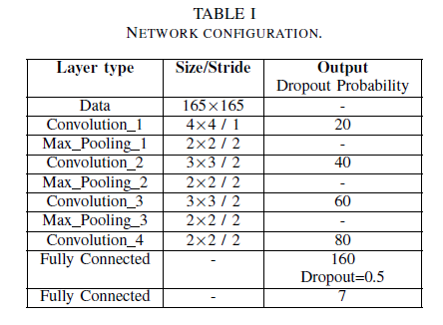
Notes:
Dropout : Reducing overfitting

Slide 11
EXPERIMENTAL RESULTS

Slide 12
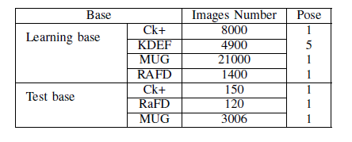
Databases
Notes:
To train their CNN architecture, they used many databases.
The CK+ database presented by 327(three hundred twenty seven) expression sequences
They use also KDEF database is a set of totally 4900(FOUR THOUSAND NINE HUNDRED) pictures of human facial expressions of emotion. This database proposed 7 facial expressions in different positions
MUG database consists of image sequences of 86(EIGHTY-SIX) persons doing facial expressions.
Database (RaFD) is a set of pictures of 67(SIXTY SEVEN) models including hildren, boys and girls, and displaying 8 emotional expressions.

Slide 13
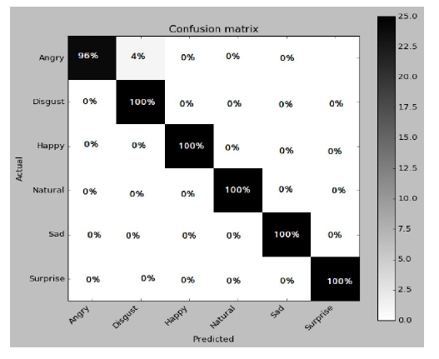
Performances of the proposed method
Confusion matrix of proposed method on CK+ database
Notes:
To verify the effectiveness of they proposed approach, they opted for a validation on standard databases MUG, Rafd and CK+.
The confusion matrix on CK+ database. We can observe that our proposed method achieves the best perfermance on only 5 database classes (Disgust, Happy,Neutral, Sad and Surprise) with recognition rate 100%.
99.33% as recognition rate

Slide 14
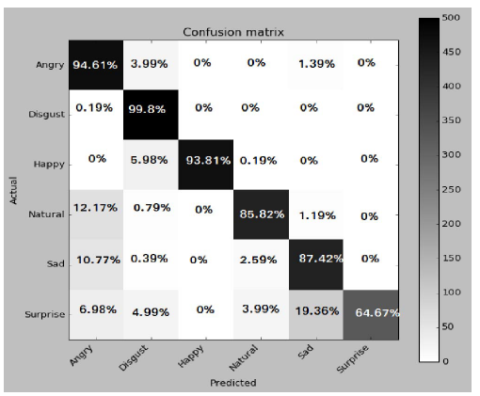
Confusion matrix of proposed method on MUG database
Notes:
This one shows the confusion matrix on MUG database we achieved only 87.65% as recognition rate, the differences between different emotions among the subjects is very subtle. Also, MUG images are in grey-scale format, whereas their model work is optimized for RGB images
87.65% as recognition rate

Slide 15
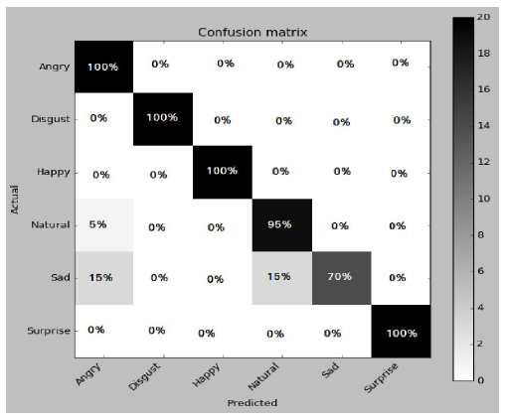
Confusion matrix of proposed method on RaFD database
Notes:
In this database we observe some incorrect classification for Sad and Neutral emotions and specially the Sad expression due to the unclarity features in this class.
accuracy rate of 93.33%

Slide 16
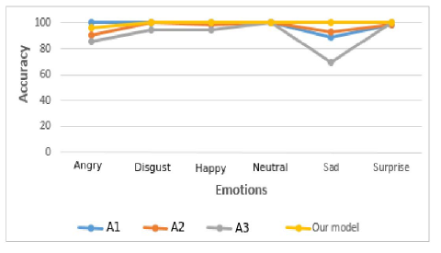
Method comparison
Notes:
To get accuracy close to 99% in training step, it took about 4 days to finish the training (300000 iterations)
They used CAFFE on ubuntu 14.04 LTS
GeForce GT 525M GPU, Which has 2GB of memory
They tried an architecture with 3, 5 and 6 hidden layers but their chosen architecture present the best accuracy of features extraction and emotions classification.
Their Deep learning method achieves the best performance on CK+ database:
performance of 96.93% accuracy on Ck+

Slide 17
CONCLUSION AND DISCUSSION
Notes:
They proposed a new deep neural network architecture for facial expression recognition. The proposed network consists of Four convolutional layers. The first three layers are followed by max pooling the last one is followed by fully connected layer.
It takes facial images as the input and classifies them into either of the six facial expressions
Results and recognition rates prove that their method had a better classification performance than the others.
Para este proyecto, entrenamos el modelo con imágenes que el la cara estaba en una posición. En el trabajo futuro, nos gustaría extender nuestro modelo a diferentes posiciones de la cara. Esto permitirá nosotros para investigar la eficacia de los modelos pre-entrenados, tales como VGGNet para reconocimiento de emociones faciales

Slide 18
Thank you very much

