Slide 1

Inside-Outside Net: Detecting Objects in Context with Skip Pooling and Recurrent Neural Networks
C. Lawrence Zitnick
Cornell University
Email: sbell,kb@cs.cornell.edu
Kavita Bala
Microsoft Research
Email: {rbg,zitnick}@fb.com

Slide 2
1. Introduction
2. Related work
3. Architecture: Inside-Outside Net (ION)
4. Results
5. CONCLUSION

Slide 3

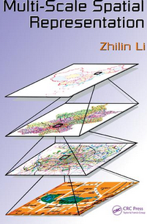
1. Introduction
Reliably detecting an object requires a variety of information, including the object’s fine-grained details and the context surrounding it. Common state-of-the-art detection approaches only use information near an object’s region of interest. This places constraints on accuracy of objects that may be detected.
To include two additional sources of information:
The first uses a multiscale representation: that captures fine-grained details by pooling from multiple lower-level convolutional layers in a ConvNet.
The second addition is the use of contextual information.
Notes:
In this paper they present the Inside-Outside Net (ION), an
object detector that exploits information both inside and
outside the region of interest.
Contextual information outside the region of interest using recurrent neural networks.
Inside, they use skip pooling to extract information at multiple scales and levels of abstraction.
And then they comparted their method with and other method which they used the some data bases.

Slide 4
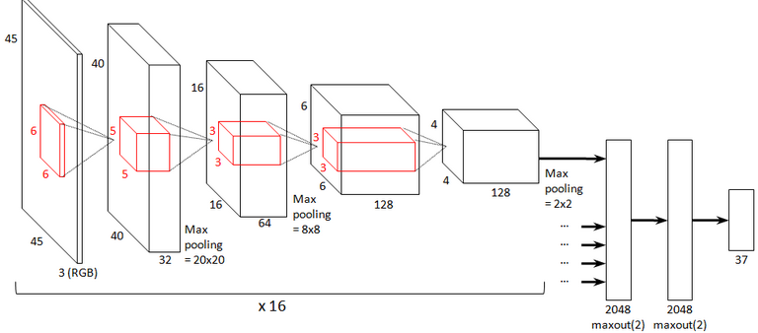
Related work
ConvNet object detectors:
ConvNets with a small number of hidden layers have been used for object detection for the last two decades(e.g. Original approach for the localization of objects in images. 1994)

Slide 5
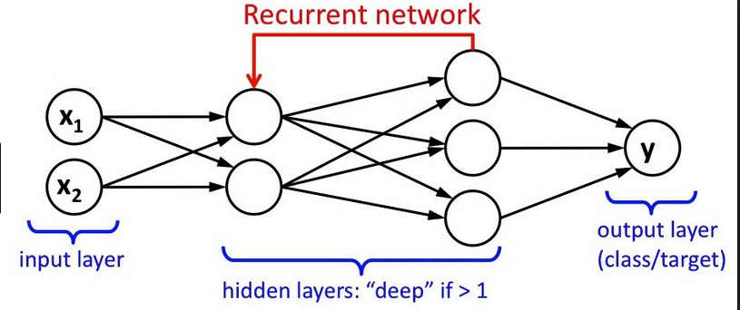
Related work(2)
Recurrent Neural Networks (RNNs):
Exist in various extended forms, including bidirectional and full multi-dimensional variants, such as those introduced by A. Graves and J. Schmidhuber 2009. for handwriting recognition.

Slide 6
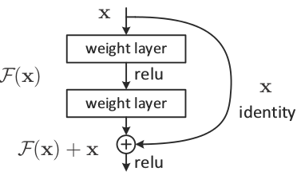
Skip-layer connections: Skip connections have been popular in recent models for semantic segmentation, such as the “fully convolutional networks” in the article " Fully convolutional networks for semantic segmentation" by E. Shelhamer.
Notes:
Skip connectoin is a direct connection between 2 non-consecutive layers.

Slide 7
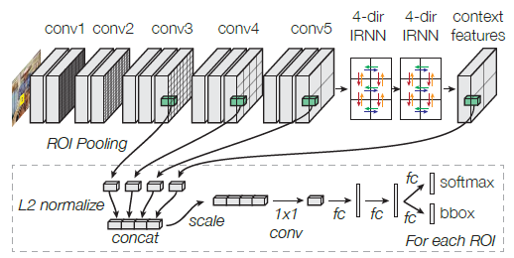
Architecture: Inside-Outside Net (ION)
Notes:
They extract this Architecture for VGG16
ROI pooling is used to extract a fixed-size descriptor from several layers
Each descriptor is L2-normalized, concatenated, scaled, and dimension-reduced (1x1 convolution) to generate a fixed-length feature descriptor.
Also has Two fully-connected (fc) layers process each descriptor
and produce two outputs: a one-of-K class prediction (“softmax”), and an adjustment to the bounding box (“bbox”).

Slide 8
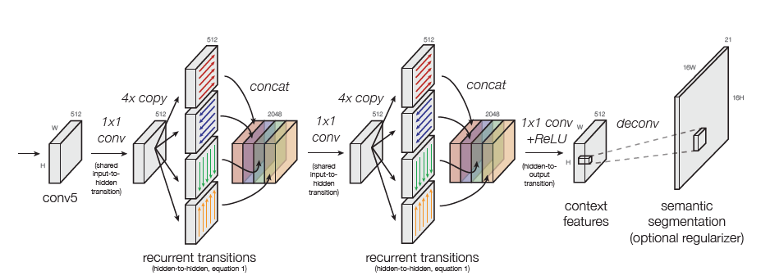
Four-directional IRNN architecture.
Notes:
They use “IRNN” which are RNNs with ReLU recurrent transitions, initialized to the identity.
ReLU: The most popular activation function for deep neural networks
They have four RNNs in total that move in the cardinal directions: right, left, down, up.
The RNNs produce an output with the same shape as conv5
All transitions to/from the hidden state are computed with 1x1 convolutions.
When computing the context features, the spatial resolution remains the same.
And semantic segmentation regularizer has a 16(sixteen)x higher resolution.

Slide 9
Result
They train and evaluate their dataset on three major datasets: PASCAL VOC2007 , VOC2012, and on MS COCO . They demonstrate state-of-the-art results on all three datasets.

Slide 10
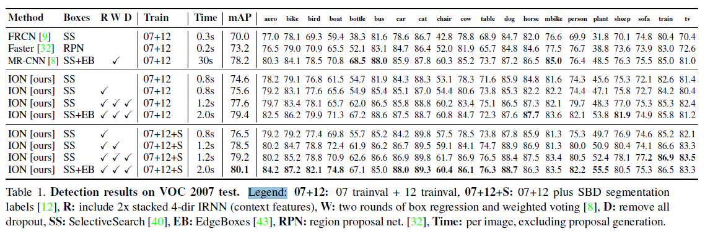
PASCAL VOC2007
Notes:
Applying our method described above, we obtain a mAP of 76.5%. We then make some simple modifications, as described below, to achieve a higher score of 79.2%.
MAP = Mean Average Precision
R= Include 2(4D- IRNN)
W: two rounds of box regression and weighted voting
D: remove all dropout
Dropout is a regularization technique for reducing overfitting

Slide 11
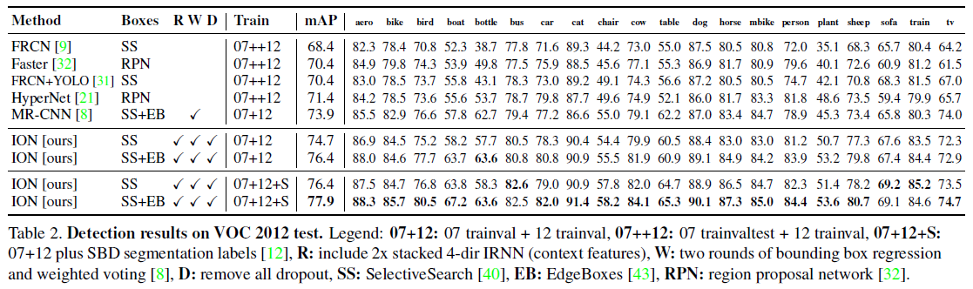
Detection results on VOC 2012 test
Notes:
Our detector obtains a mAP of 76.4%, which is several points higher than the next best
submission, and is the most accurate for most categories.

Slide 12
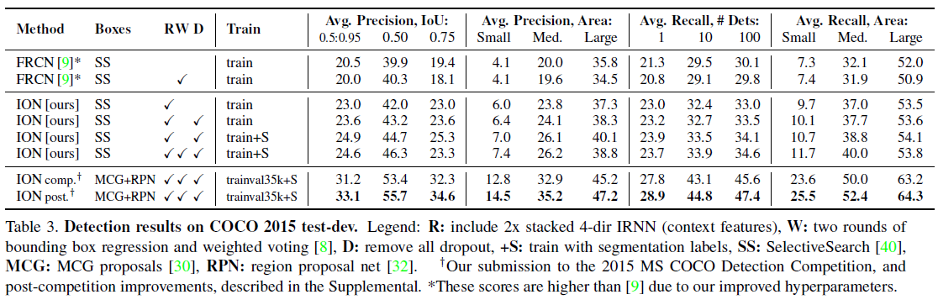
Detection results on COCO 2015 test
Notes:
COCO is a large-scale object detection, segmentation, and captioning dataset. COCO has several features:
Object segmentation
Recognition in context
Superpixel stuff segmentation
330K images (>200K labeled)
1.5 million object instances
80 object categories
91 stuff categories
5 captions per image
250,000 people with keypoints

Slide 13
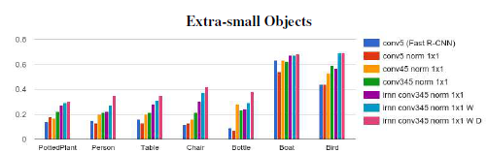
Notes:
R= Include 2(4D- IRNN)
W: two rounds of box regression and weighted voting
D: remove all dropout

Slide 14
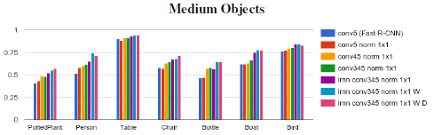

Slide 15
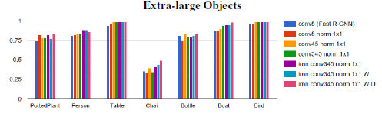

Slide 16
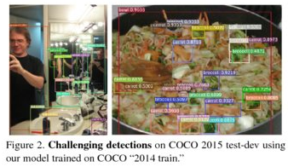
Improvement for small objects
They find that they are most significant for object types that have been historically difficult. For example.
They show improved accuracy for potted plants which are often small and amongst clutter. In general, They find that their approach is more adept at detecting small objects than previous state-of-the-art methods. For heavily occluded objects like chairs, gains are found when using contextual information.

Slide 17
Thank you very much

