Slide 1

CSE555 – Deep Learning (Spring 2018) Dr.Yakup GENÇ Prof. Dr. Yusuf Sinan AKGÜL
Harlinton Palacios Mosquera

Slide 2
Facial Expression Recognition

Slide 3
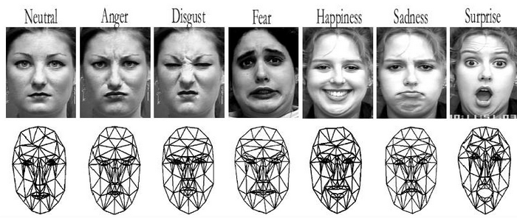

Slide 4
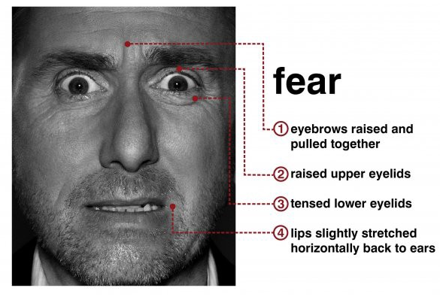
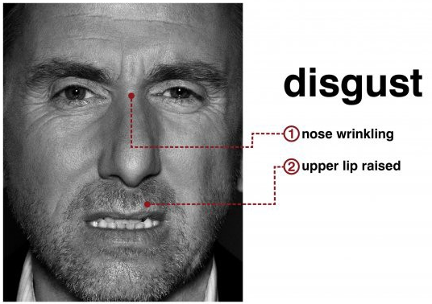
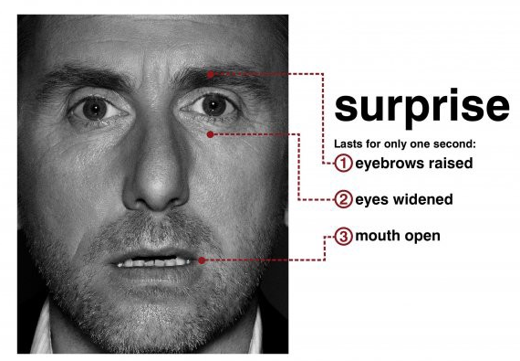

Slide 5
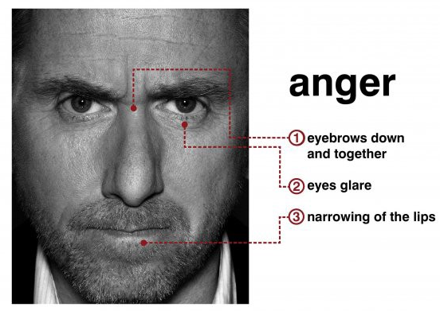
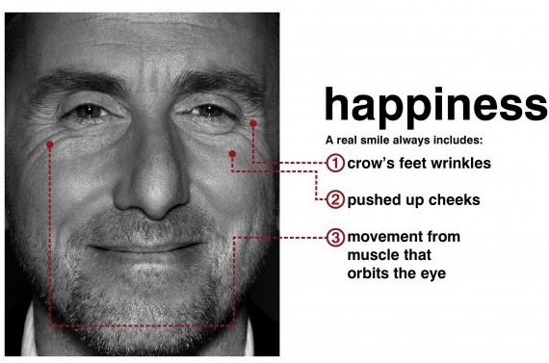
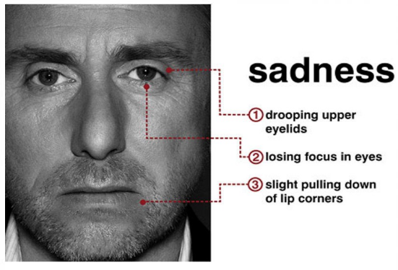

Slide 6
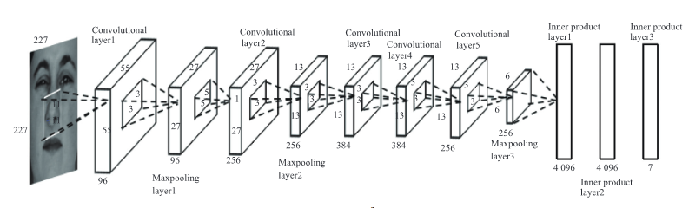
Architecture of the convolutional neural network

Slide 7
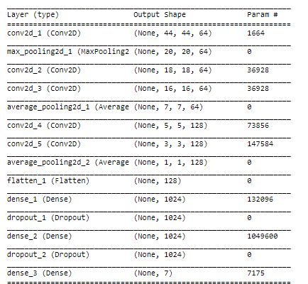
Summary of CNN
Notes:
Dropout : Reducing overfitting

Slide 8
EXPERIMENTAL RESULTS

Slide 9
Databases
The both training and evaluation operations would be handled with Fec2013 dataset.
There are 28K training and 3K testing images in the dataset.
Each image was stored as 48×48 pixel. The dataset consists of image pixels (48×48=2304 values), emotion of each image.
Notes:
Fes2013 two Thousand thirteen(2013)
Twenty-Eght Thousand Traning (28K)
Three Thousand testing (3K)
Forty-eight(48)

Slide 10
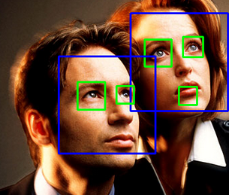
Haarcascade Detection in OpenCV

Slide 11
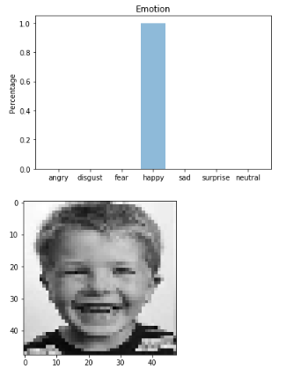
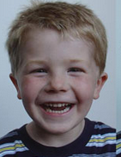

Slide 12
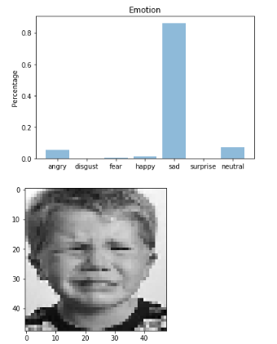


Slide 13
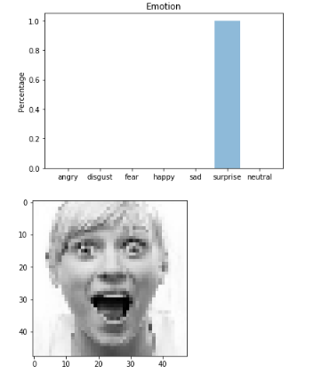


Slide 14
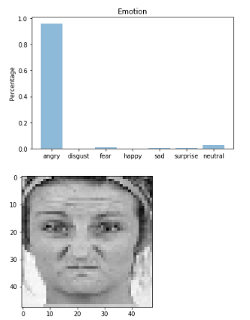
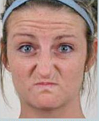

Slide 15
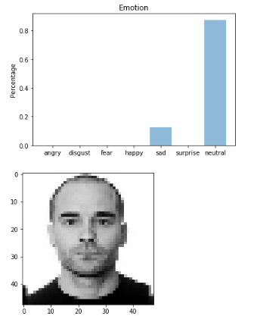


Slide 16
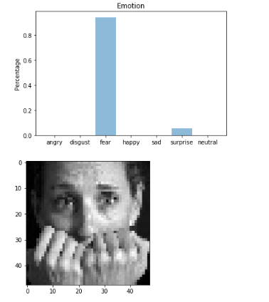
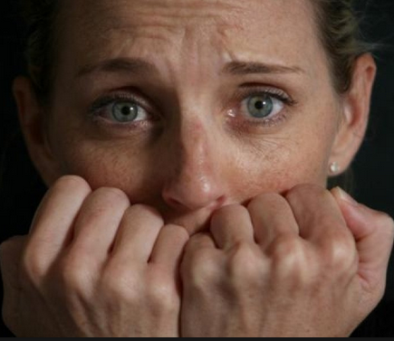

Slide 18
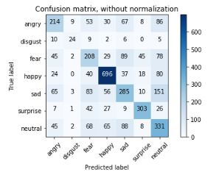
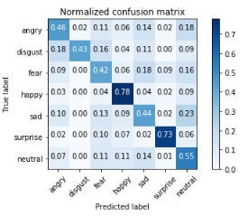
Confusion matrix

Slide 19
Accuracy(Train and Test)
Test loss: 2.2794570537223295
Test accuracy: 57.42546670713874

Slide 20
Thank you very much

