Slide 1

CSE452/552 - Machine Learning Dr.Yakup GENÇ
Harlinton Palacios Mosquera

Slide 2
Recommendation Systems on Movie Rating based on method SVD
Notes:
SVD = Singular Value Decomposition

Slide 3
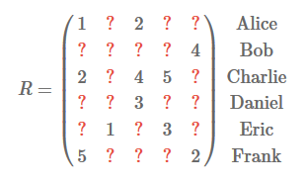
Problem and Approach
Notes:
The problem here is that of rating prediction. The data we have is a rating history:
Ratings of users for items in the interval [1,5].
Each row of the matrix corresponds to a given user
Each column corresponds to a given item.
Alice has rated the first item with a rating of 1, and Charlie has rated the third item with a rating of 4.
The matrix R is sparse (more than 99% of the entries are missing)
Our goal is to predict the missing entries.
There are many different techniques for rating prediction

Slide 4
Recommender Systems
Ratings = m x n sparse binary matrix
n columns = “products”, e.g., books for purchase or movies for viewing
m rows = users
Interpretation:
Implicit Ratings: v(i,j) = user i’s rating of product j (e.g. on a scale of 1 to 5)
Explicit Purchases: v(i,j) = 1 if user i purchased product j
entry = 0 if no purchase or rating
Automated recommender systems
Given ratings by a user on a subset of items, recommend other items that the user may be interested in
Notes:
Recommender systems are used on the Web for recommending products and services to users.
Most e-commerce sites have such systems.
These systems serve two important functions.
They help users deal with the information overload by giving them recommendations of products, etc.
They help businesses make more profits, i.e., selling more products.
ollaborative filtering, tried to find the user tastes by comparing with other similar users.
Después puedes dar Ejemplos de Paginas de recomendaciones de música, libros, películas Etc : Netflix, Spotify , Amazon

Slide 5
Recommendation Graph
Users
Items
User-User
Links
Item-Item Links
Observed preferences
Notes:
User-User Links: Links derived from similar attributes, explicit connections
Observed preferences : Ratings
Item-Item Links: Links derived from similar attributes, similar content, explicit cross references

Slide 6
Different types of recommender algorithms
Nearest-neighbor/collaborative filtering algorithms
Widely used – simple and intuitive
Matrix factorization (e.g., SVD)
Has gained popularity recent due to Netflix competition
Less used
Neural networks
Cluster-based algorithms
Probabilistic models

Slide 7
Why reduce dimensions?
Notes:
In this data matrix the dimension is essentially 3
There are three types of products and three types of users
The reduce dimensions mean is brings out the useful part of the data
If you have this data matrix you should reduction dimensió

Slide 8
Why reduce dimensions?
Real data usually have thousand's, or millions of dimensions.
For example: MovieLens DataSet:
- 1 million ratings
- 4 000 movies
- 6 000 User
We can discover hidden correlations / features in the raw data.
We can remove redundant and noisy features that are not useful.
We can interpret and visualize the data easier.
We can also access easier data storage and processing.
Notes:
I can discover hidden correlations / features in the raw data.
I can remove redundant and noisy features that are not useful.
I can interpret and visualize the data easier.
I can also access easier data storage and processing.
With that goal in mind, I'll introduce Singular Vector Decomposition (SVD) to you,
SVD a powerful dimensionality reduction technique

Slide 9
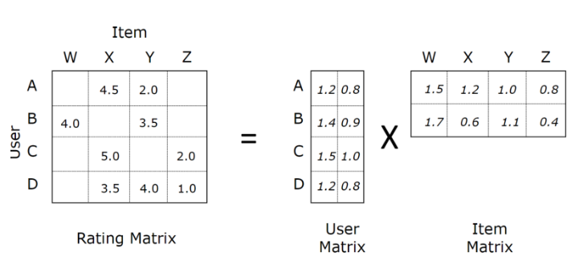
Matrix Factorization
Notes:
Low rank approximation to original matrix.
Basic Idea: Find two (or more) matrices whose product best approximate the original matrix
Generalization of many methods (e.g., SVD, QR, CUR, Truncated SVD, etc.)

Slide 10
Singular Value Decomposition (SVD)
The left singular vectors are an orthonormal basis for the row space of A.
The right singular vectors are an orthonormal basis for the column space of A.
If A has rank r, then A can be written as the sum of r rank-1 matrices
There are r “linear components” (trends) in A.
Linear trend: the tendency of the row vectors of A to align with vector v
Strength of the i-th linear trend: ||𝐴𝒗_𝒊 || =𝝈_𝒊
Notes:
The ratings matrix (X) is decomposed in three matrices: U , S and transposed matrix $V^{T}$

Slide 11
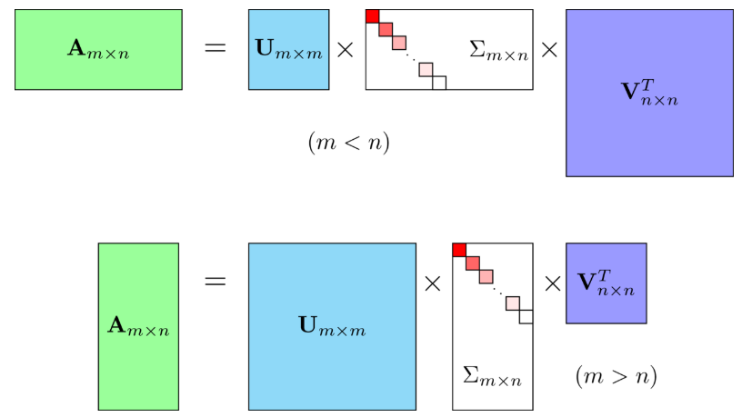
Singular Value Decomposition (SVD)2
Notes:
Where $A$ is the input data matrix (users's ratings),
$U$ is the left singular vectors (user "features" matrix),
$\sum{. }$ is the diagonal matrix of singular values (essentially weights/strengths of each concept),
$V^{T}$ is the right singluar vectors (movie "features" matrix).
$U$ and $V^{T}$ are column orthonomal, and represent different things.
$U$ represents how much users "like" each feature
$V^{T}$ represents how relevant each feature is to each movie.
To get the lower rank approximation, I take these matrices and keep only the top k features, which can be thought of as the underlying tastes and preferences vectors.

Slide 12
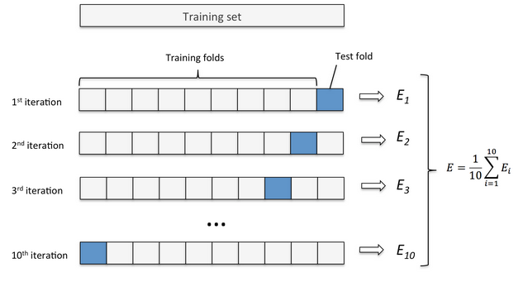
Model Evaluation
Notes:
Cross-validation is a technique to evaluate predictive models
by partitioning the original into a training set to train the model, and a test set to evaluate it.

Slide 13

Model Evaluation
RMSE or Root Mean Squared Error is a widely used method to evaluate the effectiveness of a model.

Slide 14
Results

Slide 15
The MovieLens Dataset
The dataset is MovieLens, one of the most common datasets that is available on the internet for building a Recommender System.
- 1 million ratings
- 4 000 movies
- 6 000 User

Slide 16
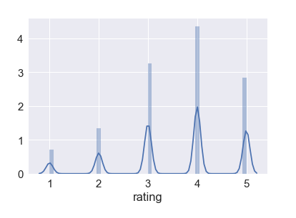
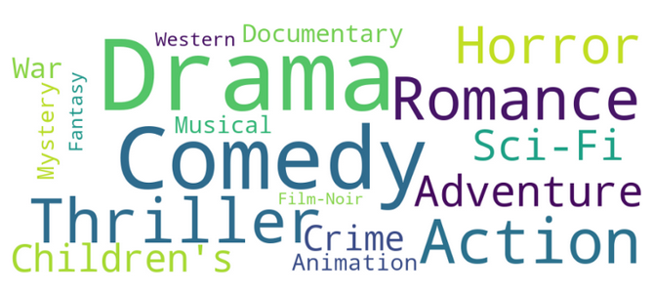
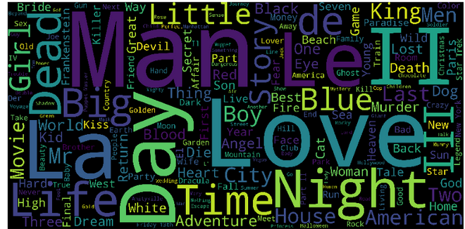
User ratings
Movie genres:
Movie Titles:

Slide 17
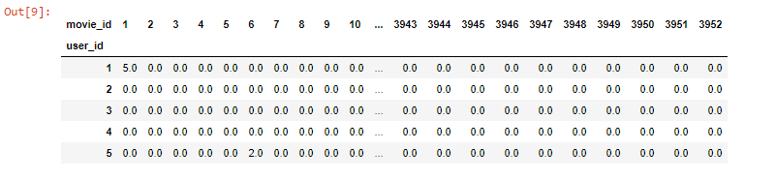
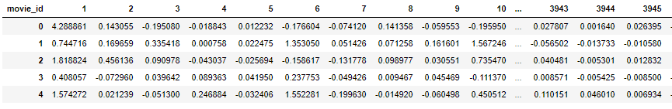
Ratings Matrix
Predictions matrix for every user

Slide 18
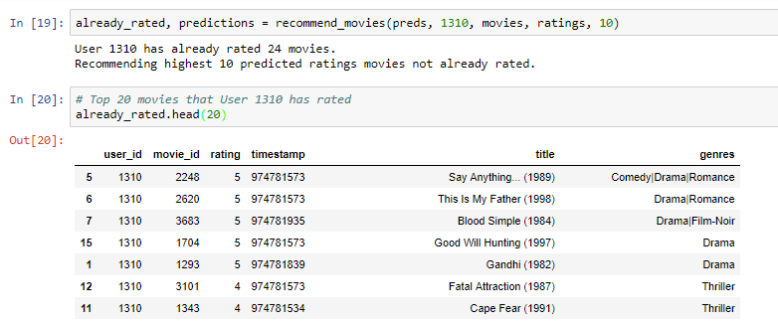
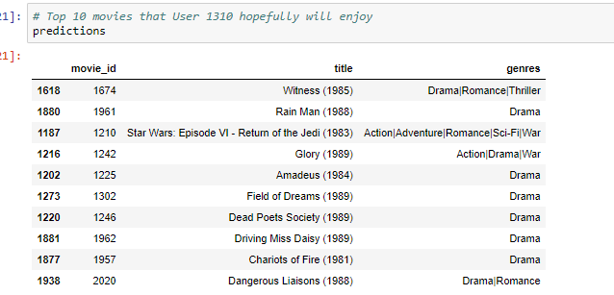
Function to Return the Movies
Predictions

Slide 19
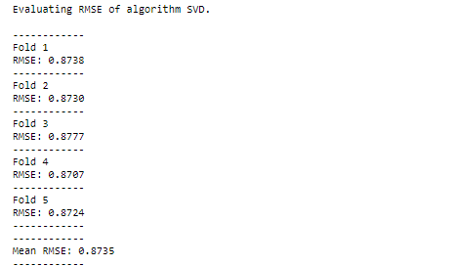
Evaluating RMSE of algorithm SVD

Slide 20
Thank you very much

