Slide 1
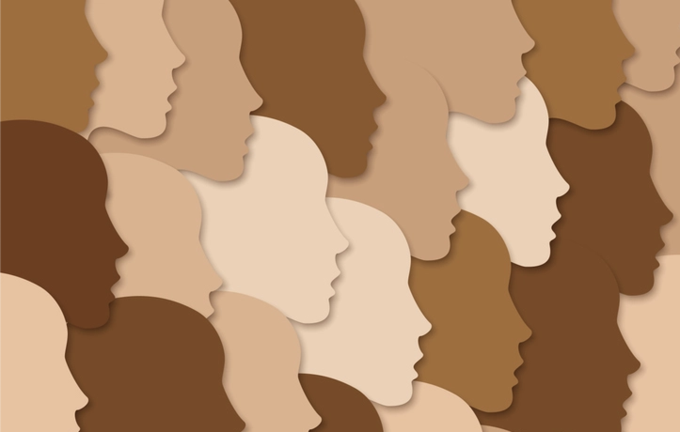
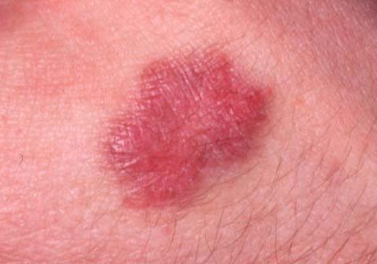

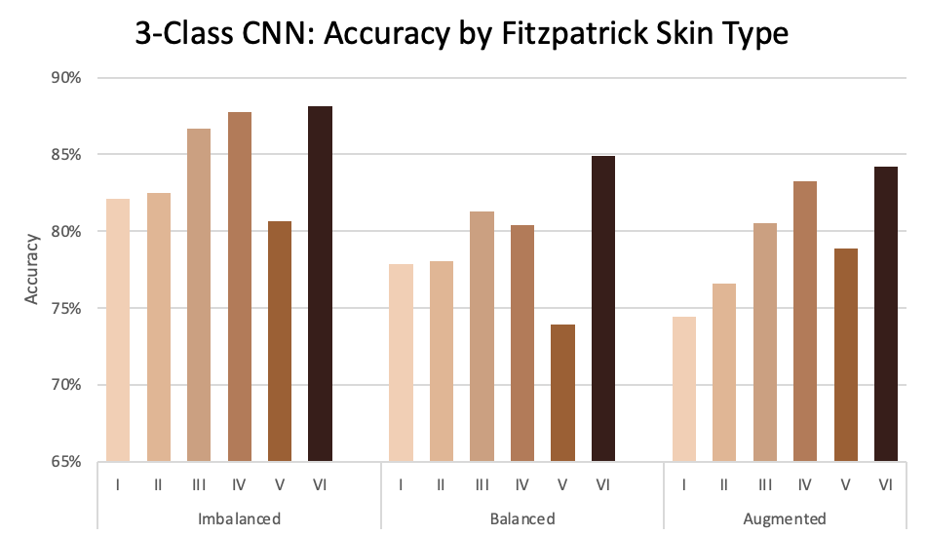
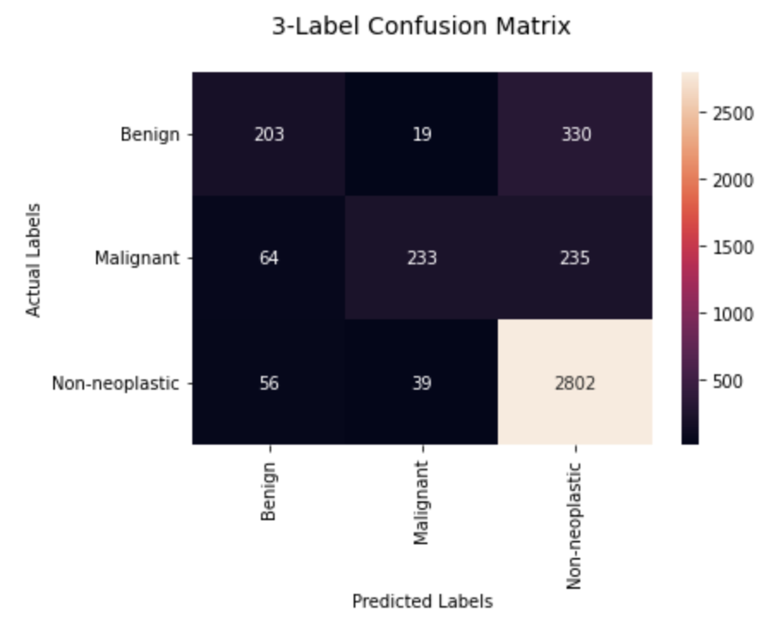
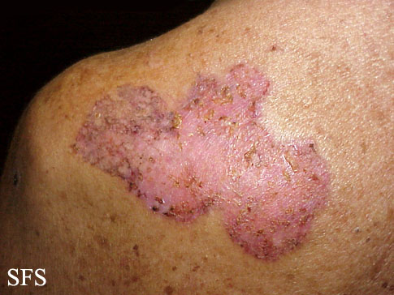
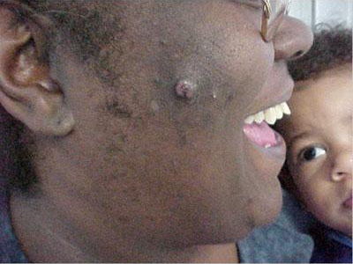
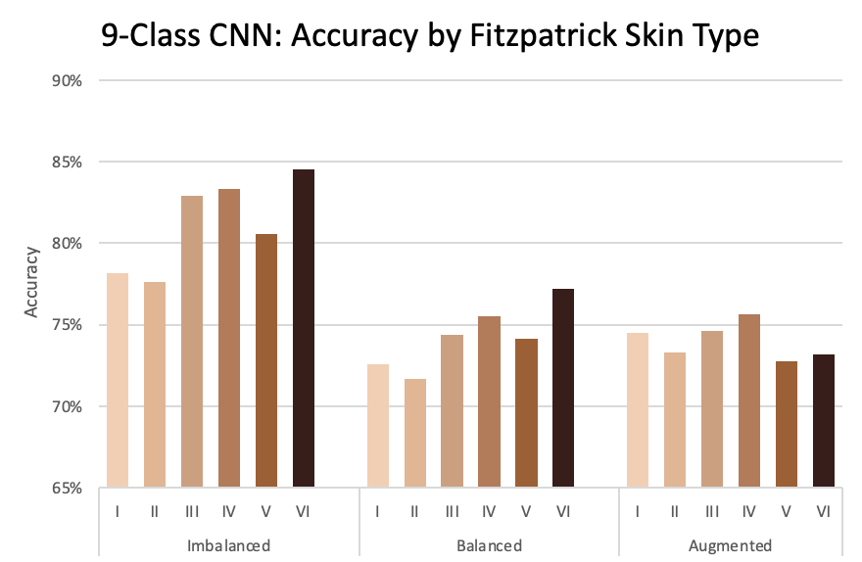
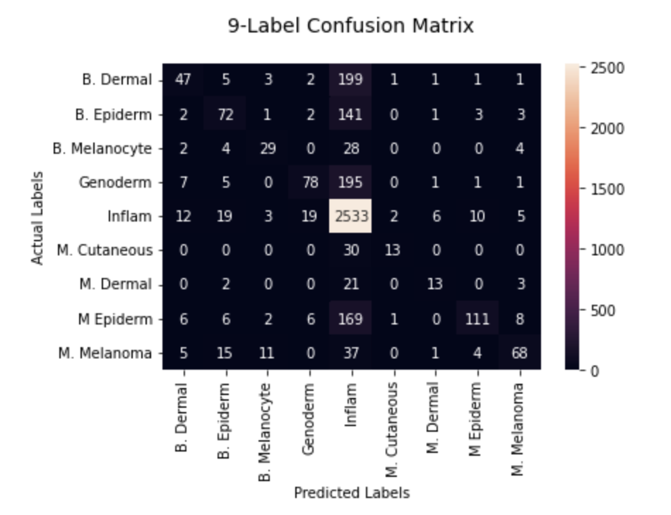
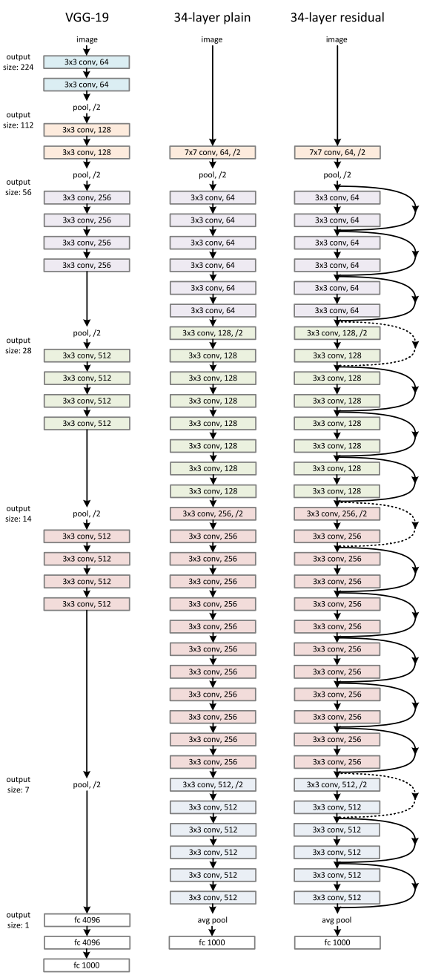
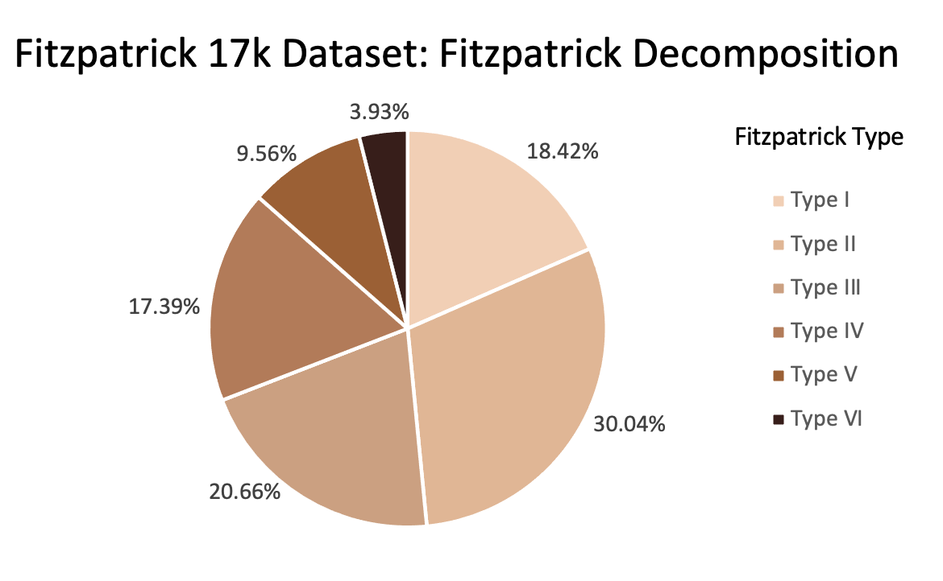
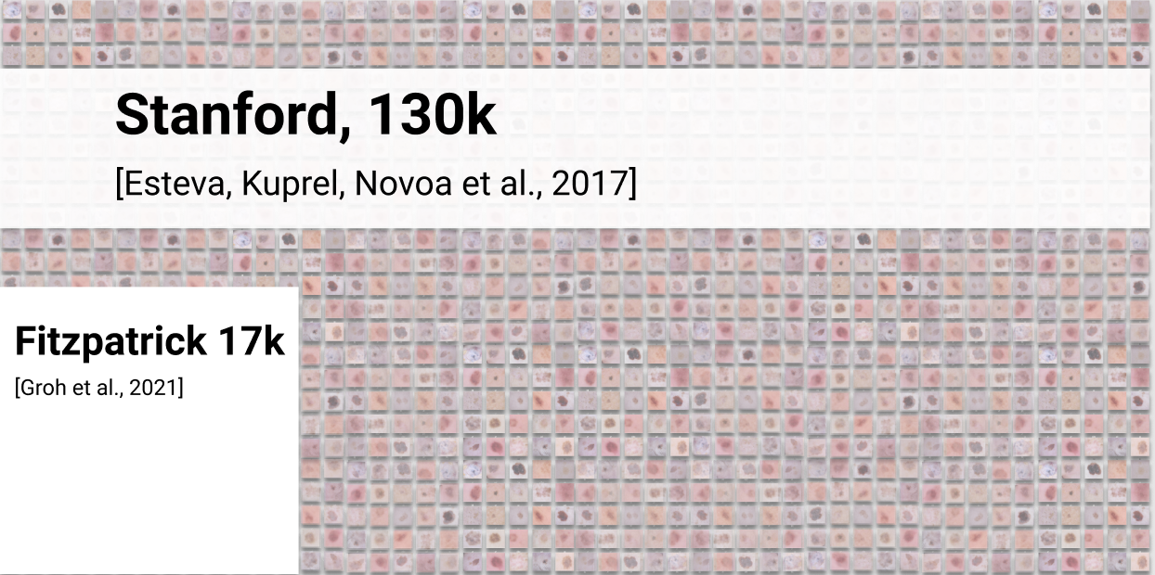
Dermatology Datasets for Neural Network Classification:
Assessing and Mitigating Skin-Tone Bias
Alex Baroody and Katie McLaughlin
Background
Results and Analysis
Conclusion
Results are tentatively promising: smaller sub-datasets do not necessarily guarantee poor performance
Disparity in ratio of accuracies and number of images calls for further exploration
Can’t conclude if high accuracy for skin type VI is due to correct predictions or lack of data
Balanced dataset preserves general distribution of accuracies over Fitzpatrick skin types
Augmented dataset with data manipulation increases differences for 3-split, decreases differences for 9-split
More diverse data is necessary for a stronger conclusion
Potential for multi-stage classification in order to more accurately classify conditions for each skin type
First classification would be only of Fitzpatrick skin type
Second classification would come from one of 6 possible CNNs and would predict the actual skin condition
Type 1 malignant condition
In dermatology textbooks and literature, black and brown skin is not represented proportionally.
Skin cancer mortality rates are 2-3x higher for patients of color.³
Concerning that this demographic gap could carry over to training datasets.
Would reinforce these disparities among darker-skinned patients.⁴
Type 4 malignant condition
Type 6 malignant condition
Methods
Works Cited
Predicting (non-)neoplastic conditions (the 3 class CNN) was very effective (all skin types > 80% accuracy on the regular dataset)
Predicting more fine grained conditions (the 9 class CNN) was also quite effective (all skin types > 75% accuracy on the regular dataset)
Model was most accurate for skin types III, IV, and VI
Inconsistent with the number of images of each skin type (see dataset decomposition in the Methods section)
Likely due to an relatively overwhelming number of images in one category, leading the model toward predicting that label almost all of the time (see confusion matrices)
Balancing the dataset did not yield different ratios
“Balanced” dataset balances by removing images
“Augmented” dataset balances by copying and randomly rotating images
1. Esteva, A., Kuprel, B., Novoa, R. et al. Dermatologist-level classification of skin cancer with deep neural networks. Nature 542,
115–118 (2017).
2. Gupta, A.K., Bharadwaj, M., & Mehrotra, R. (2016). Skin Cancer Concerns in People of Color: Risk Factors and Prevention. Asian
Pacific journal of cancer prevention: APJCP, 17(12), 5257–5264.
3. Nathan Inkawhich. (2017). Finetuning Torchvision Models—PyTorch Tutorials 1.2.0 documentation.
4. Kaufman, Bridget P. and Alexis, Andrew F. Skin Cancer Mortality in Patients With Skin of Color. May 2017. Retrieved December 12,
2021.
5. Lashbrook, A. (2018, August 16). AI-Driven Dermatology Could Leave Dark-Skinned Patients Behind. Retrieved December 11,
2021, from https://www.theatlantic.com/health/archive/2018/08/machine-learning-dermatology-skin-color/567619/
6. M. Groh et al., "Evaluating Deep Neural Networks Trained on Clinical Images in Dermatology with the Fitzpatrick 17k Dataset,"
2021 IEEE/CVF Conference on Computer Vision and Pattern Recognition Workshops (CVPRW), 2021, pp. 1820-1828
7. Ward, W.H., Lambreton, F., Goel N., et al. Clinical Presentation and Staging of Melanoma. In: Ward WH, Farma JM, editors.
Cutaneous Melanoma: Etiology and Therapy [Internet]. Brisbane (AU): Codon Publications; 2017 Dec 21. TABLE 1, Fitzpatrick Classification of Skin Types I through VI.
Continue to train a pre-trained ResNet CNN on new data
Train with 3 and 9 object classes
Train either the entire network or only the FC layer
Evaluate the trained model
for each of the 6 Fitzpatrick
skin types
ResNet Architecture
Quantity vs. Quality
Notes:
f
“you should clearly convey the intuition/background behind your idea, the key experiments you conducted and the key findings of you work. What would you like to share with your fellow students? What are the key takeaways from your project?”

Slide 2
Background
The pervasive inequalities in healthcare that disproportionately impact people of color are well-documented.
In dermatology textbooks and literature, black and brown skin is not represented proportionately.
Skin cancer mortality rates are 2-3x higher for patients of color
Concerning that this demographic gap could carry over to training datasets
Would reinforce these disparities among darker-skinned patients (Lashbrook, 2018).

Slide 3
Conclusion
Results are tentatively promising: smaller sub-datasets do not necessarily guarantee poor performance
Disparity in ratio of accuracies and number of images calls for further exploration
Can’t conclude if high accuracy for skin type VI is due to correct predictions or lack of data
Balanced dataset preserves general distribution of accuracies over Fitzpatrick skin types
Augmented dataset with data manipulation increases differences for 3-split, decreases differences for 9-split
More diverse data is necessary for a stronger conclusion
Potential for multi-stage classification in order to more accurately classify conditions for each skin type
First classification would be only of Fitzpatrick skin type
Would need large dataset of normal skin images to pre-train
Second classification would come from one of 6 possible CNNs and would predict the actual skin condition
Would need larger dataset labeled with both skin type and condition to be accurate

