Slide 1
OLIST E-COMMERCE
Diagnostic Analysis & Business Recommendations
A capstone analysis of delivery performance, freight pricing, and customer retention across 93,254 Brazilian e-commerce customers
Brijesh Arora | Data Analytics Capstone | Business Analyst

Slide 2
Agenda
Executive Summary
Business Problem & Objective
Methodology
Finding 1 — Delivery Speed & Retention
Finding 2 — Freight Artifact Correction
Predictive Baseline
Business Priority Segmentation
Interactive Dashboard
Strategic Recommendations
Limitation

Slide 3
Executive Summary
Four statistically rigorous findings, distilled from a full diagnostic and predictive pipeline
93,254
p = 0.0059
p = 0.0004 → 0.968
R$383K
Customers Analyzed
Late delivery significantly
lowers repeat purchase
Freight "risk" finding was
a statistical artifact
Expected repeat revenue
across customer tiers
Delivery speed is a genuine, actionable driver of retention. Freight cost is not — the earlier signal was a mechanical artifact of price/freight correlation, now corrected

Slide 4
Business Problem & Objective
Repeat purchase is rare on Olist's marketplace, and the business doesn't know which levers actually move it.
DATASET
Olist Brazilian E-Commerce Public Dataset
RQ1
Does late delivery genuinely reduce the odds a customer returns?
• 93,254 unique customers, 2016–2018
RQ2
Does freight cost burden customers enough to suppress retention?
• Order, item, payment, review & geolocation tables
• License: CC BY-NC-SA 4.0
RQ3
Can we predict, ahead of time, which customers will repeat?
• First-order cohort used to avoid lookback bias
RQ4
Where should retention investment be prioritized first?
Objective: quantify true drivers of repeat purchase, correct for statistical artifacts, and prioritize retention investment by customer value tier.

Slide 5
Methodology
A five-stage pipeline, from raw CSVs to prioritized business action
1
2
3
4
5
Validate
→
Clean & Model
→
Diagnose
→
Predict
→
Prioritize
Inventory & data-quality checks across all raw tables
DuckDB transformation into an analytical schema
Chi-square / logistic tests for delivery & freight effects
Baseline classifier for repeat-purchase probability
Segment-level business priority & revenue estimate
Engine: DuckDB · Stats: SciPy / statsmodels · Model: scikit-learn (class-balanced logistic baseline) · Reproducibility: config-driven paths, pytest suite

Slide 6
Finding 1: Delivery Speed Drives Retention
Customers whose first order arrives late are significantly less likely to make a repeat purchase.
p = 0.0059
Chi-square test — statistically significant
Odds Ratio = 0.811
Late-delivery customers have ~19% lower odds of a repeat purchase than on-time customers.

Slide 7
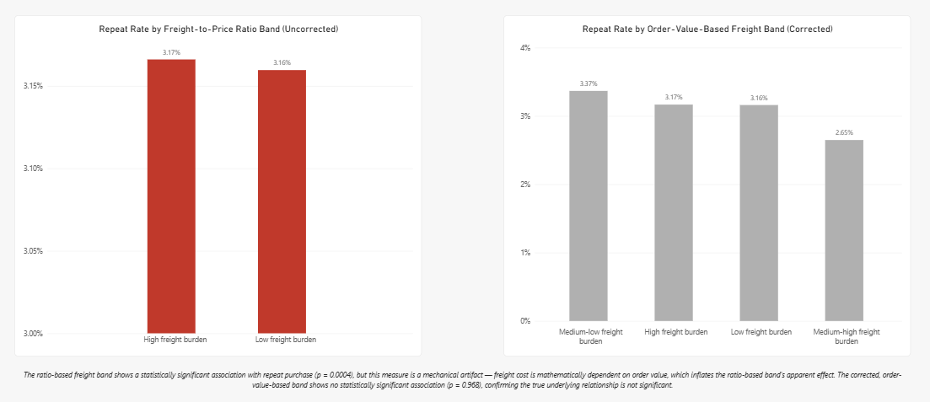
Finding 2: Freight “Risk” Was a Statistical Artifact
An initial freight-to-price ratio band looked significant — but freight cost is mathematically tied to order value, which inflated that result. A corrected, order-value-based band shows no real effect.
Source: Power BI dashboard — Freight page

Slide 8
Predictive Baseline: Honest Limits
A class-balanced logistic baseline was built to test whether repeat purchase is predictable ahead of time. It is not — consistent with the small effect sizes found above.
0.5466
66.13%
96.92%
39% / 4%
ROC-AUC
(weak discrimination)
Test accuracy
(balanced classifier)
Trivial “never repeats”
baseline accuracy
Recall / precision
on the repeat class
Interpretation: an ROC-AUC below 0.60 means the model discriminates only weakly better than chance. This isn’t a modeling failure — it’s an honest reflection of the small, real effect sizes (H1, H2) available in the data. Repeat purchase cannot be reliably predicted from delivery and pricing signals alone.

Slide 9
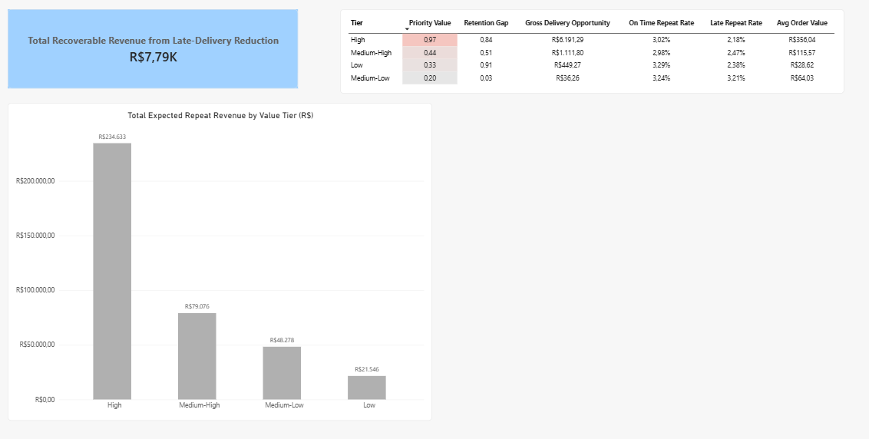
Business Priority Segmentation
Customers are ranked into value tiers; the High tier carries both the largest retention gap and the largest delivery-recovery opportunity.
Source: Power BI dashboard — Business Priority & Revenue page

Slide 10
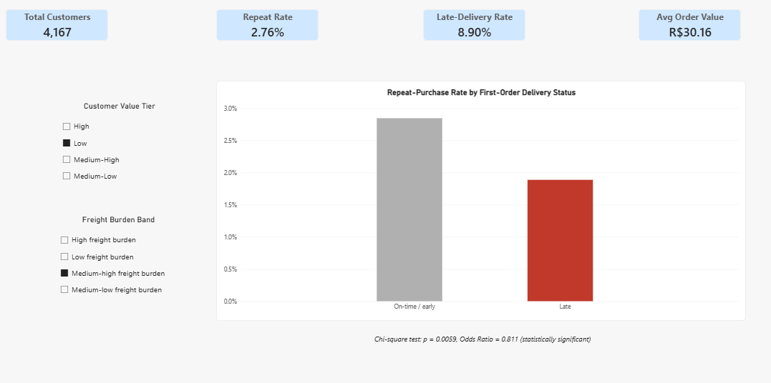
An Interactive Dashboard
All four pages cross-filter live by customer value tier and freight-burden band — shown here filtered to the Medium-Low value tier.

Slide 11
Recommendations
Prioritized by evidence strength and business impact
1
Protect delivery speed for High-value customers first
The High tier carries the largest retention gap (0.84pp) and the largest recoverable revenue (R$6,191) from on-time delivery — the highest-leverage lever confirmed by this analysis.
2
Stop using freight-to-price ratio as a retention risk signal
That metric was confirmed as a mechanical artifact (p = 0.0004 → 0.968 after correction). Continuing to act on it would misallocate retention spend.
3
Do not rely on a delivery/pricing-only predictive model
ROC-AUC of 0.55 is too weak for individual-level targeting. Use segment-level (tier-based) prioritization instead, as shown on the previous slide.
4
Extend the retention driver search beyond delivery & freight
Given the small effect sizes found here, product category, review sentiment, and payment experience are natural next variables to test.

Slide 12
Limitations
First-order cohort only — repeat behavior beyond a second order is not modeled.
Effect sizes for both confirmed findings are small; statistical significance is not the same as large practical impact.
Predictive baseline uses delivery & pricing features only — no product, review-text, or marketing-channel signals.
Public dataset covers 2016–2018; more recent logistics or pricing dynamics are not reflected.
Revenue estimates are directional projections built from observed repeat-rate and order-value differences, not a causal revenue model.

Slide 13
Thank You
Brijesh Arora | brijesharora01@gmail.com

