Slide 1


Slide 2

What is IP?
Private IP Address
Public IP Address
IPv4
IPv6

Slide 3
The advantages of IP addressing include
Routing Capability
Unique Identification
2
1
Security
4
3
Global Connectivity

Slide 4
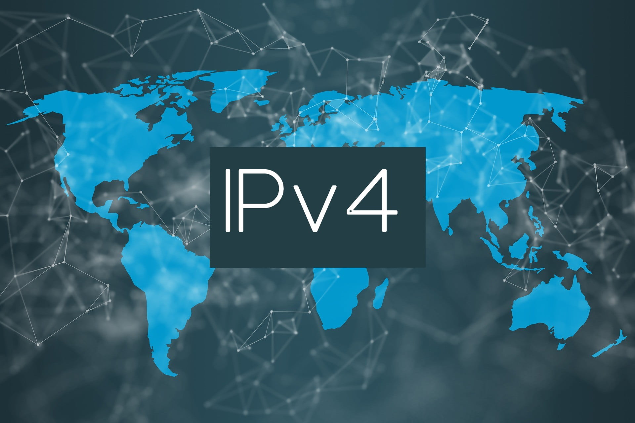
History of IP Addressing
ARPANET and the Birth of IP
IPv4 Emerges
Address Exhaustion Concerns
Introduction of IPv6
IPv4 Address Conservation Efforts
Transition Challenges
Current Landscape

Slide 5
Concept of IP Address Classification:
IP address classification is a system used to categorize IP addresses on the Internet. In this system, IP addresses are divided into several main classes, each with its own characteristics and specific ranges.
Importance of Classification in Networks:
IP address classification is highly important in the design and management of computer networks. This system allows assigning a unique IP address to each device, preventing address conflicts. Moreover, network administrators can efficiently manage network resources and ensure optimal network performance through this classification system.

Slide 6
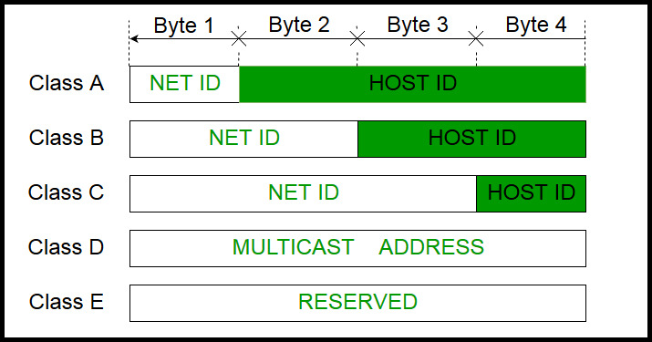
Introduction to IP Addressing
Class A
Class B
Class C
…

Slide 7
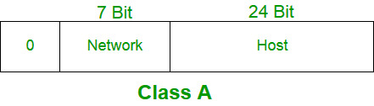
Class A
Number of Networks
Address Format
Range
There are 128 possible Class A networks
The first octet (8 bits) is reserved for network identification, while the remaining three octets (24 bits) are used for host identification
Class A addresses occupy the range from 1.0.0.0 to 126.255.255.255

Slide 8
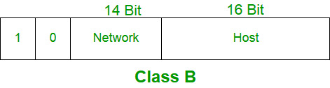
Class B
Number of Networks
Address Format
Range
There are 16,384 possible Class B networks.
The first two octets (16 bits) are allocated for network identification, leaving the remaining two octets (16 bits) for host identification.
Class B addresses span from 128.0.0.0 to 191.255.255.255.

Slide 9
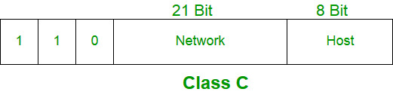
Class C
Number of Networks
Address Format
Range
here are over 2 million possible Class C networks.
The first three octets (24 bits) are dedicated to network identification, and the last octet (8 bits) is for host identification.
Class C addresses range from 192.0.0.0 to 223.255.255.255..

Slide 10
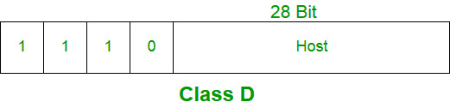
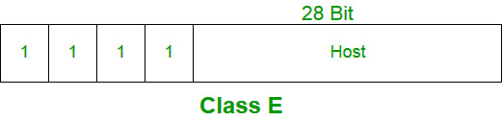
Class D & Class E

Slide 11
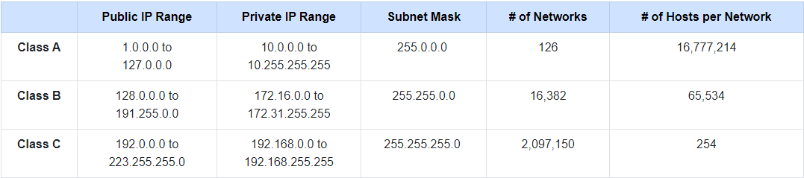
Summary of IPv4 Classes

Slide 12
the end

