Slide 1
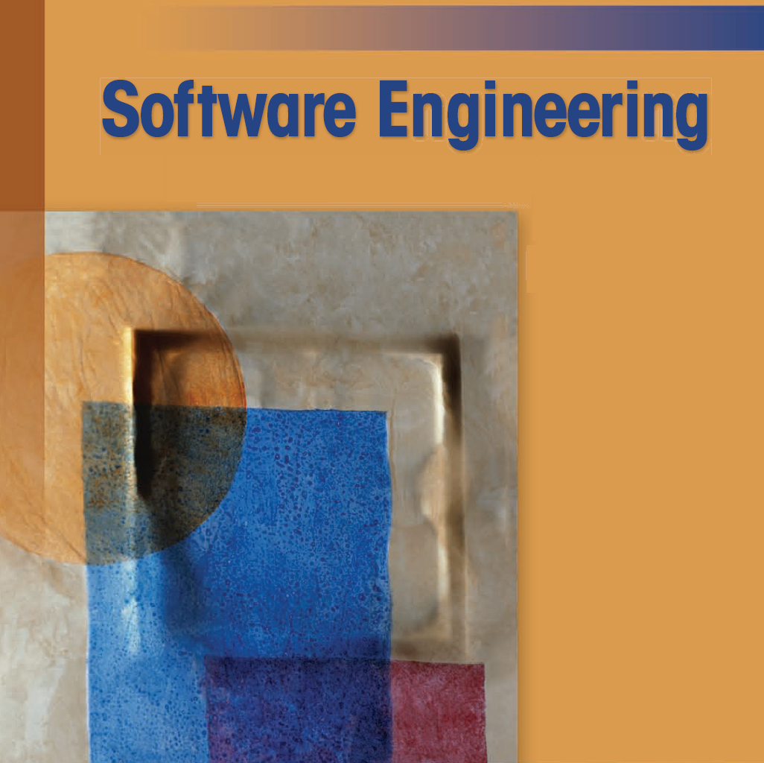
Dr. Ahmed Talib
PhD. Computer Science

Slide 2
Reference
Software Engineering: A Practitioner’s Approach, 7/e
by Roger S. Pressman
These slides are designed to accompany Software Engineering: A Practitioner’s Approach, 7/e (McGraw-Hill 2009). Slides copyright 2009 by Roger Pressman.

Slide 3
Chapter 1
Software & Software Engineering
Slide Set to accompany
Software Engineering: A Practitioner’s Approach, 7/e
by Roger S. Pressman
Slides copyright © 1996, 2001, 2005, 2009 by Roger S. Pressman
For non-profit educational use only
May be reproduced ONLY for student use at the university level when used in conjunction with Software Engineering: A Practitioner's Approach, 7/e. Any other reproduction or use is prohibited without the express written permission of the author.
All copyright information MUST appear if these slides are posted on a website for student use.
These slides are designed to accompany Software Engineering: A Practitioner’s Approach, 7/e (McGraw-Hill 2009). Slides copyright 2009 by Roger Pressman.

Slide 4
What is Software?
Software is:
instructions (computer programs) that when executed provide desired features, function, and performance;
data structures that enable the programs to adequately manipulate information and
documentation that describes the operation and use of the programs.
These slides are designed to accompany Software Engineering: A Practitioner’s Approach, 7/e (McGraw-Hill 2009). Slides copyright 2009 by Roger Pressman.

Slide 5
What is Software?
Software is a logical rather than a physical system element. Therefore, software has characteristics that are considerably different than those of hardware:
Software is developed or engineered, it is not manufactured in the classical sense.
Software doesn't "wear out."
Although the industry is moving toward component-based construction, most software continues to be custom-built.
These slides are designed to accompany Software Engineering: A Practitioner’s Approach, 7/e (McGraw-Hill 2009). Slides copyright 2009 by Roger Pressman.

Slide 6
Software Applications
system software
application software
engineering/scientific software
embedded software
product-line software
Web / Mobile applications
AI software
These slides are designed to accompany Software Engineering: A Practitioner’s Approach, 7/e (McGraw-Hill 2009). Slides copyright 2009 by Roger Pressman.

Slide 7
Legacy Software
Legacy software systems . . . were developed decades ago and have been continually modified to meet changes in business requirements and computing platforms. The proliferation of such systems is causing headaches for large organizations who find them costly to maintain and risky to evolve.
These slides are designed to accompany Software Engineering: A Practitioner’s Approach, 7/e (McGraw-Hill 2009). Slides copyright 2009 by Roger Pressman.

Slide 8
Legacy Software
Why must it change?
  software must be adapted to meet the needs of new computing environments or technology.
  software must be enhanced to implement new business requirements.
  software must be extended to make it interoperable with other more modern systems or databases.
  software must be re-architected to make it viable within a network environment.
These slides are designed to accompany Software Engineering: A Practitioner’s Approach, 7/e (McGraw-Hill 2009). Slides copyright 2009 by Roger Pressman.

Slide 9
Characteristics of WebApps - I
The following attributes are encountered in the vast majority of WebApps:
Network intensiveness. A WebApp resides on a network and must serve the needs of a diverse community of clients.
Concurrency. A large number of users may access the WebApp at one time.
Unpredictable load. The number of users of the WebApp may vary by orders of magnitude from day to day.
Performance. If a WebApp user must wait too long (for access, for server-side processing, for client-side formatting and display), he or she may decide to go elsewhere.
Availability. Although expectation of 100 percent availability is unreasonable, users of popular WebApps often demand access on a “24/7/365” basis.
These slides are designed to accompany Software Engineering: A Practitioner’s Approach, 7/e (McGraw-Hill 2009). Slides copyright 2009 by Roger Pressman.

Slide 10
Characteristics of WebApps - II
Data driven. The primary function of many WebApps is to use hypermedia to present text, graphics, audio, and video content to the end-user.
Content sensitive. The quality and aesthetic nature of content remains an important determinant of the quality of a WebApp.
Continuous evolution. Unlike conventional application software that evolves over a series of planned, chronologically-spaced releases, Web applications evolve continuously.
Immediacy. Although immediacy—the compelling need to get software to market quickly—is a characteristic of many application domains, WebApps often exhibit a time to market that can be a matter of a few days or weeks.
Security. Because WebApps are available via network access, it is difficult, if not impossible, to limit the population of end-users who may access the application.
Aesthetics. An undeniable part of the appeal of a WebApp is its look and feel.
These slides are designed to accompany Software Engineering: A Practitioner’s Approach, 7/e (McGraw-Hill 2009). Slides copyright 2009 by Roger Pressman.

Slide 11
Software Engineering
Some realities:
  a concerted effort should be made to understand the problem before a software solution is developed
  design becomes a pivotal activity
  software should exhibit high quality
  software should be maintainable
The seminal definition:
  [Software engineering is] the establishment and use of engineering principles in order to obtain economically software that is reliable and works efficiently on real machines.
These slides are designed to accompany Software Engineering: A Practitioner’s Approach, 7/e (McGraw-Hill 2009). Slides copyright 2009 by Roger Pressman.

Slide 12
A Layered Technology
tools
methods
process model
a “quality” focus
Software Engineering
These slides are designed to accompany Software Engineering: A Practitioner’s Approach, 7/e (McGraw-Hill 2009). Slides copyright 2009 by Roger Pressman.

Slide 13
S/W Process
In the context of software engineering, a process is not a rigid prescription for how to build computer software. Rather, it is an adaptable approach that enables the people doing the work (the software team) to pick and choose the appropriate set of work actions and tasks.
The intent is always to deliver software in a timely manner and with sufficient quality to satisfy those who have sponsored its creation and those who will use it.
These slides are designed to accompany Software Engineering: A Practitioner’s Approach, 7/e (McGraw-Hill 2009). Slides copyright 2009 by Roger Pressman.

Slide 14
A Process Framework
A process framework establishes the foundation for a complete software engineering process by identifying a small number of framework activities that are applicable to all software projects, regardless of their size or complexity.
In addition, the process framework encompasses a set of umbrella activities that are applicable across the entire software process. A generic process framework for software engineering encompasses five activities:
These slides are designed to accompany Software Engineering: A Practitioner’s Approach, 7/e (McGraw-Hill 2009). Slides copyright 2009 by Roger Pressman.

Slide 15
Framework Activities
Communication
Planning
Modeling
  Analysis of requirements
  Design
Construction
  Code generation
  Testing
Deployment
(See details in the book)
These slides are designed to accompany Software Engineering: A Practitioner’s Approach, 7/e (McGraw-Hill 2009). Slides copyright 2009 by Roger Pressman.

Slide 16
Umbrella Activities
Software project tracking and control
Risk management
Software quality assurance
Formal technical reviews
Measurement
Software configuration management
Reusability management
Work product preparation and production
(See details in the book)
These slides are designed to accompany Software Engineering: A Practitioner’s Approach, 7/e (McGraw-Hill 2009). Slides copyright 2009 by Roger Pressman.

Slide 17
The Essence of Practice
George Polya suggests:
    1. Understand the problem (communication and analysis).
    2. Plan a solution (modeling and software design).
    3. Carry out the plan (code generation).
    4. Examine the result for accuracy (testing and quality assurance).
These slides are designed to accompany Software Engineering: A Practitioner’s Approach, 7/e (McGraw-Hill 2009). Slides copyright 2009 by Roger Pressman.

Slide 18
Understand the Problem
Who has a stake in the solution to the problem? That is, who are the stakeholders?
What are the unknowns? What data, functions, and features are required to properly solve the problem?
Can the problem be compartmentalized? Is it possible to represent smaller problems that may be easier to understand?
Can the problem be represented graphically? Can an analysis model be created?
These slides are designed to accompany Software Engineering: A Practitioner’s Approach, 7/e (McGraw-Hill 2009). Slides copyright 2009 by Roger Pressman.

Slide 19
Plan the Solution
Have you seen similar problems before? Are there patterns that are recognizable in a potential solution? Is there existing software that implements the data, functions, and features that are required?
Has a similar problem been solved? If so, are elements of the solution reusable?
Can subproblems be defined? If so, are solutions readily apparent for the subproblems?
Can you represent a solution in a manner that leads to effective implementation? Can a design model be created?
These slides are designed to accompany Software Engineering: A Practitioner’s Approach, 7/e (McGraw-Hill 2009). Slides copyright 2009 by Roger Pressman.

Slide 20
Carry Out the Plan
Does the solution conform to the plan? Is source code traceable to the design model?
Is each component part of the solution provably correct? Has the design and code been reviewed, or better, have correctness proofs been applied to algorithm?
These slides are designed to accompany Software Engineering: A Practitioner’s Approach, 7/e (McGraw-Hill 2009). Slides copyright 2009 by Roger Pressman.

Slide 21
Examine the Result
Is it possible to test each component part of the solution? Has a reasonable testing strategy been implemented?
Does the solution produce results that conform to the data, functions, and features that are required? Has the software been validated against all stakeholder requirements?
These slides are designed to accompany Software Engineering: A Practitioner’s Approach, 7/e (McGraw-Hill 2009). Slides copyright 2009 by Roger Pressman.

Slide 22
Hooker’s General Principles
Hooker proposes seven principles that focus on software Engineering practice as a whole
1: The Reason It All Exists
to provide value to its users
2: KISS (Keep It Simple, Stupid!)
All design should be as simple as possible, but no simpler .
3: Maintain the Vision
A clear vision is essential to the success of a software project
These slides are designed to accompany Software Engineering: A Practitioner’s Approach, 7/e (McGraw-Hill 2009). Slides copyright 2009 by Roger Pressman.

Slide 23
Hooker’s General Principles
4: What You Produce, Others Will Consume
Always specify, design, and implement ..knowing someone else will have to understand what you are doing .
5: Be Open to the Future
A system with a long lifetime has more value, true “industrial-strength” software systems must endure far longer.
These slides are designed to accompany Software Engineering: A Practitioner’s Approach, 7/e (McGraw-Hill 2009). Slides copyright 2009 by Roger Pressman.

Slide 24
6: Plan Ahead for Reuse
Planning ahead for reuse reduces the cost and increases the value of both the reusable components and the systems into which they are incorporated .
7: Think!
Placing clear, complete thought before action almost always produces better results
These slides are designed to accompany Software Engineering: A Practitioner’s Approach, 7/e (McGraw-Hill 2009). Slides copyright 2009 by Roger Pressman.

