Slide 1
Chapter 5: Deadlocks

Slide 2
What is deadlock?
Deadlock is when two or more processes never make progress because each is waiting for some resource held by another process.
الجمود هو عندما اثنين أو أكثر من العمليات لا يتقدمون لأن كل عملية تنتظر بعض الموارد التي تحتفظ بها عملية أخرى

Slide 3
Deadlock Characterization
Deadlock has 3 conditions:
Circular Wait - processes are waiting for resources held by other processes, which are waiting for other resources
No Pre-emption لا للاجهاض- processes do not have the ability to take resources from others if they have itالعمليات ليس لديها القدرة على اتخاذ الموارد من الآخرين إذا كان لديهم
Hold & Wait - processes are holding one resource while waiting for another العمليات تحتفظ بمورد واحد بينما تنتظر آخر

Slide 4
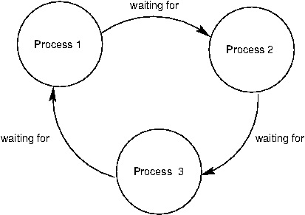
The circular wait is the most popular to attack in system design.
الانتظار الدائري هو الأكثر شهرة للهجوم في تصميم النظام.

Slide 5
Resource-Allocation Graph
A set of vertices V and a set of edges E.
V is partitioned into two types:
  P = {P₁, P₂, …, P_{n}}, the set consisting of all the processes in the system
  R = {R₁, R₂, …, R_{m}}, the set of all resource types in the system
request edge P_{i} → R_{j}
assignment edge R_{j} → P_{i}

Slide 6



Resource-Allocation Graph (Cont.)
Process
Resource Type with 4 instances
P_{i} requests instance of R_{j}
P_{i} is holding an instance of R_{j}
P_{i}
R_{j}
P_{i}
R_{j}

Slide 7

Example of a Resource Allocation Graph

Slide 8

Resource Allocation Graph With A Deadlock

Slide 9
If graph contains no cycles -> no deadlock.
If graph contains a cycle ->
if only one instance per resource type, then deadlock.
if several instances per resource type, possibility of deadlock.

Slide 10

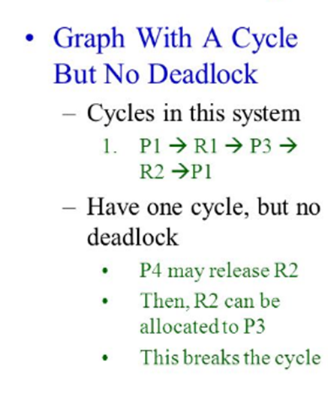
Graph With A Cycle But No Deadlock

Slide 11
Basic Facts
If graph contains no cycles ⇒ no deadlock
If graph contains a cycle ⇒
  if only one instance per resource type, then deadlock
  if several instances per resource type, possibility of deadlock

Slide 12
Methods for Handling Deadlocks
Ensure that the system will never enter a deadlock state:
  Deadlock prevention
  Deadlock avoidance
Allow the system to enter a deadlock state and then recover
Ignore the problem and pretend that deadlocks never occur in the system.

Slide 13
Deadlock Prevention
Deadlock prevention algorithms ensure that at least one of the conditions (hold and wait, no preemption and circular wait) does not hold true.
تضمن خوارزميات الوقاية من الجمود أن أحد الشروط على الأقل (الانتظار والانتظار، لا الانتظار المسبق والانتظار الدائري) لا ينطبق

Slide 14
Safe State
System is in safe state if there exists a sequence <P₁, P₂, …, P_{n}> , for each P_{i}, the resources that P_{i} can still request can be satisfied by currently available resources + resources held by all the P_{j}.
That is:
  If P_{i} needs resources that are not immediately available, then P_{i} can wait until all P_{j} have finished
  When P_{j} is finished, P_{i} can obtain needed resources, execute, return allocated resources, and terminate
  When P_{i} terminates, P_{i +1} can obtain its needed resources, and so on

Slide 15
Basic Facts
If a system is in safe state ⇒ no deadlocks
If a system is in unsafe state ⇒ possibility of deadlock
Avoidance ⇒ ensure that a system will never enter an unsafe state.

Slide 16
Deadlock Detection
Allow system to enter deadlock state
Detection algorithm
Recovery scheme

Slide 17
Several Instances of a Resource Type
Available: A vector of length m indicates the number of available resources of each type
Allocation: An n x m matrix defines the number of resources of each type currently allocated to each process
Request: An n x m matrix indicates the current request of each process.

Slide 18
Detection Algorithm
1. Let Work and Finish be vectors of length m and n, respectively Initialize:
  (a) Work = Available
  (b) For i = 1,2, …, n, if Allocation_{i} ≠ 0, then
  Finish [i] = false; otherwise, Finish [i] = true
2. Find an index i such that both:
  (a) Finish [i] == false
  (b) Request_{i} ≤ Work
  If no such i exists, go to step 4

Slide 19
Detection Algorithm (Cont.)
3. Work = Work + Allocation_{i}
Finish [i] = true
go to step 2
4. if Finish [i] == false, then P_{i} is deadlocked

Slide 20
Recovery from Deadlock: Process Termination
Cancel all deadlocked processes
Cancel one process at a time until the deadlock cycle is eliminated
In which order should we choose to cancel? في أي ترتيب يجب أن نختار لإلغاء
  Priority of the process أولوية العملية
  Resources the process has used الموارد التي استخدمتها العملية
  How many processes will need to be terminated

