Slide 1
Operating System Scheduling Algorithms

Slide 2
CPU scheduling
CPU scheduling is a process which allows one process to use the CPU while the execution of another process is in waiting state due to unavailability of any resource like I/O etc,
The aim of CPU scheduling is to make the system efficient, fast and fair.
Whenever the CPU becomes idle فارغ, the operating system must select one of the processes in the ready queue to be executed.

Slide 3
Scheduling Criteria Throughput , turnaround time , waiting time , and response time
Parameter | Description
Throughput | Number of completed processes per time unit
Waiting time | Time a process waits in the ready state
Turnaround time | Time a process takes from submission to completion
Response time | Time between a command request and the beginning of a response

Slide 4
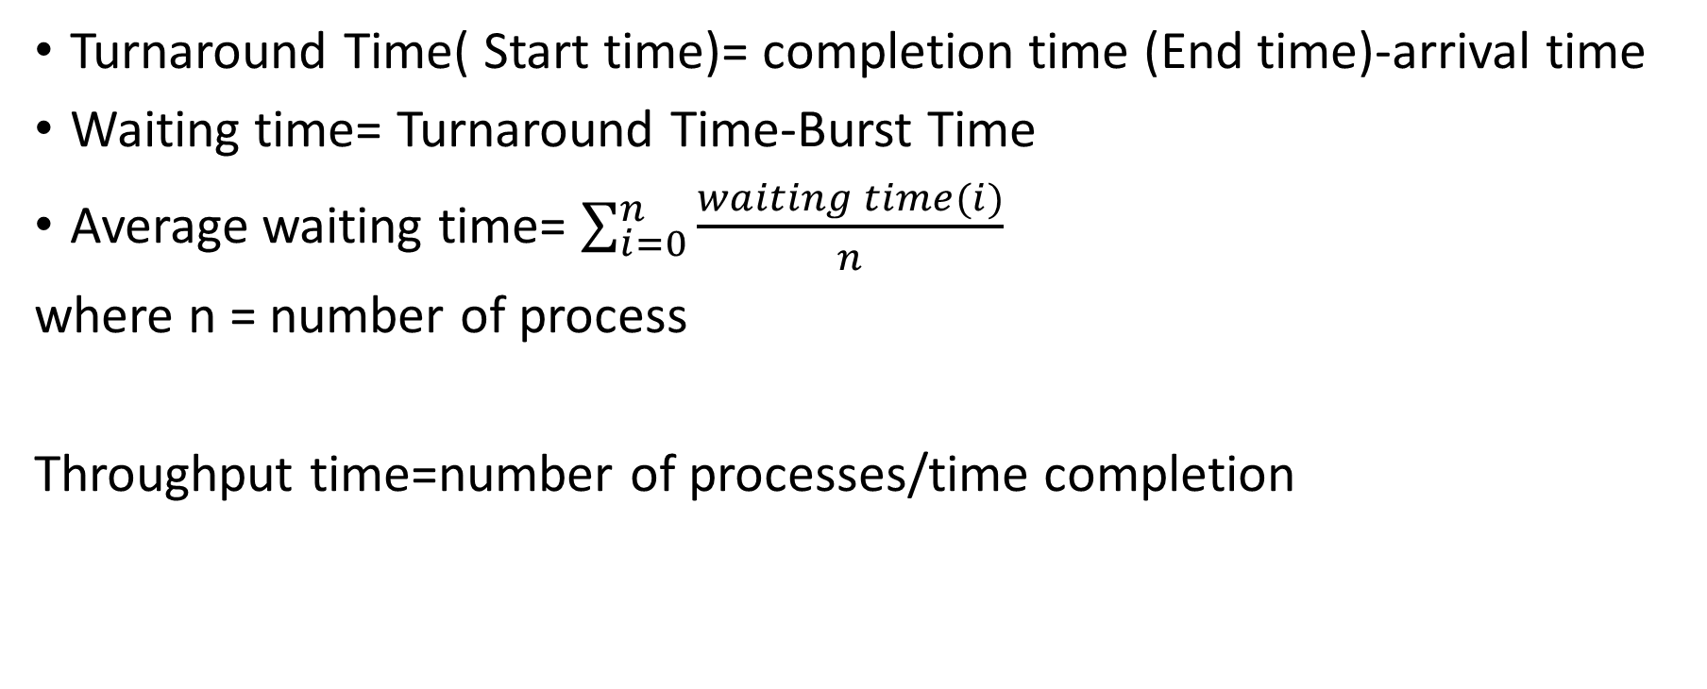
Turnaround Time( Start time)= completion time (End time)-arrival time
Waiting time= Turnaround Time-Burst Time
Average waiting time= $\sum_{i=0}^{n}{\frac{waiting time(i)}{n}}$
where n = number of process
Throughput time=number of processes/time completion

Slide 5
Scheduling Algorithms
First Come First Serve(FCFS) Scheduling
Shortest-Job-First(SJF) Scheduling
Priority Scheduling
Round Robin(RR) Scheduling
Multilevel Queue Scheduling
Multilevel Feedback Queue Scheduling

Slide 6
First Come First Serve(FCFS) Scheduling
FCFS is very simple - Just like a FIFO queue.
Processes are executed on first come, first serve.
Poor in performance because average wait time is high.

Slide 7
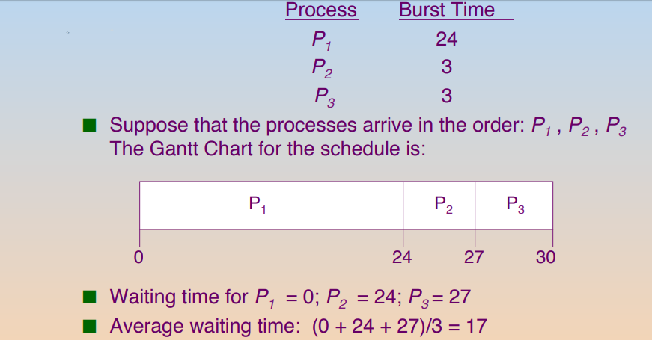
Example 1:
Burst Time – CPU execution time
Process هو الوقت الذي يستغرقه المعالج للأنتهاء من الـ

Slide 8
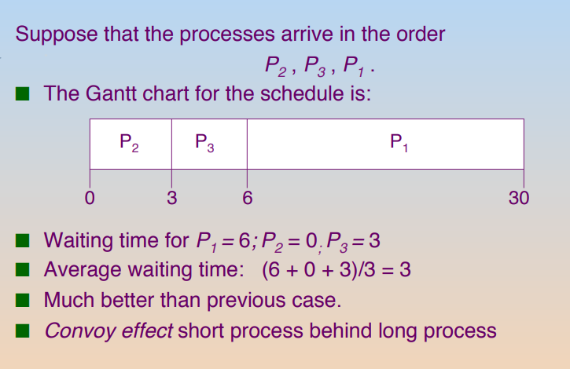
Example 2:

Slide 9
Shortest-Job-First(SJF) Scheduling
SJF is optimal – gives minimum average waiting time for a given set of processes
This algorithm picks a process based on the next shortest CPU burst.
SJF is non-preemptive or preemptive

Slide 10
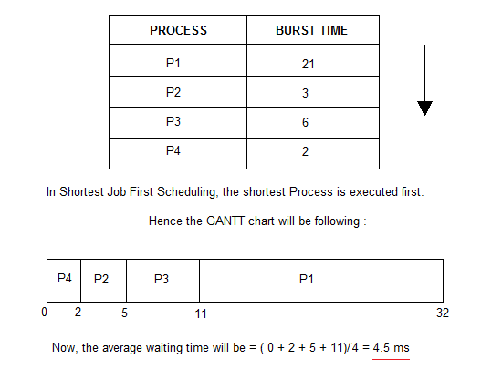

Slide 11
Priority Scheduling
Priority is assigned for each process.
The CPU is allocated to the process with the highest
priority (smallest integer ≡ highest priority).
Process with highest priority is executed first and so on.
Processes with same priority are executed in FCFS manner.
Priority can be decided based on memory requirements, time requirements or any other resource requirement.

Slide 12
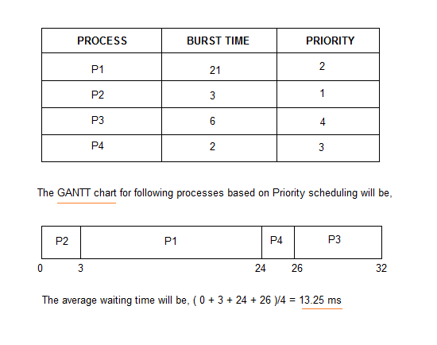
Example

Slide 14
Round Robin(RR) Scheduling
A fixed time is allotted time الوقت المخصصto each process, called Time quantum كمية الوقت, for execution.
Each process gets a small unit of CPU time (time quantum). After this time has elapsed, the process is preempted and added to the end of the ready queue.
Newly-arriving processes (and processes that complete their I/O bursts) are added to the end of the ready queue

Slide 15
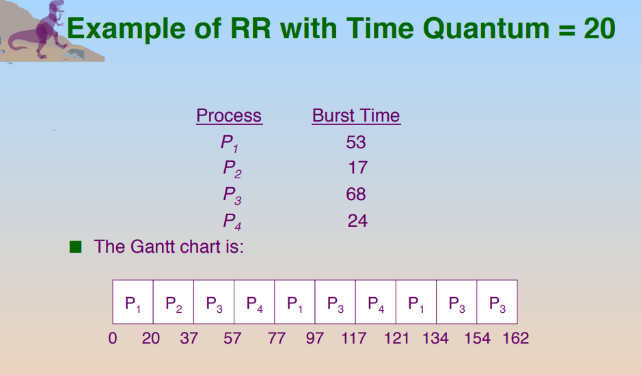
Example

Slide 16
Multilevel Queue Scheduling
A multi-level queue scheduling algorithm partitions the ready queue into several separate queues.
The processes are assigned to one queue based on some property of the process, such as memory size, process priority, or process type.
Each queue has its own scheduling algorithm.

Slide 17
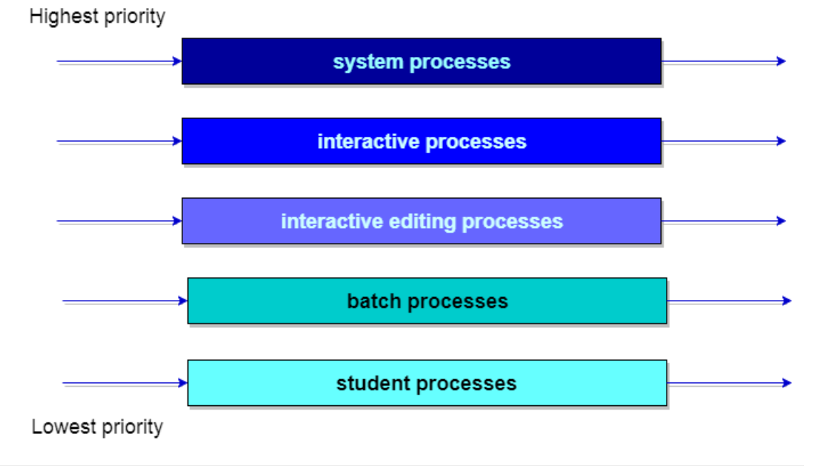
Example

Slide 18
Multilevel Feedback Queue Scheduling
Multilevel feedback queue scheduling allows a process to move between queues.
The idea is to separate processes with different CPU-burst characteristics.
If a process uses too much CPU time, it will be moved to a lower-priority queue.
Similarly, a process that waits too long in a lower-priority queue may be moved to a higher-priority queue

Slide 19
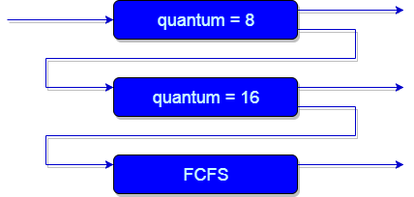
Example

