Slide 1
File-System Interface& implementation

Slide 2
File Concept
Contiguous logical address space
Types:
  Data
    numeric
    character
    binary
  Program
Contents is defined by file’s creator
  text file,
  source file,
  executable file

Slide 3
File Attributes
Name – only information kept in human-readable form
Identifier –number identifies file within file system
Type – needed for systems that support different types
Location – pointer to file location on the device (disk)
Size – current file size
Protection – controls who can do reading, writing, executing
Time, date, and user identification – information kept for creation time, last modification time, and last use time.
  Useful for data for protection, security, and usage monitoring

Slide 4
File Operations
Create
Write – at write pointer location
Read – at read pointer location
Reposition within file - seek
Delete
Cut
Open(F_{i}) – search the directory on disk for F_{i}, and move the content of the entry to memory
Close (F_{i}) – move the content of F_{i} in memory to directory on disk.

Slide 5
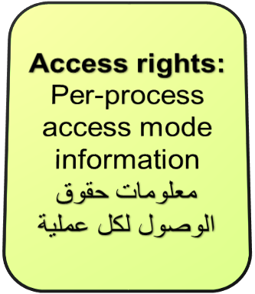
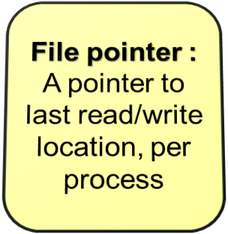

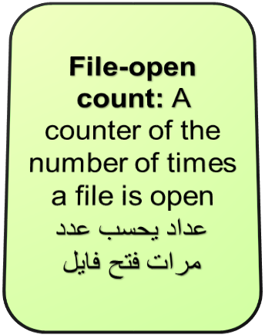
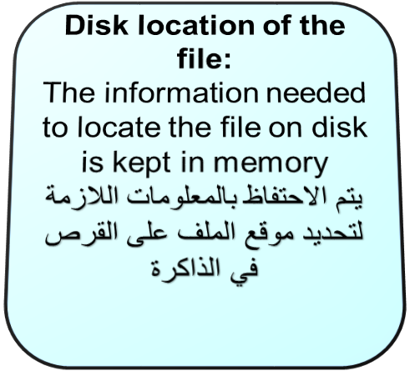
Open File table

Slide 6
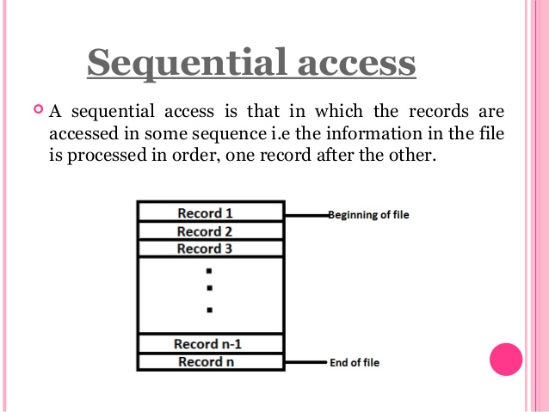
Access Methods

Slide 7
Access Methods
Direct Access
File is made up of fixed-length logical records that allow programs to read and write records rapidly in no particular order.
File is viewed as a numbered sequence of blocks or records. For example, can read block 14, then read block 53, and then write block 7.
Operations:
  read(n) – reads block number n.
  write(n) – writes block number n.
block numbers allow OS to decide where file should be placed

Slide 8
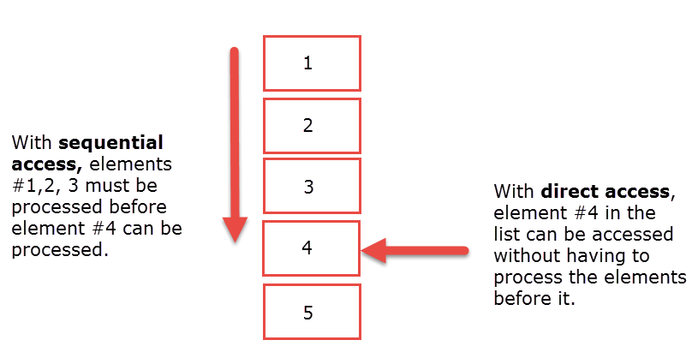
Direct Access vs. Sequential Access

Slide 9
Directory Structure
A collection of nodes containing information about all files
Directory
Files
F 1
F 2
F 3
F 4
F n
Both the directory structure and the files reside on disk

Slide 10
Operations Performed on Directory
Search for a file
Create a file
Delete a file
List a directory
Rename a file
Traverse the file system

Slide 11
Directory Organization
The directory is organized logically to obtain
Efficiency – locating a file quickly
Naming – easy to users
  Two users can have same name for different files
  The same file can have several different names
Grouping – logical grouping of files by properties (e.g., all Java programs, all games, …)

Slide 12

Single-Level Directory
A single directory for all users
Naming problem
Grouping problem

Slide 13

Two-Level Directory
Separate directory for each user
Path name
Can have the same file name for different user
Efficient searching
No grouping capability لا توجد قابلية التجميع

Slide 14

Tree-Structured Directories

Slide 15
Tree-Structured Directories (Cont.)
Efficient searching
Grouping Capability
Current directory (working directory)
  cd /spell/mail/prog

Slide 16

In-Memory File System Structures
A. Frank - P. Weisberg
(a) Opening a file
(b) Reading a file

Slide 17
Virtual File Systems
A. Frank - P. Weisberg
Virtual File Systems (VFS) provide an object-oriented way of implementing file systems.
VFS allows the same system call interface
(the API) to be used for different types of file systems.

Slide 18

Schematic View of Virtual File System
A. Frank - P. Weisberg

Slide 19
Allocation Methods
A. Frank - P. Weisberg
An allocation method refers to how disk blocks are allocated for files:
  Contiguous allocation
  Chained/Linked allocation
  Indexed allocation

Slide 20

Contiguous Allocation Example
A. Frank - P. Weisberg
(a) Contiguous allocation of disk space for 7 files.
(b) The state of the disk after files D and F have been removed.

Slide 21
Contiguous Allocation
A. Frank - P. Weisberg
Each file occupies a set of contiguous blocks on the disk.
Simple: only starting location (block #) and length (number of blocks) required.
Enables random access.
Wasteful of space (dynamic storage-allocation problem).
Files cannot grow.

Slide 22
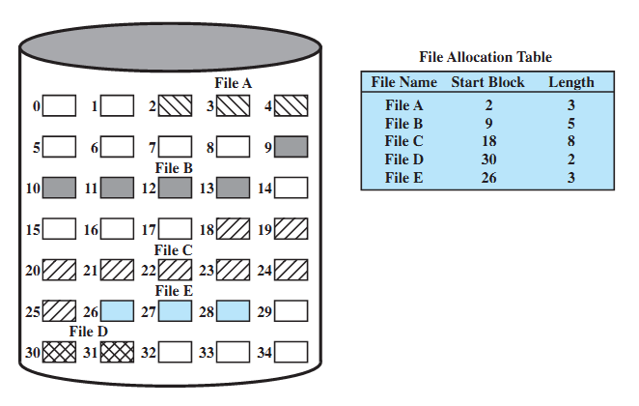
Contiguous File Allocation Example
A. Frank - P. Weisberg

Slide 23
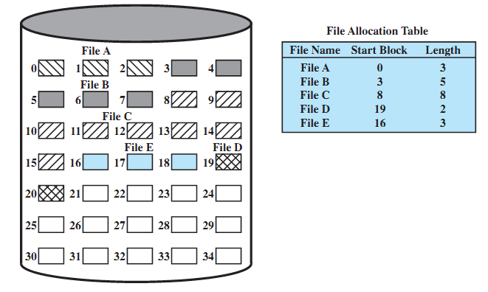
Contiguous file allocation (after compaction)
A. Frank - P. Weisberg

Slide 24

Chained/Linked Allocation Example
A. Frank - P. Weisberg

Slide 25
Chained Allocation
A. Frank - P. Weisberg
Each file is a linked list of disk blocks: blocks may be scattered anywhere on the disk.
Simple: need only starting address.
Free-space management: no waste of space.
No random access.
block =
pointer

Slide 26
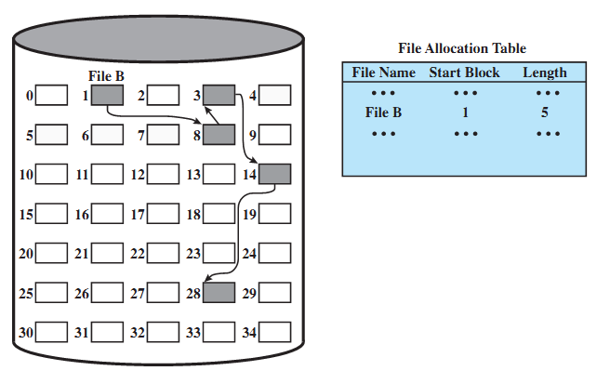
Chained File Allocation Example
A. Frank - P. Weisberg

Slide 27
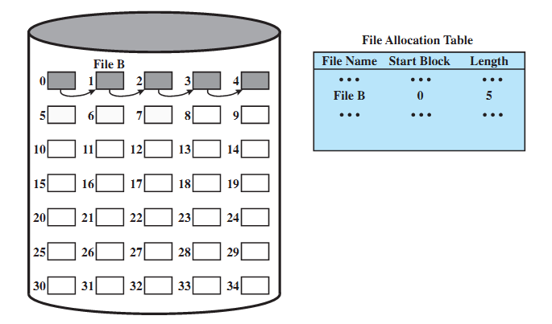
Chained File Allocation (after consolidation)
A. Frank - P. Weisberg

Slide 28
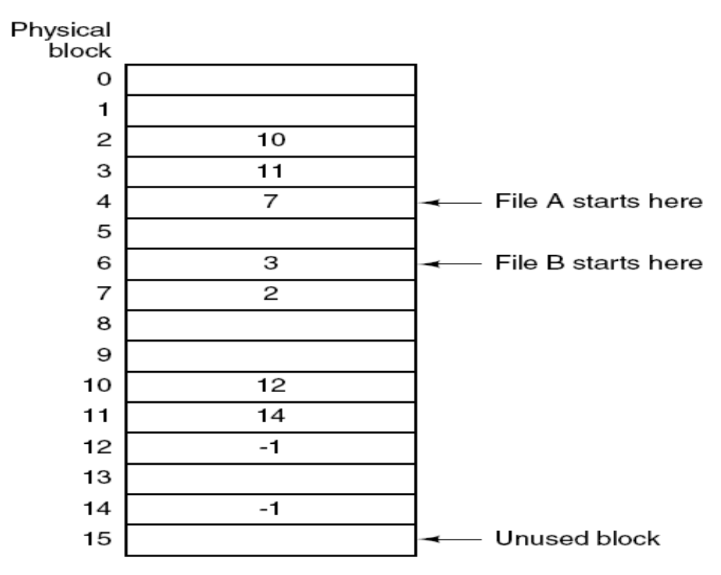
Linked List Allocation Using a Table in Memory
A. Frank - P. Weisberg

Slide 29

File-Allocation Table (FAT) Example
A. Frank - P. Weisberg

Slide 30
Indexed Allocation
A. Frank - P. Weisberg
Brings all pointers together into
the index block.
It’s a logical view.
Need index table.
Provides random access.
Dynamic access without external fragmentation, but have overhead of
index block.
index table

Slide 31
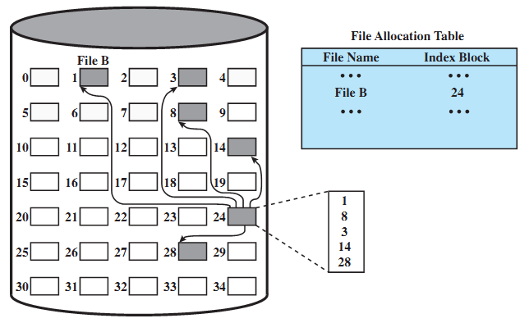
Indexed File Allocation Example
A. Frank - P. Weisberg

