Slide 1
Memory Management

Slide 2
Memory Management
• Is the task carried out by the OS and hardware to accommodate multiple processes in main memory لاستيعاب عمليات متعددة في الذاكرة الرئيسية
• Program must be brought into memory and placed within
a process for it to be executed.
• Input queue – collection of processes on the disk that are waiting to be brought into memory for execution.
• Select one process from input queue to load it into
memory for execution. After execution (terminates)
memory space becomes available.
• The address space of the computer starts at 00000.

Slide 3
Binding of Instructions and Data to Memory
Address binding of instructions and data to memory addresses can happen at three different stages:
• Compile time: If memory location known a priori, a code can be generated; must recompile the code if starting location changes.
إذا كان موقع الذاكرة معروف مسبقا، يمكن إنشاء رمز؛ يجب إعادة ترجمة التعليمات البرمجية إذا بدأ تغيير الموقع.
• Load time: Must generate relocatable code if memory location is not known at compile time.
يجب إنشاء رمز تحديد موقع إذا كان موقع الذاكرة غير معروف في وقت الترجمة
• Execution time: Binding delayed until run time if the process can be moved during its execution from one memory segment to another تاخر الربط حت وقت التشغيل اذا العملية تنتقل من شريحة ذاكرة الى اخرى

Slide 4
Difference Between Logical and Physical Address
Logical address – generated by the CPU; also referred to as virtual address.
Physical address – address seen by the memory unit (address is loaded ).
• Logical and physical addresses are the same in compile time and load-time address-binding schemes;
• Logical (virtual) and physical addresses are different in execution-time address-binding scheme.
• The set of all logical address generated by a program.

Slide 5
Swapping
• A process can be swapped temporarily out of memory to a backing store, and then brought back into memory for continued execution.
• Backing store – fast disk large enough to accommodate copies of all memory images for all users.
• Roll out, roll in – swapping variant used for priority-based scheduling algorithms; lower-priority process is swapped out so higher-priority process can be loaded and executed.
• Example: Round Robin CPU scheduling.

Slide 6
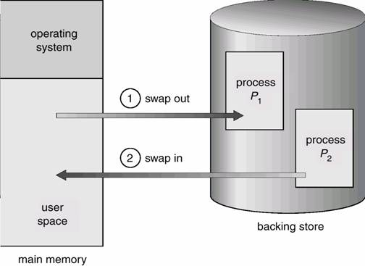
Schematic View of Swapping

Slide 7
Contiguous Memory Allocation
تخصيص الذاكرة المتجاورة
Contiguous memory allocation is a classical memory allocation model that assigns a process consecutiveمتتالية memory blocks (that is, memory blocks having consecutive addresses).

Slide 8
Contiguous Memory Allocation strategy
When a process needs to execute, memory is requested by the process.
The size of the process is compared with the amount of contiguous main memory available to execute the process.
If sufficient contiguous memory is found, the process is allocated memory to start its execution.
Otherwise, it is added to a queue of waiting processes until sufficient free contiguous memory is available.

Slide 9
Basics
Physical memory is divided into frames
Logical memory is divided into pages
A frame has the same size as a page is a place where a (logical) page can be (physically) placed

Slide 10
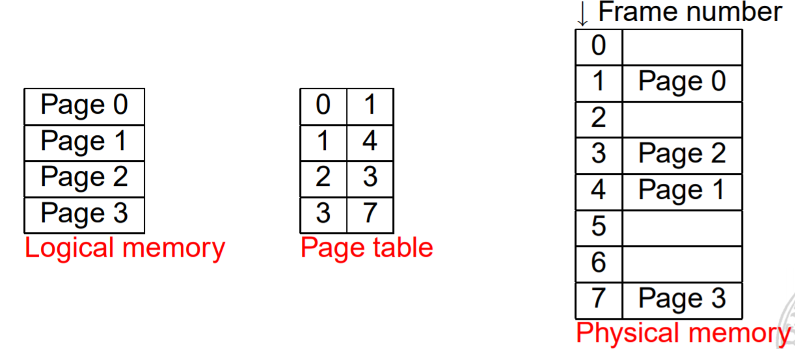
Logical to Physical
Translation Logical address space → page table per process → physical address space

Slide 11
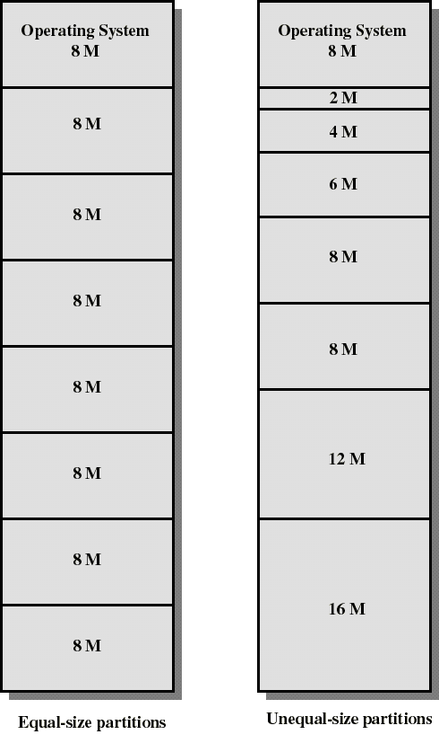
Fixed Partitioning
Partition main memory into a set of non overlapping regions called partitions
Partitions can be of equal or unequal sizes

Slide 12
Simple Paging
Main memory is partition into equal fixed-sized chunks قطع(of relatively small size)
Each process is also divided into chunks of the same size called pages
The process pages can thus be assigned to the available chunks in main memory called frames (or page frames)
Consequence: a process does not need to occupy a contiguous portion of memory

Slide 13
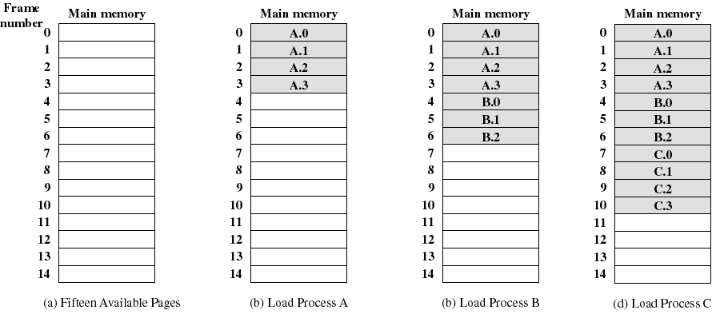
Example of process loading
a sequence of processes using the page frames

Slide 14
Simple Segmentation
Each program is subdivided into blocks of non-equal size called segments
When a process gets loaded into main memory, its different segments can be located anywhere
Each segment is fully packed with instructs/data: no internal fragmentation
There is external fragmentation; it is reduced when using small segments

Slide 15
Simple Segmentation
In contrast with paging, segmentation is visible to the programmer
The OS maintains a segment table for each process. Each entry contains:
  the starting physical addresses of that segment.
  the length of that segment (for protection)

Slide 16
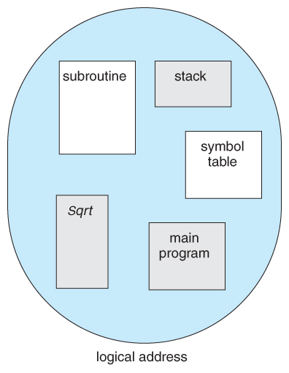
For example, a C compiler might generate 5 segments for the user code, library code, global ( static ) variables, the stack, and the heap, as shown in the Figure
Programmer's view of a program

Slide 17
segmentation and paging comparison
Segmentation requires more complicated hardware for address translation
Segmentation suffers from external fragmentation
Paging only yield a small internal fragmentation
Segmentation is visible to the programmer whereas paging is invisible

