Slide 1
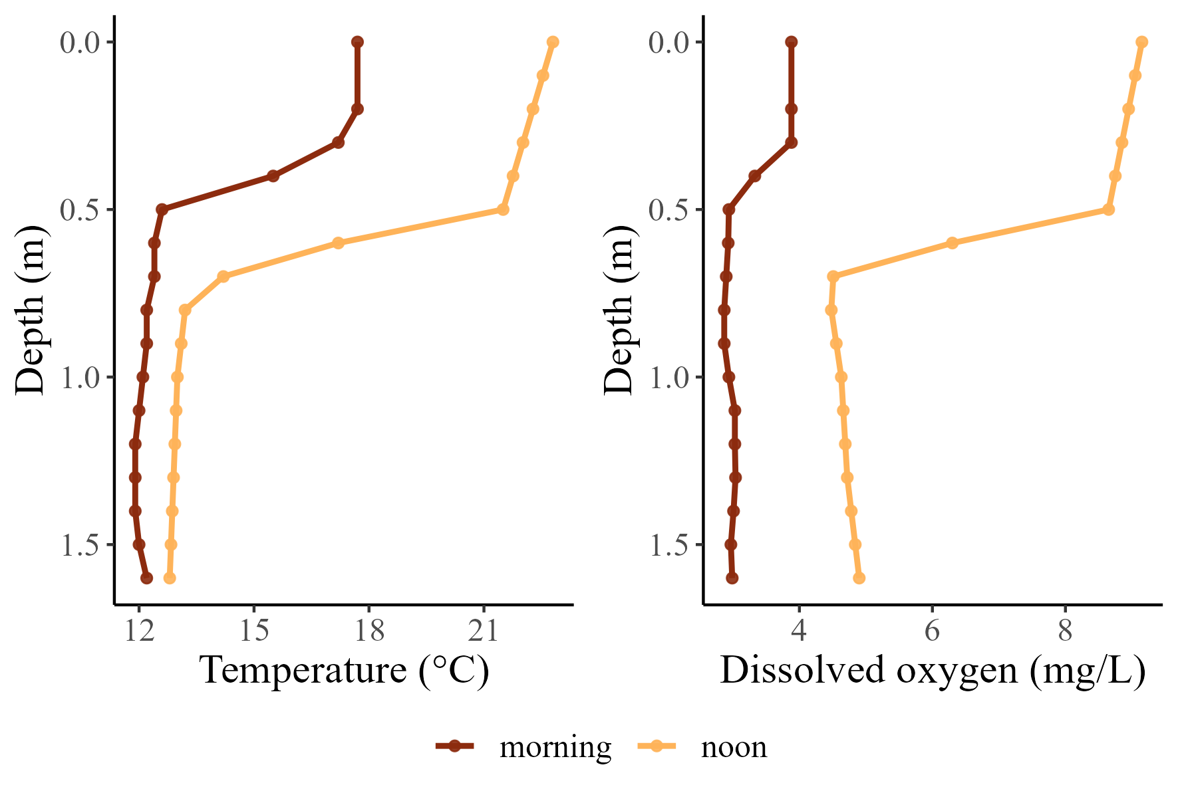
Notes:
Figure 1. Diel contrasts in temperature and dissolved oxygen profiles for a floodplain alcove that provides thermal refuge for cold-water fishes of the Willamette River. Profiles were recorded at dawn (6:00, near DO-minima), and late afternoon (15:00, near the DO-maxima). Data are shown for Blue Ruin alcove.

Slide 2
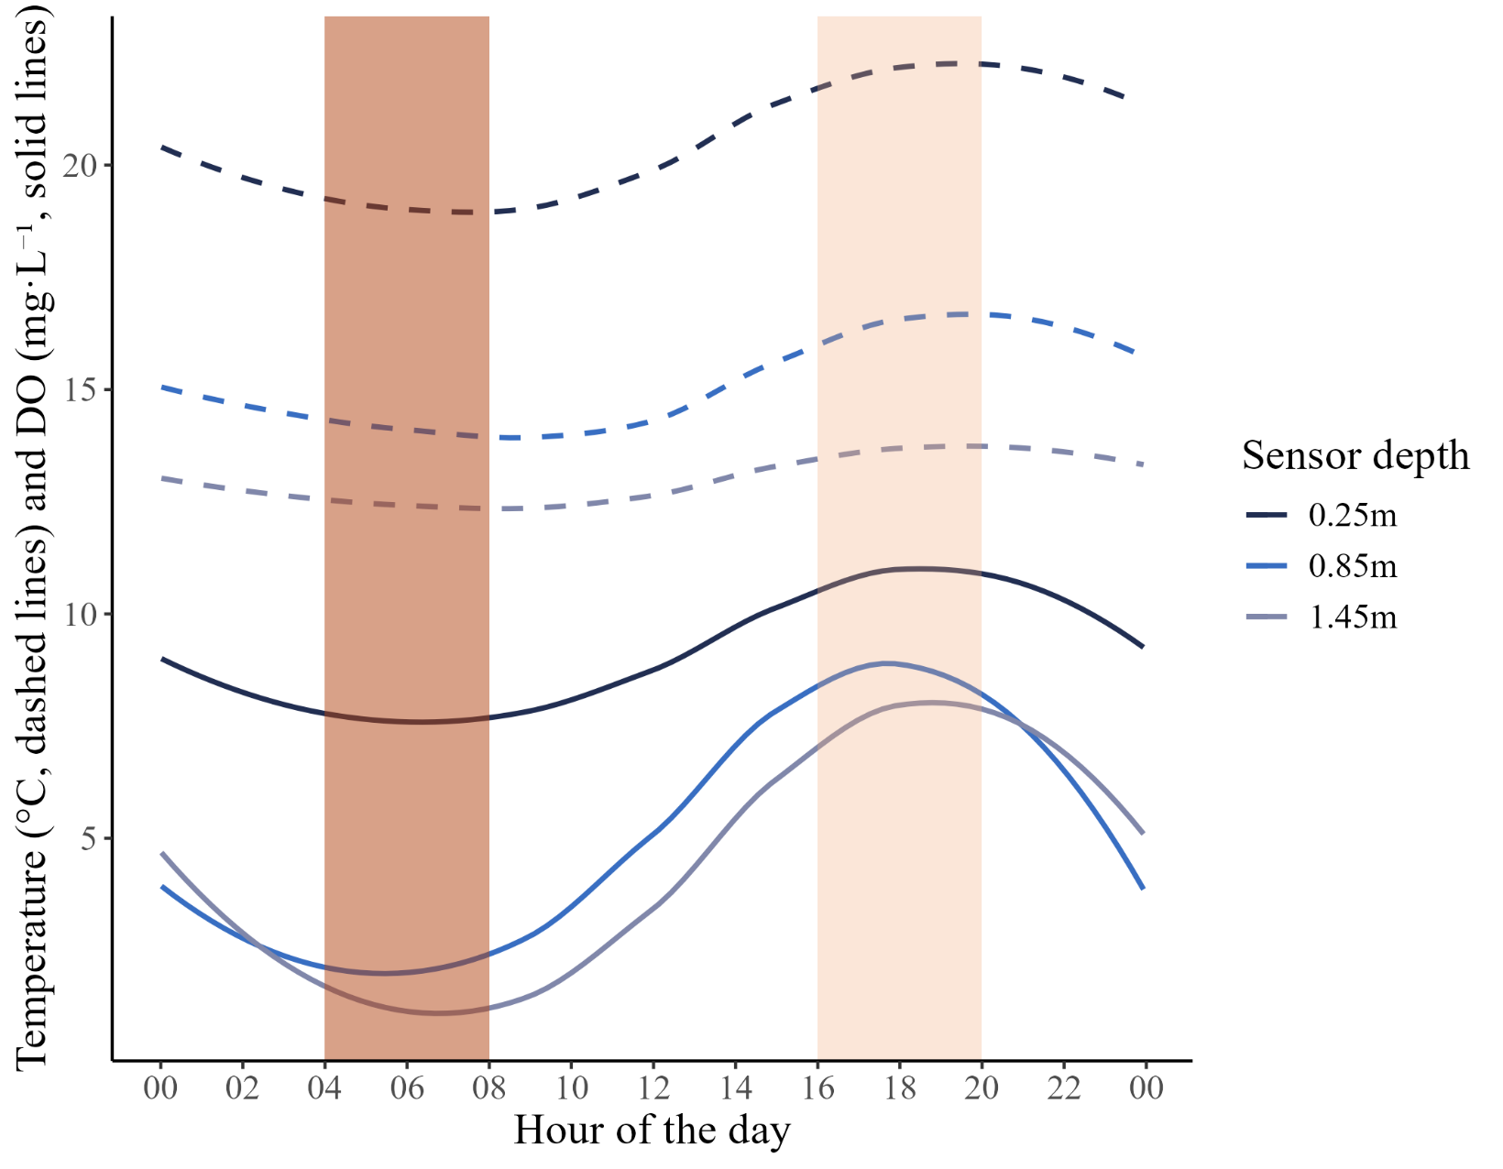
DO-min
Temp-max
Notes:
Figure 2. The diel cycle of water temperature and dissolved oxygen at three depths of a stratified floodplain alcove. Dashed lines represent temperature (°C), and solid lines represent dissolved oxygen (mg • L⁻¹). Shaded bars highlight the asynchrony between periods of peak hypoxia (dark pink) and peak thermal stress (light pink). Data shown here are for July 27th 2021 in Norwood alcove and have a 5-minute temporal resolution.

Slide 3
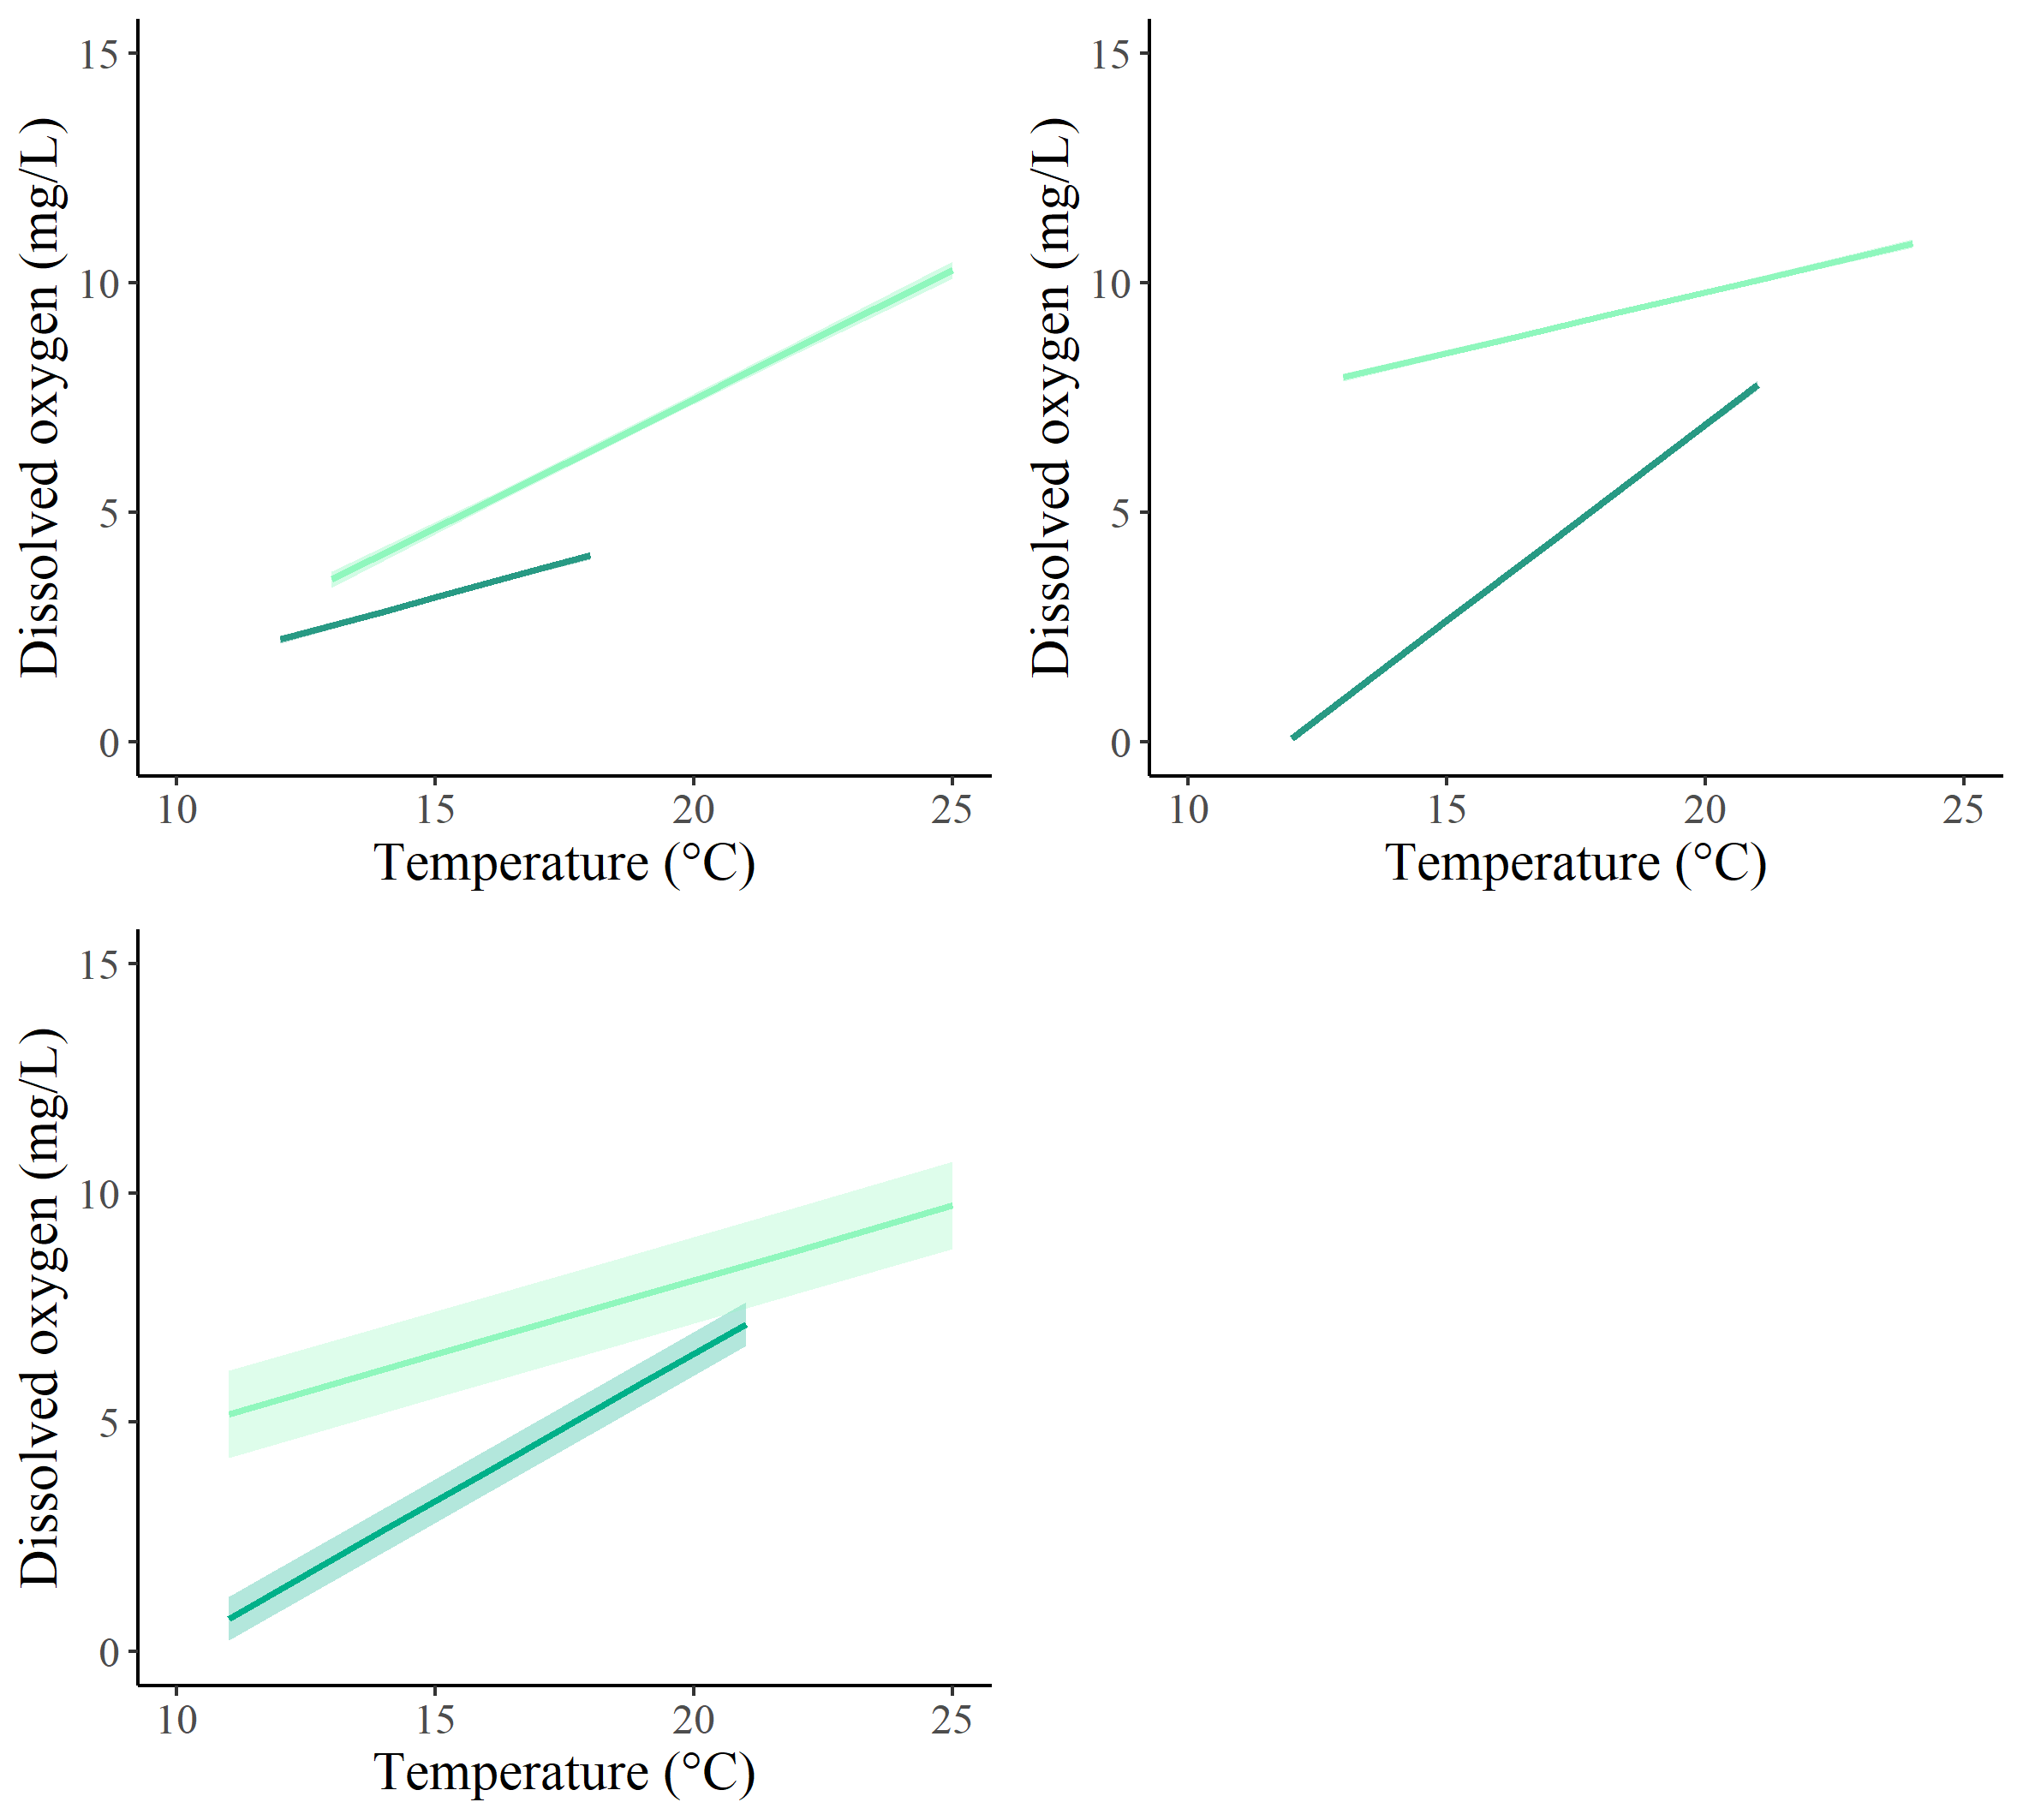
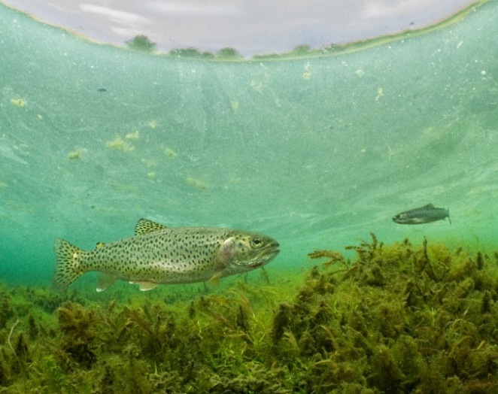
Notes:
Figure 3. Results from linear mixed models evaluating the relationship between temperature and DO comparing the 2-hour window that approximates the DO-minima (dark green) to the 2-hour window that approximates the DO-maxima (light green) in a. Blue Ruin cold-water alcove, b. Norwood cold-water alcove, and c. all six cold-water alcoves. All linear fits are plotted with their 95% confidence interval envelopes. d. Photo of a coastal cutthroat trout in Blue Ruin cold-water alcove (photo credit: Dave Herasimtschuk, Freshwaters Illustrated).

Slide 4
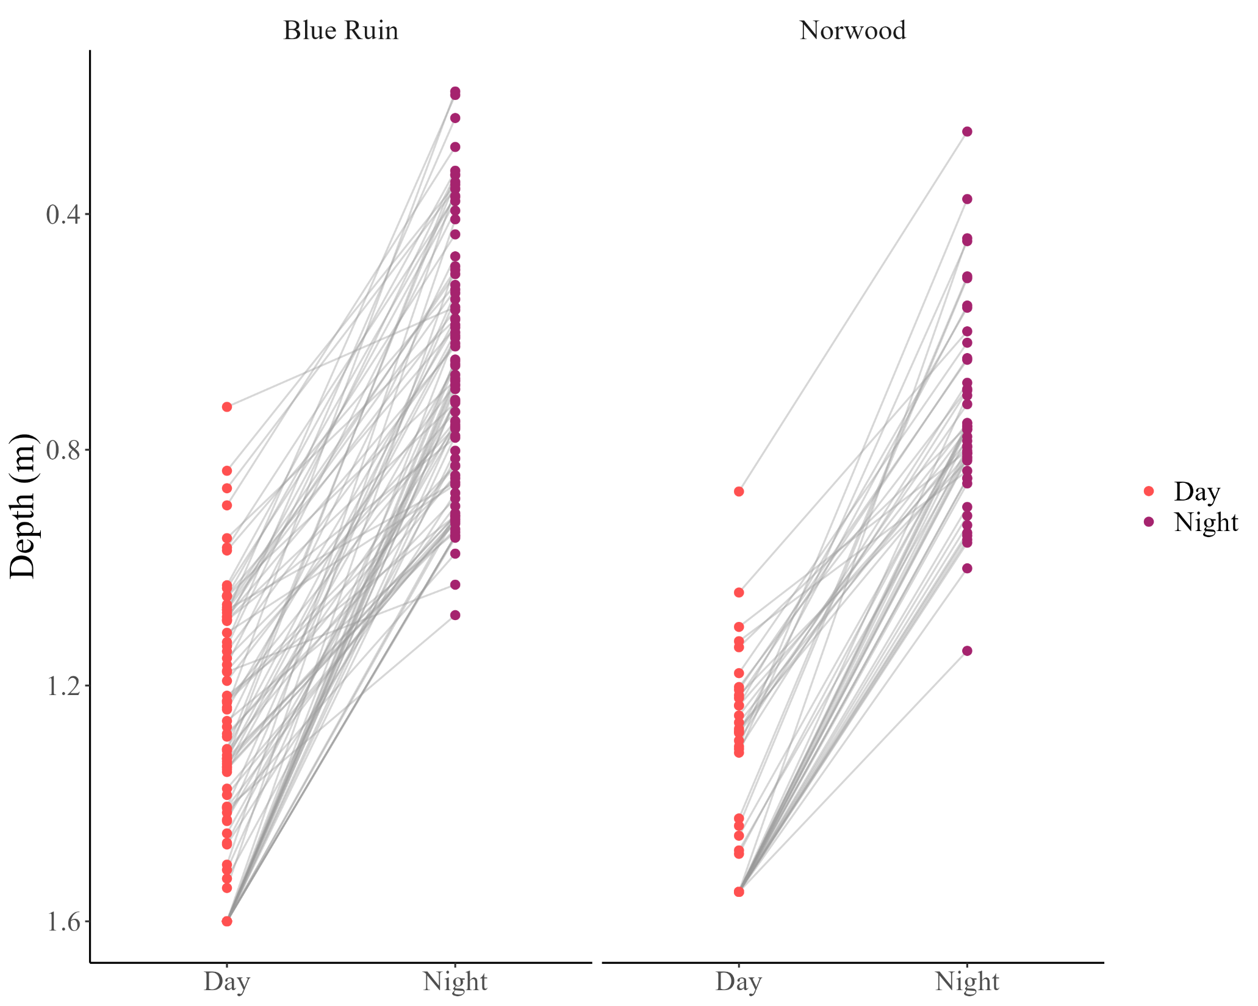
Notes:
Figure 4. Diel changes in vertical position of tagged cutthroat trout for one week (July 30 – August 6). Each point represents the median depth of an individual fish during either day (red) or night (purple), and gray lines connect paired day-night values for the same fish and date.

Slide 5
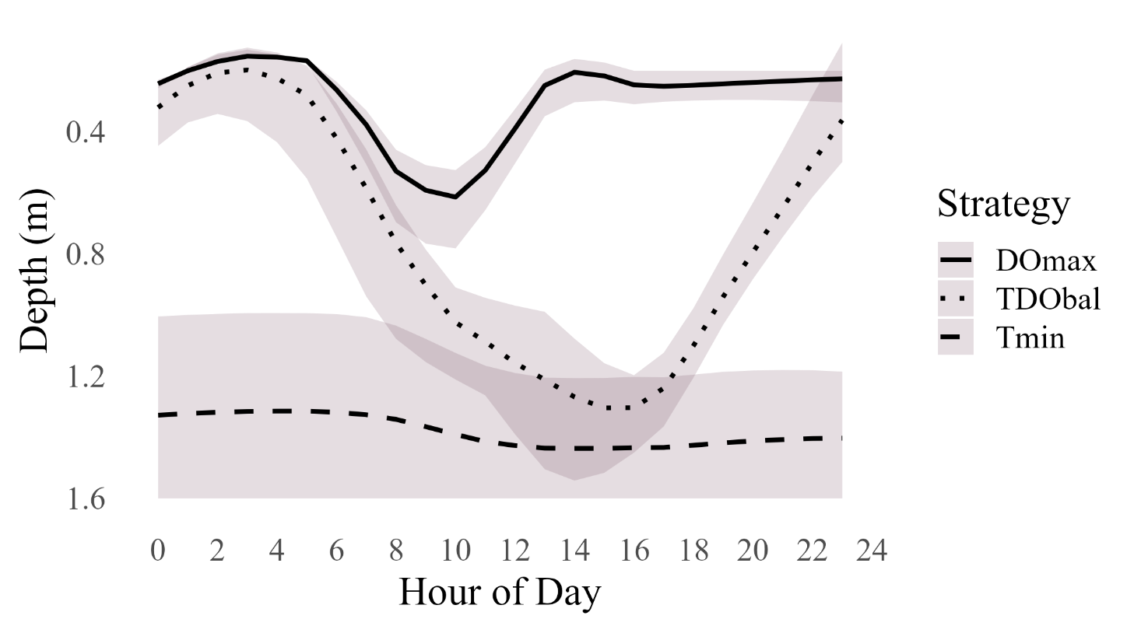
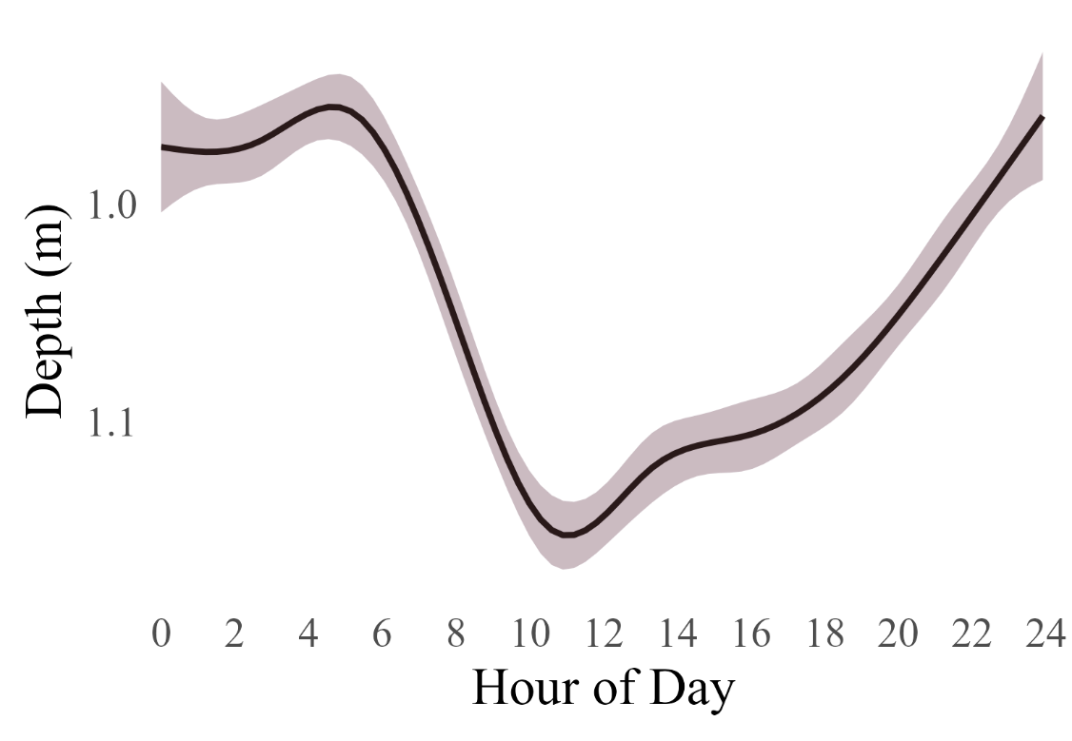
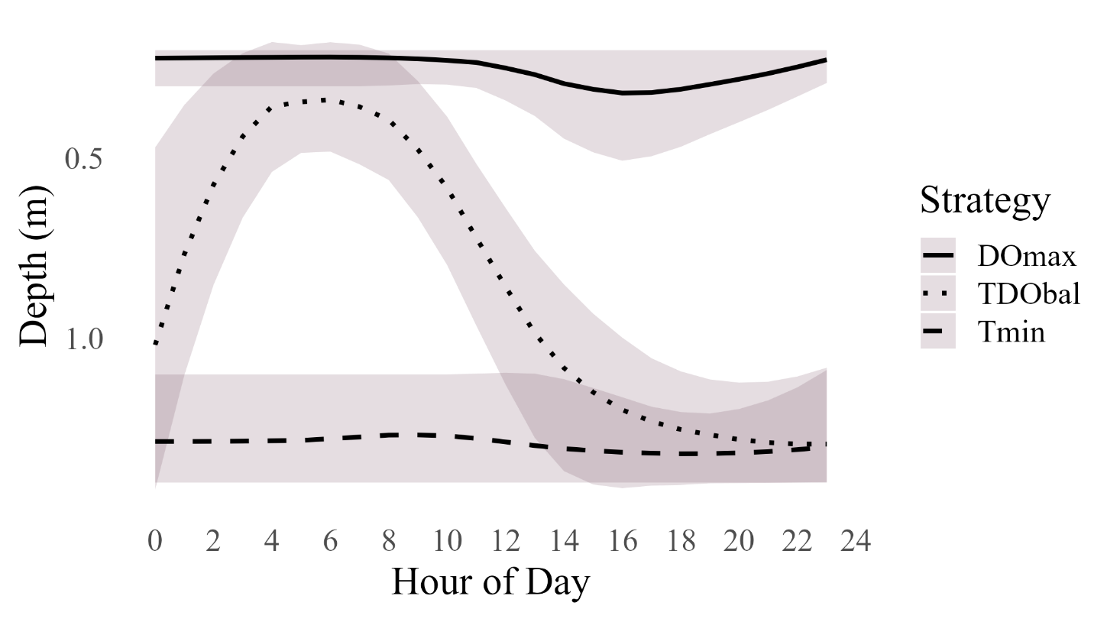
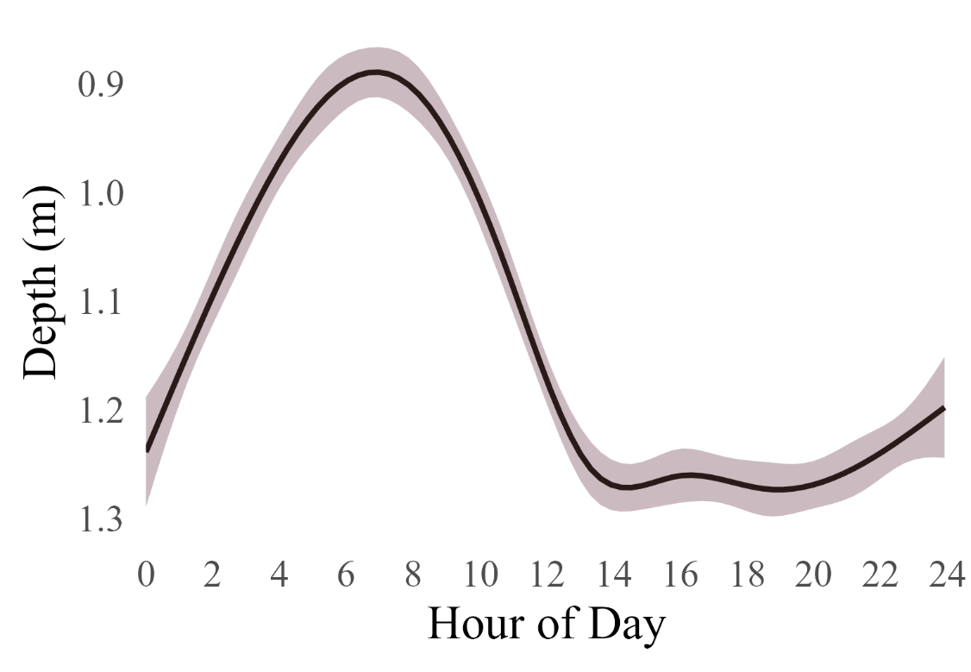
Notes:
Figure 5. Depth selection behavior of cutthroat trout in Norwood and Blue Ruin alcoves across diel cycles. a. Conceptual simulation of fish depth over a 24-hour period at Norwood (August 1), based on three idealized behavioral strategies: maximizing dissolved oxygen (DOmax), minimizing water temperature (Tmin), or optimizing both concurrently (TDOopt). b. Smoothed plot of observed diel vertical migration for tagged cutthroat trout at Norwood, pooled across individuals from August 1–7. c. Conceptual simulation of fish depth over a 24-hour period at Blue Ruin (August 1), using the same behavioral strategies. d. Smoothed plot of observed diel vertical migration for pooled iButton temperature data from Blue Ruin, August 1–7.
Ameliorate exposure to DO but mainly reduce exposure to temperature – restate temperature as metabolic costs plot inverse of oxygen to show radial plots of stressors metabolic costs and hypoxia

Slide 6
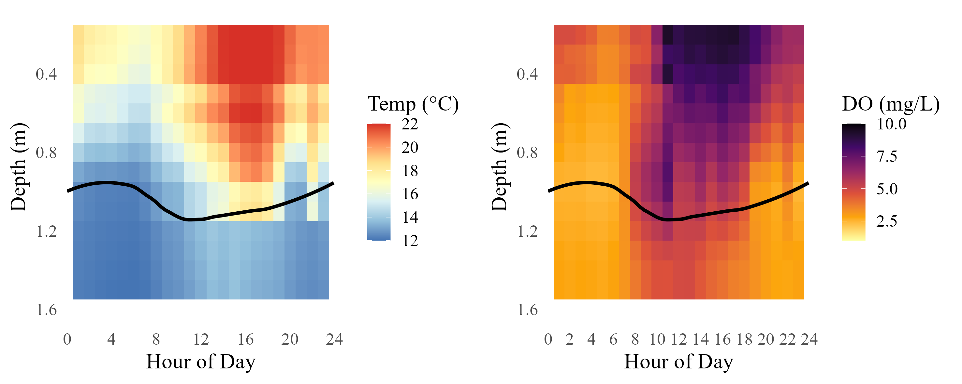
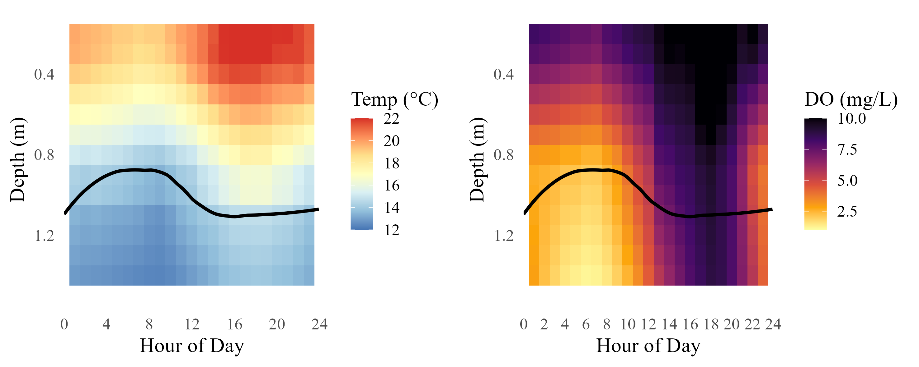
Notes:
Figure 6. Temperature and dissolved oxygen (DO) profiles in relation to observed fish depth in Blue Ruin and Norwood alcoves. Color gradients represent hourly environmental conditions on August 1. Black lines indicate the smoothed depth of tagged cutthroat trout, pooled across individuals from August 1–7. a. Temperature profile in Blue Ruin. b. Dissolved oxygen profile in Blue Ruin. c. Temperature profile in Norwood. d. Dissolved oxygen profile in Norwood.

Slide 8
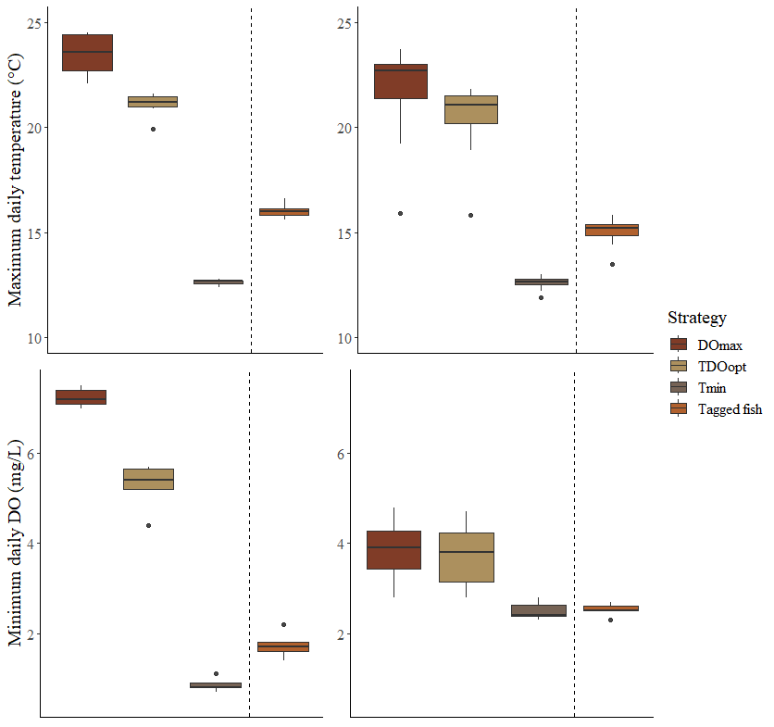
Norwood
Blue Ruin
Notes:
Need to redo now that we’ve added stochasticity to simulation. Figure 5. Maximum daily temperature and minimum daily DO encountered by simulated fish under three different strategies (n = 7 days), compared to corresponding average maximum and average minimum values for tagged fish held in enclosures (n = 19 individuals). - what did they select irellevant of how much is available, just care about range – this shows that they are between tmin and tdo opt – in Norwood avoid lowest Dos, in BR doesn’t buffer them from DO that much

Slide 9
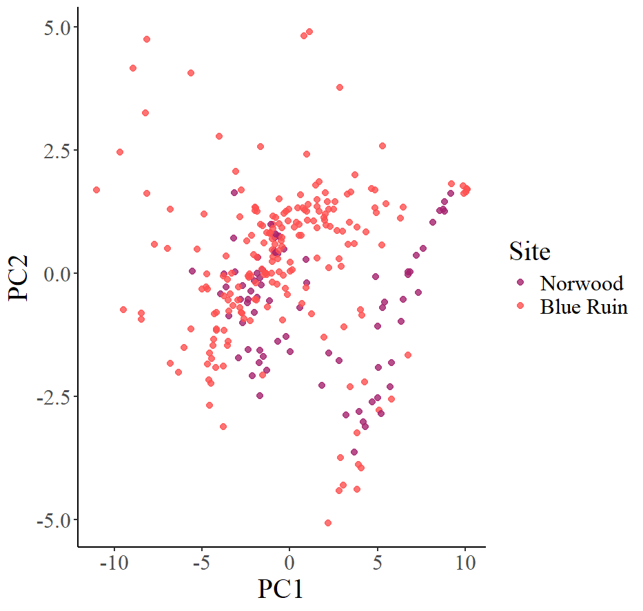
Notes:
Principal component analysis (PCA) revealed that fish depth profiles were structured along two primary behavioral gradients: overall depth use (PC1, 69% of variance explained) and diel vertical migration (DVM) strength (PC2, 10%). Depth profiles with high PC1 scores reflected greater overall depth use throughout the day, while PC2 differentiated individuals based on the strength and timing of vertical movement. Blue Ruin fish tended to score higher on PC2, consistent with more pronounced DVM behavior, while Norwood fish generally occupied deeper positions in the water column (higher PC1 scores). A PERMANOVA on the scaled hourly depth matrix confirmed that site explains a small but statistically significant portion of the variation in vertical habitat use (R² = 0.092, p = 0.001). These patterns were also supported by the PCA loadings, which showed a gradual diel shift in depth use structure along PC2.

Slide 10
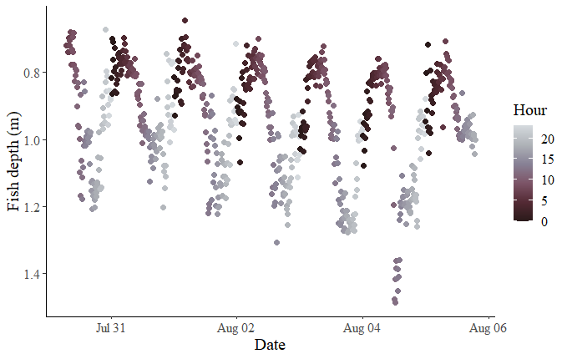
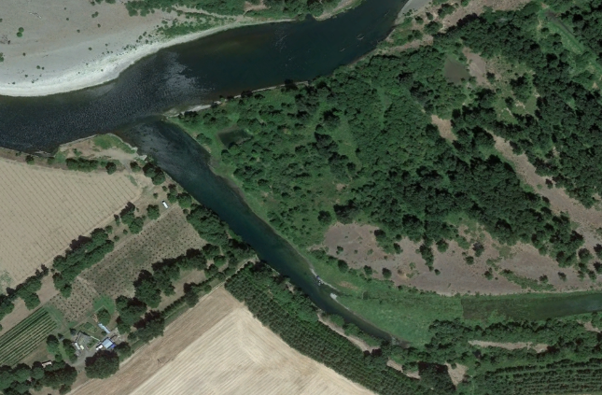
Notes:
Old part of Figure 4 to be removed?

Slide 11
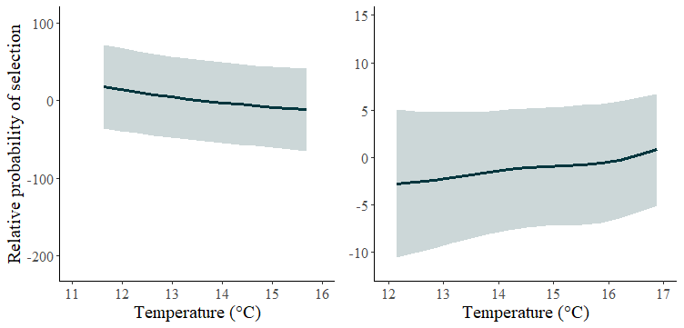
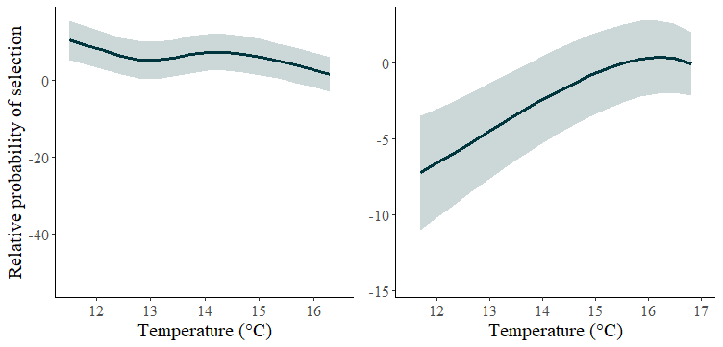
Notes:
Old figure 6 to be removed? Predicted temperature selection for tagged coastal cutthroat trout held in enclosures during the 2-hour windows of DO-maxima and DO-minima. In all plots, DO was held constant at 4mg • L⁻¹ (EPA threshold for cold-water fish), and the x-axis was constrained to the range of temperatures selected by fish during the 2-hour window.

