Slide 1
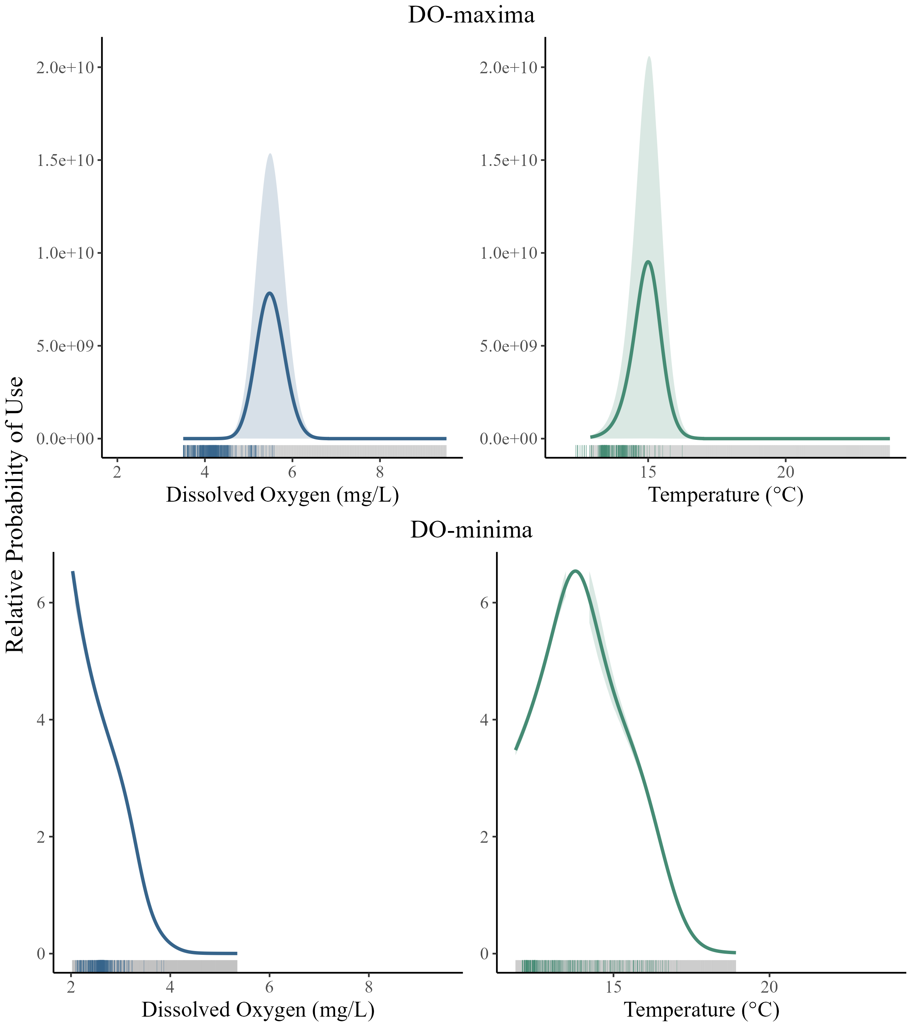
a
DO-maximum
DO-minimum

Slide 2
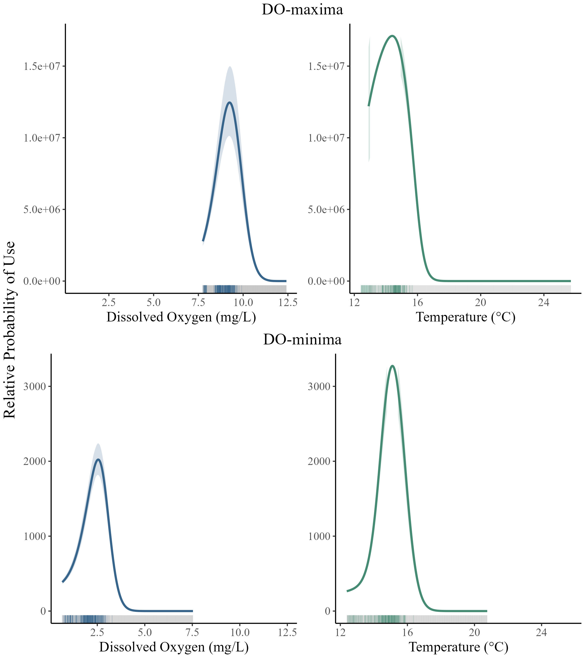
b
DO-maximum
DO-minimum

