Slide 1
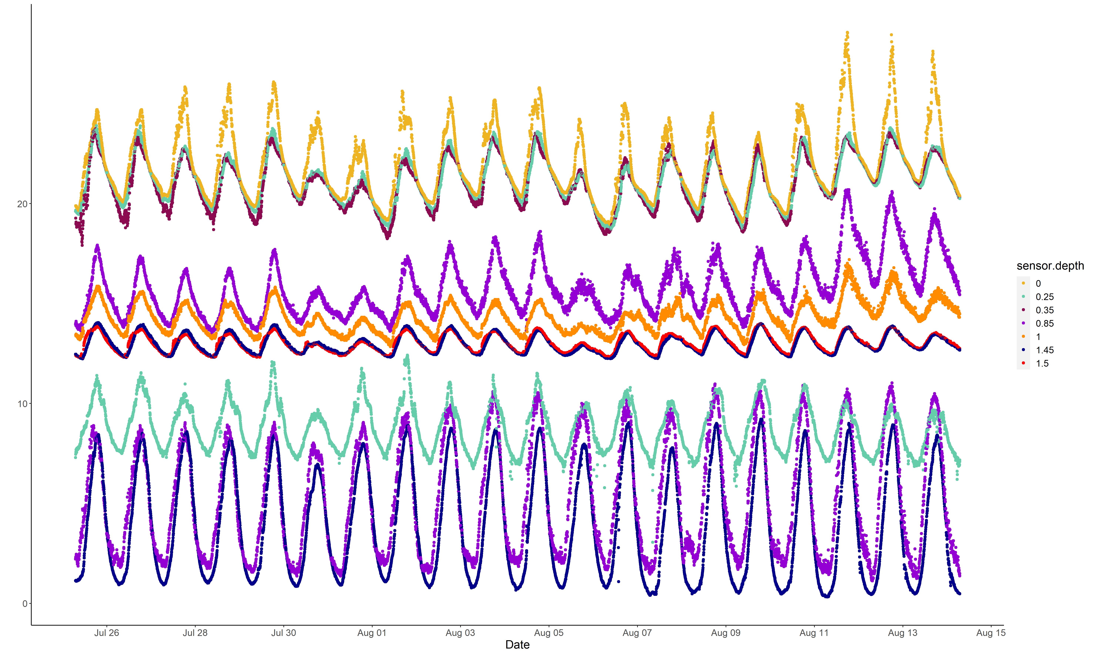
Temperature ℃
Dissolved oxygen mg/L

