Slide 1
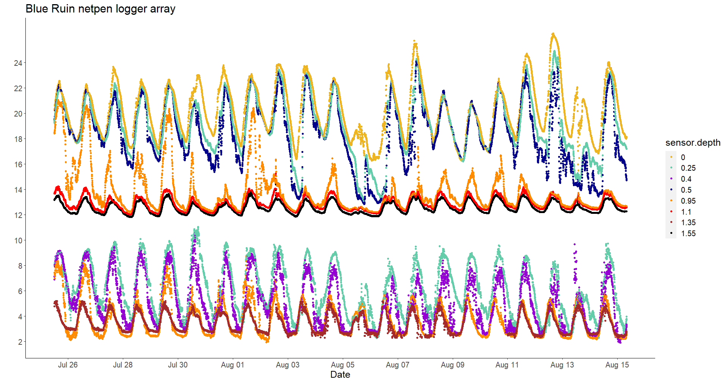
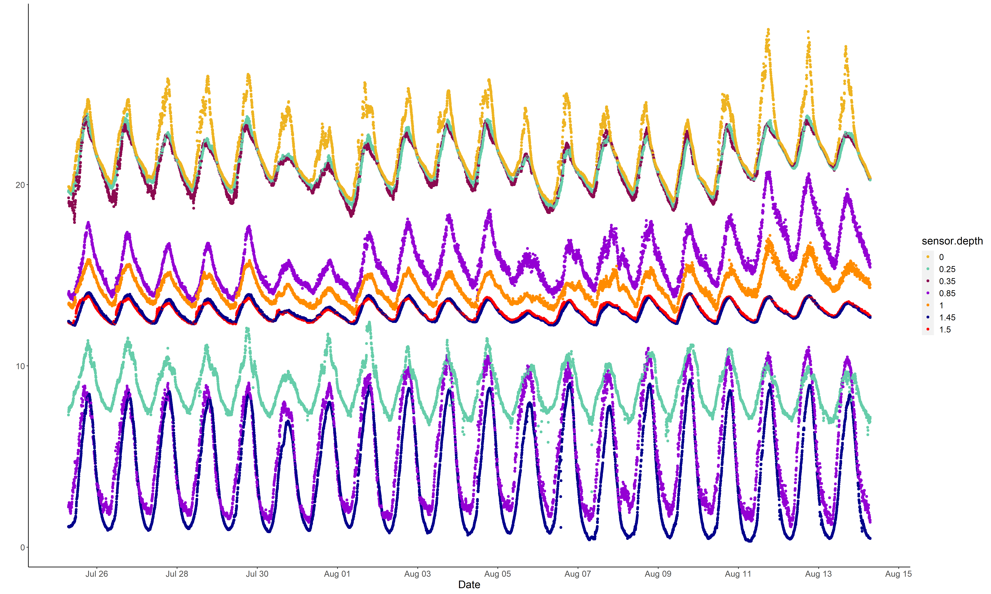
A
B
Notes:
Increase font size, match axis label ticks (A is BR, B is NOR), how to differentiate temperature and oxygen – bracket with label or box with slight shading?

Slide 2
A
Temp ℃
DO mg/L
B
Temp ℃
DO mg/L
Notes:
Increase font size, match axis label ticks (A is BR, B is NOR), how to differentiate temperature and oxygen – bracket with label or box with slight shading?

Slide 3
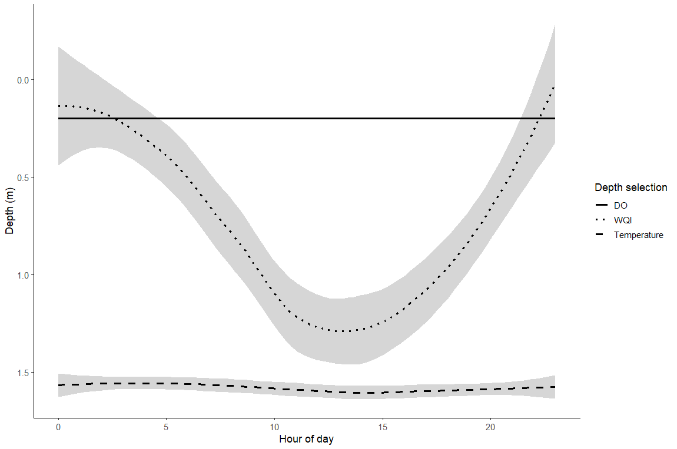

Slide 4
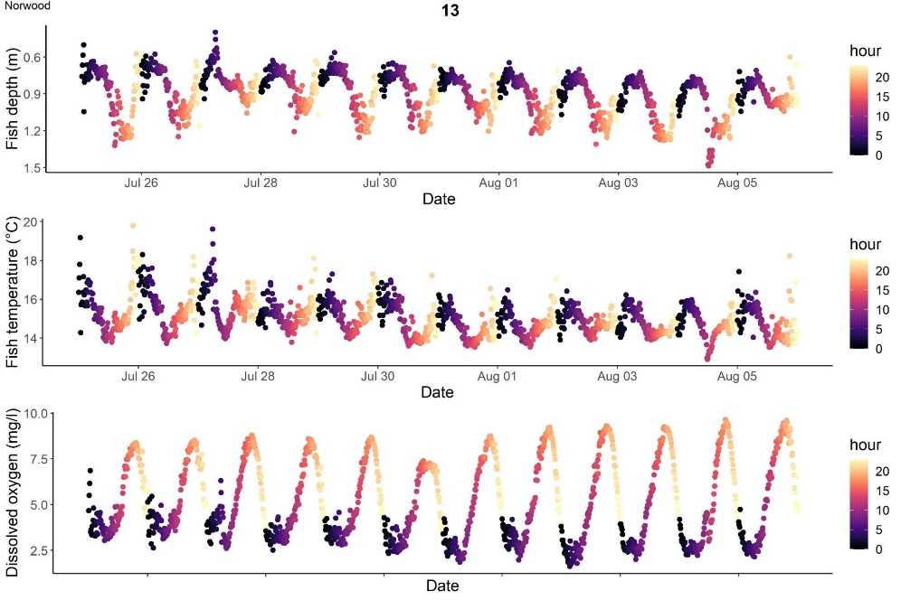
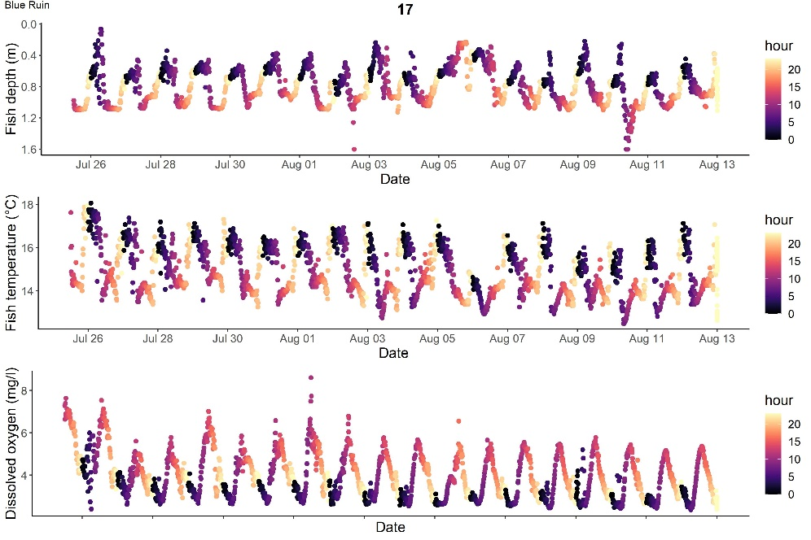
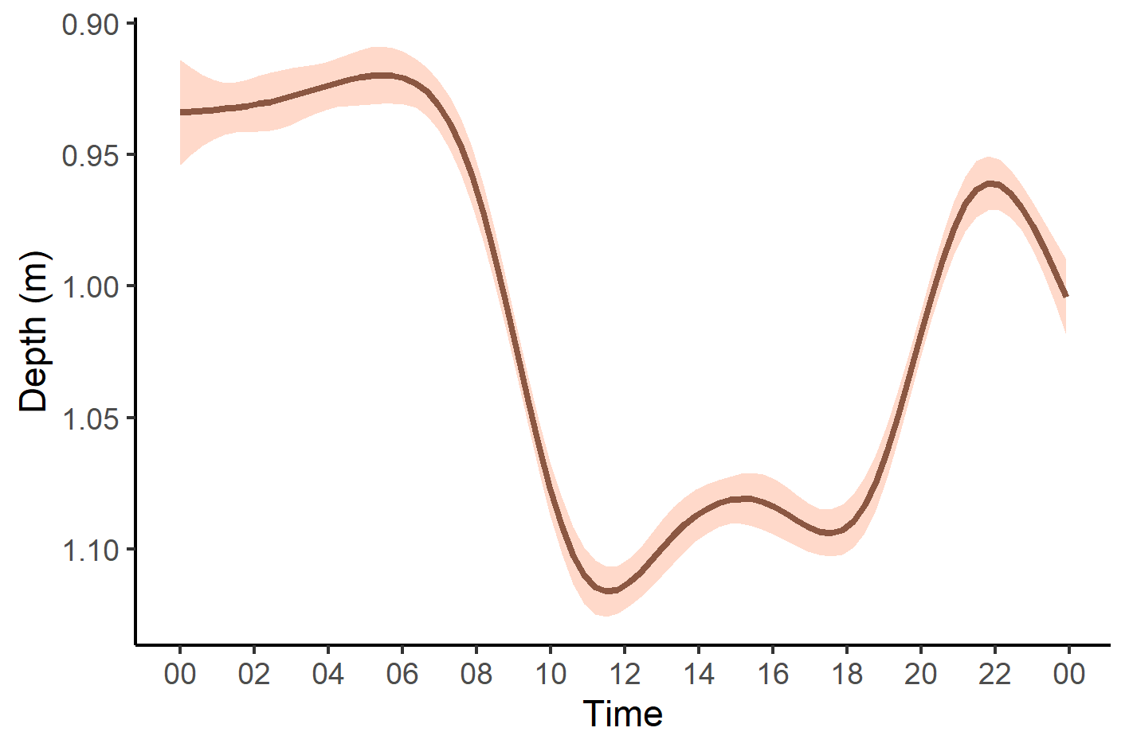
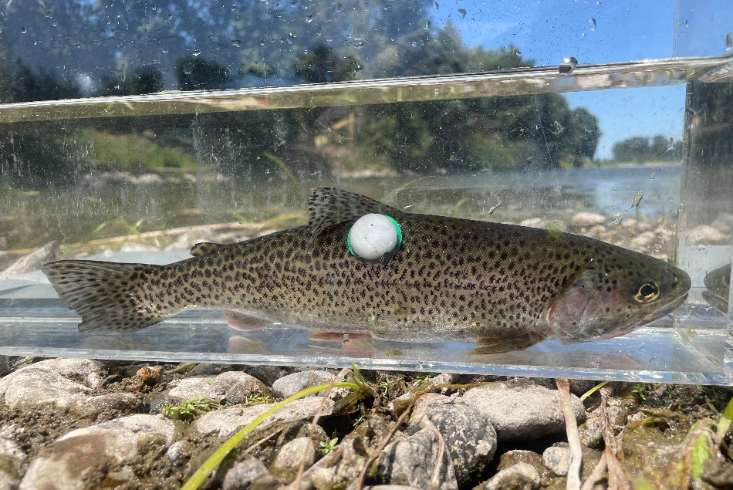
Notes:
Is smoothed fit just for BR fish? If so fourth panel could be smoothed fit for NOR fish (remove fish pic) – do separate and joined fits to see

Slide 5
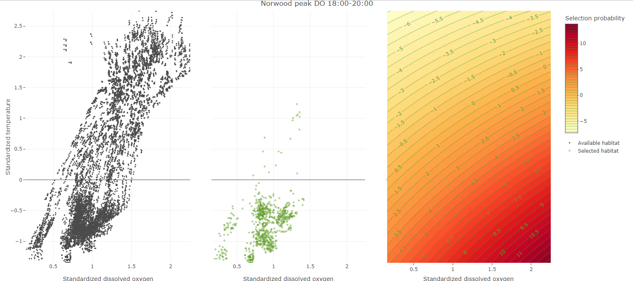
Notes:
modeled selection probability – contours with values greater than 0 (or warmer colors) represent increasing probability of selection. This probability space will predict beyond the bounds of observed data, so I have cut off the margins so we are just looking at the space that is representative of the data. We can see that the warmest colors/highest probability of selection is in areas of low temp high do

Slide 6
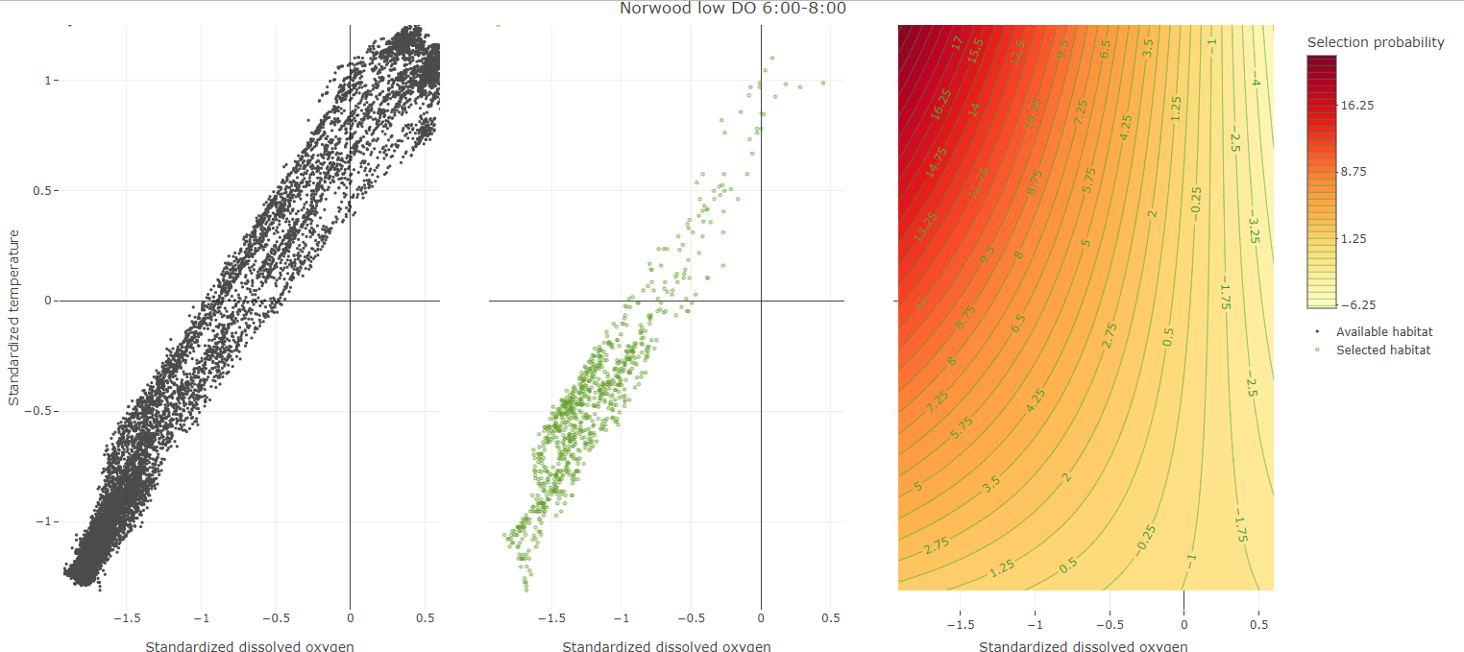
Notes:
Now looking at the selection probability we can see that the highest probability of selection is correlated with this moderately low temp and do. So here fish appear to be moving towards the surface just enough to grab a bit higher DO, but are generally avoiding areas with the warmer temps and highest DO.
The takeaway here is that selection probability is shifting from lowest available temperatures (during period high do), to more moderate temperatures (during period of low do) – given what is available, probability of temperature selection is shifting from coolest available to warmer.

