Slide 1
Coldwater fish navigate fine scale diel variation in dissolved oxygen and temperature in a floodplain thermal refuge habitat

Slide 2
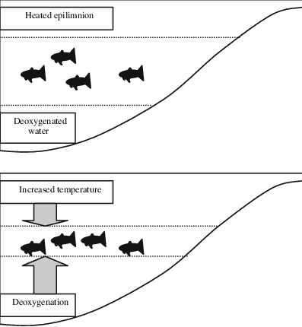
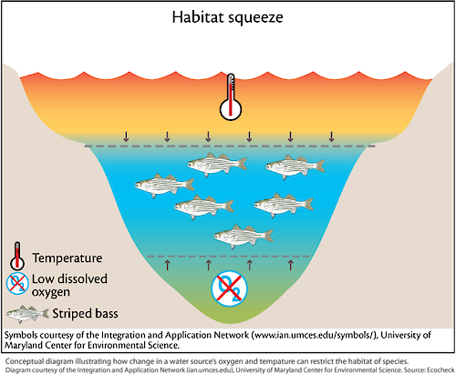
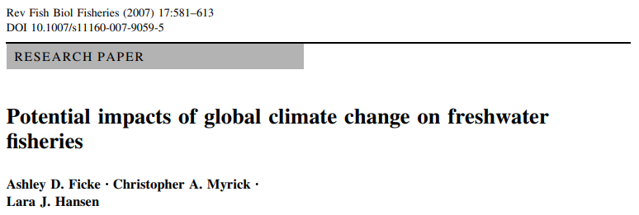
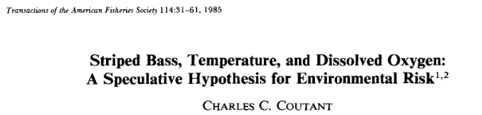
Temperature oxygen squeeze
Notes:
In thermally heterogeneous environments, we would expect animals to find cooler habitat in response to warming. For terrestrial ectotherms, this may be as simple as moving into the shade or under a rock – there is still oxygen there. For fish however, available cold water can be unsuitable in other aspects, like dissolved oxygen.
The temperature oxygen squeeze is often discussed in the context of larger water bodies like marine environments, lakes, and reservoirs where fish are constrained both by warmer surface temperatures, and periodically to consistent hypoxia or anoxia at depth. However, we are interested in how this dynamic may play out in smaller bodies of water on river floodplains.
Metalimnion/thermocline is where you get both do and temp, we wanted to see if they were holding in this zone.

Slide 3
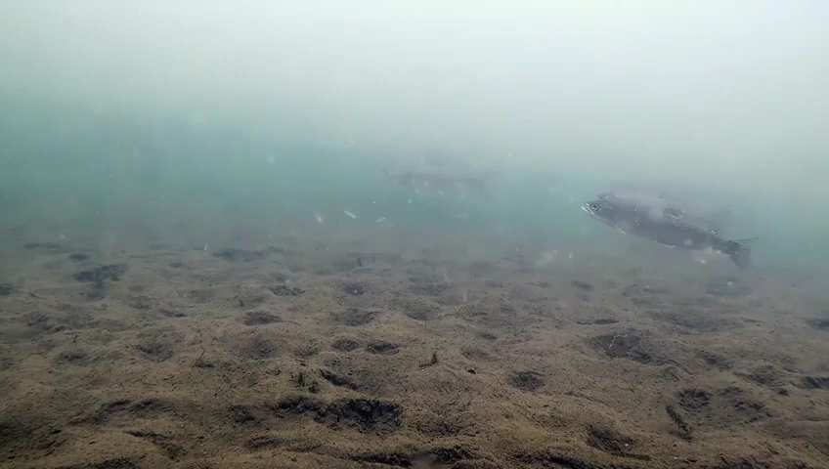
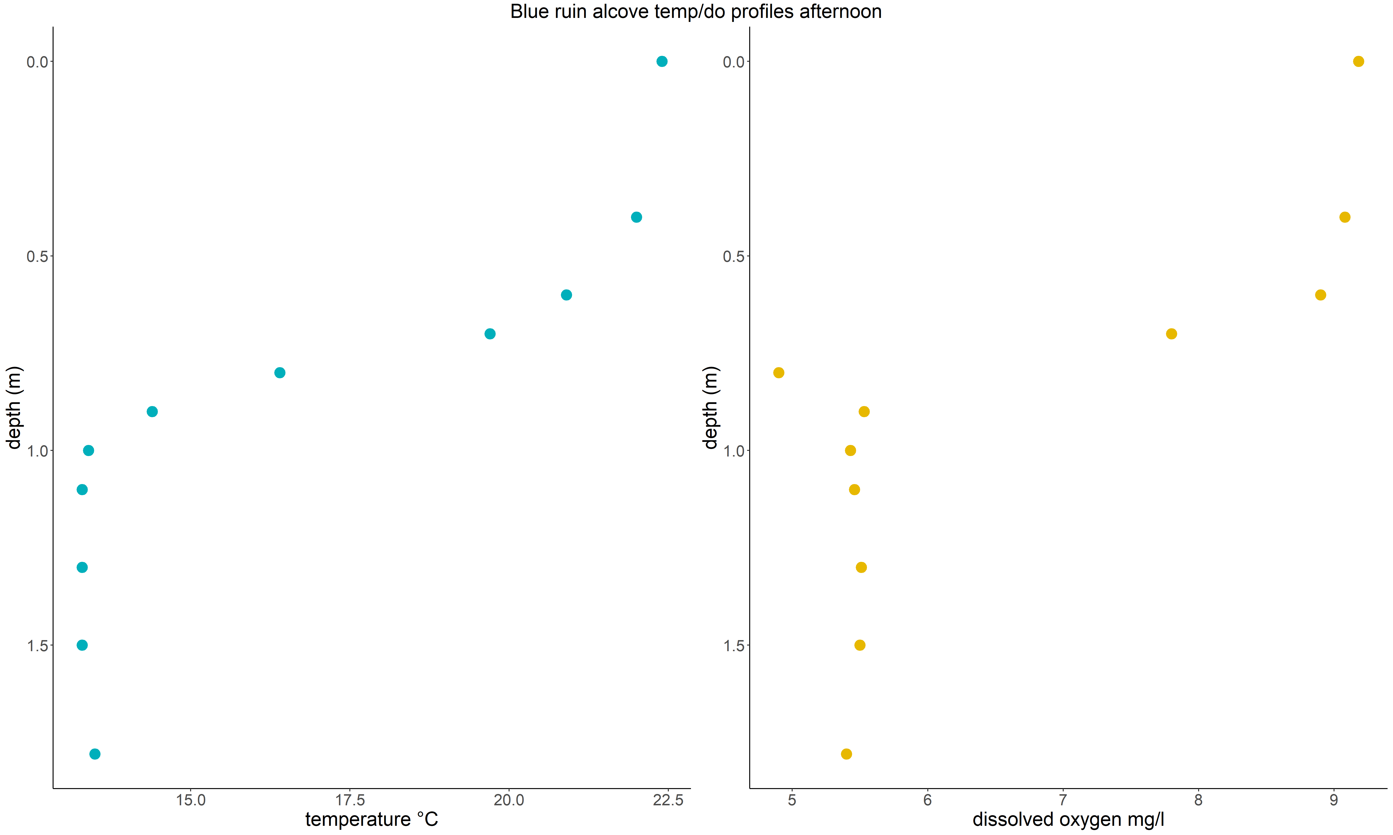
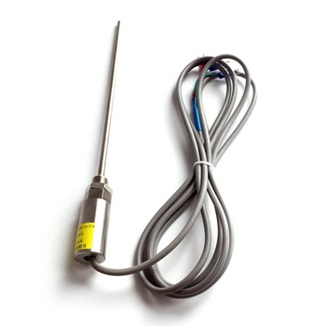
Notes:
During our time working in these alcoves, we noticed that fish appeared to consistently hold at a certain depth, and that depth appeared to correspond with the thermocline and oxycline. So we designed a study where we used a fine gauge rapid response thermocouple to take subdermal temperatures of fish we captured within select coldwater alcoves – since fish are ectothermic their internal tempertures should reflect the water temperature they were holding in. Fish were captured using electrofishing and immediately tested for internal temperature while still under electrical narcosis (~15 seconds). A handheld YSI was then used to measure the vertical profile of do/temperature where the fish was captured.
Tried all kinds of things that didn’t work…ARIS clip
Make points larger

Slide 4
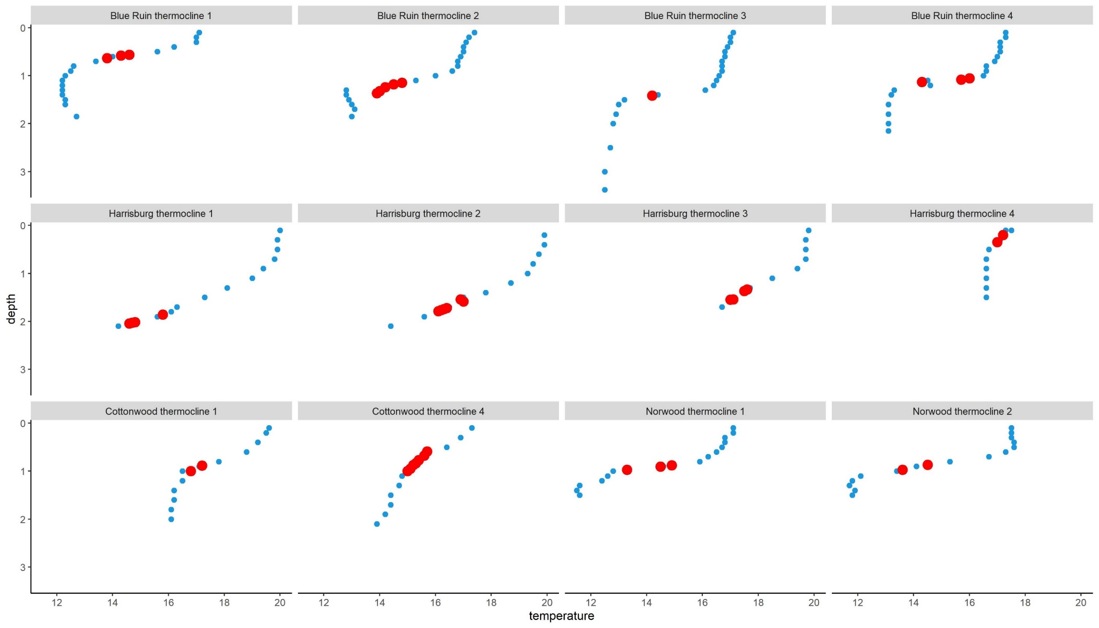

Slide 5
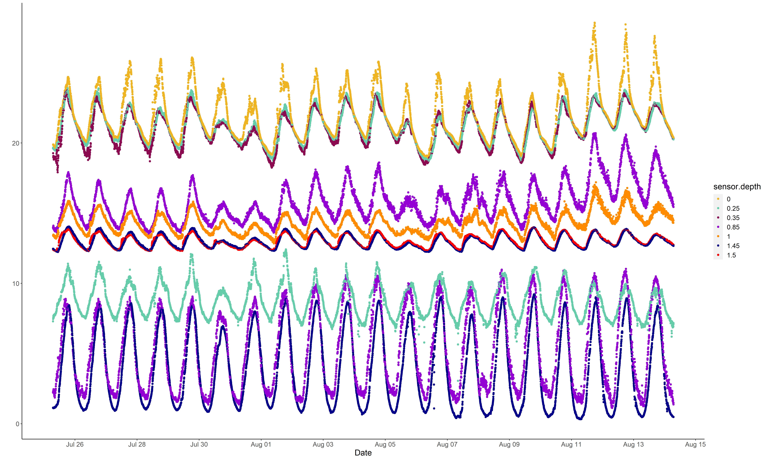
Norwood netpen logger array
Temperature ℃
Dissolved oxygen mg/L

Slide 6
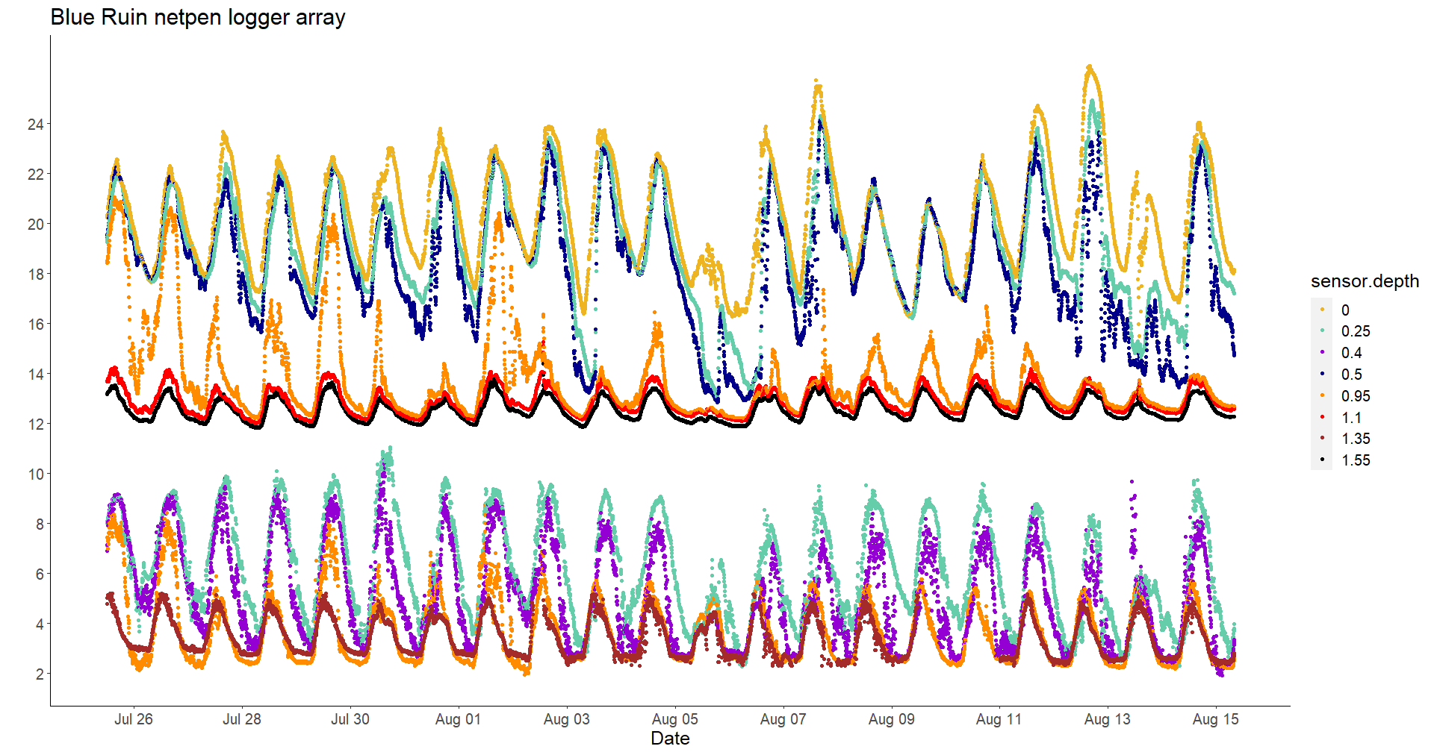
Temperature ℃
Dissolved oxygen mg/L

Slide 7
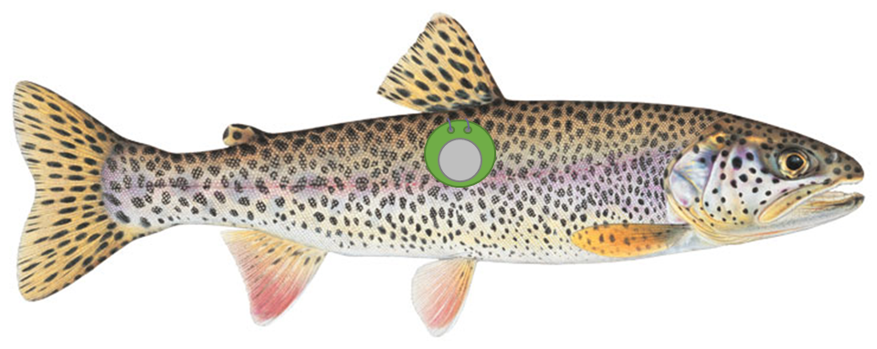
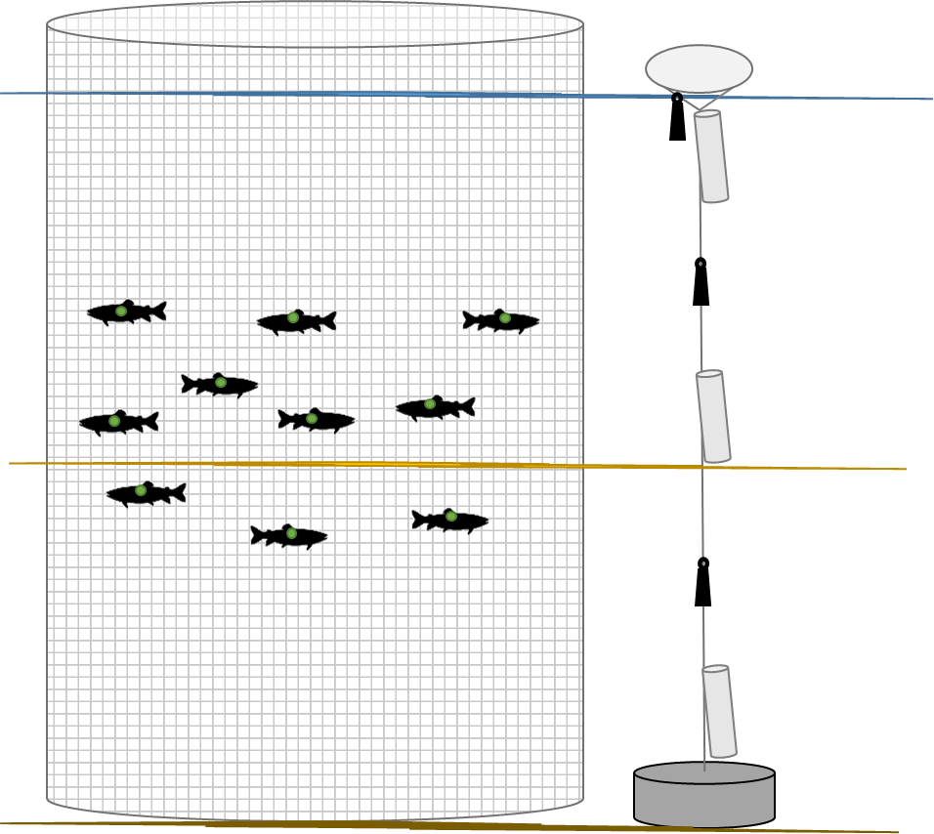
Notes:
So we designed a study where we externally attached waterproofed temperature recording ibuttons to fish captured in two coldwater alcoves, and released these fish in large netpens that spanned the entire depth of the alcove. An array of temperature and dissolved oxygen loggers set outside of the netpen continually recorded these physiochemical variables

Slide 8
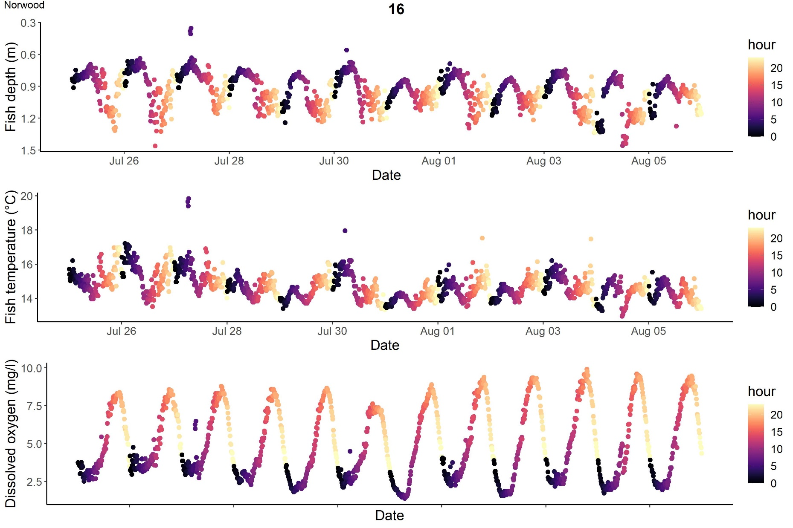

Slide 9
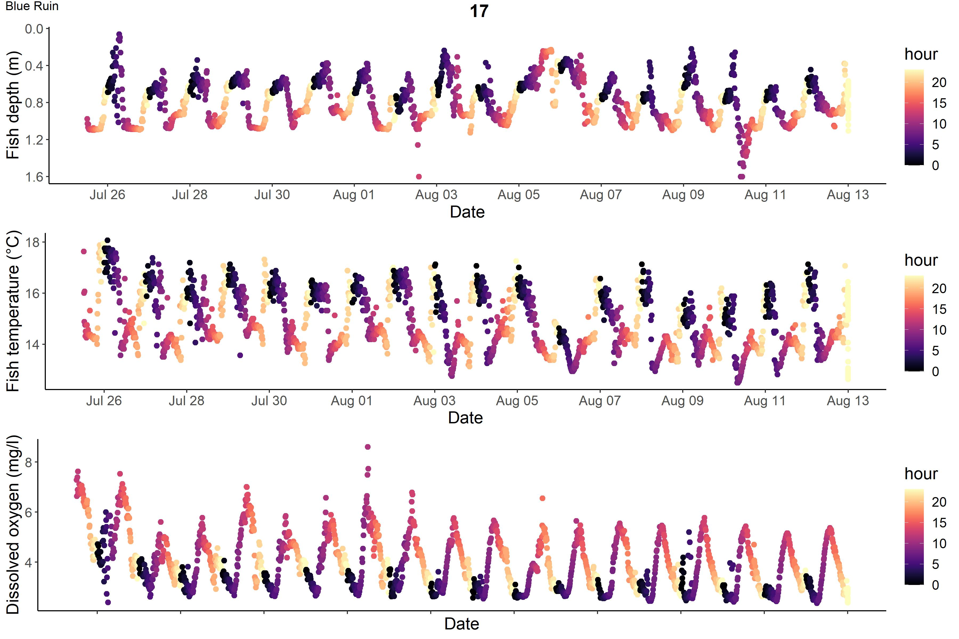

Slide 10
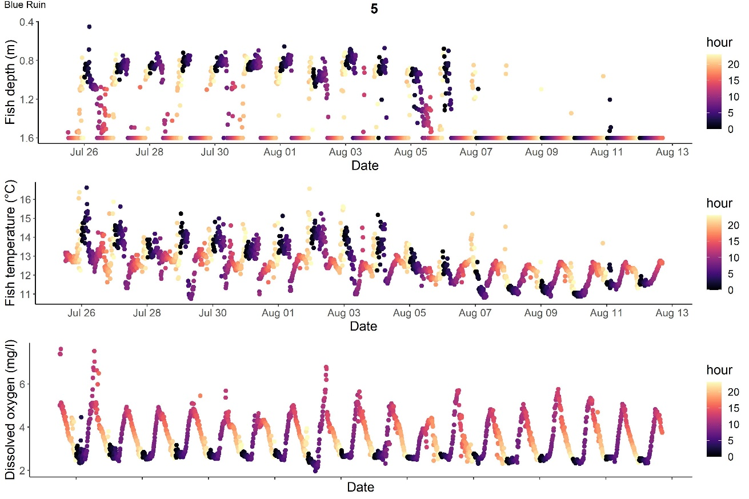
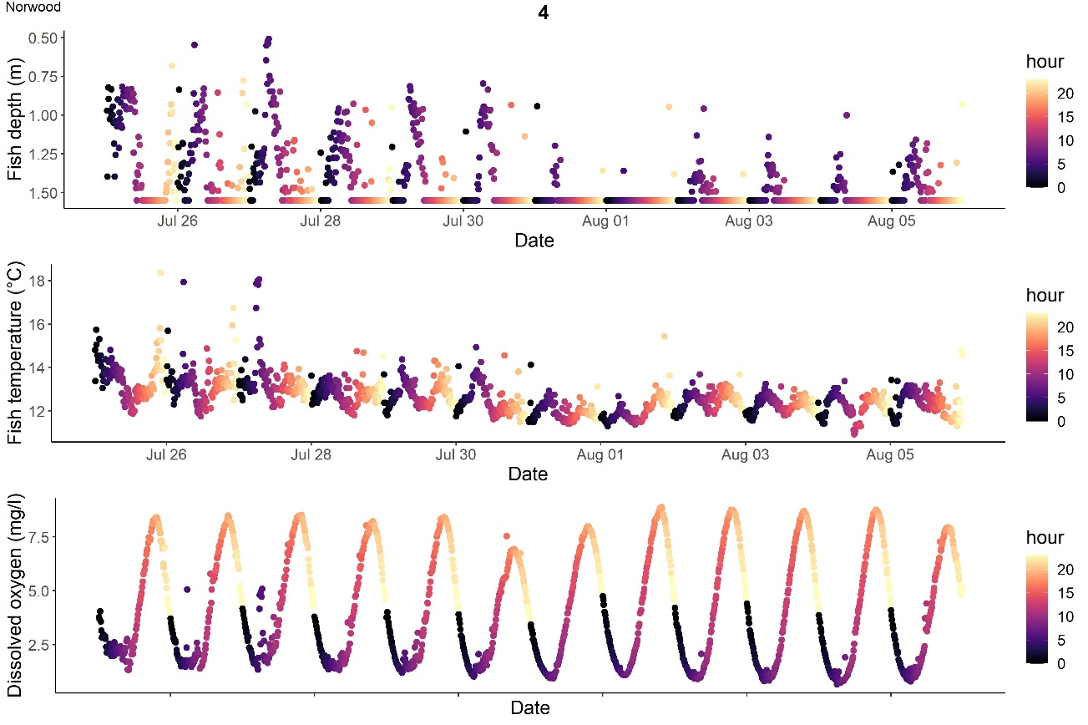
Individual and intra-individual behavioral variation
Fine scale vertical migration persists, extended time in hypolimnion and reduced vertical amplitude

Slide 11
Step selection function

Slide 12
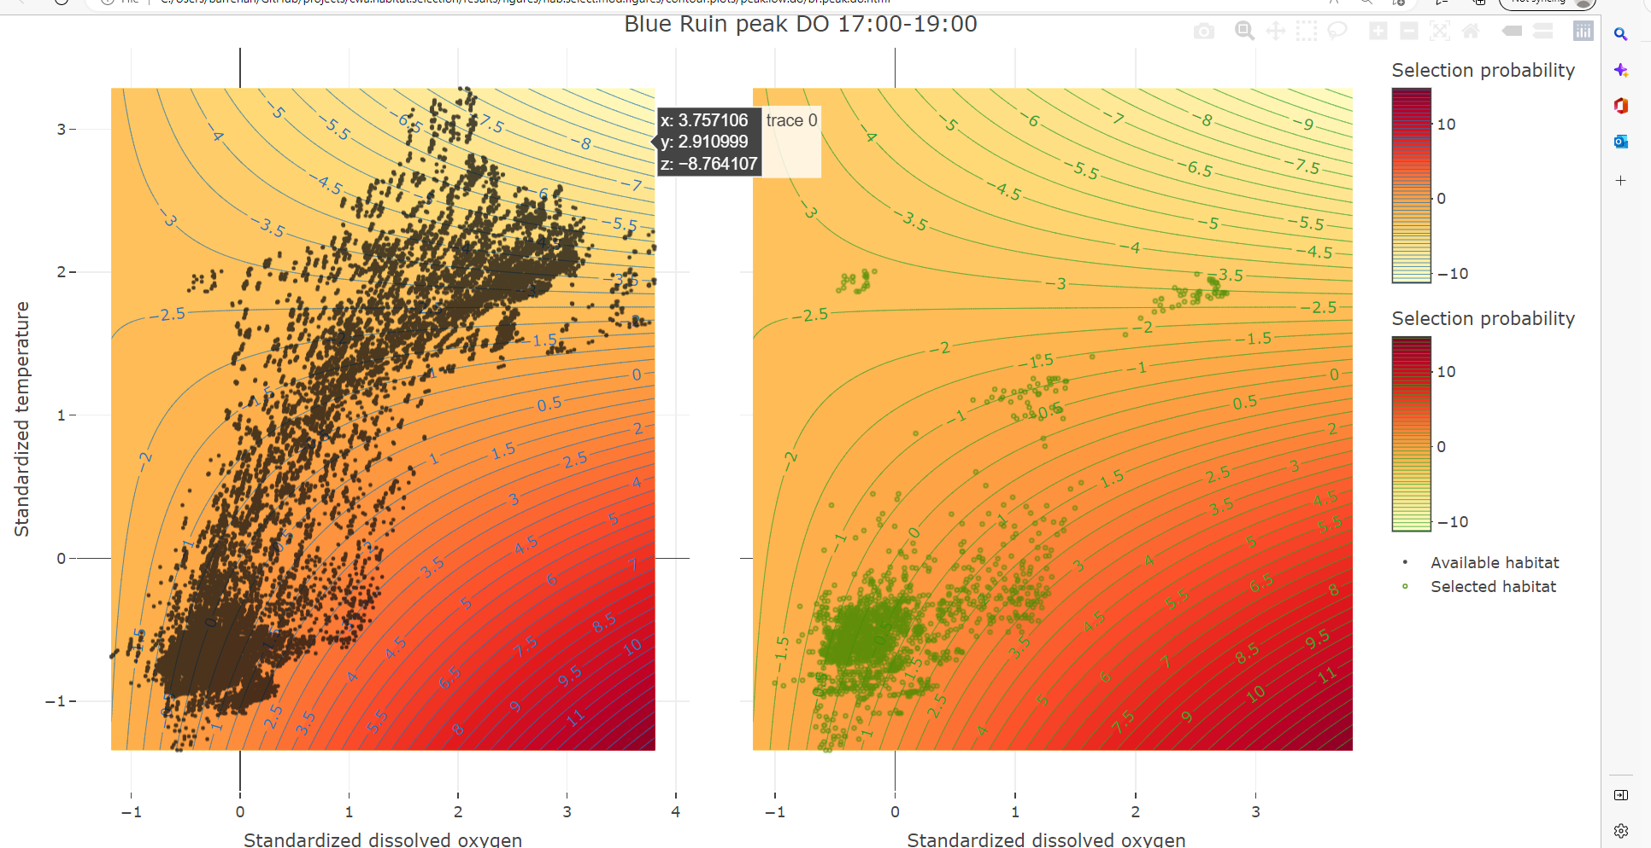

Slide 13
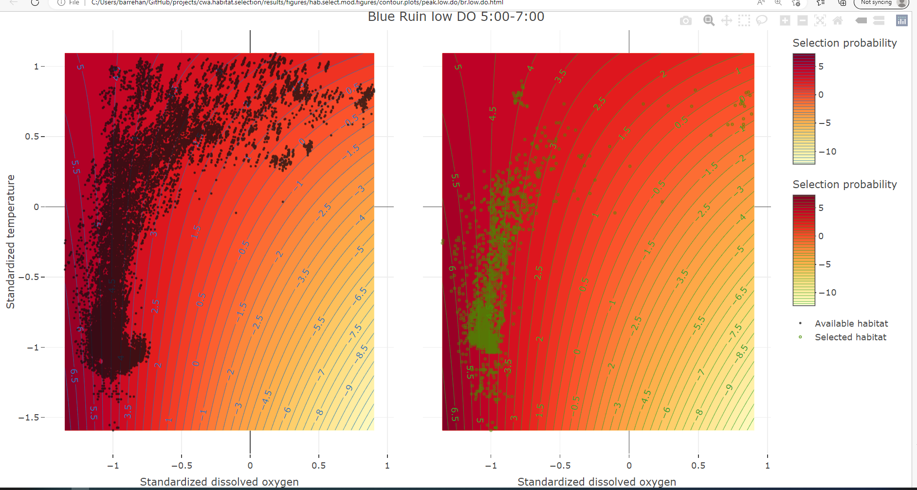

Slide 14
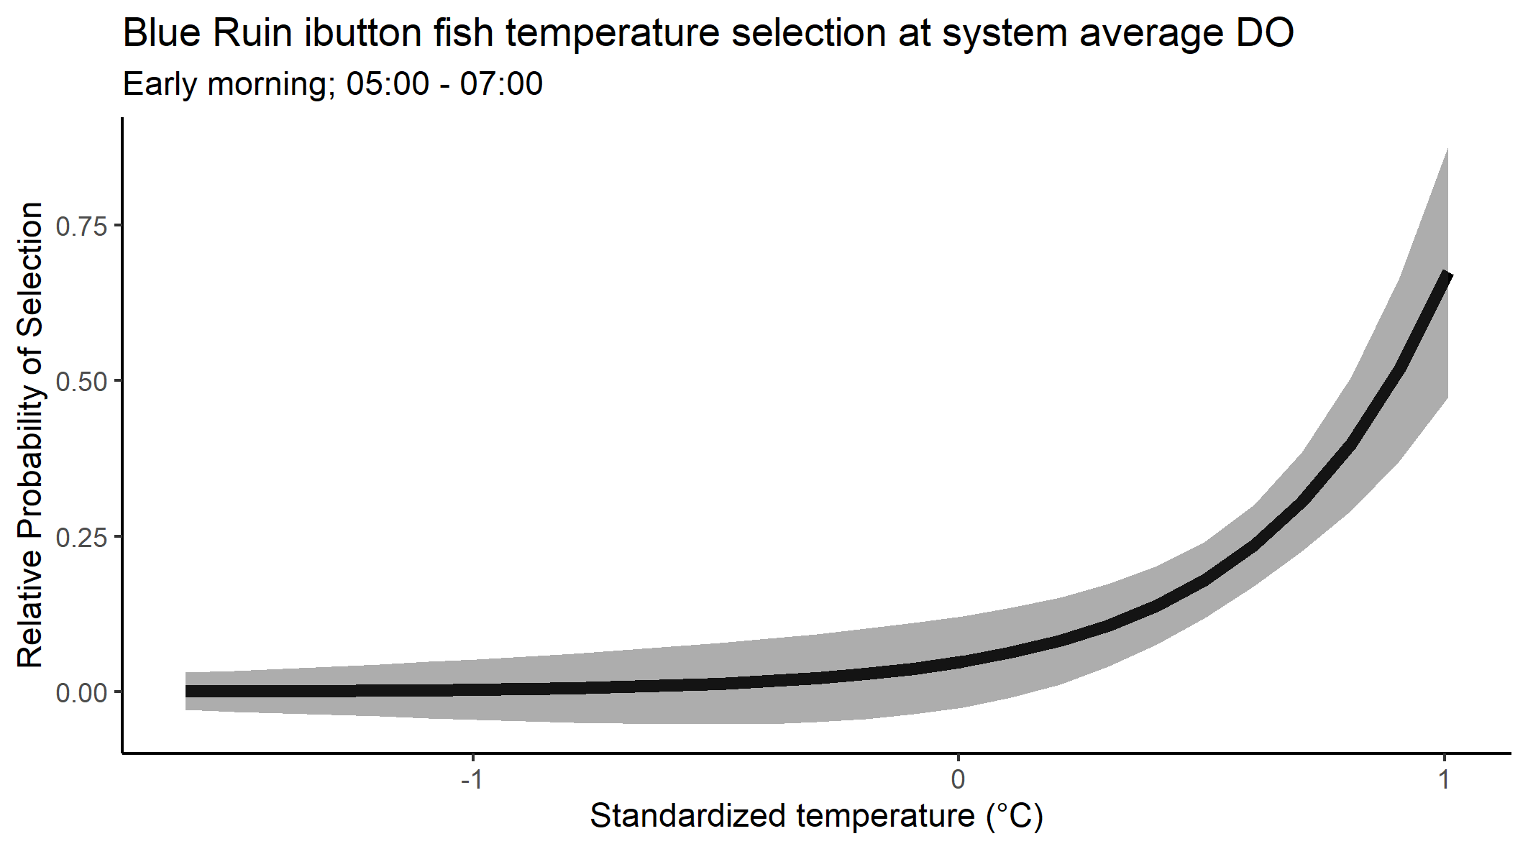
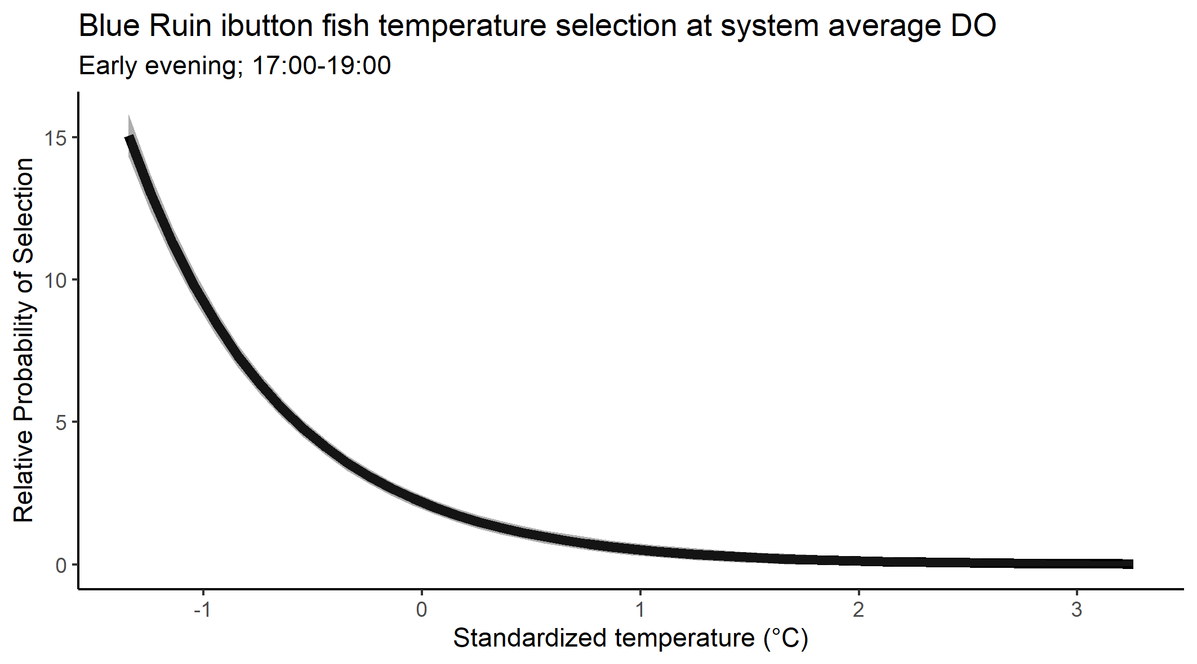

Slide 15
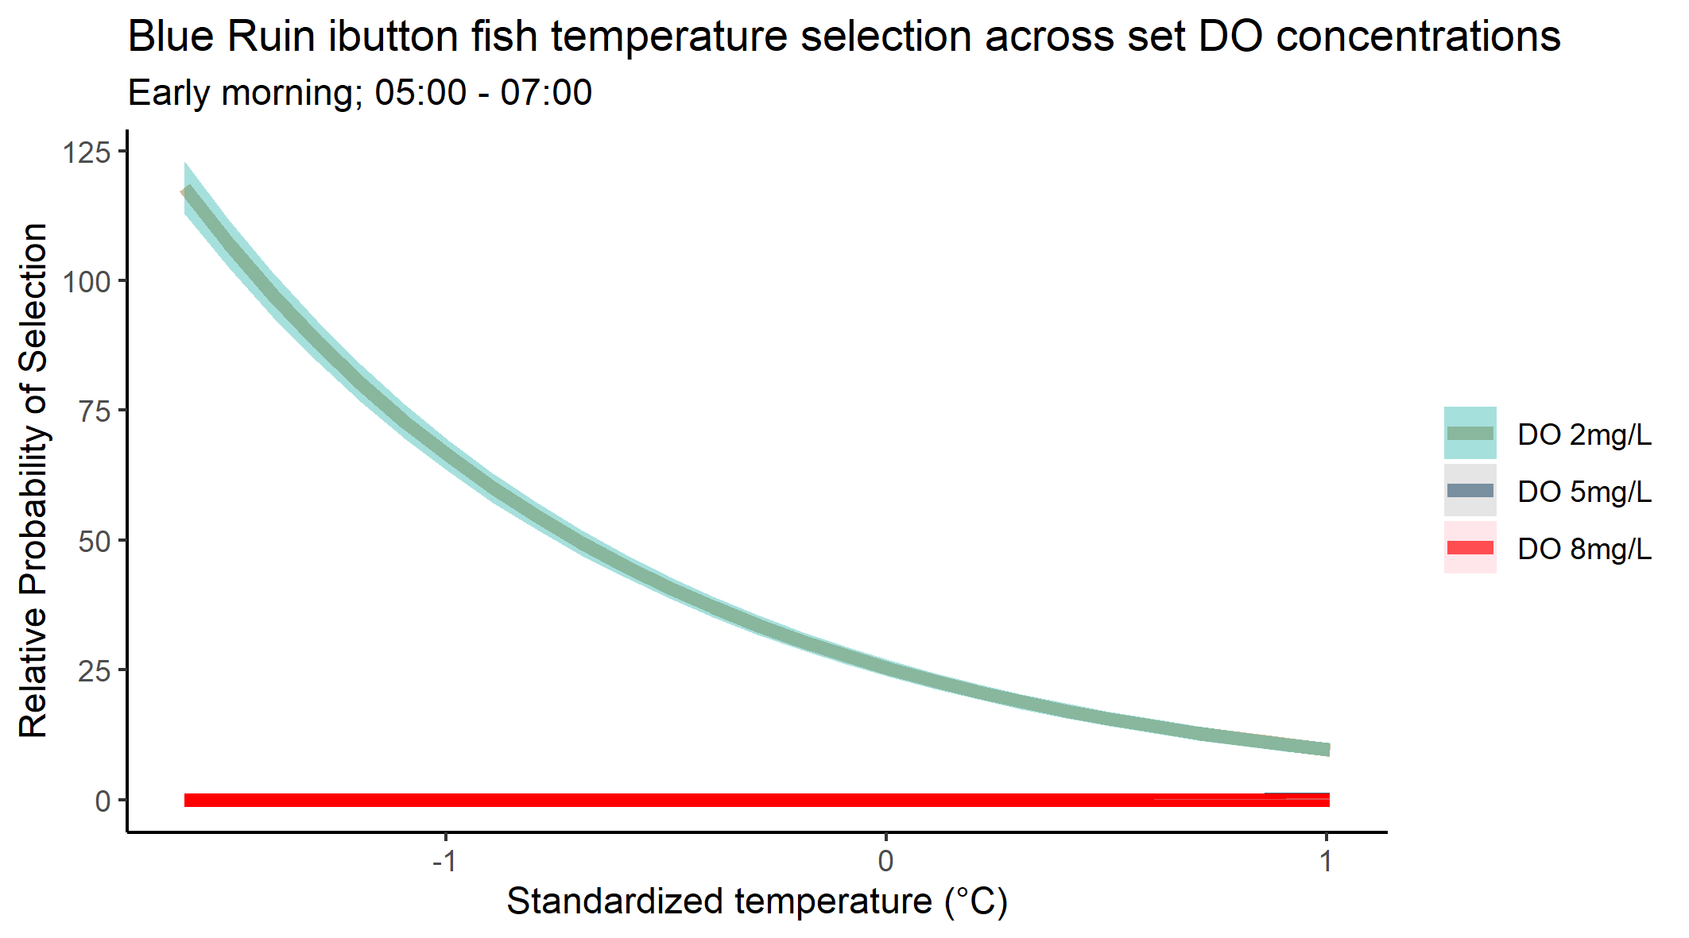
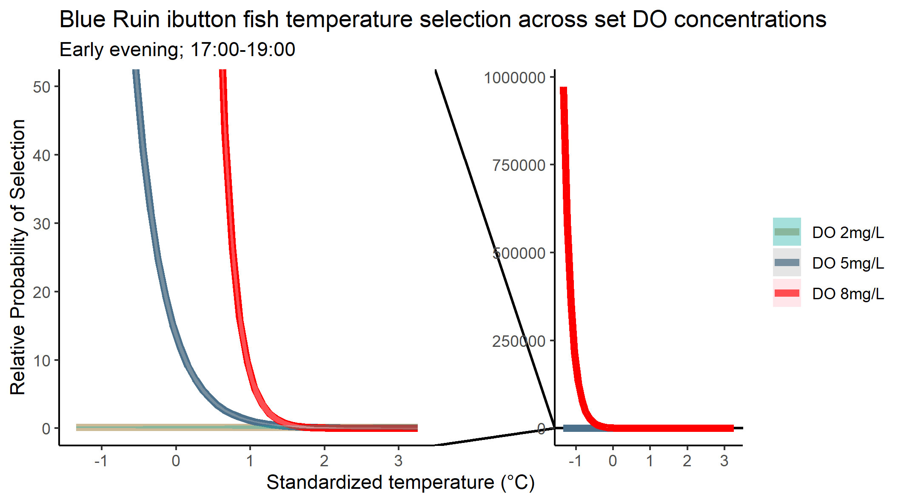

Slide 16
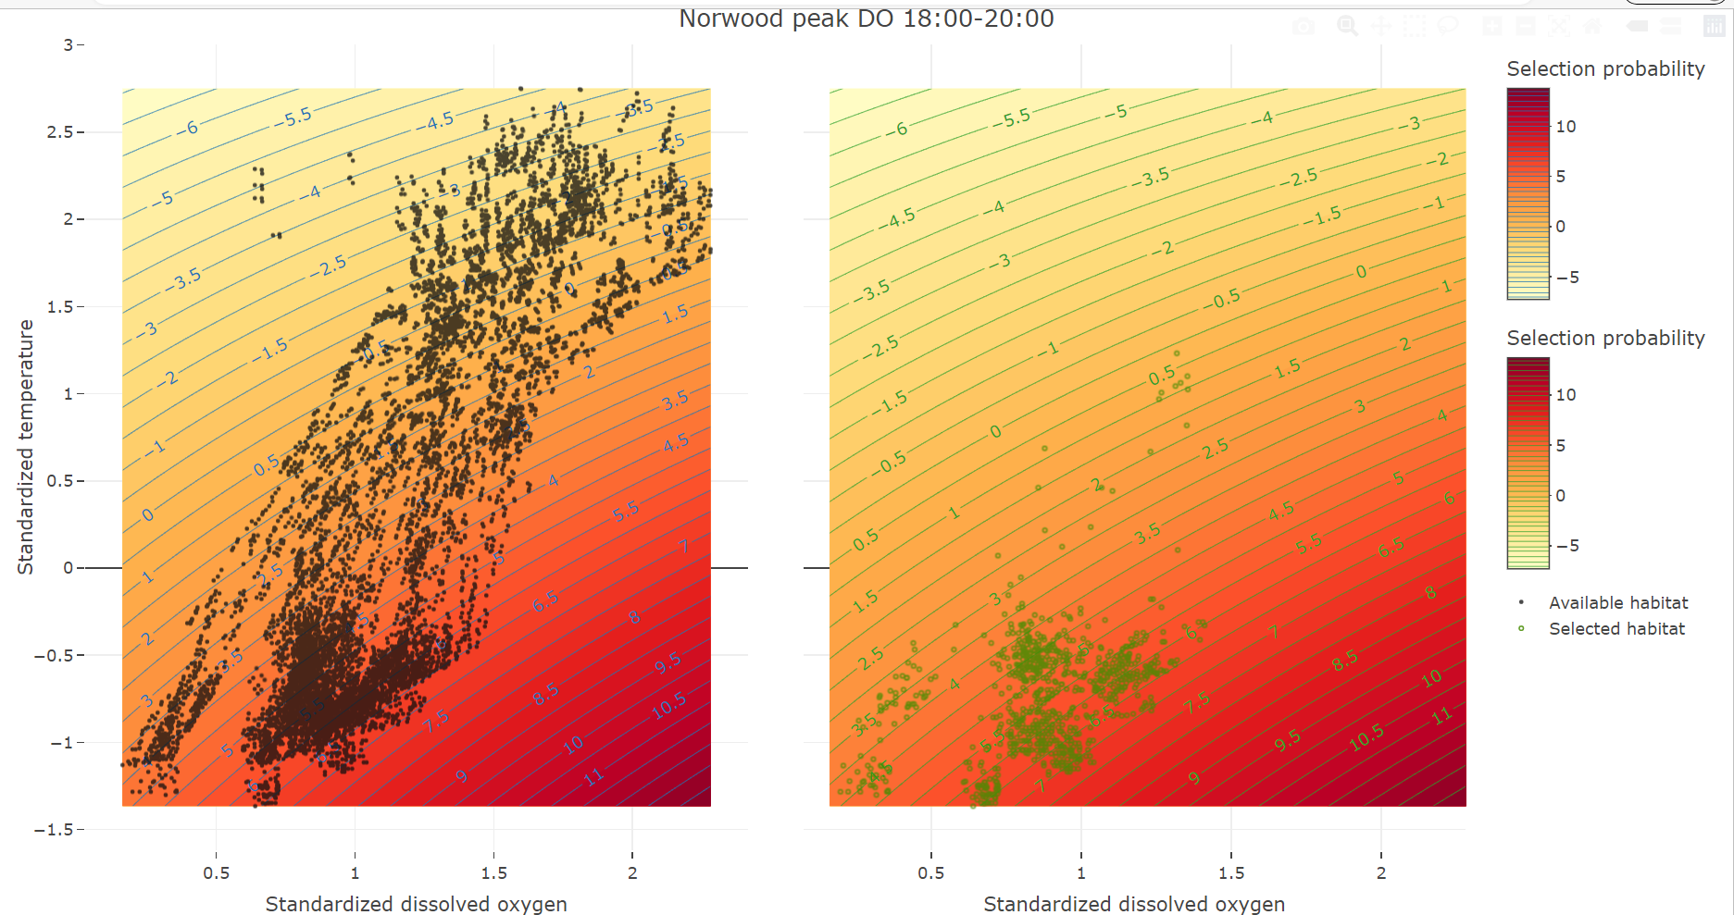

Slide 17
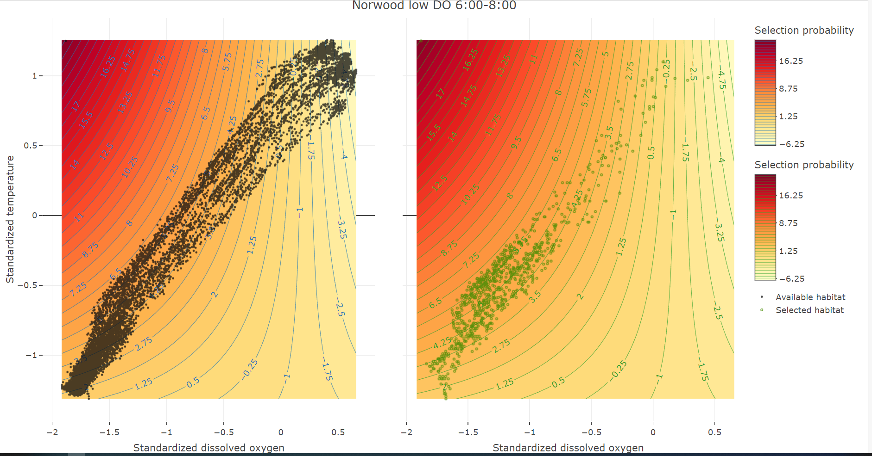

Slide 18
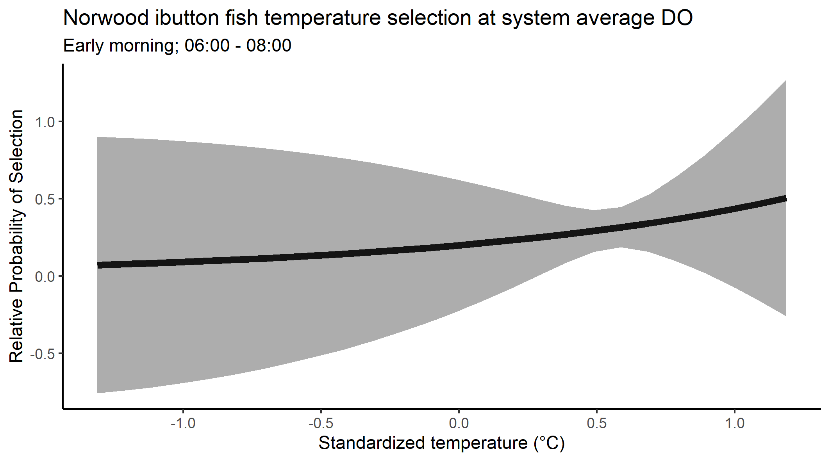
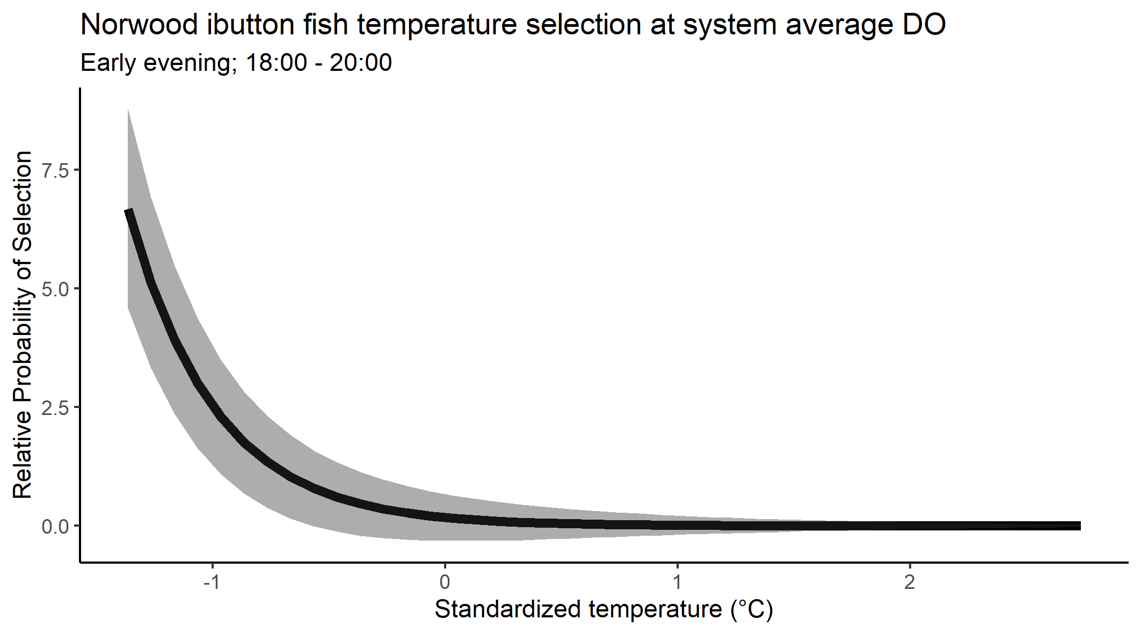

Slide 19
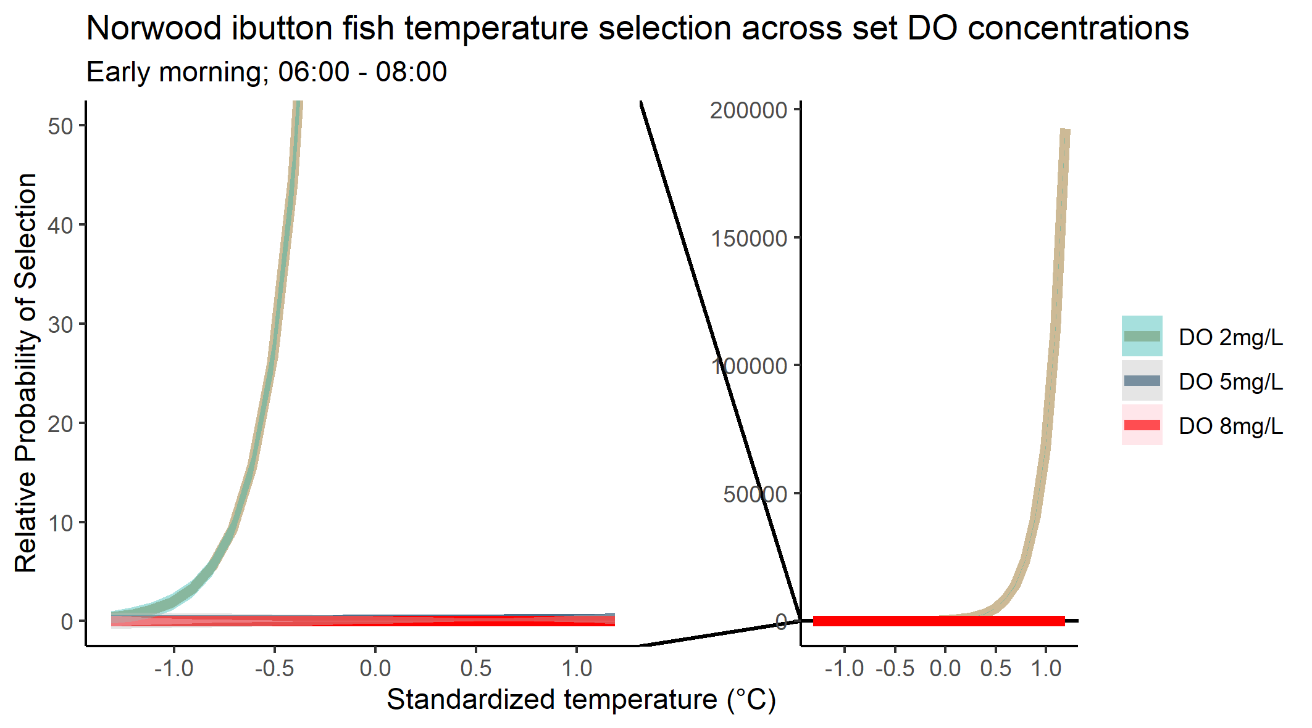
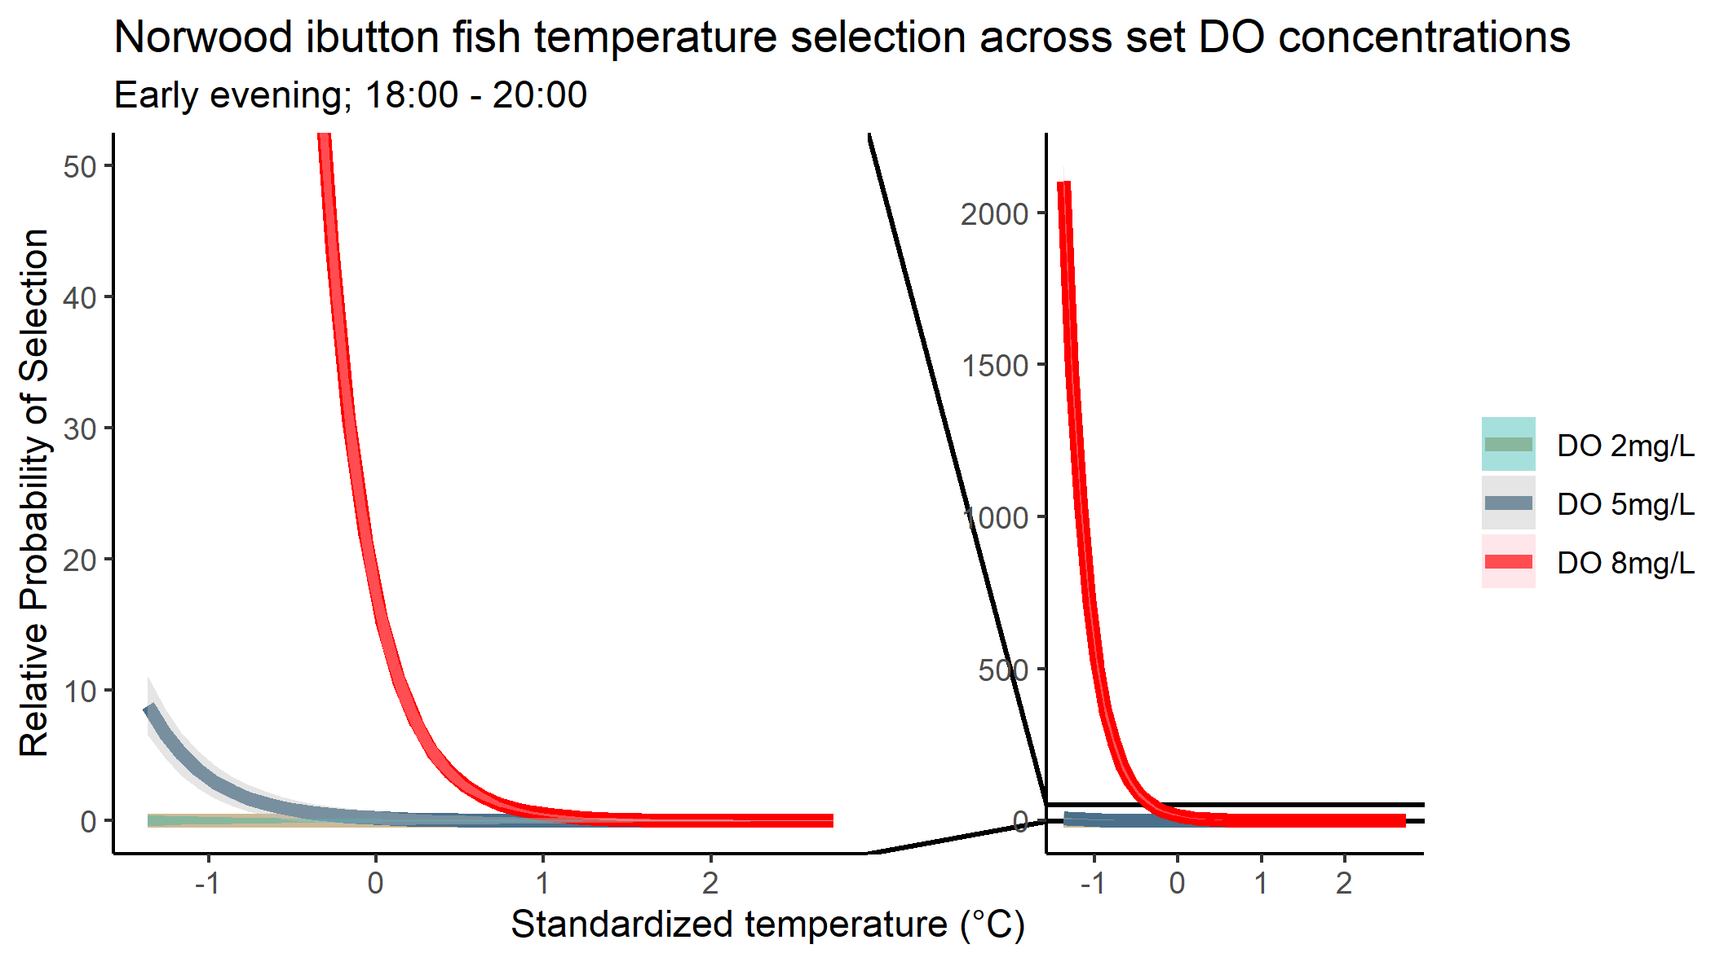

Slide 20
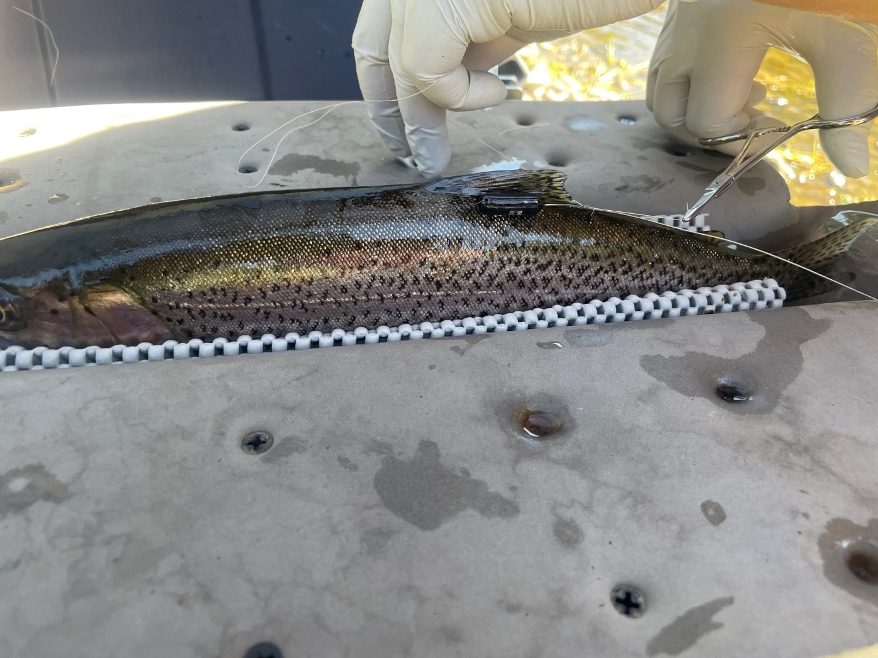

Slide 21



Slide 22
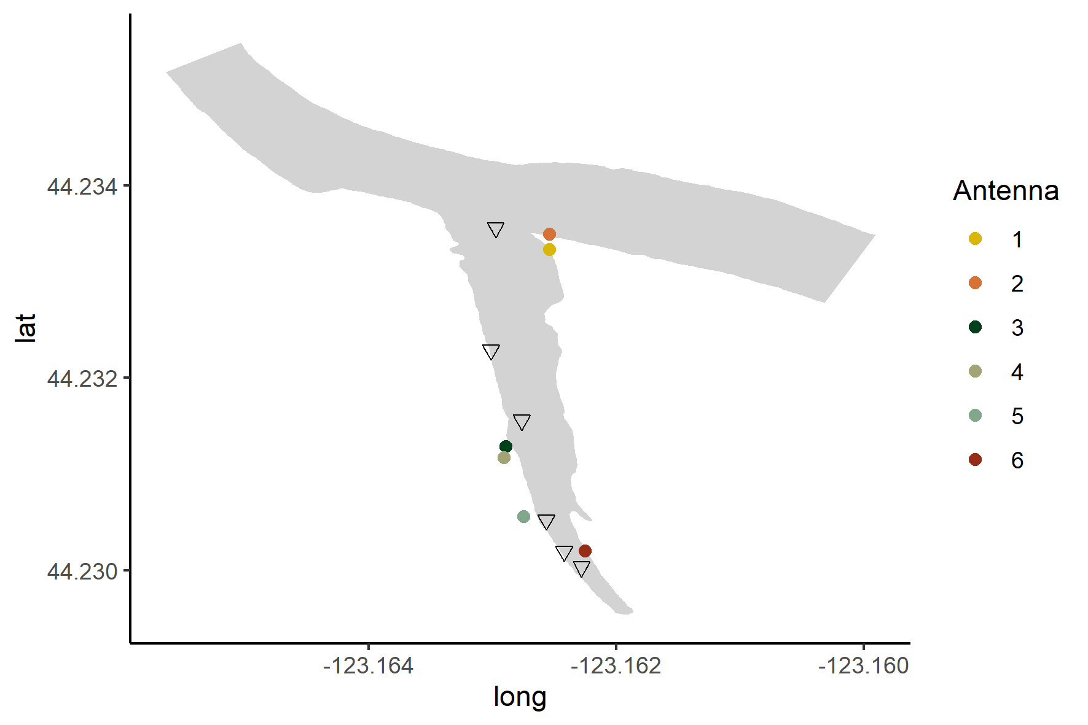

Slide 23
Detection efficiency 98%
Calculated as #good_detections/(#good_detections + #missed_detections)
Where good detections are those where receiver was not skipped between reads (e.g. fish read at receiver 1 and then again at receiver 1 or 2 is good, whereas fish read at receiver 1 and next at receiver 3 is a miss)

Slide 24
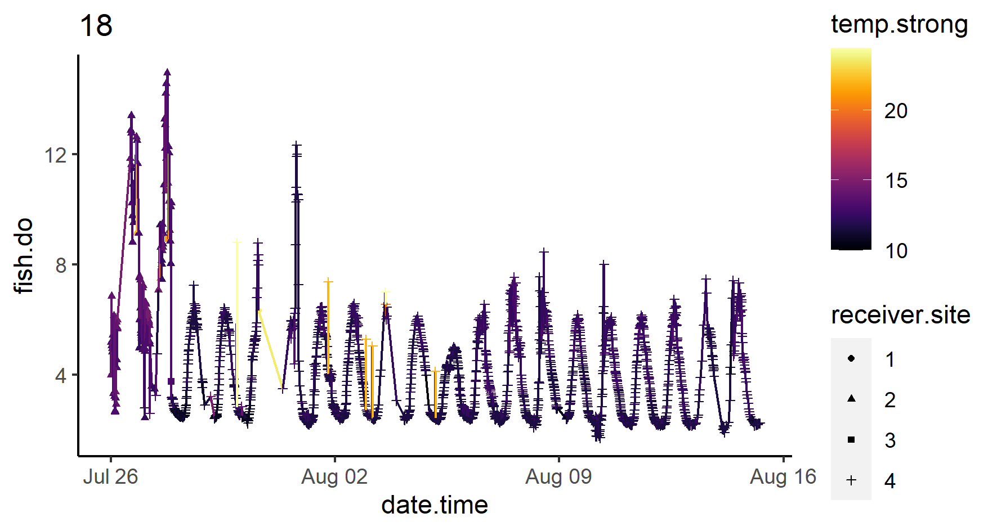
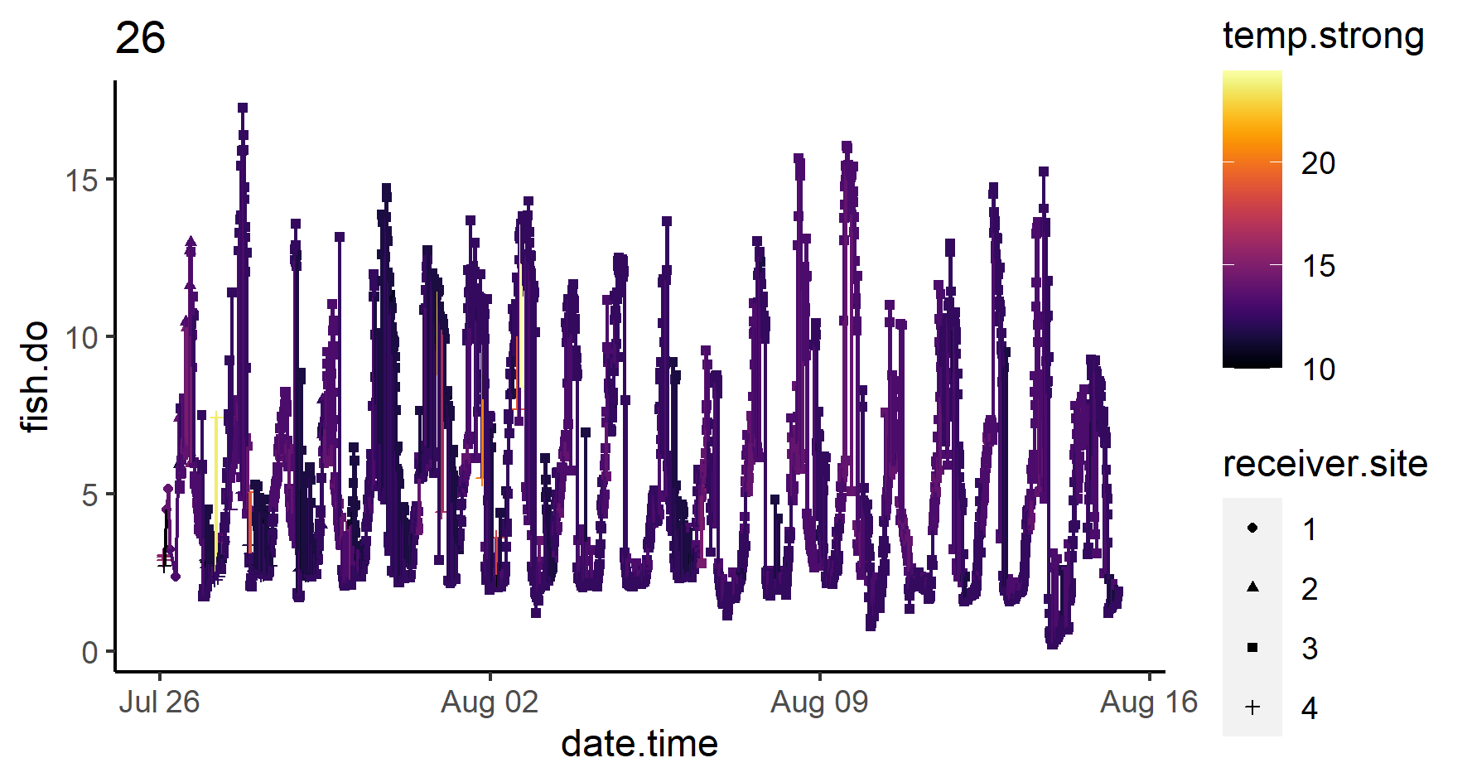
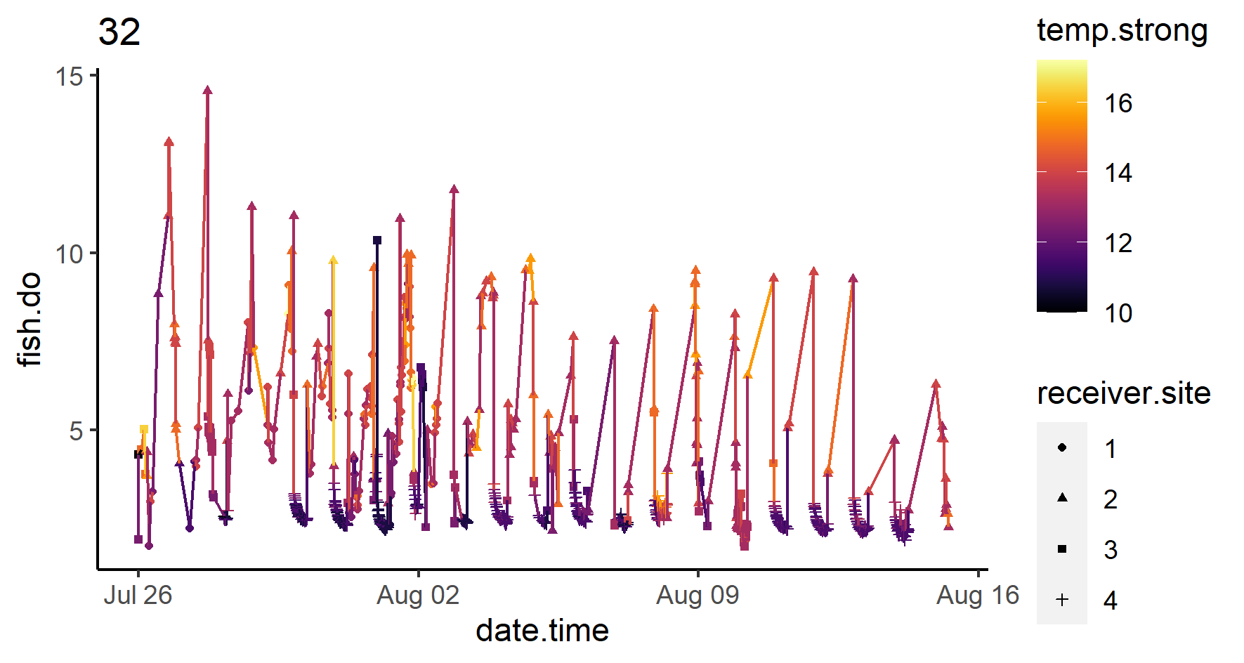
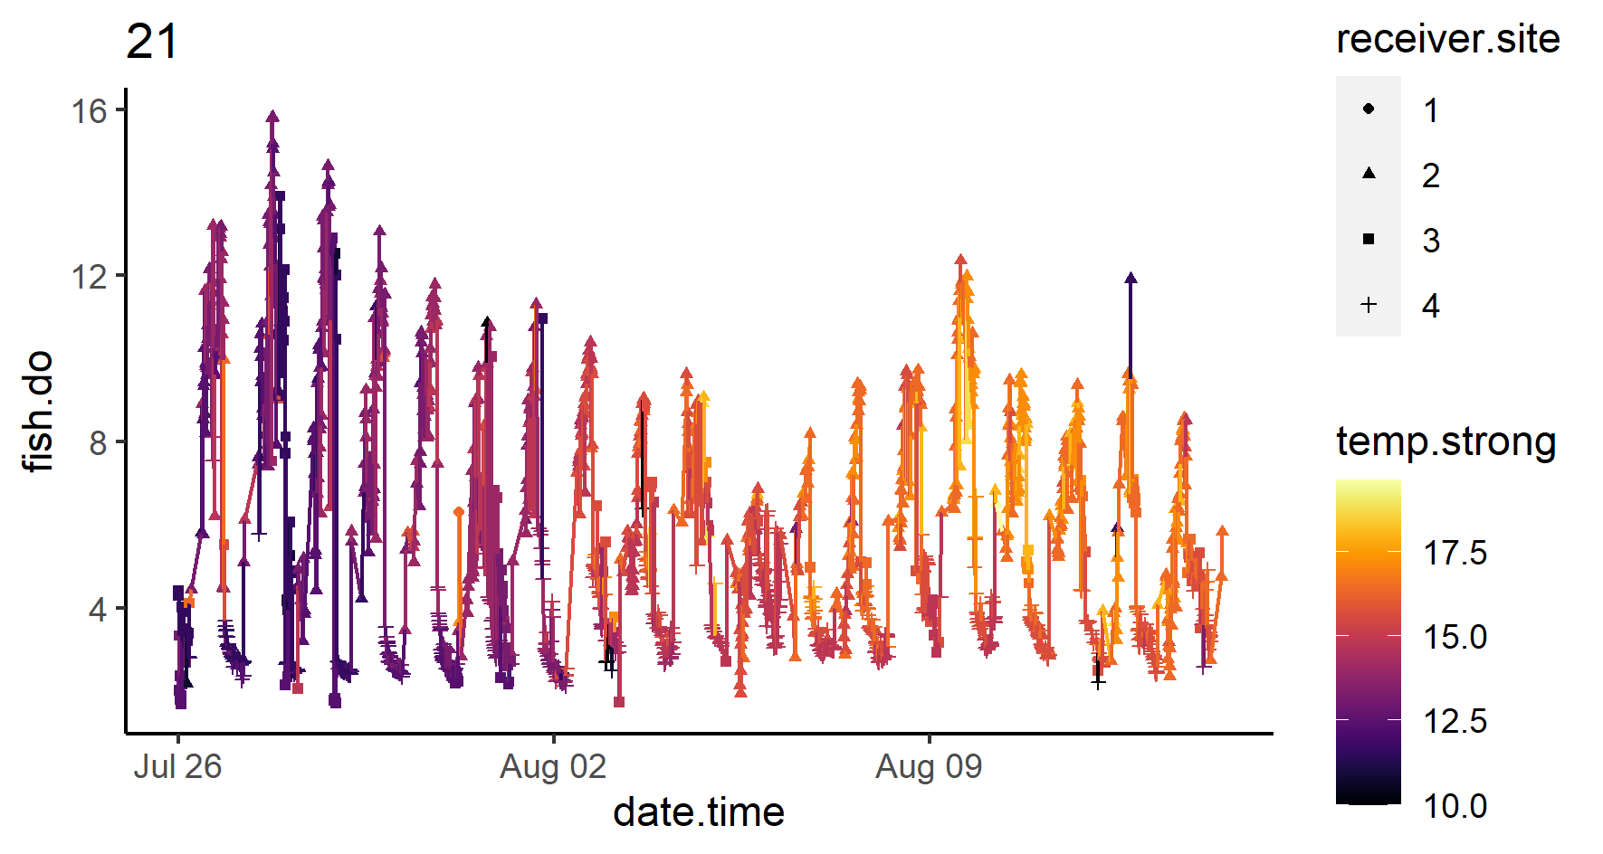

Slide 25
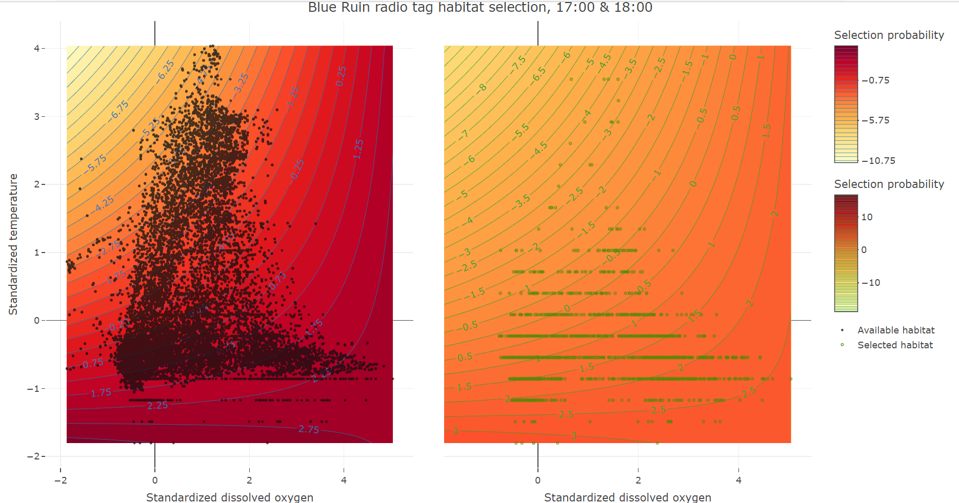

Slide 26
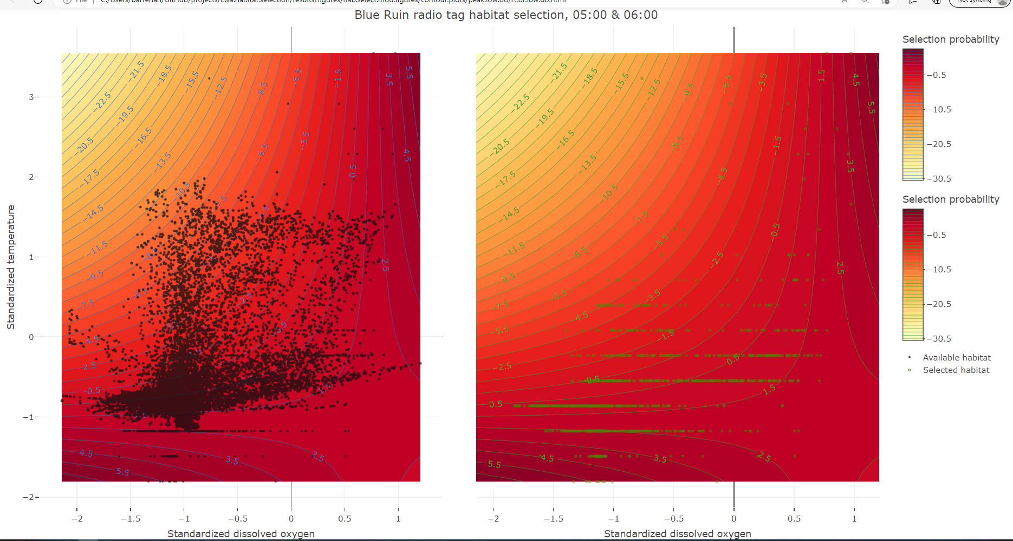

Slide 27
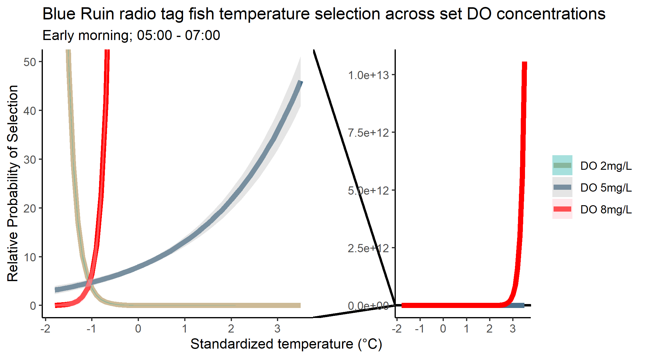
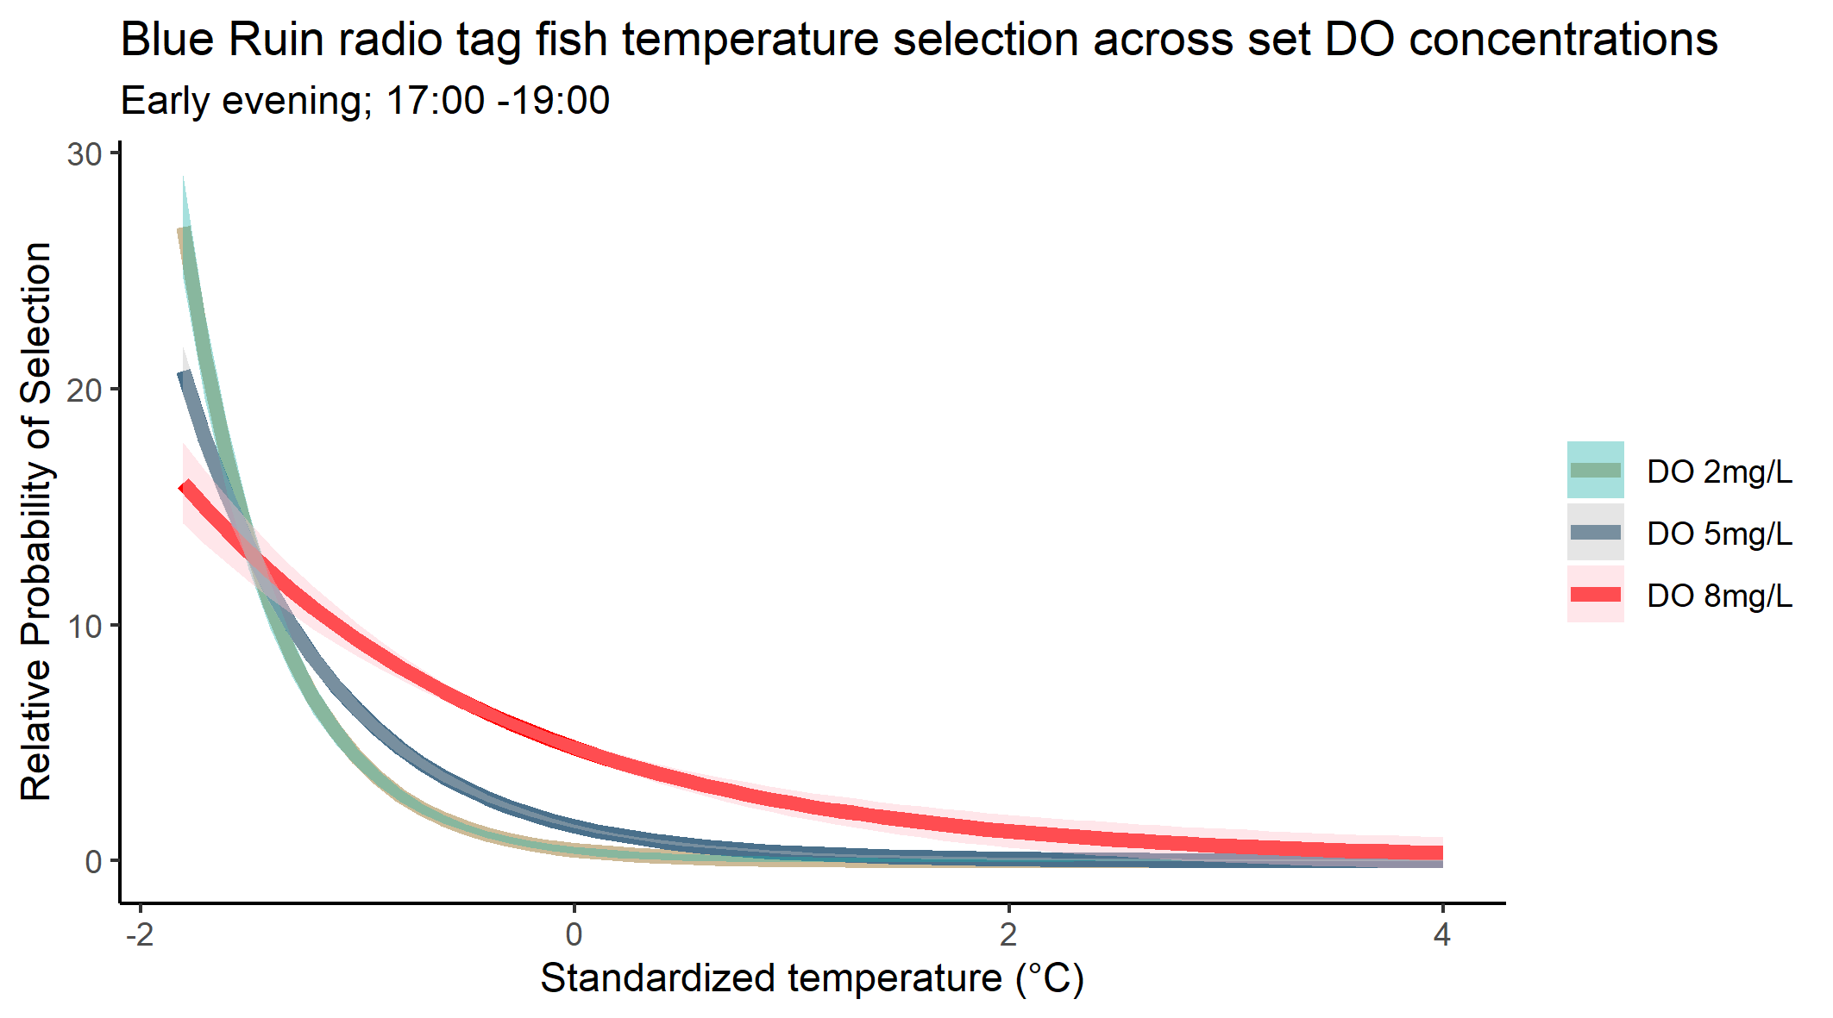

Slide 28
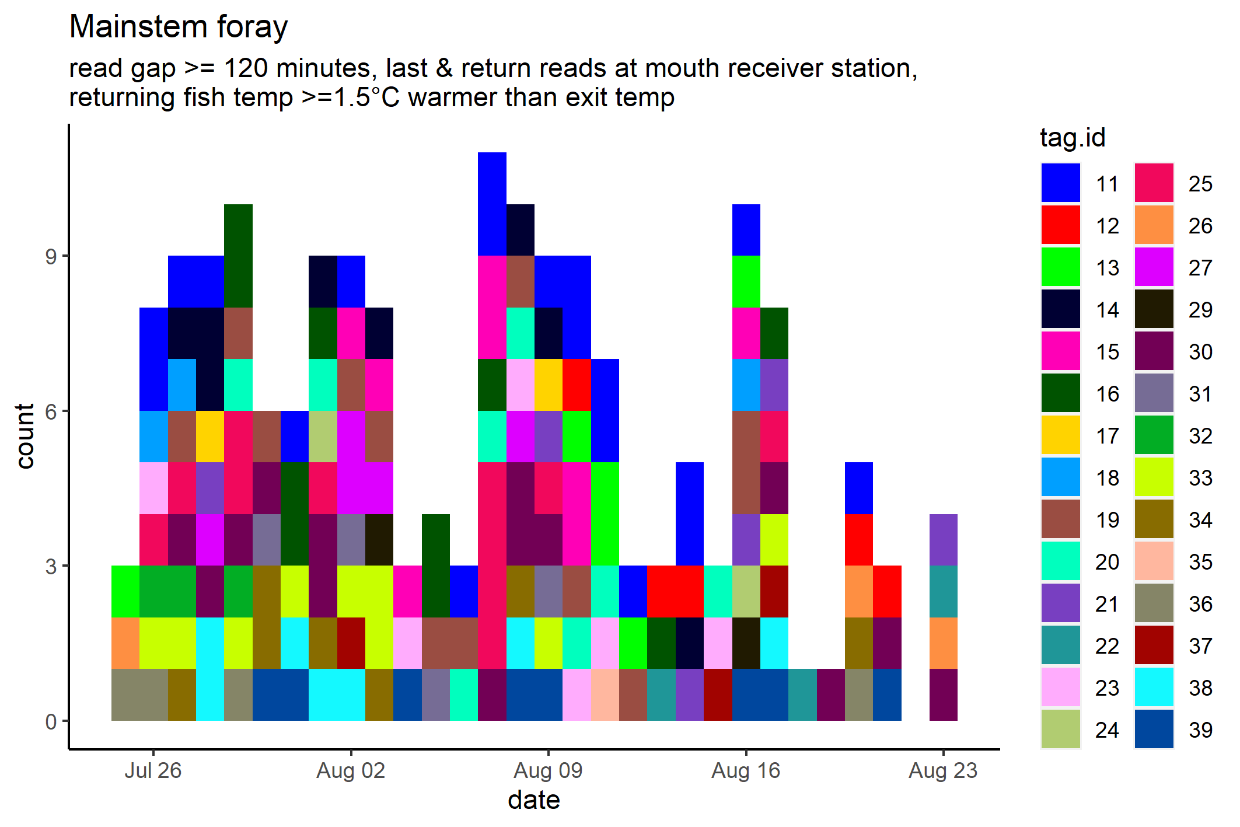
Tag ID | 11 | 12 | 13 | 14 | 15 | 16 | 17 | 18 | 19 | 20 | 21 | 22 | 23 | 24 | 25 | 26 | 27 | 29 | 30 | 31 | 32 | 33 | 34 | 35 | 36 | 37 | 38 | 39
# of forays | 19 | 5 | 6 | 8 | 8 | 10 | 2 | 3 | 12 | 8 | 6 | 3 | 6 | 2 | 11 | 3 | 5 | 2 | 14 | 4 | 3 | 9 | 7 | 1 | 4 | 3 | 7 | 8

Slide 29
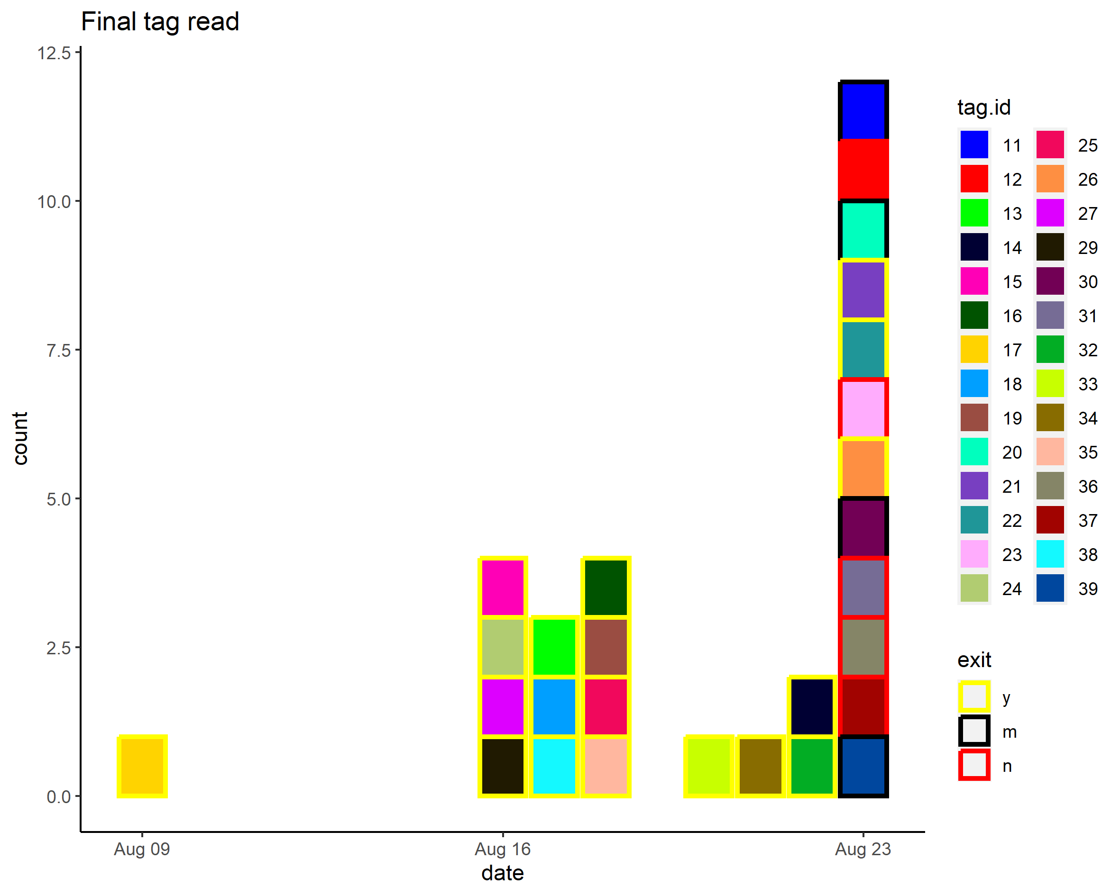
Final exit

