Slide 1
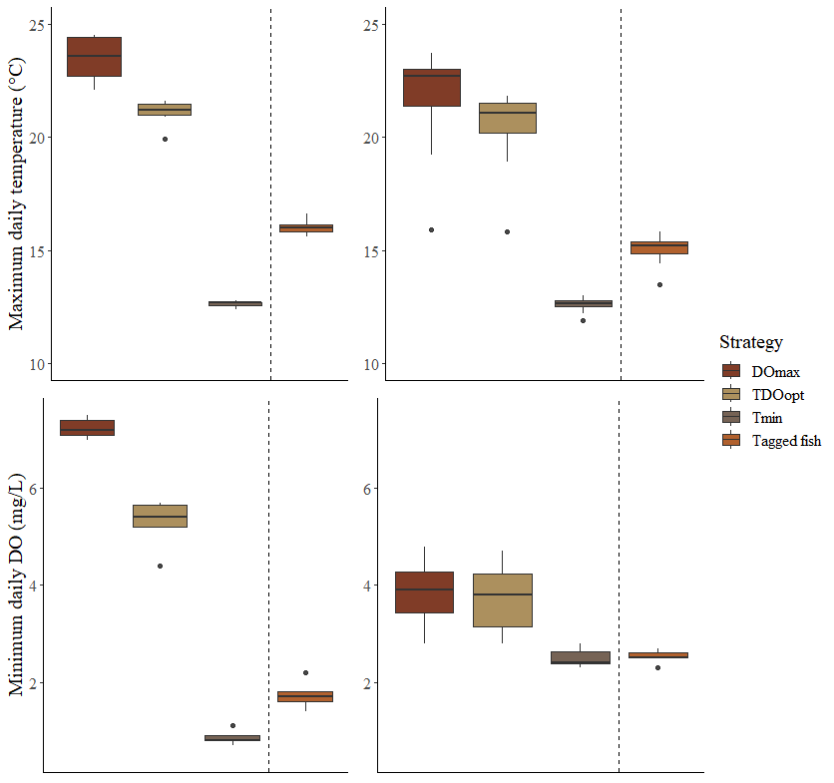
Norwood
Blue Ruin

