Slide 1
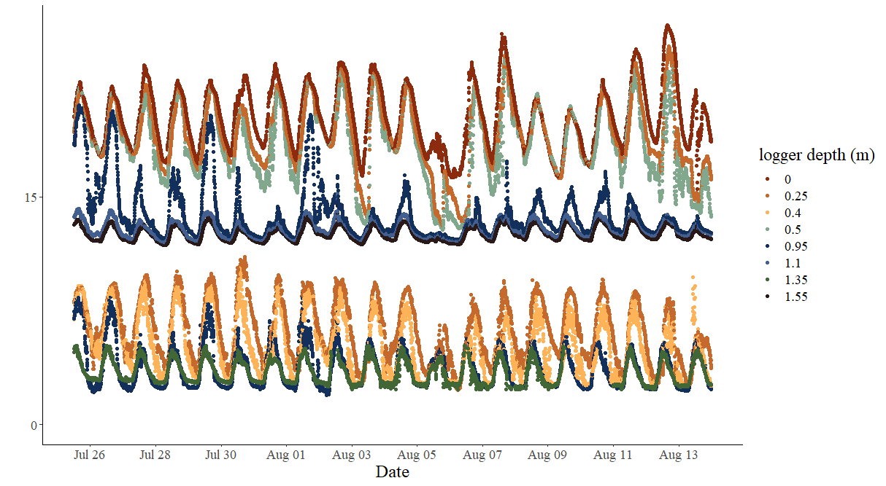
Temperature ℃
Dissolved oxygen mg/L

Slide 2
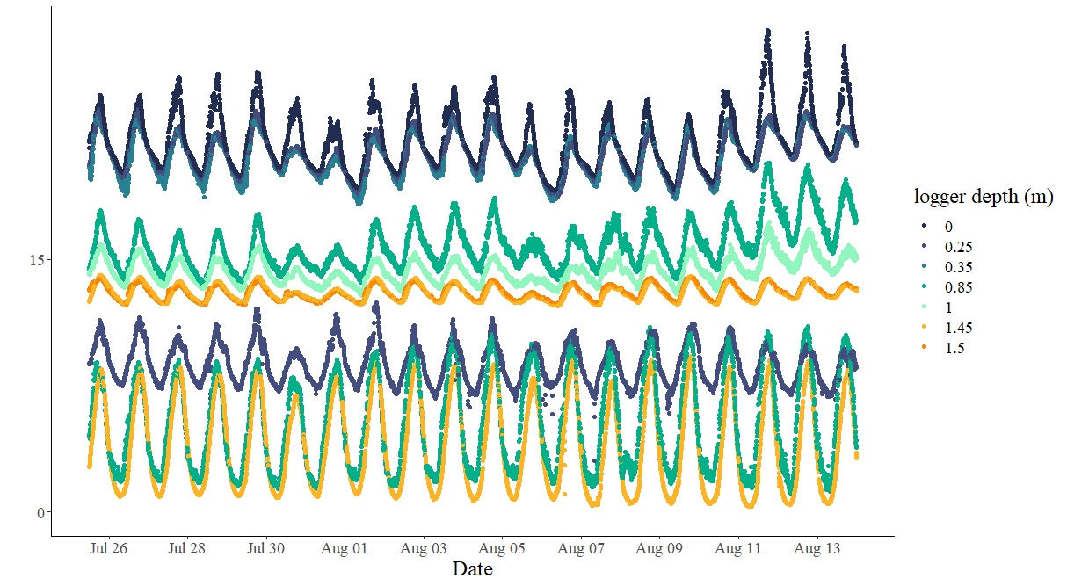
Temperature ℃
Dissolved oxygen mg/L

