Slide 1
Lecture 2: Introduction to Financial Market
人工智慧理論與實務

Slide 2
2.0 Objectives
The purpose of this lecture is to give students:
background on the fundamentals of finance;
an outlook on the most common financial instruments;
an idea of the places where these are traded;
an introduction to investment strategies, portfolio management and basic asset pricing.
Learning Outcomes Statements (LOS):
Will have a brief knowledge of the key financial securities;
Will have a brief idea of their features, payoffs and profits;
Will learn the cornerstone concepts for computational finance.
Note: This lecture slides are prepared mainly based on the book “Computational Finance”^.
^ A. Arratia, Computational Finance, Atlantis Studies in Computational Finance and Financial Engineering 1,
DOI: 10.2991/978-94-6239-070-6_1
Notes:
Detail learning objectives?

Slide 3
2.1 Financial Securities
The financial instruments that are the objects of study of the methods presented in this week belong to the broad category known as securities.
A security is a fungible, negotiable financial instrument representing financial value.
We will have a brief look into their types, features, payoffs and profits.

Slide 4
2.1.1 Financial Securities
Debt
Bonds
Bank deposits
Equity
Common Stocks
Preferred Stocks
Derivatives
Futures
Options
Three main type of securities
Financial Markets: Exchanges, Over-the-counter (OTC), or Directly

Slide 5
2.1.1 Bonds & the Continuous Compounding of Interest Rates
A bond: a long-term loan contract between two parties, the issuer and the holder
the issuer receives a specified amount of money from the holder, and;
is obliged to pay it back at a later date (together with some interest).
Issuer
Bond
Bond-holder
Principal ($)
At maturity date
(borrower/ debtor)
(Lender)
Issuer
Principal + Interests
Bond-holder
-Bond-
(coupons)
At issue date

Slide 6

2.1.1 Compounding the Interest
The value of the security with interest depends not only on the interest rate, but also on the frequency in which the interest is compounded.
p.s. assumed reinvested at save rate
P₀ represents the amount of the principal at the initial time t₀, r the interest rate per annum and n the number of years, then the value of the bond by the nth year is given by:
(1.1)
If the frequency of payment of the interest augments, hence increasing the frequency of compounding the interest, say by m > 1 times in a year, the value of P_{n} is
(1.2)

Slide 7
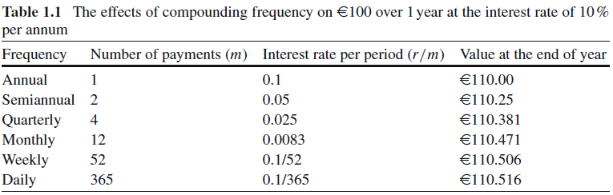
2.1.1 Compounding the Interest
For securities whose value is frequently changing, it is convenient to consider that trading can be done continuously in time.
A risk-free security with a constant interest rate r that is continuously compounded in a period τ > 0, the value
(1.3)
where P_{τ} is the value of the investment that mature from time t0 to time t₀ + τ , and e^{x} is the exponential function.

Slide 8

2.1.1 Payoff & Profit of Bonds
Payoff for a bond: Principal + All Interests
which can be obtained by Eq. (1.2), or Eq. (1.3) if continuously compounding.
The profit is its risk-adjusted payoff discounting the initial investment, which includes contract fees or any other transaction costs.
Hence, the profit = discounting the principal to the payoff; i.e., for a constant interest rate r through a period τ and m coupons on a principal of P₀ , this is

Slide 9
2.1.2 Stocks: Trade & Price
Two main types of stock: common & preferred.
Common: usually entitles the owner to vote at shareholders’ meetings and to receive dividends;
Preferred: generally does not give voting rights, but have priority over common stock regarding payment of dividends
Market capitalization = (number of shares outstanding) × (price of share).
Involved Players
A shareholder: an owner of stock of certain corporation.
The financial institutions with brokerage services assume the custody, but not the obligations, of the shares.
The brokerage firm or individual broker serves as a third-party to facilitate the transactions of stocks between buyers & sellers.

Slide 10
2.1.2 Stocks: Trade & Price
The buy or sell orders that investors can issue to their brokers are regulated by the market authority and have different forms to allow for different trading strategies. For example:
Market order: An order that is send to the market demanding for the trade on the security to be executed immediately at the current market price.
Limit order: An order that is send to the market demanding for a given or better price at which to buy or sell the security.
Stop order: An order that is held by the broker and only send to the market when the price of the security reaches a specified amount (the stop price).
Stop order vs. limit order: Although both demand a certain price, the former is not send to the market while the latter is send immediately, even though it might not get executed.

Slide 11
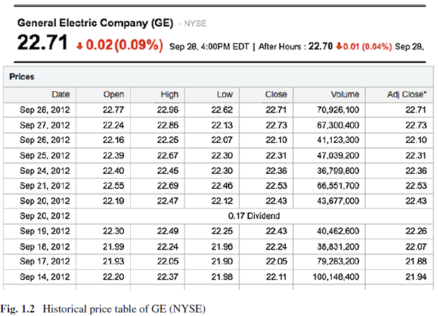
2.1.2 Stocks: Trade & Price
Reading a stock quotes table
In Fig. 1.2 we have a partial view of the General Electric Co. (NYSE) stock’s quotes table, as provided by Yahoo! (from finance.yahoo.com).
Ticker: the company’s id for the market.
Open: the price of the stock at the opening time of the market session.
Close: the price of the stock at the opening time of the market session.
High: (or Max) is the maximum price reached by the stock between the Open and the Close price.
Low: (or Min) is the minimum price reached by the stock between the Open and the Close price.

Slide 12
2.1.2 Stocks: Trade & Price
Volume: is the number of shares traded between the times of Open and Close.
Adjusted Close: is the closing price adjusted to include any dividend payments plus any other corporate actions that affect the stock price (e.g. splits and rights offerings).
Dividend: a cash payment given periodically by some companies reflecting profits returned to shareholders.

Slide 13
2.1.2 Payoff & Profit of Stocks
Payoff:
if we buy one share of a stock at a time t = t₀ for a price of S₀, and sell the share at a later time t = T for a price of S_{T}, the payoff is S_{T}.
Profit:
Because the equation S_{T} −S₀ involves cash flows at different points in time, and there is some risk involved in the investment which has to be taken into consideration. Any real investor could have instead put his money in a risk-free security. Therefore, the profit is
S_{T} −S₀ e^{rτ} (1.6)
To include dividends and transaction costs. The profit is
S_{T} + D_{τ} − C(S₀) e^{rτ} (1.7)

Slide 14
2.1.2 Stock Indices
A measure of the value of the market, or of a sector, is given by the stock indices.
A stock index tracks the changes in the value of a selected group of stocks that supposedly represent the market or an industrial sector
Purpose of a stock index: act as general reference of the market’s value trend, the general state of health of the economy, a benchmark for the performance of their investments.
Price weighted: only the price of each component stock is consider. E.g. the Dow Jones Industrial Average (DJIA),which (as of today) takes the average of the prices of 30 of the largest publicly owned companies based in the U.S.
Capitalization-weighted: considers the market capitalization of each stock composing the index. E.g. the NASDAQ Composite.
Notes:
stock indices, formally, an index is a mathematical function that measures the changes in a representative group of data points.

Slide 15


2.1.2 Stock Indices (Examples)
(A price weighted index) The Dow Jones Industrial Average, conceived by Charles Dow and Edward Jones (1896), is computed by the following formula
where S_{i,t} is the price of stock i at time t and D is the Dow Divisor.
(A capitalization weighted index) The Madrid Stock Exchange principal index, IBEX35, is computed by the following formula
where IBEX_{t} is the value of the index at time t, Cap_{i,t} is the free float market capitalization of company i at time t, and J a coefficient used to adjust the index.
Note: in practice, the hardest part for replicating an index is calculating the adjusting coefficient (eg. D in DJIA, J in IBEX) because of corporate actions.

Slide 16
2.1.2 Comparing the Performance of Two or More Stocks
Indices are always used as proxies of different markets/ industries.
Most common way of evaluate the performance of their stock investments is to compare their price behavior with another reference stock’s price history, or usually with the history of the market index.
E.g. cumulative rate of benefits that one obtains throughout the investment period.
Total return: when measuring performance, is the actual rate of return of an investment or a pool of investments over a given evaluation period. Total return includes interest, capital gains, dividends and distributions realized over a given period of time. (source: Investopedia.com)

Slide 17
2.1.3 Options & Other Derivatives
Options: a contract that investors can buy for a fee in order to have the opportunity (ie. option), but not the obligation, to trade an asset in an exchange market at a future date, and at a given price.
European: may only be exercised on expiration date
American: may be exercised on any trading day on or before the expiration date.
Bermudan: may be exercised only on predetermined dates before expiration (ie. In between European and American).
Asian: the payoff of these type of options is determined by the avg of the price of the underlying asset during some period of time within the life of the option.
European & American are classified as vanilla (options with direct and simple payoff conditions); other options with more involved conditions for exercising are termed exotic. Furthermore, the Asian is path dependent options.

Slide 18
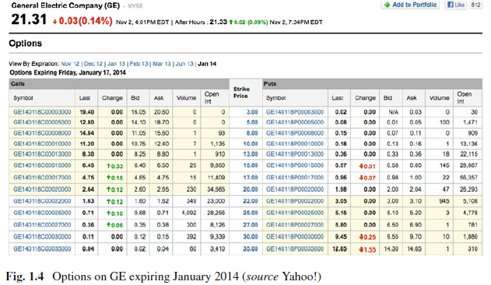
2.1.3 Reading an Option Quotes
Premium: the price of an option ($ per share).
An option on a stock corresponds to a defined amt of shares (eg. 100 shares).
Writer
Option
Holder
Premium
Based on the strike & current px, the time to maturity, & the type
The options are organized in series of different premiums, for a fixed maturity date, and quoted at the exchange market using the following standard nomenclature, as example in Fig. 1.4.

Slide 19
2.1.3 Payoff & Profit of Options
The payoff of an option depends on the possibility of exercising it or not.
If exercised, the payoff is the difference between the exercise price and the price of the asset at maturity;
if not exercised, the payoff is 0.
Call option: max(P_{T} – K, 0) (1.12) Put option: max(K- P_{T}, 0) (1.13)
where K is the strike price & P_{T} is the price of the underlying asset at the exercise date T.
Profit: Payoff minus the cost (fee/ commission).
Call option: max(P_{T} – K, 0) – C(P₀, T) e^{rτ} (1.15)
C(P0 , T ) the price of the option (always positive). e^{rτ} is the possible gains given by a risk-free asset earning a constant interest rate r for the period τ = T−t₀ and continuously compounded.

Slide 20
2.1.3 Payoff & Profit of Options
Advantages from buying options Vs common stocks directly
can buy (or reserve to buy at later date) more shares with less money (leverage).
have in advanced a limit on losses, while we can still make theoretically unlimited profits.
Example Suppose that common stock of company XYZ is trading today at €20, & a call option on XYZ with strike K = 20 and a month of maturity is selling for C₀ = 2, or €200 (= 2 × 100). Buying one call option would have at expiration a loss on the downside of the price of the stock limited to −200, since we would not exercise the option. On the contrary, buying the stock could have a future loss of −2000, in the worst scenario where the stock losses 100% of its value. (see Table 1.2 & Fig. 1.5.)

Slide 21
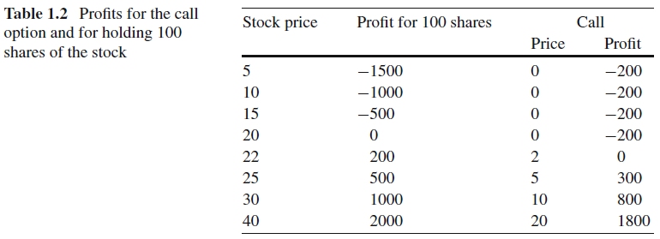
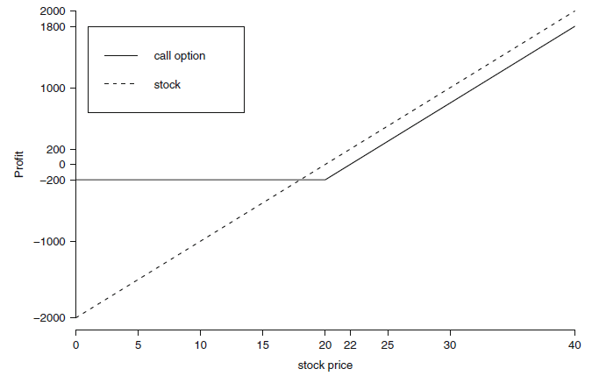
2.1.3 Payoff & Profit of Options
We will discuss more on this topic in next week!

Slide 22
2.1.3 Forward & Futures Contracts
In these contracts two parties subscribe an obligation to trade a specific asset, for a specified price (the delivery price) and at a specified future date (for the forward contract) or time period (e.g. a month, for the futures contract).
The asset specified in the contract is usually any commodity (i. e. agricultural products or raw materials), currencies, or bonds, but could also be any stock.
Forward | Future
Not traded on exchange | Traded on exchanges
Delivery px is settled by the two parties involved | Marked to the market on a regular basis
As lock in a future purchase of some asset from a supplier (the seller) at a px settled today, w/o actually paying the full amount up until the date of expiration or maturity on the contract. | As Investment instruments and traded at exchanges worldwide.

Slide 23
2.1.3 Payoff & Profit of Forward/ Futures
Payoff
If K is the delivery price of the asset written in the contract and P_{T} is the price at exercise date T, the payoff for the buyer in the contract on one unit of the asset is P_{T} – K, while the payoff for the seller on one unit of the asset is K – P_{T}.
Profit
Since there are no fees for writing a forward or futures contract (no for contract itself but there is transaction cost that not discussed here), nor initial investment,
the profit function for either party is the same as the payoff, and
this can be positive or negative at maturity.

Slide 24
2.1.4 Portfolios & Collective Investment
A portfolio: a collection of one or more securities owned by an investor or an investment company.
The positions: the elements of a portfolio.
The value (the profit) of a portfolio at any given time is the sum of the values (the profits) of its positions at that point in time.
Portfolios are designed to fit certain investment objectives and aiming at accomplishing the investor’s expected rewards which are in continuous confrontation with his tolerance to risk.
The management of portfolio risk involves opening new positions with better expected reward, and closing positions in the portfolio.
Asset allocation: The dynamic of opening and closing out positions in a portfolio.

Slide 25
2.1.4 Mutual funds & Exchange-Traded Fund (ETF)
A collective investment vehicle in managed by a professional company that does the selection of securities, monitors their performance, & the subsequently asset allocation.
Mutual funds: characterize by being regulated and registered in the exchange market, publicly available.
closed-end: the number of shares in the portfolio is fixed.
open-end: no restrictions on the amount of shares that can be issued.
ETF: like a closed-end fund with the added feature that it is traded in the stock exchange.
There are many ETFs build with the purpose of tracking an specific index (i.e. a portfolio of stocks that replicates the index’s price behavior), so this is a way for an investor to trade on the index. (p.s. not necessary index or passive.)

Slide 26
2.2 Financial Engineering
We have so far acquired knowledge on various securities and how to trade them at exchange markets.
Next, we will look into some investment criteria:
What attitudes should we have towards investment?
What is a fair price to pay for a security? How to control risk and secure some benefits?
We introduce these matters in this section and expand them further in later chapters.

Slide 27
2.2.1 Trading Positions & Attitudes (Long and short positions)
 | Owning the Asset | W/o owning the Asset
Buy | Long | (Buy to) Cover
Sell | Sell | Short (Sell)
E.g. the buyer of a call option is long on the option (long the call), while the writer of that option is short (short the call).
Short selling is highly regulated and sometimes banned by governments because it is believe to contribute to the downfall of market prices.
The general rule for profiting from a long or short position is the following:
Being long in any security implies to have a profit if the price increases, & a lost if the price decreases;
whereas being short carries a profit if the price decreases, & a lost if it increases.

Slide 28
2.2.1 Trading Positions & Attitudes (Hedgers, speculators, & arbitrageurs)
Hedgers trade to reduce or eliminate the risk in taking a position on a security;
main goal: protect the portfolio from loosing value at the expense of lowering the possible benefits. This attitude/trading strategy is called hedging.
An hedging strategy usually involves taking contrarian positions in two or more securities.
Speculators take risk on purpose by betting on future movements of the security’s price.
Arbitrageurs are traders that take advantage of a price difference between two or more markets.
look for an imbalance in the pricing of a security in two different markets, and
buy it at the cheap price in one market to immediately sell it at the higher price in the other market, making a profit on the difference.
This procedure is called arbitrage.

Slide 29
2.2.1 Trading Positions & Attitudes (Bull & Bears)
When the market trend is upward, as reflected by the main index or the majority of its composite stocks, it is said to be the bulls are in charge.
On the contrary if the market trend is downward then it is the bears have taken over.
Thus, bulls are those investors that take long positions in stocks whose prices are in uptrend, while bears are investors that go short in stocks whose prices are in downtrend.
So here is your first trading principle:
When the market is bullish you should assume long positions; and when bearish you should assume short positions.

Slide 30
2.2.1 Trading Positions & Attitudes (Market timing or buy-and-hold)
Buy-and-hold: buying various securities & maintaining them in the portfolio for a long time.
What sustains this static strategy is the observed tendency of almost all securities to increase their value if sufficient time is given to them to mature.
Market timing: observing how the price roller-coasters through time, waiting for his investments to reach the desired rate of benefits, and may wonder if returns would be greater by selling at the peaks and re-buying at the troughs.
using models for forecasting returns, analysis of structural properties of prices and of the business economic fundamentals, and others.
In any case, whatever the methodology chosen for constructing a market timing trading, the general accepted test of performance of a market timing strategy is to compare its results with the buy-and-hold.

