Slide 1
股票撮合
20230920

Slide 2
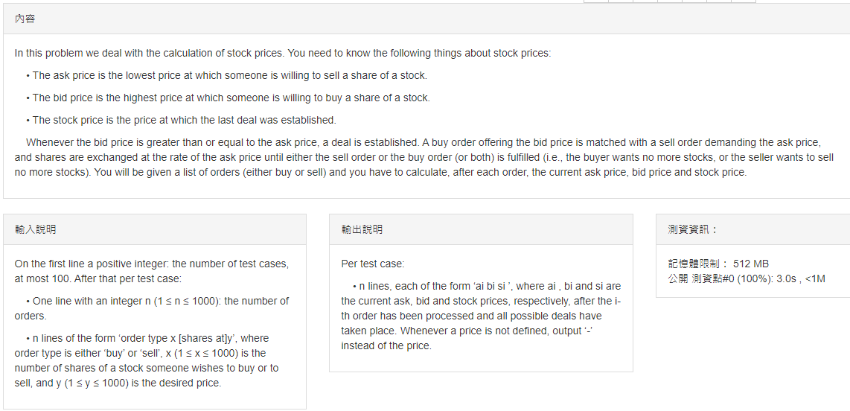

Slide 3
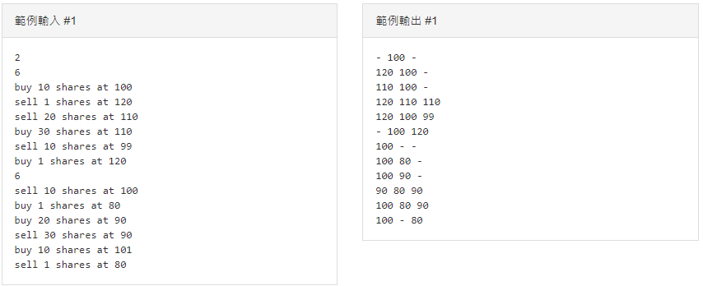

Slide 4
股票交易
委託：
限價委託：投資人自行決定買賣價格
市價委託：依當時市場交易的價格撮合交易 一定要買到或賣到某股票時，採用市價委託

Slide 5
撮合
價格優先
買方(bid)：出價高的優先
賣方(ask)：出價低的優先
時間優先
先下單的先成交
價格優先＞時間優先

Slide 6
股價決定
如果成交在買價賣價相同處，則該價格為成交價
如果成交在買價比賣價高的地方，則賣價為成交價

Slide 7
例子1
順序 | 動作
1 | buy 10 shares at 100
2 | sell 1 shares at 120
3 | sell 20 shares at 110
4 | buy 30 shares at 110
5 | sell 10 shares at 99
6 | buy 1 shares at 120

Slide 8
例子1
順序 | 動作
1 | buy 10 shares at 100
2 | sell 1 shares at 120
3 | sell 20 shares at 110
4 | buy 30 shares at 110
5 | sell 10 shares at 99
6 | buy 1 shares at 120
委買 |  | 委賣
價格 | 張數 | 價格 | 張數
100 | 10
T | Ask | Bid | Price
1 | - | 100 | -

Slide 9
例子1
順序 | 動作
1 | buy 10 shares at 100
2 | sell 1 shares at 120
3 | sell 20 shares at 110
4 | buy 30 shares at 110
5 | sell 10 shares at 99
6 | buy 1 shares at 120
委買 |  | 委賣
價格 | 張數 | 價格 | 張數
100 | 10 | 120 | 1
T | Ask | Bid | Price
1 | - | 100 | -
2 | 120 | 100 | -

Slide 10
例子1
賣方：出價低的優先
委買 |  | 委賣
價格 | 張數 | 價格 | 張數
100 | 10 | 120 | 1
 |  | 110 | 20
順序 | 動作
1 | buy 10 shares at 100
2 | sell 1 shares at 120
3 | sell 20 shares at 110
4 | buy 30 shares at 110
5 | sell 10 shares at 99
6 | buy 1 shares at 120
T | Ask | Bid | Price
1 | - | 100 | -
2 | 120 | 100 | -
3 | 110 | 100 | -
委買 |  | 委賣
價格 | 張數 | 價格 | 張數
100 | 10 | 110 | 20
 |  | 120 | 1

Slide 11
例子1
買方：出價高的優先
買價賣價相同
該價格為成交價
委買 |  | 委賣
價格 | 張數 | 價格 | 張數
100 | 10 | 110 | 20
 |  | 120 | 1
順序 | 動作
1 | buy 10 shares at 100
2 | sell 1 shares at 120
3 | sell 20 shares at 110
4 | buy 30 shares at 110
5 | sell 10 shares at 99
6 | buy 1 shares at 120
T | Ask | Bid | Price
1 | - | 100 | -
2 | 120 | 100 | -
3 | 110 | 100 | -
4 |  |  | 110
委買 |  | 委賣
價格 | 張數 | 價格 | 張數
100 | 10 | 120 | 1
110 | 10

Slide 12
例子1
買方：出價高的優先
委買 |  | 委賣
價格 | 張數 | 價格 | 張數
100 | 10 | 120 | 1
110 | 10
順序 | 動作
1 | buy 10 shares at 100
2 | sell 1 shares at 120
3 | sell 20 shares at 110
4 | buy 30 shares at 110
5 | sell 10 shares at 99
6 | buy 1 shares at 120
T | Ask | Bid | Price
1 | - | 100 | -
2 | 120 | 100 | -
3 | 110 | 100 | -
4 | 120 | 110 | 110
委買 |  | 委賣
價格 | 張數 | 價格 | 張數
110 | 10 | 120 | 1
100 | 10

Slide 13
例子1
買價比賣價高
賣價為成交價
委買 |  | 委賣
價格 | 張數 | 價格 | 張數
110 | 10 | 120 | 1
100 | 10
順序 | 動作
1 | buy 10 shares at 100
2 | sell 1 shares at 120
3 | sell 20 shares at 110
4 | buy 30 shares at 110
5 | sell 10 shares at 99
6 | buy 1 shares at 120
T | Ask | Bid | Price
1 | - | 100 | -
2 | 120 | 100 | -
3 | 110 | 100 | -
4 | 120 | 110 | 110
5 | 120 | 100 | 99
委買 |  | 委賣
價格 | 張數 | 價格 | 張數
100 | 10 | 120 | 1

Slide 14
例子1
買方：出價高的優先
委買 |  | 委賣
價格 | 張數 | 價格 | 張數
100 | 10 | 120 | 1
順序 | 動作
1 | buy 10 shares at 100
2 | sell 1 shares at 120
3 | sell 20 shares at 110
4 | buy 30 shares at 110
5 | sell 10 shares at 99
6 | buy 1 shares at 120
T | Ask | Bid | Price
1 | - | 100 | -
2 | 120 | 100 | -
3 | 110 | 100 | -
4 | 120 | 110 | 110
5 | 120 | 100 | 99
6 | - | 100 | 120
委買 |  | 委賣
價格 | 張數 | 價格 | 張數
100 | 10

Slide 15
例子2
順序 | 動作
1 | sell 10 shares at 100
2 | buy 1 shares at 80
3 | buy 20 shares at 90
4 | sell 30 shares at 90
5 | buy 10 shares at 101
6 | sell 1 shares at 80

Slide 16
例子2
順序 | 動作
1 | sell 10 shares at 100
2 | buy 1 shares at 80
3 | buy 20 shares at 90
4 | sell 30 shares at 90
5 | buy 10 shares at 101
6 | sell 1 shares at 80
委買 |  | 委賣
價格 | 張數 | 價格 | 張數
 |  | 100 | 10
T | Ask | Bid | Price
1 | 100 | - | -
2
3
4
5
6

Slide 17
例子2
委買 |  | 委賣
價格 | 張數 | 價格 | 張數
80 | 1 | 100 | 10
順序 | 動作
1 | sell 10 shares at 100
2 | buy 1 shares at 80
3 | buy 20 shares at 90
4 | sell 30 shares at 90
5 | buy 10 shares at 101
6 | sell 1 shares at 80
委買 |  | 委賣
價格 | 張數 | 價格 | 張數
 |  | 100 | 10
T | Ask | Bid | Price
1 | 100 | - | -
2 | 100 | 80 | -
3
4
5
6
T | Ask | Bid | Price
1 | 100 | - | -
2
3
4
5
6

Slide 18
例子2
委買 |  | 委賣
價格 | 張數 | 價格 | 張數
80 | 1 | 100 | 10
順序 | 動作
1 | sell 10 shares at 100
2 | buy 1 shares at 80
3 | buy 20 shares at 90
4 | sell 30 shares at 90
5 | buy 10 shares at 101
6 | sell 1 shares at 80
委買 |  | 委賣
價格 | 張數 | 價格 | 張數
90 | 20 | 100 | 10
80 | 1
T | Ask | Bid | Price
1 | 100 | - | -
2 | 100 | 80 | -
3 | 100 | 90 | -
4
5
6
T | Ask | Bid | Price
1 | 100 | - | -
2 | 100 | 80 | -
3
4
5
6

Slide 19
例子2
委買 |  | 委賣
價格 | 張數 | 價格 | 張數
90 | 20 | 100 | 10
80 | 1
委買 |  | 委賣
價格 | 張數 | 價格 | 張數
80 | 1 | 100 | 10
順序 | 動作
1 | sell 10 shares at 100
2 | buy 1 shares at 80
3 | buy 20 shares at 90
4 | sell 30 shares at 90
5 | buy 10 shares at 101
6 | sell 1 shares at 80
委買 |  | 委賣
價格 | 張數 | 價格 | 張數
80 | 1 | 90 | 10
 |  | 100 | 10
T | Ask | Bid | Price
1 | 100 | - | -
2 | 100 | 80 | -
3 | 100 | 90 | -
4
5
6
 | 90 | 80 | 90

Slide 20
例子2
委買 |  | 委賣
價格 | 張數 | 價格 | 張數
80 | 1 | 90 | 10
 |  | 100 | 10
順序 | 動作
1 | sell 10 shares at 100
2 | buy 1 shares at 80
3 | buy 20 shares at 90
4 | sell 30 shares at 90
5 | buy 10 shares at 101
6 | sell 1 shares at 80
委買 |  | 委賣
價格 | 張數 | 價格 | 張數
80 | 1 | 100 | 10
T | Ask | Bid | Price
1 | 100 | - | -
2 | 100 | 80 | -
3 | 100 | 90 | -
4 | 90 | 80 | 90
5
6
 | 100 | 80 | 90

Slide 21
例子2
委買 |  | 委賣
價格 | 張數 | 價格 | 張數
80 | 1 | 100 | 10
順序 | 動作
1 | sell 10 shares at 100
2 | buy 1 shares at 80
3 | buy 20 shares at 90
4 | sell 30 shares at 90
5 | buy 10 shares at 101
6 | sell 1 shares at 80
委買 |  | 委賣
價格 | 張數 | 價格 | 張數
 |  | 100 | 10
 | 100 | - | 80
T | Ask | Bid | Price
1 | 100 | - | -
2 | 100 | 80 | -
3 | 100 | 90 | -
4 | 90 | 80 | 90
5 | 100 | 80 | 90
6

