Slide 1
人工智慧理論與實務
Ensemble Learning

Slide 2
Ensemble Learning
集成學習
類似盲人摸象的概念，一群盲人每個人摸到大象的不同部位，最後透過集體討論來認知整隻大象
三個臭皮所，勝過一個諸葛亮
一群有個別差異的分類方法，且每個方法要比亂猜還好，當整合夠多個分類來做共同決策時，最終準確率會趨近於1

Slide 3
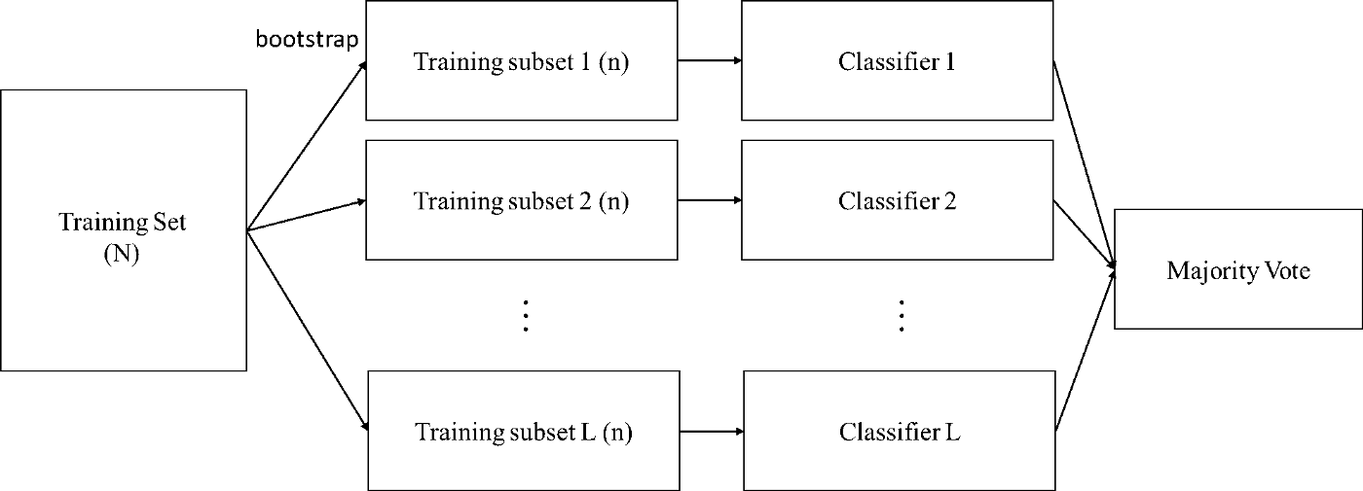
Bagging
隨機從N個training sample中抽取n個樣本來建模 (取出後放回且n<N)
重覆上述動作T次
由這T個分類器來投票決定最終結果
這種抽樣方法在統計上稱為bootstrap
優點在於當訓練樣本中有noise sample時，Bagging有機會讓某些classifier不被影響，故能增進learning的robustness

Slide 4
Boosting Algorithm
Boosting is a machine learning ensemble meta-algorithm for reducing bias primarily and also variance in supervised learning, and a family of machine learning algorithms which convert weak learners to strong ones.
Boosting is based on the question posed by Kearns and Valiant (1988, 1989): Can a set of weak learners create a single strong learner? A weak learner is defined to be a classifier which is only slightly correlated with the true classification (it can label examples better than random guessing). In contrast, a strong learner is a classifier that is arbitrarily well-correlated with the true classification.

Slide 5
AdaBoost
AdaBoost, short for "Adaptive Boosting", is a machine learning meta-algorithm formulated by Yoav Freund and Robert Schapire who won the Gödel Prize in 2003 for their work.
It can be used in conjunction with many other types of learning algorithms to improve their performance.
The output of the other learning algorithms ('weak learners') is combined into a weighted sum that represents the final output of the boosted classifier.
AdaBoost is adaptive in the sense that subsequent weak learners are tweaked in favor of those instances misclassified by previous classifiers.

Slide 6
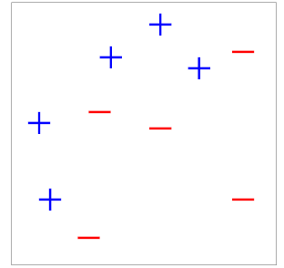
AdaBoost
Freund and Schapire originally proposed the AdaBoost algorithm in 1995 and its journal version was published in 1997

Slide 7
AdaBoost

Slide 8
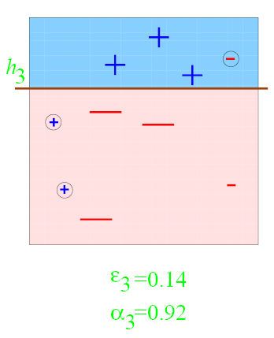
AdaBoost

Slide 9
AdaBoost

Slide 10
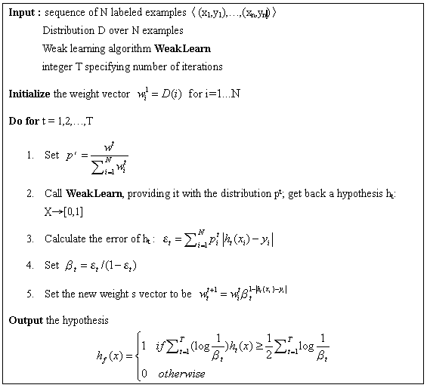
AdaBoost Algorithm

Slide 11
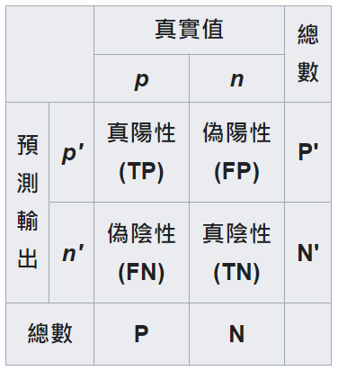
evaluation metrics for binary classification
陽性 (P, positive)
陰性 (N, Negative)
真陽性 (TP, true positive)
正確的肯定。又稱：命中 (hit)
真陰性 (TN, true negative)
正確的否定。又稱：正確拒絕 (correct rejection)
偽陽性 (FP, false positive)
錯誤的肯定，又稱：假警報 (false alarm)
偽陰性 (FN, false negative)
錯誤的否定，又稱：未命中 (miss)
真陽性率 (TPR, true positive rate)
又稱：命中率 (hit rate)、敏感度(sensitivity)
TPR = TP / P = TP / (TP+FN)
偽陽性率(FPR, false positive rate)
又稱：錯誤命中率，假警報率 (false alarm rate)
FPR = FP / N = FP / (FP + TN)
準確度 (ACC, accuracy)
ACC = (TP + TN) / (P + N)
即：(真陽性+真陰性) / 總樣本數
真陰性率 (TNR)
又稱：特異度 (SPC, specificity)
SPC = TN / N = TN / (FP + TN) = 1 - FPR
陽性預測值 (PPV)
PPV = TP / (TP + FP)
陰性預測值 (NPV)
NPV = TN / (TN + FN)
假發現率 (FDR)
FDR = FP / (FP + TP)
F1評分
F1 = 2TP/(P+P')

