Slide 1


Slide 2

SQL Project
Name: Bharat Singh
Batch: K-404
Incharge: Sandip Jaiswar Sir

Slide 3



Abstract
The Hospital Management System (HMS) is a comprehensive database solution designed to streamline hospital operations and improve patient care. Built using SQL and MySQL Workbench, the system efficiently manages patient records, doctor record, appointment, billing. It ensures data accuracy, security, and accessibility while reducing manual errors and administrative overhead. The HMS enhances communication between departments and facilitates quick decision-making through real-time data availability. Its user-friendly interface makes it easy for hospital staff to adapt, ultimately contributing to better healthcare delivery and operational efficiency.

Slide 4
INTODUCTION
The Hospital Management System (HMS) is an advanced software solution designed to simplify and automate the complex administrative, financial, and operational processes of a hospital.
Built using SQL and MySQL Workbench, the system is designed to handle large volumes of data securely and efficiently, promoting better decision-making and enhancing the overall quality of healthcare delivery.
OBJECTIVES
Efficient Patient , Doctor Record Management
Enhance Billing and Payment Status
Ensure Data Security and Privacy
Reduce Paperwork Overhead
Enhance Patient Experience

Slide 5
In this project, there are 5 tables
Patient
Doctor
Department
Appointment
Bills

Slide 6
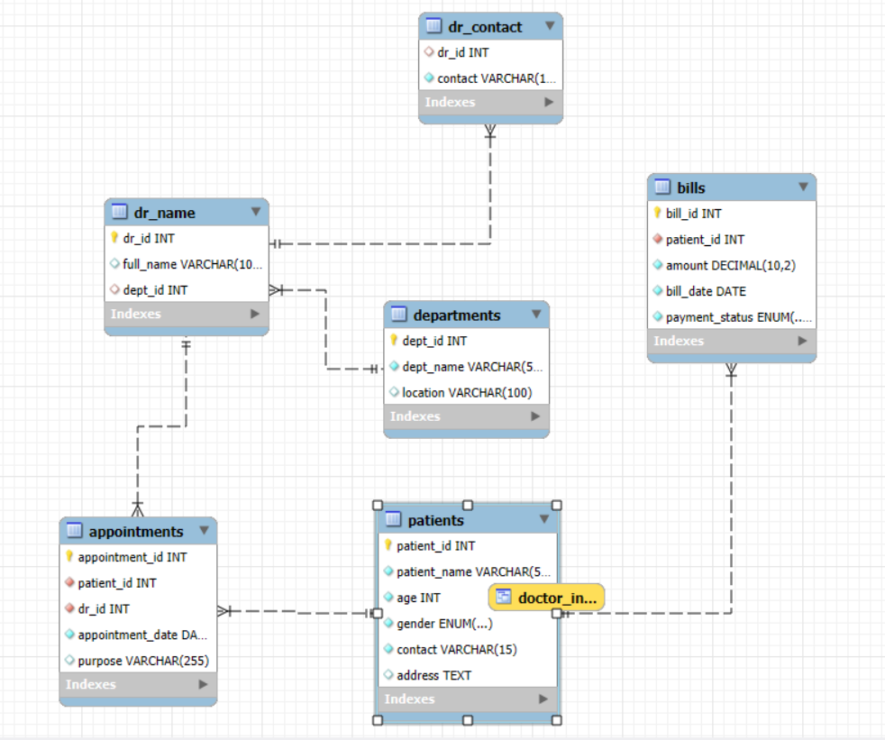
E R Diagram

Slide 7
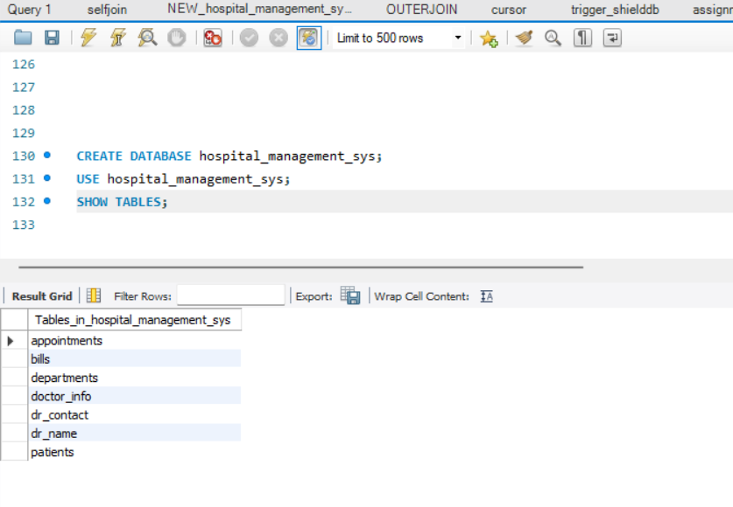
Tables In hospital_management_sys

Slide 8
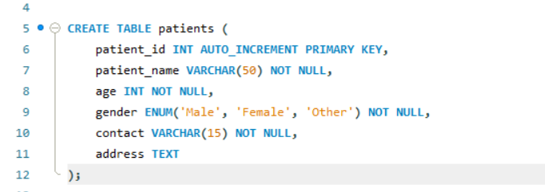
Patient Table

Slide 9
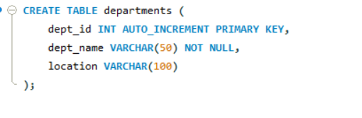
Department Table

Slide 10
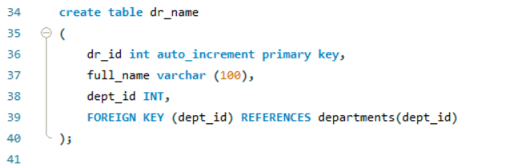
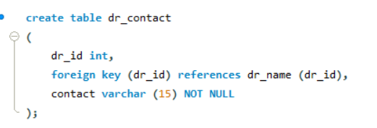
Doctor Table

Slide 11
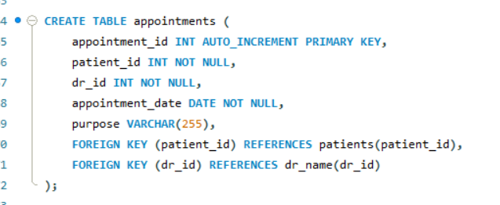
Appointment Table

Slide 12
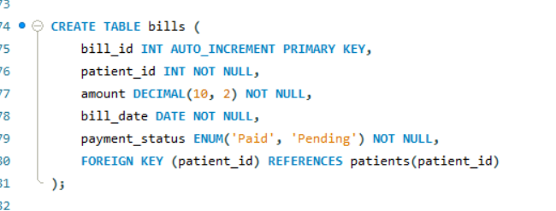
Bills Table

Slide 13
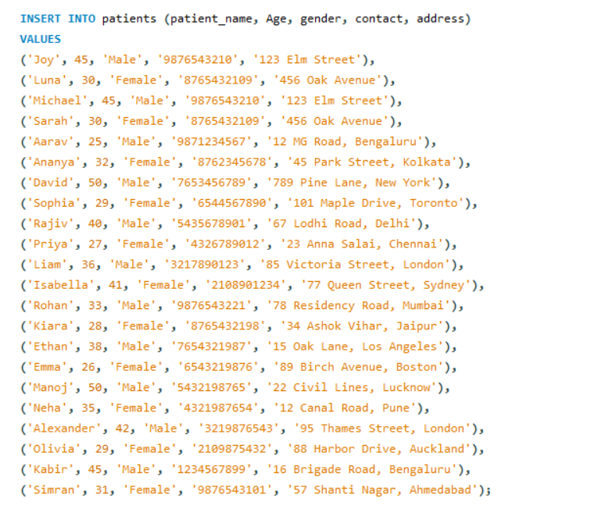
Inserting Data inside the tables
Patients table

Slide 14
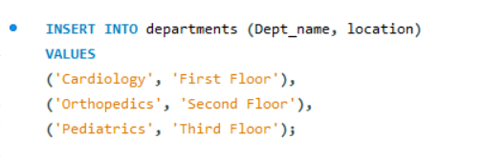
Inserting Data inside the tables
Department Table

Slide 15
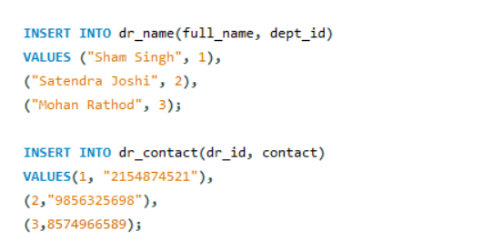
Inserting Data inside the tables
Doctor table

Slide 16
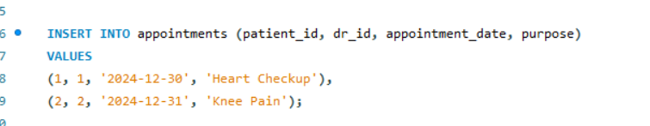
Inserting Data inside the tables
Appointment Table

Slide 17
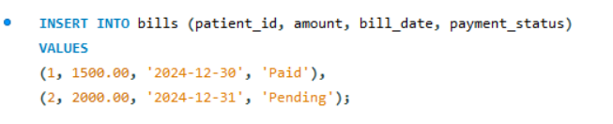
Inserting Data inside the tables
Bills Table

