Slide 1


Slide 2

SQL Project
Name: Bharat Singh
Batch: K-404
Incharge: Sandip Jaiswar Sir

Slide 3



Abstract
The Hospital Management System (HMS) is a comprehensive database solution designed to streamline hospital operations and improve patient care. Built using SQL and MySQL Workbench, the system efficiently manages patient records, doctor record, appointment, billing. It ensures data accuracy, security, and accessibility while reducing manual errors and administrative overhead. The HMS enhances communication between departments and facilitates quick decision-making through real-time data availability. Its user-friendly interface makes it easy for hospital staff to adapt, ultimately contributing to better healthcare delivery and operational efficiency.

Slide 4
INTRODUCTION
The Hospital Management System (HMS) is an advanced software solution designed to simplify and automate the complex administrative, financial, and operational processes of a hospital.
Built using SQL and MySQL Workbench, the system is designed to handle large volumes of data securely and efficiently, promoting better decision-making and enhancing the overall quality of healthcare delivery.
OBJECTIVES
Efficient Patient, Doctor Record Management
Enhance Billing and Payment Status
Ensure Data Security and Privacy
Reduce Paperwork Overhead
Enhance Patient Experience

Slide 5
In this project, there are 5 tables
Patient
Doctor
Department
Appointment
Bills

Slide 6
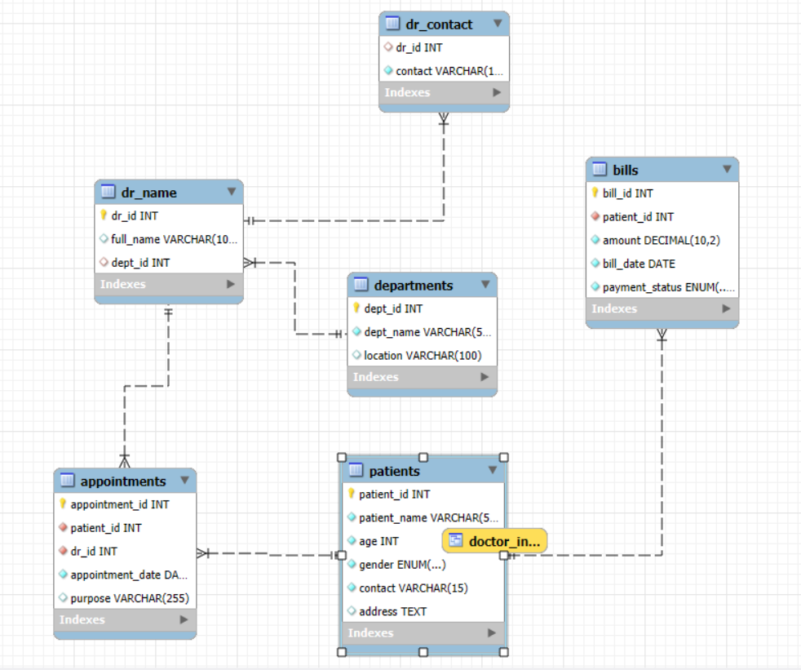
E R Diagram

Slide 7
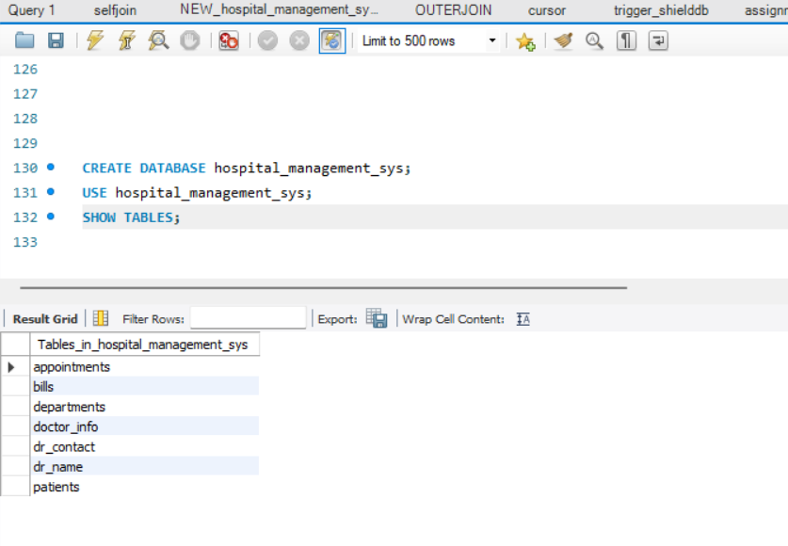
Tables In hospital_management_sys

Slide 8
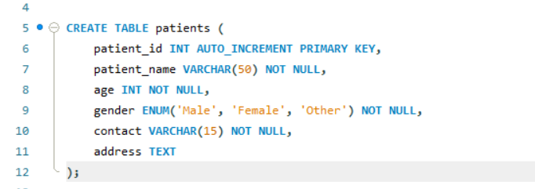
Patient Table

Slide 9
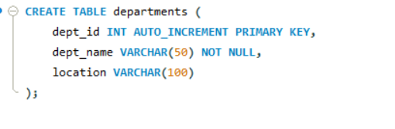
Department Table

Slide 10
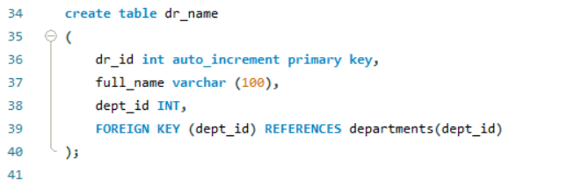
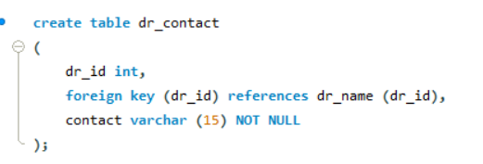
Doctor Table

Slide 11
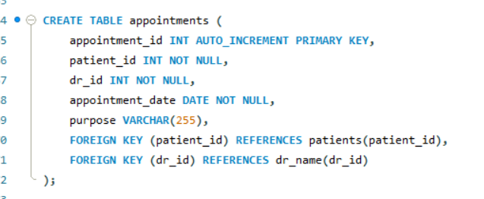
Appointment Table

Slide 12
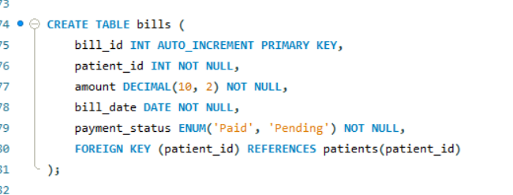
Bills Table

Slide 13
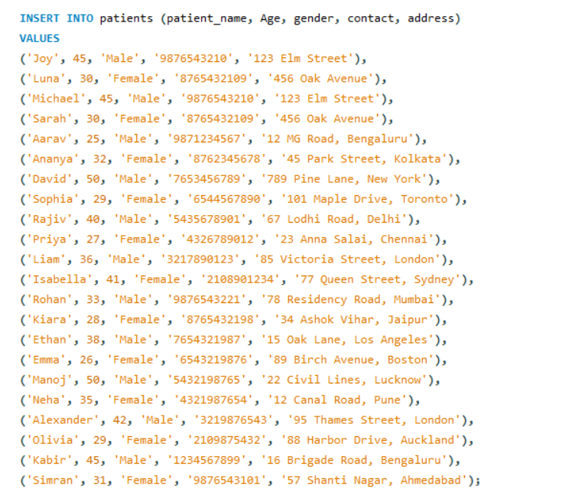
Inserting Data inside the tables
Patients table

Slide 14
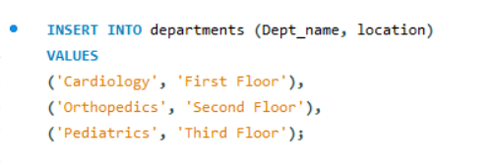
Inserting Data inside the tables
Department Table

Slide 15
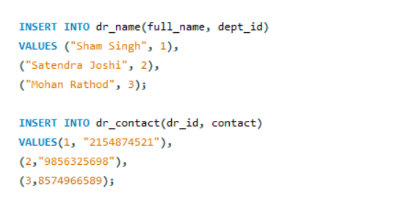
Inserting Data inside the tables
Doctor table

Slide 16
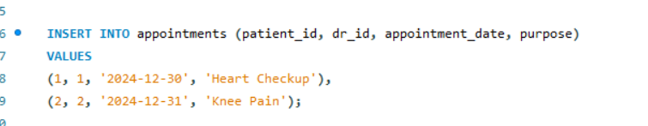
Inserting Data inside the tables
Appointment Table

Slide 17
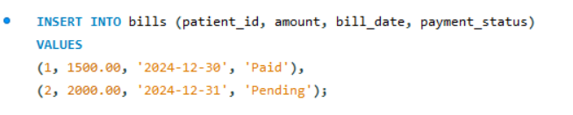
Inserting Data inside the tables
Bills Table

Slide 18
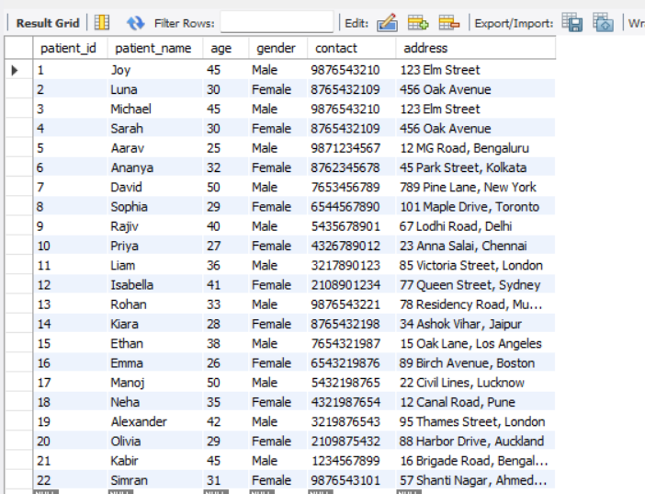
Content Of Tables
Patient Table: (SELECT * FROM patients;)

Slide 19
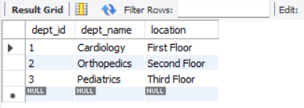
Content Of Tables
Department Table: (SELECT * FROM department;)

Slide 20
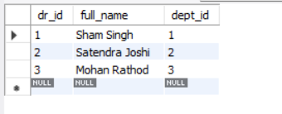
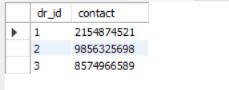
Content Of Tables
Doctor Table: (SELECT * FROM dr_name;)
(SELECT * FROM dr_contact)

Slide 21
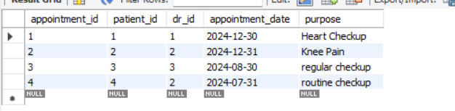
Content Of Tables
Appointments Table: (SELECT * FROM appointments)

Slide 22
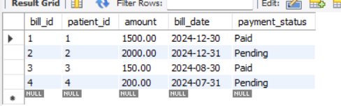
Content Of Tables
Bills Table: (SELECT * FROM bills)

Slide 23

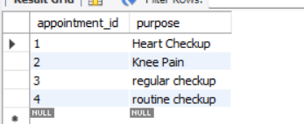
Queries
SELECT: It is used to retrieve the data from the dataset

Slide 24
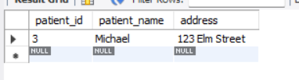
Queries
WHERE: It is used to filter the records and show those records which are specifying the condition

Slide 25
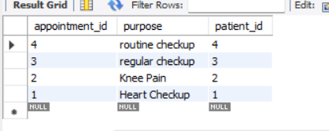
Queries
Order By: It is used to sort the data in ascending or descending

Slide 26

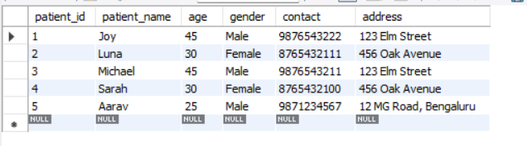
Queries
LIMIT: It is used to apply limitations while displaying the records

Slide 27

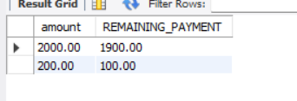
Queries
Operators: Arithmetic Operators
Arithmetic operators are used to perform mathematical operations.
ADDITION, SUBTRACTION, MULTIPLY, DIVISION, MODULUS

Slide 28

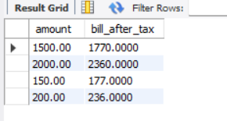
Queries
Operators: Arithmetic Operators
Arithmetic operators are used to perform mathematical operations.
ADDITION, SUBTRACTION, MULTIPLY, DIVISION, MODULUS

Slide 29

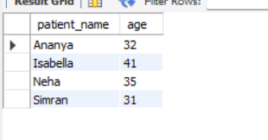
Queries
Logical Operator: It is used when we want multiple conditions for a single query
AND, OR, NOT

Slide 30

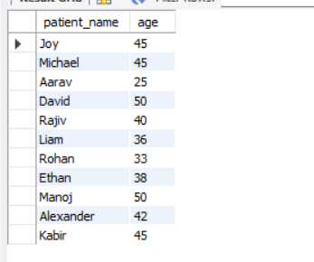
Queries
Logical Operator: It is used when we want multiple conditions for a single query
AND, OR, NOT

Slide 31
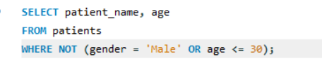
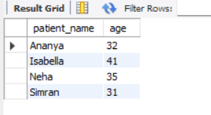
Queries
Logical Operator: It is used when we want multiple conditions for a single query
AND, OR, NOT

Slide 32
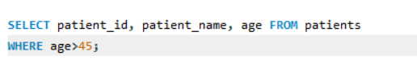
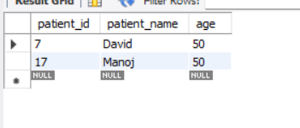
Queries
Comparison Operator: It is used to compare the values
> , BETWEEN, <, ==, >=, <=, IN, LIKE, etc.

Slide 33
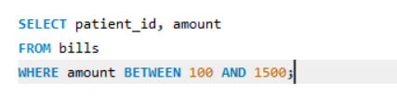
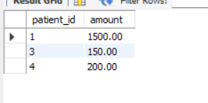
Queries
Comparison Operator: It is used to compare the values
> , BETWEEN, <, ==, >=, <=, IN, LIKE, etc.

Slide 34
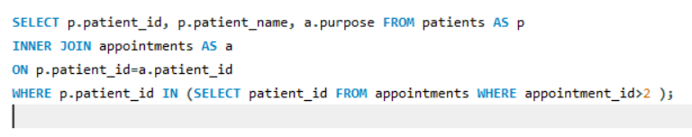
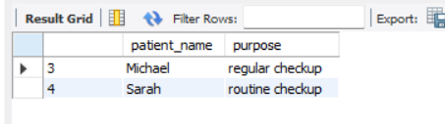
Queries
Comparison Operator: It is used to compare the values
> , BETWEEN, <, ==, >=, <=, IN, LIKE, etc.

Slide 35

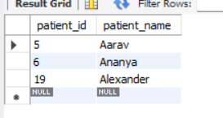
Queries
Queries
Comparison Operator: It is used to compare the values
> , BETWEEN, <, ==, >=, <=, IN, LIKE, etc.

Slide 36


Queries
AVG(): It is used for the average of multiple rows.

Slide 37

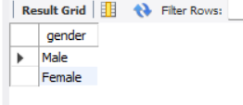
Queries
Distinct: It is used to identify the unique values in specific column.

Slide 38
Queries

Slide 39
Queries

