Slide 1


Slide 2

SQL Project
Name: Bharat Singh
Batch: K-404
Incharge: Sandip Jaiswar Sir

Slide 3



Abstract
The Hospital Management System (HMS) is a comprehensive database solution designed to streamline hospital operations and improve patient care. Built using SQL and MySQL Workbench, the system efficiently manages patient records, doctor record, appointment, billing. It ensures data accuracy, security, and accessibility while reducing manual errors and administrative overhead. The HMS enhances communication between departments and facilitates quick decision-making through real-time data availability. Its user-friendly interface makes it easy for hospital staff to adapt, ultimately contributing to better healthcare delivery and operational efficiency.

Slide 4
INTRODUCTION
The Hospital Management System (HMS) is an advanced software solution designed to simplify and automate the complex administrative, financial, and operational processes of a hospital.
Built using SQL and MySQL Workbench, the system is designed to handle large volumes of data securely and efficiently, promoting better decision-making and enhancing the overall quality of healthcare delivery.
OBJECTIVES
Efficient Patient, Doctor Record Management
Enhance Billing and Payment Status
Ensure Data Security and Privacy
Reduce Paperwork Overhead
Enhance Patient Experience

Slide 5
In this project, there are 5 tables
Patient
Doctor
Department
Appointment
Bills

Slide 6
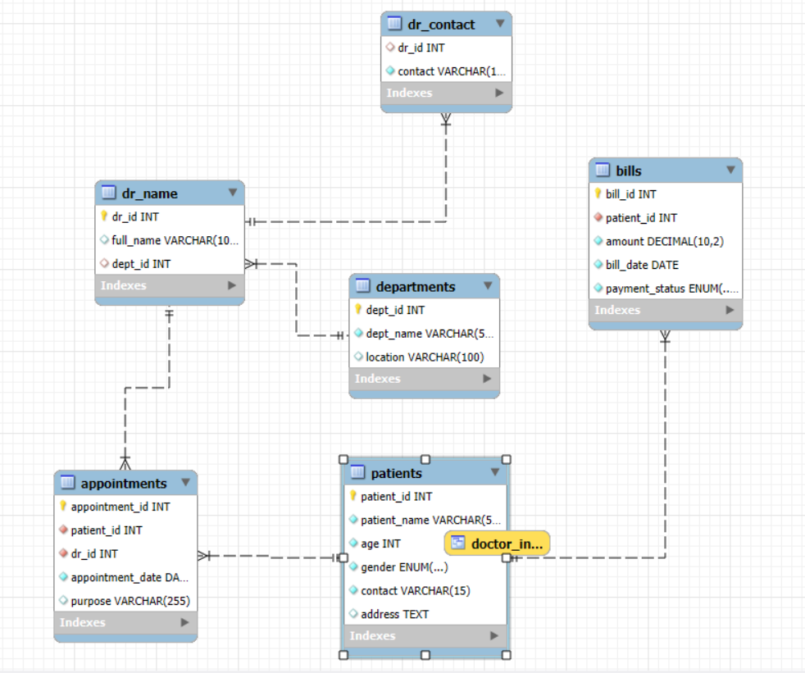
E R Diagram

Slide 7
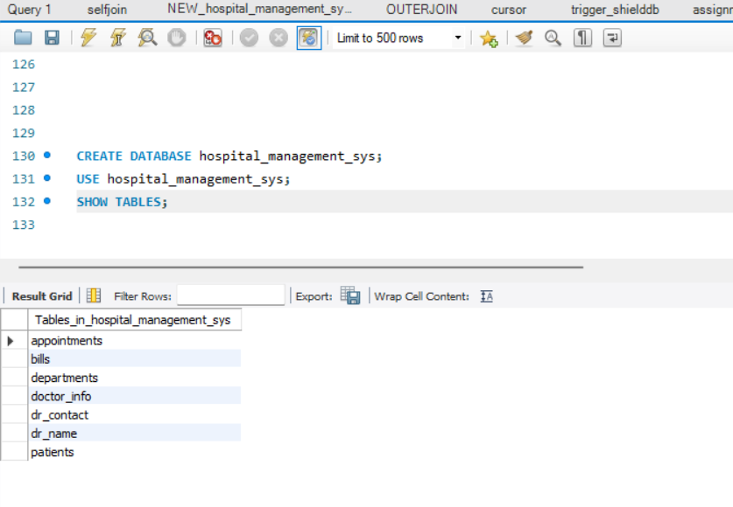
Tables In hospital_management_sys

Slide 8
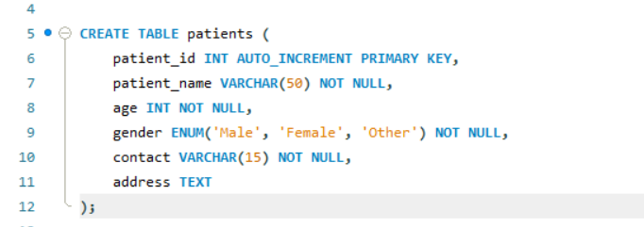
Patient Table

Slide 9
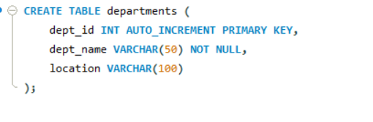
Department Table

Slide 10
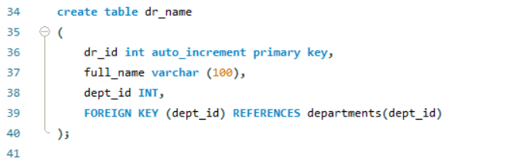
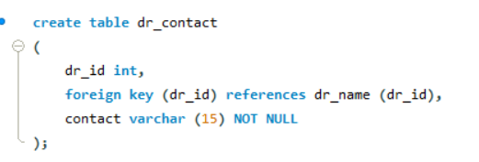
Doctor Table

Slide 11
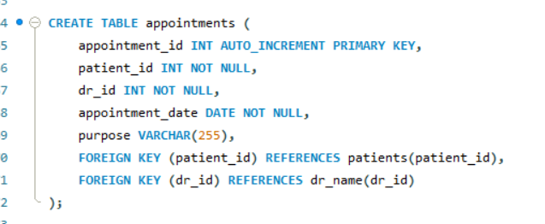
Appointment Table

Slide 12
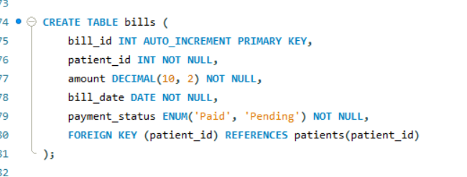
Bills Table

Slide 13
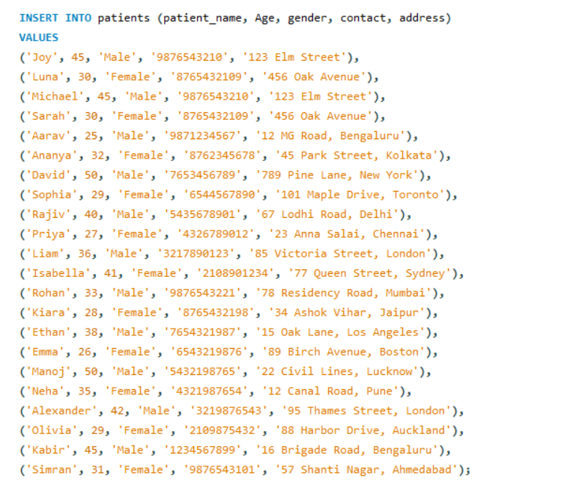
Inserting Data inside the tables
Patients table

Slide 14
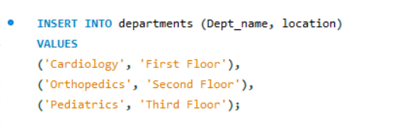
Inserting Data inside the tables
Department Table

Slide 15
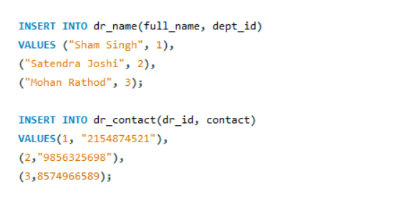
Inserting Data inside the tables
Doctor table

Slide 16
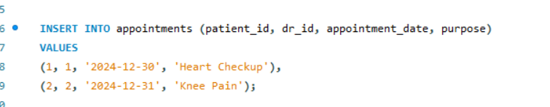
Inserting Data inside the tables
Appointment Table

Slide 17
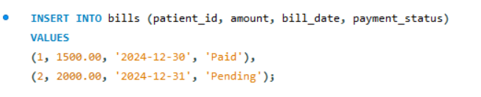
Inserting Data inside the tables
Bills Table

Slide 18
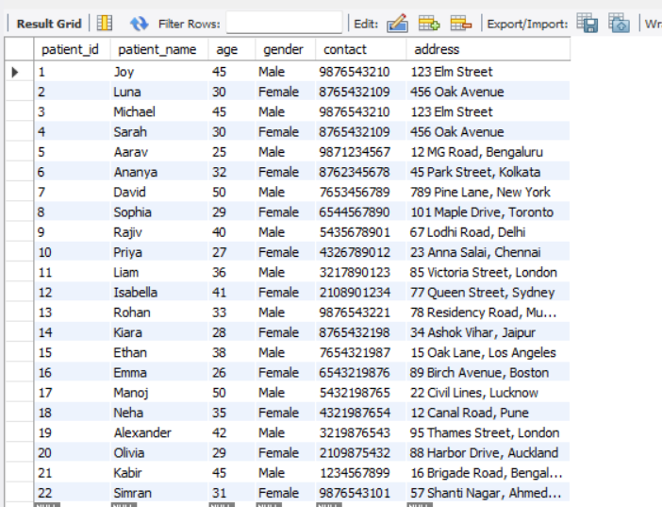
Content Of Tables
Patient Table: (SELECT * FROM patients;)

Slide 19
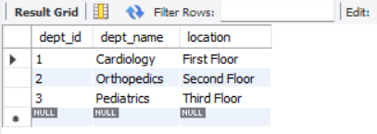
Content Of Tables
Department Table: (SELECT * FROM department;)

Slide 20
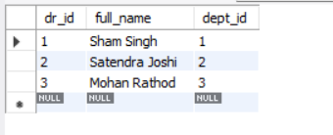
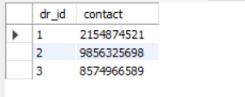
Content Of Tables
Doctor Table: (SELECT * FROM dr_name;)
(SELECT * FROM dr_contact)

Slide 21
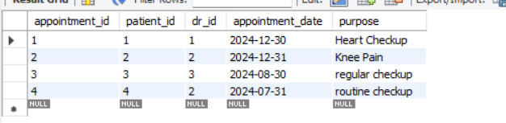
Content Of Tables
Appointments Table: (SELECT * FROM appointments)

Slide 22
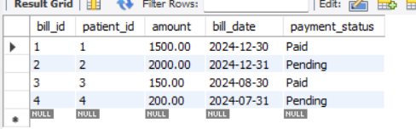
Content Of Tables
Bills Table: (SELECT * FROM bills)

Slide 23

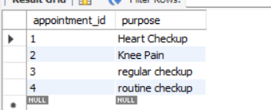
Queries
SELECT: It is used to retrieve the data from the dataset

Slide 24
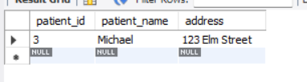
Queries
WHERE: It is used to filter the records and show those records which are specifying the condition

Slide 25
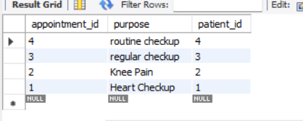
Queries
Order By: It is used to sort the data in ascending or descending

Slide 26

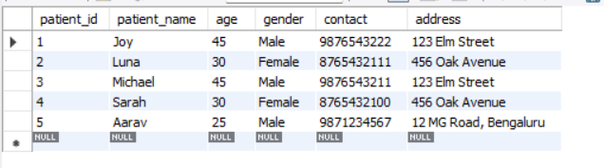
Queries
LIMIT: It is used to apply limitations while displaying the records

Slide 27

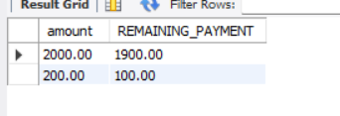
Queries
Operators: Arithmetic Operators
Arithmetic operators are used to perform mathematical operations.
ADDITION, SUBTRACTION, MULTIPLY, DIVISION, MODULUS

Slide 28

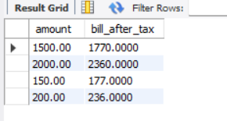
Queries
Operators: Arithmetic Operators
Arithmetic operators are used to perform mathematical operations.
ADDITION, SUBTRACTION, MULTIPLY, DIVISION, MODULUS

Slide 29

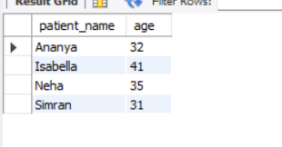
Queries
Logical Operator: It is used when we want multiple conditions for a single query
AND, OR, NOT

Slide 30

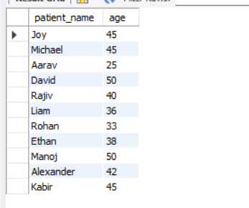
Queries
Logical Operator: It is used when we want multiple conditions for a single query
AND, OR, NOT

Slide 31
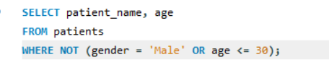
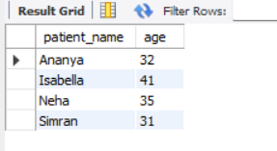
Queries
Logical Operator: It is used when we want multiple conditions for a single query
AND, OR, NOT

Slide 32
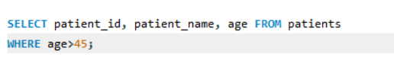
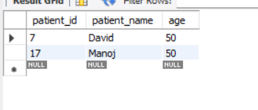
Queries
Comparison Operator: It is used to compare the values
> , BETWEEN, <, ==, >=, <=, IN, LIKE, etc.

Slide 33
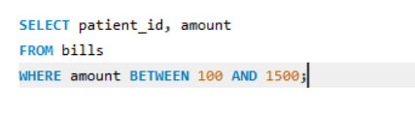
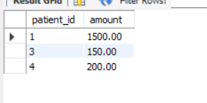
Queries
Comparison Operator: It is used to compare the values
> , BETWEEN, <, ==, >=, <=, IN, LIKE, etc.

Slide 34
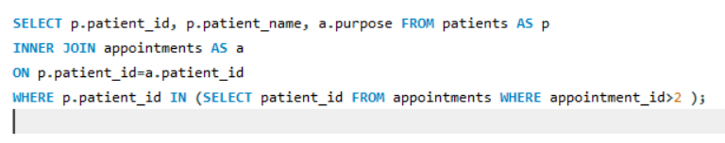
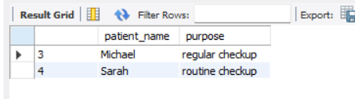
Queries
Comparison Operator: It is used to compare the values
> , BETWEEN, <, ==, >=, <=, IN, LIKE, etc.

Slide 35

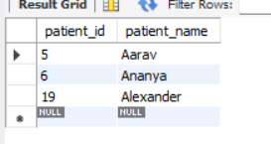
Queries
Queries
Comparison Operator: It is used to compare the values
> , BETWEEN, <, ==, >=, <=, IN, LIKE, etc.

Slide 36

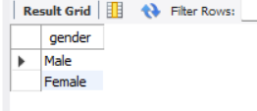
Queries
Distinct: It is used to identify the unique values in specific column.

Slide 37
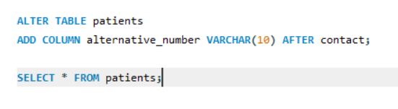
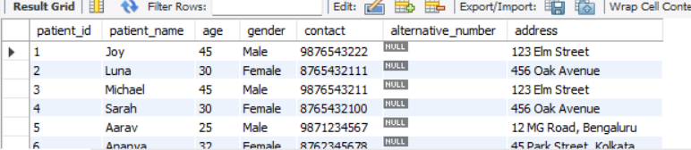
Queries
Alter Table: It is used to modifying the existing table structure like ADD column, Change, Modify, Drop.
Adding Column “alternative_number” after “contact”
AFTER: It is used to define after which table we want to add the new column

Slide 38
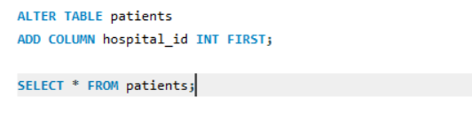
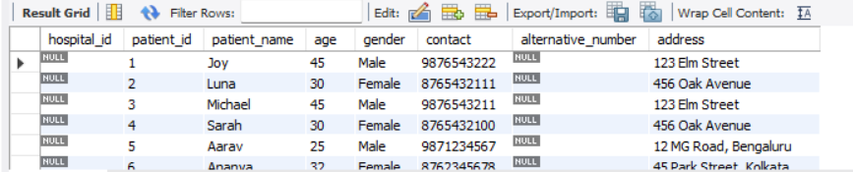
Queries
ALTER TABLE -> FIRST
FIRST: It is used to adda new column in 1st position i.e before everything

Slide 39
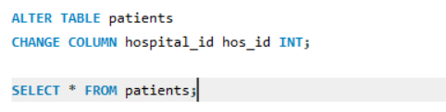
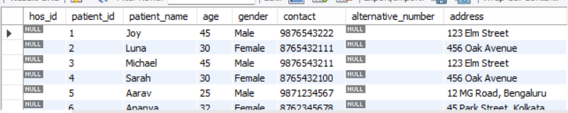
Queries
CHANGE COLUMN: It is used to change the column name or add constraints if required
Changing hospital_id to hos_id

Slide 40
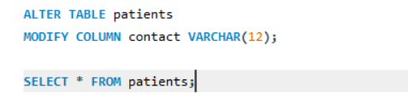
Queries
MODIFY COLUMN: It is used to change the properties of the column as its data type, length, and constraints.
Changing length of the contact

Slide 41
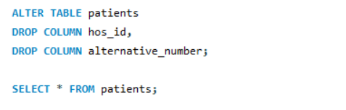
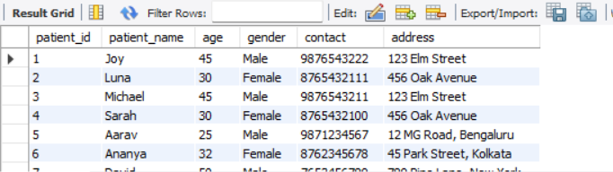
Queries
DROP: It is used to drop the column of the table
Dropping those new columns that we added earlier using add column.

Slide 42
Queries
UPDATE TABLE: It is used to update the existing record inside the table.

Slide 43
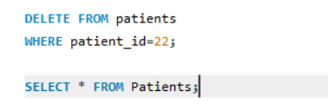
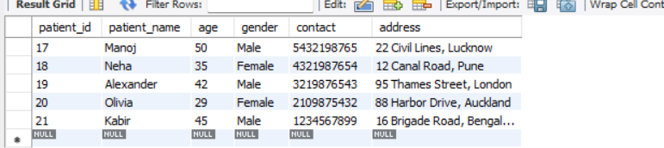
Queries
DELETE: It is used to delete the record from the table.
Deleting row whose patient_id is 22

Slide 44

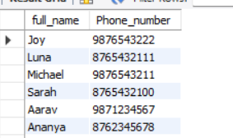
Queries
Alias: It is used to give a temporary name to make the output more readable and easier to understand.
“AS” is the keyword used to assign the name.

Slide 45
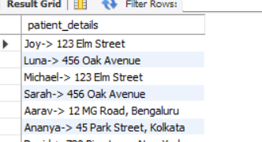
Queries
Functions: String Functions
It is used to manipulate the data using multiple functions.
CONCAT, UPPER, LOWER, SUBSTRING
Concat(): is used to add two or more strings together.

Slide 46


Queries
Functions: String Functions
It is used to manipulate the data using multiple functions.
CONCAT, UPPER, LOWER, SUBSTRING
Upper(): it is used when we want upper case to any string.

Slide 47


Queries
Functions: String Functions
It is used to manipulate the data using multiple functions.
CONCAT, UPPER, LOWER, SUBSTRING.
Substring(): It is used for subtracting a substring from the string

Slide 48


Queries
MATH FUNCTIONS: It is used to perform mathematical expressions on numerical data.
ABS, CEILING, FLOOR, POWER, ROUND, SQRT.
Round(): it will give the round figure of the data

Slide 49


Queries
MATH FUNCTIONS: It is used to perform mathematical expressions on numerical data.
ABS, CEILING, FLOOR, POWER, ROUND, SQRT.
SQRT(): is used for finding the square root of the given data

Slide 50

Queries
Date Function
Year(): returns the year, Month(): returns the month

Slide 51


Queries
Date Function
Dayname(): it will returns the date

Slide 52


Queries
Aggregate Functions: It performs calculations on sets of values and returns a single value.
COUNT, SUM, AVG, MIN, MAX.
Count of all patients

Slide 53


Queries
Aggregate Functions: It performs calculations on sets of values and returns a single value.
COUNT, SUM, AVG, MIN, MAX.

Slide 54


Queries
GROUP BY CLAUSE: It is used in conjunction with aggregate functions (such as SUM, AVG, COUNT, MAX, MIN) to perform calculations on groups of rows
Using GROUP BY now we will make a group of paid and pending statuses and display sum of it as a result

Slide 55


Queries
HAVING CLAUSE: It is used in conjunction with the group by clause to filter out the result.
Using the having clause we filtered the result whose amount less than 2000 after summing up the amount

Slide 56
Queries
CONSTRAINTS: Constraint is a rule or condition that is applied to a table column or a set of columns to maintain the integrity, accuracy, and consistency of the data stored in the database.
There are different types of constraints that we can apply to the column of the table
NOT NULL
UNIQUE
DEFAULT
CHECK
PRIMARY KEY
FOREIGN KEY

Slide 57


Queries
NOT NULL: This ensures that a column cannot have a NULL VALUES, every row should have some values in it.
Adding a NOT NULL constraint to the contact column in the patient table

Slide 58


Queries
UNIQUE: It ensures that each row should have a unique value, it is mainly used for the contact/phone no. columns

Slide 59


Queries
INFORMATION SCHEMA: It is used to see the constraint on the column of the table

Slide 60


Queries
FOREIGN KEY: It is a column or set of columns in one table that refers to the primary key in another table
It is also known as the Referential Integrity
In this project, I have used dept_id as a foreign key in the dr_name table

Slide 61


Queries
JOINS: It is used to combine rows from two or more tables based on a related column between them.
CROSS JOIN: It is a Cartesian product of two tables, resulting in every possible combination of rows.

Slide 62


Queries
INNER JOIN: It is used to return rows from both tables where there is a match based on specific join condition.
EQUI JOIN: This join condition typically uses the equality operator (=) to compare values in the specified columns.

Slide 63


Queries
NON-EQUI JOIN: A non-equi join is a type of join in SQL where the join condition involves a comparison other than equality between the columns of the joined tables.
In this we have to use (!=) operator to find out all the values which is not in

Slide 64


Queries
NATURAL JOIN: It automatically joins the tables based on columns with the same name and data type.

Slide 65


Queries
LEFT OUTER JOIN: It returns all rows from the left table which is table1 and matches rows from the right table which is table2.
Using left join on bills and patients table.

Slide 66


Queries
RIGHT OUTER JOIN: It returns all rows from the right table which is table2 and matches rows from the left table which is table1.
Using the right join on dr_name and departments table

Slide 67


Queries
FULL OUTER JOIN: It returns all rows from both tables, combining the results of both LEFT and RIGHT joins. If there is no match, NULL values are returned

Slide 68



Queries
VIEW: It is used to create a virtual table based on the result of a SELECT query
We have dr_name and dr_contact so a view is created for the doctor_info

Slide 69


Queries
NORMALIZATION: Normalization in SQL is the process of organizing a database to reduce data redundancy and improve data integrity.

Slide 70
Queries

