Slide 1

Fraym Product Team Data Case
By Barrett Buhler

Slide 2
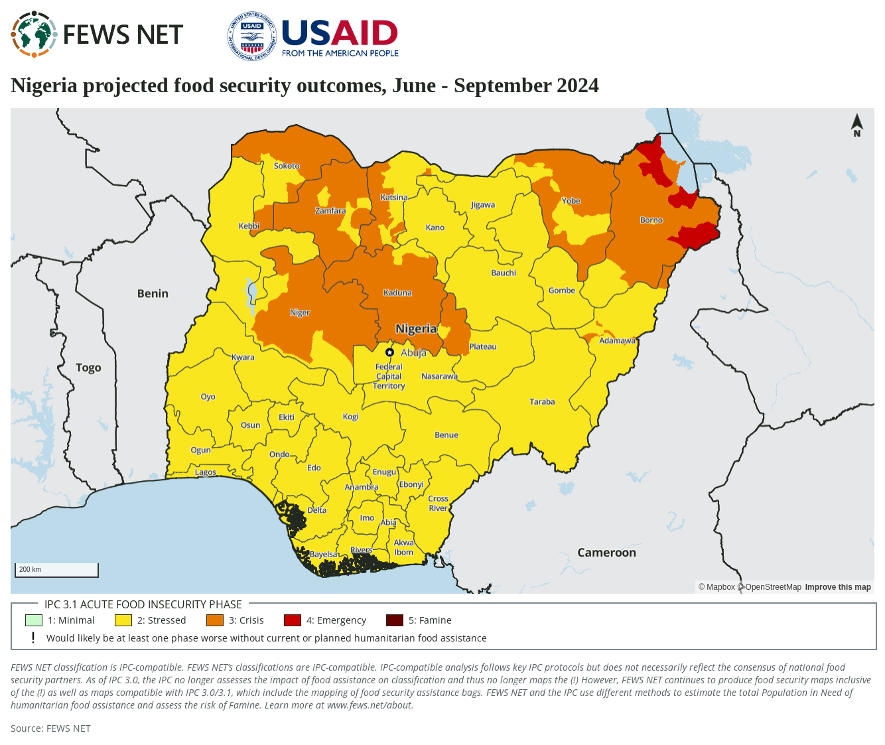

Slide 3
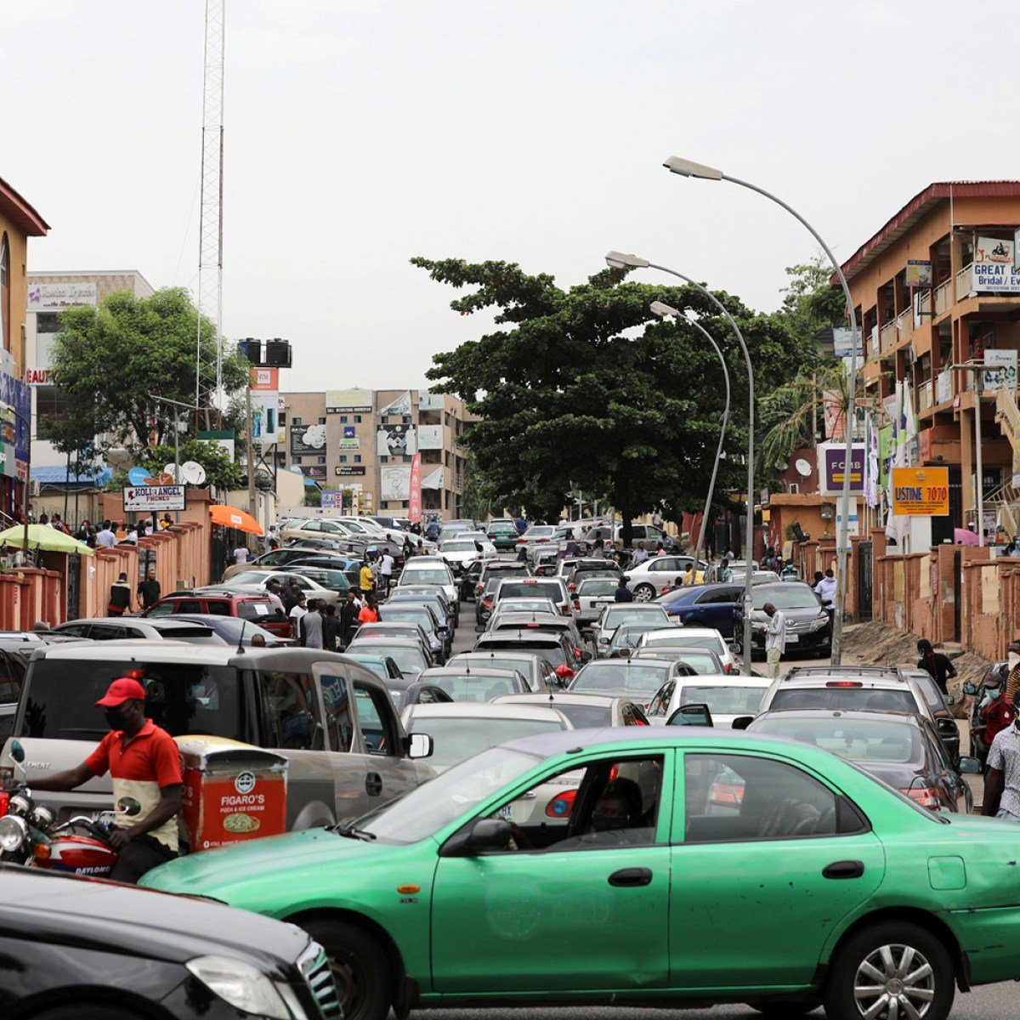
Reducing Food Insecurity among Nigerian Children Under 5: Data Wrangling Process and Key Indicators
Survey questions were added to the study with the direct goal to be used in potential modelling
Variables were created to answer potential questions
Utilized Spatial Join to accurately pinpoint participants
Individuals are accompanied with province data for future modelling
Left zone and neighborhood indices to allow researchers to create potential subsets
Measurable Indicators
Actionable Insights
Accurate Geographic Data
Flexibility for Future Models
Key Zoning Data

Slide 4
Reducing Food Insecurity among Nigerian Children Under 5: Data Wrangling Process and Key Indicators
Average Spending
Under 5 Pop.
Famine Indicator
Socio-Demographics
Land-Proportion
Performed a spatial join on the dataset titled nga_householdgeovars with the FEWS dataset
Created a current famine indicator to discover what factors led to current famine conditions
Created future famine indicator for future progress and measure potential impact
Added key demographic questions to discover if the father is in the home
Created a family size count variable that counts how many individuals are in each household
Added food spending variable that tracked total purchases on food over last 30 days
Variable summed over all purchases for each household in the last 30 days
Amount was used to track household spending rather than the individual
Under 5 population for each state was added for everyone in the respective state
Approximately 35% of people employed in Nigeria work in Agriculture
Included key indicators such as cultivation of land to discover if this portion of the population are at risk

Slide 5
Leveraging Data to Address Nigeria’s Challenges
Which areas of Nigeria are most vulnerable or at risk of experiencing food insecurity?
How do key socio-demographics of households in these areas compare to those of households in less at-risk areas?
To predict which areas are at risk of experiencing food insecurity in the future it would be useful to first discover what variables have the highest coefficients in utilizing a model-based approach
It could then be useful to use that model to predict future data
A traditional or Bayesian approach could also be useful to discover which of these variables are significantly different
These data characteristics can be directly answered through our data
The problem arises in creating samples that accurately represent Nigeria as a whole
There is an overrepresentation of participants in areas not affected by inadequate access

Slide 6
Leveraging Data to Address Nigeria’s Challenges
What is the average spending in at risk areas as well as how many children under 5 reside there?
What proportion of Nigerian children under the age of 5 reside in households in at-risk zones that own agricultural land?
To discover average spending, I would suggest using a model-based approach such as KNN or linear regression
Statisticians could run these models on different subsets of at-risk areas
To discover the children under 5 researchers could sample each area according to the population and use the sample proportions to calculate the number of children under 5
T-tests or similar methods could be used for this problem
Researchers could use similar methods as when answering the question of how many children under-5 live in at-risk areas but with the additional criterion of households that own agricultural land
This could be answered through t-tests or similar methods as well

