Slide 1
A primer on using macros in Microsoft PowerPoint

Slide 2
What are macros?
Macros are low-level programs used to automate tasks like:
  Report generation
  Analysis workflows
  Document formatting
Microsoft Office products (Word, Excel, Powerpoint, etc.) all have built-in compatibility for creating and running macros
Macros for Microsoft Office are written in VBA

Slide 3
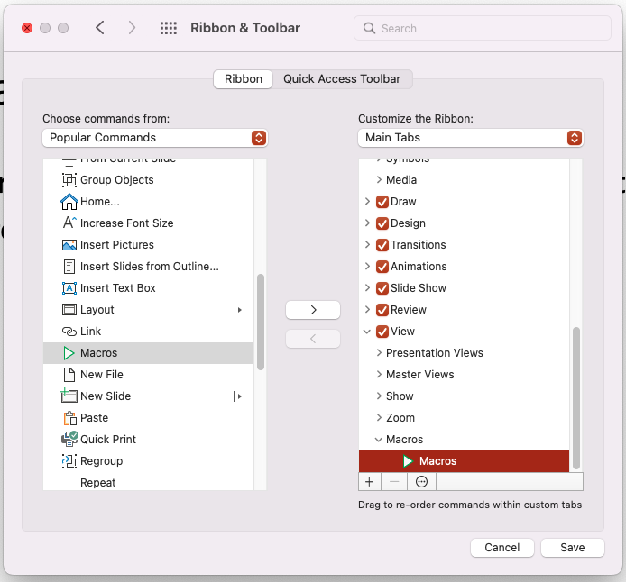
Where do I find macros?
The option to view, create and edit macros in my version of PowerPoint is under the toolbar’s View tab
If you can’t find this icon in your versions’ toolbar, you may need to add it from the Preferences menu

Slide 4
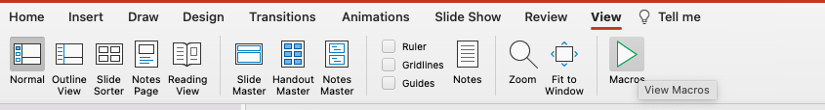
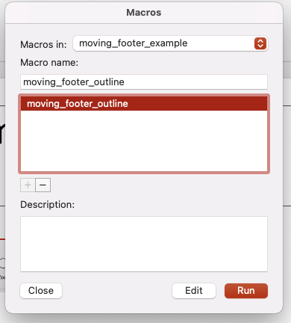
How do I run macros?
Click on the Macros icon in your toolbar to view available macros in your presentation
Click on the macro you want to run to highlight it and then press “Run”
Note:
If you do not see any available macros, you can create one by typing a name into the “Macro name” box and clicking the “+” icon
You can also view and run macros from other open presentations through the “Macros in” dropdown menu

Slide 5

Before
(there’s nothing here)

Slide 6

After
Hey! Look at that!
⇩

Slide 7
How do macros effect my work?
Macros will be applied across any slides/sheets/pages you let them
The moving_footer macro is applied to all slides except the first (assumed to be your title) and last one (when the audience is delivering their standing ovation)
You can edit the style by tweaking the macro
Note:
Currently, I must run the moving_footer macro twice:
  Once to generate footer boxes across the presentation
  Twice to fill in and format those footers

Slide 8
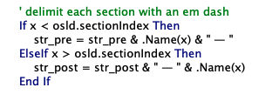



How do I edit macros?
This block lets you change the delimiter
str_pre = str_pre & .Name(x) & “ · ”
Want the other sections to be even lighter?
RGB (200, 200, 200)
How about making your current section stand out?
RGB(255, 0, 0)
Maybe you want to stop adding footers the last 3 slides?
If (osld.SlideIndex > 1) And (osld.SlideIndex < ActivePresentation.Slides.Count - 2) Then

Slide 9
Anything else I should know?
Macros are not continuously applied – after making any changes (adding sections, renaming slides) you will need to run them again to see any results
Like with any software downloaded off the internet, macros can present security risks (especially if you don’t know who wrote them!)
  Because of this, PowerPoint usually asks to save macro-enabled workbooks as normal .pptx files when you save your work
  Saving as a .pptx file removes any macros, but they can always be added back or called from other .pptm files (like this one) should you need

Slide 10
Macros are great, you should use them!
This is a .pptm presentation with the moving_footer macro built in
Feel free to copy or run that macro for your own presentations!

