Slide 1
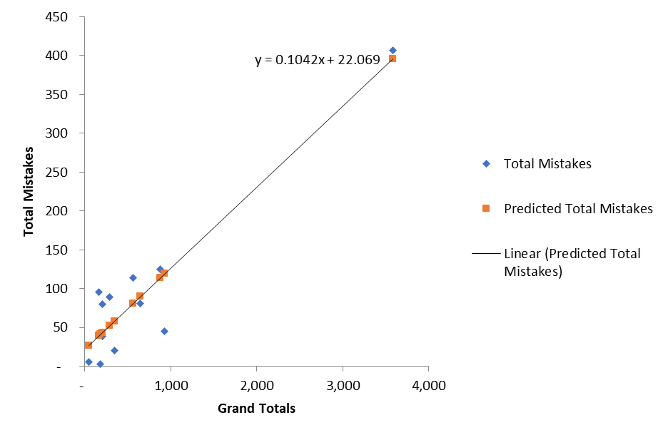
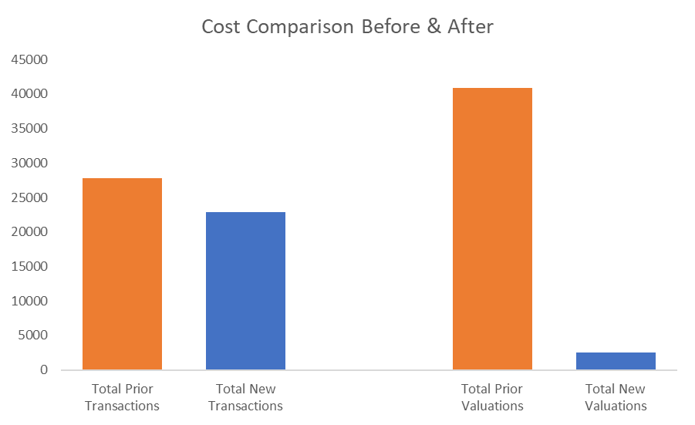
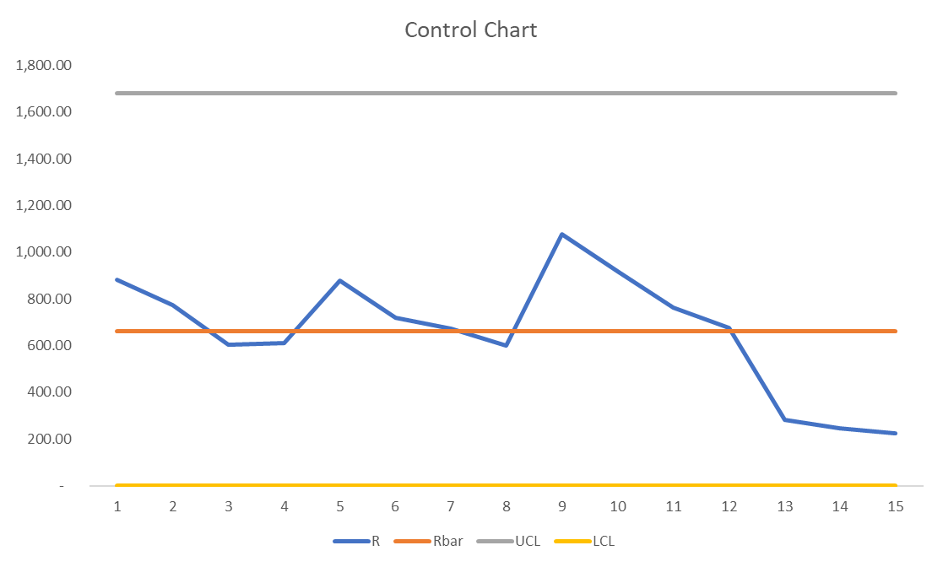
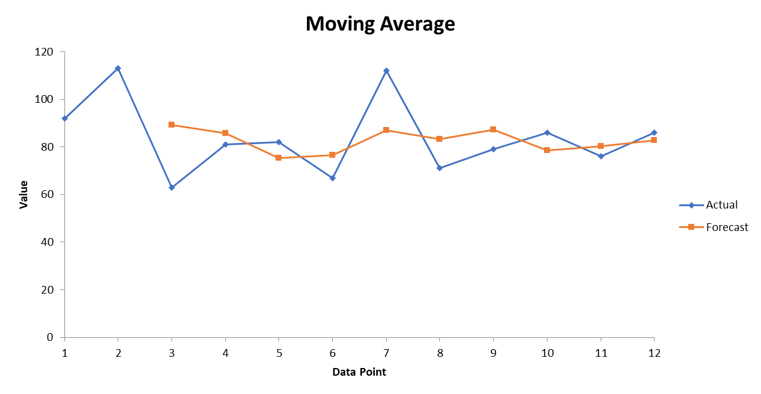
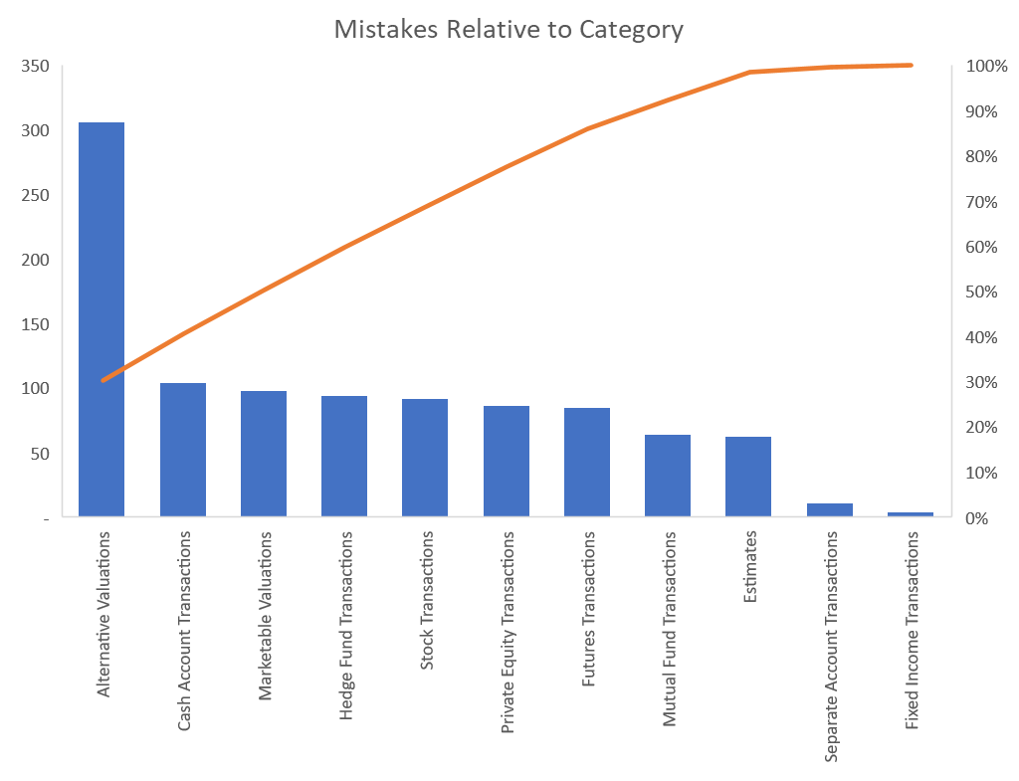
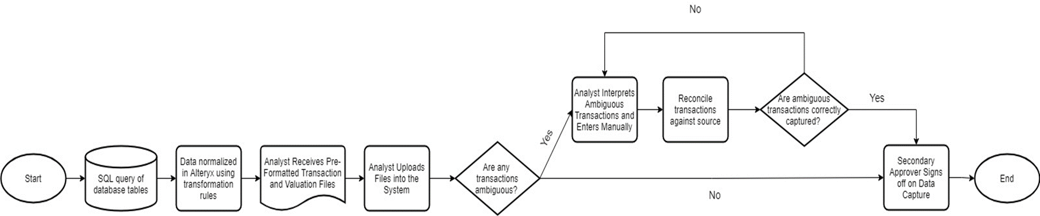
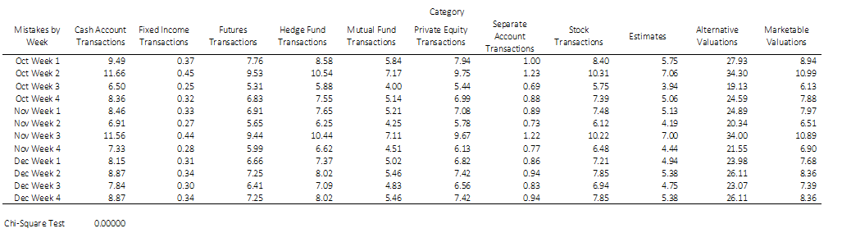
MBC 638 | Process Improvement Storyboard Barrett Franks
Define
Measure
Analyze
Improve
Control
Current Problems:
Manual data entry is a time-consuming process
Manual data entry is prone to human error
Chicago based resources are expensive (relatively speaking)
If demand remains high we will not be able to scale the business using today’s model
Data Collection:
Collect three months worth of data from our audit logs
Discrete data
Break down data by week to understand patterns
Linear Regression:
Test whether spikes in operational activity caused more mistakes
Cost Savings:
Visualize whether costs have decreased as a result of process improvement
Control Phase:
The new process showed to fall significantly under the historic averages
The trend is expected to decline as more future state enhancements are put into production
Significant projected cost reductions
New process stable & well below mistake tolerance
Moving Average:
Understand what might happen if current mode of operation continues
SQL 3.24
New Process Map:
Detail of the new process workflow mapped
Shows enhancements to the number of decision points an analyst needs to make
Further shows the limited manual interaction with the data
Data Visualized:
Business Impact: Solving the issue of manual data capture will benefit Northern Trust internally and clients externally.
Reduced cost for the same set of operational tasks
Clients will experience higher levels of data entry quality
Analysts will be able to focus on value add services; opposed to focusing on manual data capture.
80% of issues caused by many processes
Future projections continue negative trend
Goals:
Initial goals were to eliminate:
100% of data extraction – which was reached
75% of data normalization – which was not reached
75% of manual transaction capture – which was almost reached
90% of valuation capture – which was easily reached
Hypothesis Testing:
Can we accept the alternative hypothesis that fewer mistakes are made after process improvement?
SQL 3.63
Chi-Square Test:
P-value low between old and new Ho must go!

Slide 2
Define
Background Context: I work at a Chicago based financial services firm, Northern Trust. In 2018 we began the acquisition of a fintech software provider to support a new SaaS offering.
Problem Statement: The new software was external to the bank and therefore had no inherent link to Northern Trust data. Demand for the product was instant in 2018. To support this demand, we had to hire operations professionals in Chicago to enter client data manually. There are several issues currently:
Manual data entry is a time-consuming process
Manual data entry is prone to human error
Chicago based resources are expensive (relatively speaking)
If demand remains high we will not be able to scale the business using today’s model
Business Impact: Solving the issue of manual data capture will benefit Northern Trust internally and clients externally.
Internally we will eliminate redundancy, risk and free our resources up to focus on value add services and activities. Currently, we have ~33 professionals on staff. Typically, we assume that the average cost per head is $100,000 annually (this number represents salary, benefits and miscellaneous organizational costs). This problem, today, is worth ~$3,300,000 / year - and this number is expected to grow.
Externally our clients will experience higher quality of data inputs and they will additionally benefit from our ability to focus on value add services and activities.
Success will be measured by time spent today on various activities relative to time spent in a future state on the same activities. Additionally, success will be measured by the reduction in error from manual data entry. The dollar value impact of solving the manual data entry problem will be the difference between these two sets of observations.
Goals: There are four main tasks our operational staff are completing today
The download and extraction of the data
This is a daily task
Because there are reporting portals established the download of Excel files is a fairly quick task
Goal: Eliminate 100% of manually data extraction
The normalization of the downloaded data
This is a daily task
While reporting portals make the file download easy, the file does not come in exactly the format required for entry in our system. This could be as simple as converting nomenclature - for example, they call a transaction “Purchase” and we call the same transaction a “Buy”
Goal: Eliminate at least 75% of manually data normalization
Note: Naturally, there remains some ambiguity in this process as well as client preference for how data is transformed. 100% automation of this process is not necessarily feasible.

Slide 3
Define – Part II
The capture of the data
This is a daily task
This is the most time-consuming task as well as the task that carries the most risk
Broadly speaking there are two main types of data entered, transactions and valuations
Goal One: Eliminate at least 75% of manual transaction capture
Goal Two: Eliminate at least 90% of manual valuation capture
Reconciliation of the data
This is a monthly task
This is the process of validating that the data captured was done so correctly
Goal: Eliminate at least 50% of the time spent on reconciliation
Project Scope: The scope of this project will include solving for / improving upon three of the aforementioned categories - data extraction, transformation and upload.
Note: In the initial Problem Definition Worksheet I had included reconciliation in scope but we had to push it to a day two item due to fundamental system development work. The was a double edged sword because while we weren’t able to tackle all aspects of the work this allowed me to keep the timeline within the duration of this class
The initial activity will be completing a time study to understand where operational resources are spending their time. We will then assess vendors and solutions to solve for the manual data capture. Upon completion of initial assessment we will engage in a proof-of-concept phase, followed by implementation (final step).
Team:
Jane - Project Sponsor
Barrett Franks (me) - Product Lead
Sean - Project Manager
Zheng - Business Analyst
Project Plan:
Define
One Week
Measure
Time Study. We will use historic data to measure time spent
One Week

Slide 4
Define – Part III
Analyze
Analysis of time study to understand most critical areas to solve for (i.e. what are the biggest pain points today)
3 Days
Improve
Phase 1: Engagement in vendor / process selection and proof-of-concept
Note: this was an area I overestimated initially – we were asked to use a pre-approved ETL tool (Extract, transform, load) called Alteryx
Phase 2: Implementation of selection
Anticipate 6 – 8 Weeks
Control
Documentation, training on process & procedures
Anticipate 1 – 2 Weeks
Process Map (Original State Process):

Slide 5
Measure – Sigma Quality Level (SQL)
Data Collection: To initially measure a Sigma Quality Level (SQL) for the original process I collected operational data from our audit logs. An important note about this data is it contains both new transactions and edited transactions. In the next slide I will present / summarize the data in two ways.
The number of unique transactions and valuations (I.e. If data entry was perfect how many pieces of operational data are there?)
The total number of transactions and valuations (I.e. Count for item 1 above plus any edits caused by initial error)
When I organized the data I also categorized the data by investment type. I was interested to see where the biggest possible pain points were in terms of volumes. Additionally, I wanted to know if I had to focus my attention on one area what should it be?
Time Frame: Because the audit log is very easy to run and download into Excel I decided to pull three months worth of data. I further subcategorized these months into weeks when I organized the data because I knew I wouldn’t be able to collect three months work of data after the process enhancement. Further, I wanted three months worth of data because there tends to be a spike in work at the end of each quarter – so any single month could misrepresent the average volume – whereas including an entire quarter will help smooth for peaks in volume
Type of Data: The data collected is discrete data. I.e. you can either have a transaction / valuation or not
Defect Opportunities: For any transaction an analyst enters transaction date, transaction amount, transaction type. And for any valuations and analyst enters valuation date and valuation / price and the share class (different share classes can have different valuations). Given I am looking to solve for both there are a total of three possible defects for any given entry
Definition of an Actual Defect: I define a defect as any edited operational data
Possible Errors in Data Collection: Operational actions that are deleted are only logged as “deleted” on the servers – in other words any / all edit history is removed and replaced by a single delete record. This is only possible for transactions as logically there always needs to be some valuation on record for an investment (I.e. updates only). It is possible that errors are slightly understated.
Initial SQL:
Sigma Quality Level (SQL)
D | 3
U | 681
D * U | 2,043
A | 84
A / DU = DPO | 4.11%
DPMO | 41,116
SQL Score | 3.24

Slide 6
Measure – Data Collected

Slide 7
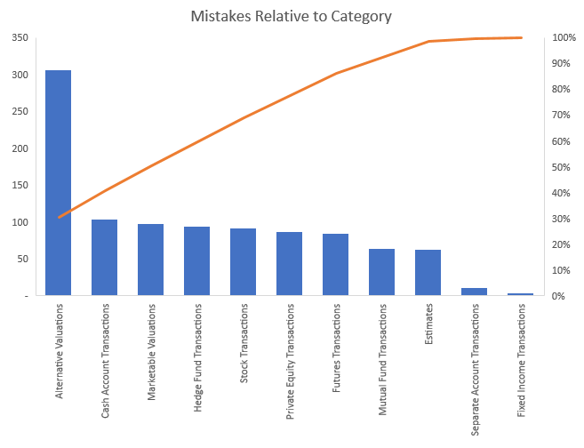
Analyze – Pareto Chart
Pareto Chart: Is The purpose of the Pareto chart is to, at a high level, visualize where the errors might be coming from. I.e. is there a task or two that are causing the vast majority of the operational mistakes?
Results: While clearly the largest single contributor is the entry of alternative valuations this only accounts for ~30% of the total. The next eight or so categories have relatively consistent mistakes to getting to the 80% mark really covers the majority of the categories. From this visualization it is clear that the alternative asset valuation requires considerable focus; the other categories still need attention. It would be fair to say that just through the quantity of valuations that are expected consistently and the fact that it makes up the largest category this may be a good initial area of focus

Slide 8
Analyze – Chi-Square Test
Chi-Square Test: Is there a relationship between asset class and mistakes?
I wanted to use this test to determine whether there was a relationship between the asset class category and the mistakes being made – i.e. is it possible more confusing or difficult to interpret and enter the data for a particular asset class?
Ho = Mistakes and asset class are independent (no relationship)
Ha = Mistakes and asset class are not independent (is a relationship)
Preparation: I gathered the data in Excel and created a two way table with the expected frequencies then used the function: =CHISQ.TEST()
The result was extremely low which indicates that there is a relationship between asset class and mistakes (i.e. the null hypothesis is rejected

Slide 9
Analyze – Regression Analysis
Regression Analysis: I wanted to test whether in periods where volume spikes whether more operational errors tend to occur.
The Results: R = 0.93 shows a strong relationship between the volumes and mistakes made and the adjusted R0square suggests that these two variables account for ~86% of the variability. Finally, the P-value of the Grand Totals is sufficiently low – well below 0.05.

Slide 10

Analyze – Moving Average
Moving Average: I wanted look at what might happen in the next period if there was no change to the process. While the change to the process wouldn’t impact the next period per se it is still important to project ahead and use this as a case for what might continue to happen in the future if the status quo is maintained.
Results: The results suggest that in the following period there would be 83 mistakes. This is based on the average of the previous three observations (I selected three because there were only 12 total actual observations). As mentioned above, while this is only projecting a single future period the results are telling of what has happened in the past and what will continue to happen in the future if no process enhancement is made.

Slide 11
Analyze – Introducing the Element of Cost Using a Trend Chart
Trend Chart: Because cost save is an important element in this project I wanted to introduce the weekly costs / operational category in a visualization that is easy to digest. When I show the data from post improvement I plan to summarize these categories into transactions and valuations only so it is easy to visualize the before and after improvement state.

Slide 12
Analyze – Introducing the New Data
Post Improvement Data: I was able to collect three weeks worth of data after the initial implementation of the solution. The first visual focuses on the same metrics as prior to give an apples to apples comparison. As expected there wasn’t really a decrease in raw volumes – the real question is what are our analysts responsible for today?
In the second visual I have separated out the data. I was able to do this through the same audit logs – however, I filtered by real analyst IDs; opposed to a systematic ID. This helped me isolate what our analysts actually entered.
We saw our analysts were still entering ~60% of transactions. This is because there is still a lot of interpretation that we aren’t able to glean from other system’s data fed automatically.
Encouragingly, we saw valuations were close to eliminated. The only time an analyst was intervening was when a client provided a directed price or challenged the valuation we were auto mapping in.
I then used the prior average hours and applied it to the new observed volumes to come up with an estimated new required FTE count.

Slide 13
Analyze – Before vs. After Analysis
Putting the prior slide into a visualization I wanted to show is reduction in cost of having an analyst complete the work. On the transaction side, as noted, the reduction was only limited at this point. However, there was a massive reduction in time and cost as a result of enhancements to the valuation data capture.
Prior Sigma Quality Level (SQL)
New Sigma Quality Level (SQL)
D | 3
U | 681
D * U | 2,043
A | 84
A / DU = DPO | 4.11%
DPMO | 41,116
SQL Score | 3.24
SQL Score comparison shows that with roughly the same amount of operational opportunities the errors have gone down. The was expected given the reduction in the volume of valuations – because now technically the majority of valuations are not handled manually.
Note: In this new test I counted client directed pricing as an error because an analyst had to intervene

Slide 14
Analyze – Hypothesis Test
Hypothesis Test: If the level of automation of operational data is increased will analysts make fewer manual mistakes?
Ho = Mistakes made before are equal to or less than mistakes made after
Ho = μ1 <= μ2
Ha = Mistakes made before are greater than mistakes made after
Ha = μ1 > μ2
Result: I used the =VAR.P() formula in excel to calculate the known variance input and found that the two tail P-value was extremely close to zero. Therefore, the null is rejected and we can accept the alternative hypothesis which is mistakes made before are greater than mistakes made after (i.e. fewer mistakes are made now after the process improvement

Slide 15

Improve – Discussion & New Process Chart
Tool / Vendor Selection: As mentioned above we were asked to use a pre-approved ETL tool called Alteryx. Through Alteryx we were able to connect directly to the internal databases to retrieve data. So as opposed to running canned reports we were able to get exactly the data points we required.
Method: After we validated we could get the required data points we wrote in a repeatable rule set to normalize the data into the format we required for upload. On the valuation side this was very straight forward. Where we ran into some difficulties was on the transaction side. When mapping a transaction you need to be aware of the transaction type – for example, you can have buys, sells, corporate actions, fees / expenses, etc. Each has a specific impact on accounting basis, market value, performance measurement and so on – so it becomes a very difficult task to automate. For day one we were able to eliminate ~40% of manual transaction volumes; which is still a win initially – however, there is still work that can and will be done over time.
New Process Chart: Below is the new process. In place of deciding whether something was a transaction or valuation and then validating whether the data was entered correctly there is only this step for ambiguous transactions. I am defining ambiguous transactions as transactions that require manual intervention from an analyst – either because it was too complex to map in an initial rule set; or it truly required some interpretation.

Slide 16
Control – Moving Range Chart
Tool / Vendor Selection: I wanted to use the control chart to see exactly how my new weeks stacked up against the previously measured weeks. While still in control it is clear that the new process weeks are clearly below the average and well within range. I would expect as more data comes available and more improvements keep being made to the process the more this trend will continue downward (or minimally stay low relative to historic averages)

