Slide 1

PARA TODOS
PACIFIC SOUTH · BCS
Exploring Our Future
Together.
A regional conversation about how decisions get made
on the Pacific South of BCS.
“This is an exploration, not a proposal. We're here
to listen, learn, and decide together.”

Slide 2
01
WHY NOW
Why this conversation, why now?
Growing fast
The pressure is real
The question is honest
• ~11,000 residents in the southern region today.
• 3–6% annual growth — among the highest in BCS.
• More homes, visitors, and businesses every year.
• Water under stress: rising demand, saltwater intrusion.
• Power interruptions and capacity limits in peak season.
• New developments decided in La Paz, often without local input.
• Are decisions made for us being made by us?
• If not, is that the structure we want for the next 20 years?
• And what's the right way to even ask?
“We don't have answers yet. We're trying to ask the right questions, with the right people, in the right way.”
PARA TODOS
2 / 14

Slide 3
02
THE REALITY
What this looks like in daily life
A
WATER
When the aquifer drops, local farmers wait for permits from La Paz. Decisions about how much water gets pumped — and where it flows — are made by people who don't live with the consequences.
B
POWER
When the transmission line from La Paz fails, our region waits. Decisions about grid investment in our area are made hours away by people prioritizing the city center.
C
DEVELOPMENT
When a new development is proposed near your neighborhood, the permitting process runs through La Paz. By the time you find out, the decision is often already made.
Local governance wouldn't fix any of these overnight. But it would put the decisions closer to the people who live with them.
PARA TODOS
3 / 14

Slide 4
03
CURRENT STRUCTURE
How decisions get made today
Federal Government (Mexico City)
La Paz Municipality is 1 of 5 municipalities in BCS.
Our region is 1 of 30+ delegations within that municipality.
Municipal officials are elected by the entire municipality — ~96% of deciding voters live in La Paz or its suburbs.
State Government (La Paz, BCS)
La Paz Municipality — cabecera: La Paz
La Paz City
Southern Region (us)
~300,000+ residents
~11,000 residents
This is not a criticism of La Paz. It's a structural observation: no system can prioritize 11,000 people when 300,000+ live an hour away.
PARA TODOS
4 / 14

Slide 5
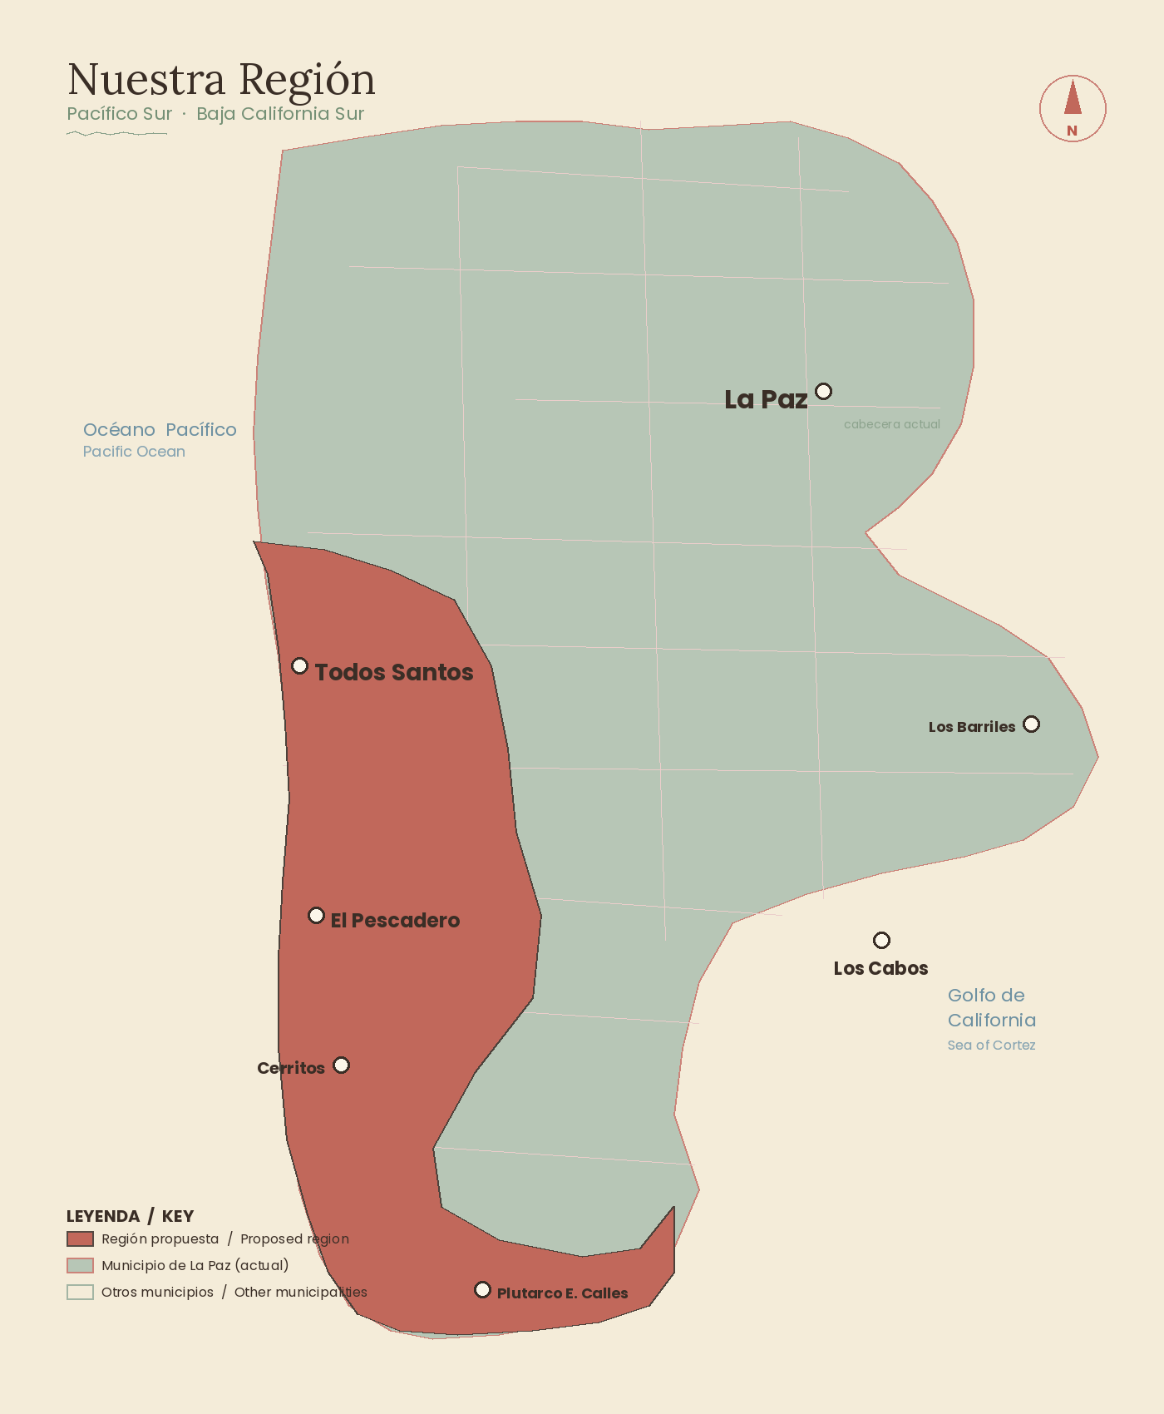
04
OUR REGION
What we mean by 'our region'
Communities included:
• Todos Santos
• Pescadero
• Cerritos
• Las Tunas
• Las Playitas
• Elías Calles
• Neighboring communities
Two scenarios under study:
• A — Pacific Coast Only
• B — Pacific + East Cape (Los Barriles, La Ribera)
The final boundary, if any, would be decided by the community through the formal process.
(Approximate visualization — official cartographic study in Stage I)
PARA TODOS
5 / 14

Slide 6
05
TWO HONEST FUTURES
Two paths, honestly compared
Scenario A — Stay in La Paz
Scenario B — Our own municipality
What changes
What changes
Nothing structurally. Region continues to grow in the current framework.
New municipality. Local cabildo. Local presidente municipal.
What it gives us
What it gives us
Stability. Shared resources with a larger entity. Established governance.
Local control over development, infrastructure, budget. Property tax stays.
What it costs us
What it costs us
Continued delays. Decisions made by people far from the consequences.
One-time transition costs. Build administrative structure. New responsibility.
Property tax
Property tax
Most leaves region for La Paz priorities.
Stays in region.
Federal & state taxes · Immigration status · Property ownership · Federal/state voting rights — unchanged under either scenario.

Slide 7
06
THE LEGAL FRAMEWORK
The legal pathway — what Mexican law says
Mexican federal law and the BCS State Constitution explicitly allow the creation of new municipalities through a citizen-initiated process. This is not a workaround. It's a legal right.
I
Gate 1 — Citizen Petition
II
Gate 2 — Plebiscite
III
Gate 3 — State Congress
At least 33% of registered voters in the proposed territory must sign a formal petition.
At least 2/3 of citizens who vote in the plebiscite must vote YES.
At least 2/3 of BCS State Deputies must vote YES on the constitutional reform.
BCS State Constitution, Art. 122 · Citizen Participation Law, Art. 19
BCS State Constitution, Art. 122.VIII
BCS State Constitution, Art. 64.XXXV
These gates are high — intentionally so. They ensure no new municipality is created without genuine, demonstrated community support. If we can't pass them, we shouldn't create it.
PARA TODOS
7 / 14

Slide 8
07
COSTS & COMMITMENTS
Cost of the process — every peso, public
A proper municipalization process — done with technical rigor, community input, and legal grounding — costs approximately 10 million pesos over 20 months.
I
Stage I — Foundation
II
Stage II — Plebiscite
III
Stage III — Approval
• Promoter Committee
• Public opinion survey (600 questionnaires)
• Cartographic study
• Information campaign
• Signature collection (3,500+)
• Community plebiscite
• Legislative lobbying
• Transition program
• Municipal Development Plan
600,000 MXN · 2 months
5,000,000 MXN · 6 months
2.7M + 1–3M lobbying · 12 months
Three public commitments
Stage-gated funding
Open books
Community veto
We don't raise the next stage until the current stage's deliverables are public. If the community decides not to continue after Stage I, we stop.
Public quarterly financial report. Independent audit at the end of each stage.
If community sentiment shifts, the Founding Committee pauses and consults publicly before proceeding.
PARA TODOS
8 / 14

Slide 9
08
WHO'S BEHIND THIS
This conversation is convened by your neighbors
This conversation is convened by TODOS PARA TODOS A.C., a Mexican civil association whose mission is to improve quality of life in our communities. The association is registered, governed by a community board, and accountable to its mission.
Initial Founding Committee
ST
Sarai Torres
BM
Barrett Masso
+
More members soon
resident and co-founder
resident and co-founder
as the group is built
This is not a top-down initiative. It started with neighbors asking neighbors: should we be having this conversation? The answer was yes — and we wanted to host it openly, with transparency and rigor.
PARA TODOS
9 / 14

Slide 10
09
A REGIONAL EXAMPLE
What's possible — looking at Los Cabos
In 1992, Los Cabos became its own municipality, separated from La Paz. The community followed a similar legal pathway. Since then:
$7.7 B USD
350,000
130%
Annual economic output (2024)
Approximate annual visitors
Tourism growth over the past decade
What this does NOT say
What it does show
Los Cabos had different geography, different timing, different leadership, different luck. Rapid growth has costs: traffic, housing pressure, character shifts. Not every resident would say it went perfectly.
That the legal pathway works. That a coastal BCS community can self-govern. That community character can survive and adapt under local governance.
PARA TODOS
10 / 14

Slide 11
10
THE PROCESS
How this conversation unfolds
1
Weeks 1–4 · Listening phase
Confidential conversations with community leaders, business owners, residents from all sectors. Public opinion survey designed and fielded. Boundary scenarios studied by an independent technical team. No commitments. No signatures. We listen.
2
Weeks 5–8 · Public engagement
Town halls in Todos Santos, Pescadero, Las Tunas, Las Playitas, Elías Calles. Smaller listening sessions in surrounding communities. Bilingual. Online + WhatsApp Q&A. Preliminary results shared publicly.
3
Week 8 · Community decision point
Do we continue to Stage II (formal plebiscite process)? Or do we pause / not proceed? The decision is made publicly, with full data, transparent reasoning, and Founding Committee consultation.
4
After week 8 — only if community supports
Stage II begins: information campaign, signature collection, formal plebiscite filing. Electoral authority schedules the plebiscite. The community votes.
PARA TODOS
11 / 14

Slide 12
11
IF IT WERE TODAY
If we were our own municipality tomorrow
What changes
What does NOT change
Local cabildo, local presidente municipal, local services
Federal immigration status (FM3, residency, citizenship) — unchanged
Local water management
Property ownership rights — unchanged
Local power infrastructure planning and advocacy
Federal taxes — unchanged
Local first responders
Federal and state voting rights — unchanged
Local development permitting
State law and state services — unchanged
Property tax revenue stays in region
Federal health programs (IMSS) — unchanged
Direct voice in municipal politics
Federal and state education programs — unchanged
This is a municipal-level change. It changes who decides on local matters. It does not change your federal life, your state life, or your property.
PARA TODOS
12 / 14

Slide 13
12
THREE WAYS TO PARTICIPATE
Three ways to be part of the conversation
L
V
C
LISTEN + SHARE
VOLUNTEER
CONTRIBUTE
Attend a session (in person or online). Read the materials we publish. Share with neighbors. No commitment required. This is the most important step.
Host · Signature gatherer (Stage II) · Translator (ES ↔ EN) · Design / video / social · Accounting / legal · Advisory committee · Sector outreach
Any amount counts — from 50 to 500,000+ pesos. Donations fund only the staged process. Public quarterly report. Tax-deductible status: SAT pending.
“A volunteer is worth as much as a donor. We need both, equally.”
paratodosbcs.mx · hola@paratodosbcs.mx · Sessions: Jun 1 (ES) & Jun 2 (EN), 5pm · Teatro-Cine Manuel Márquez
PARA TODOS
13 / 14

Slide 14
PARA TODOS
Our Region.
Our Future.
Our Decision.
We're not asking you to vote yes.
We're not asking you to vote no.
We're asking you to be part of the conversation.
Because this region's future will be decided by someone.
It should be decided by us.
PARA TODOS · An exploratory regional conversation · 2026

